Slide 1

Notes:
Markov Modelling in Health Economics, a deep dive. Page 1 of 43. Rendered from the R Markdown teaching resource; the live HTML version has the foldable code and the tabbed sections.

Slide 2
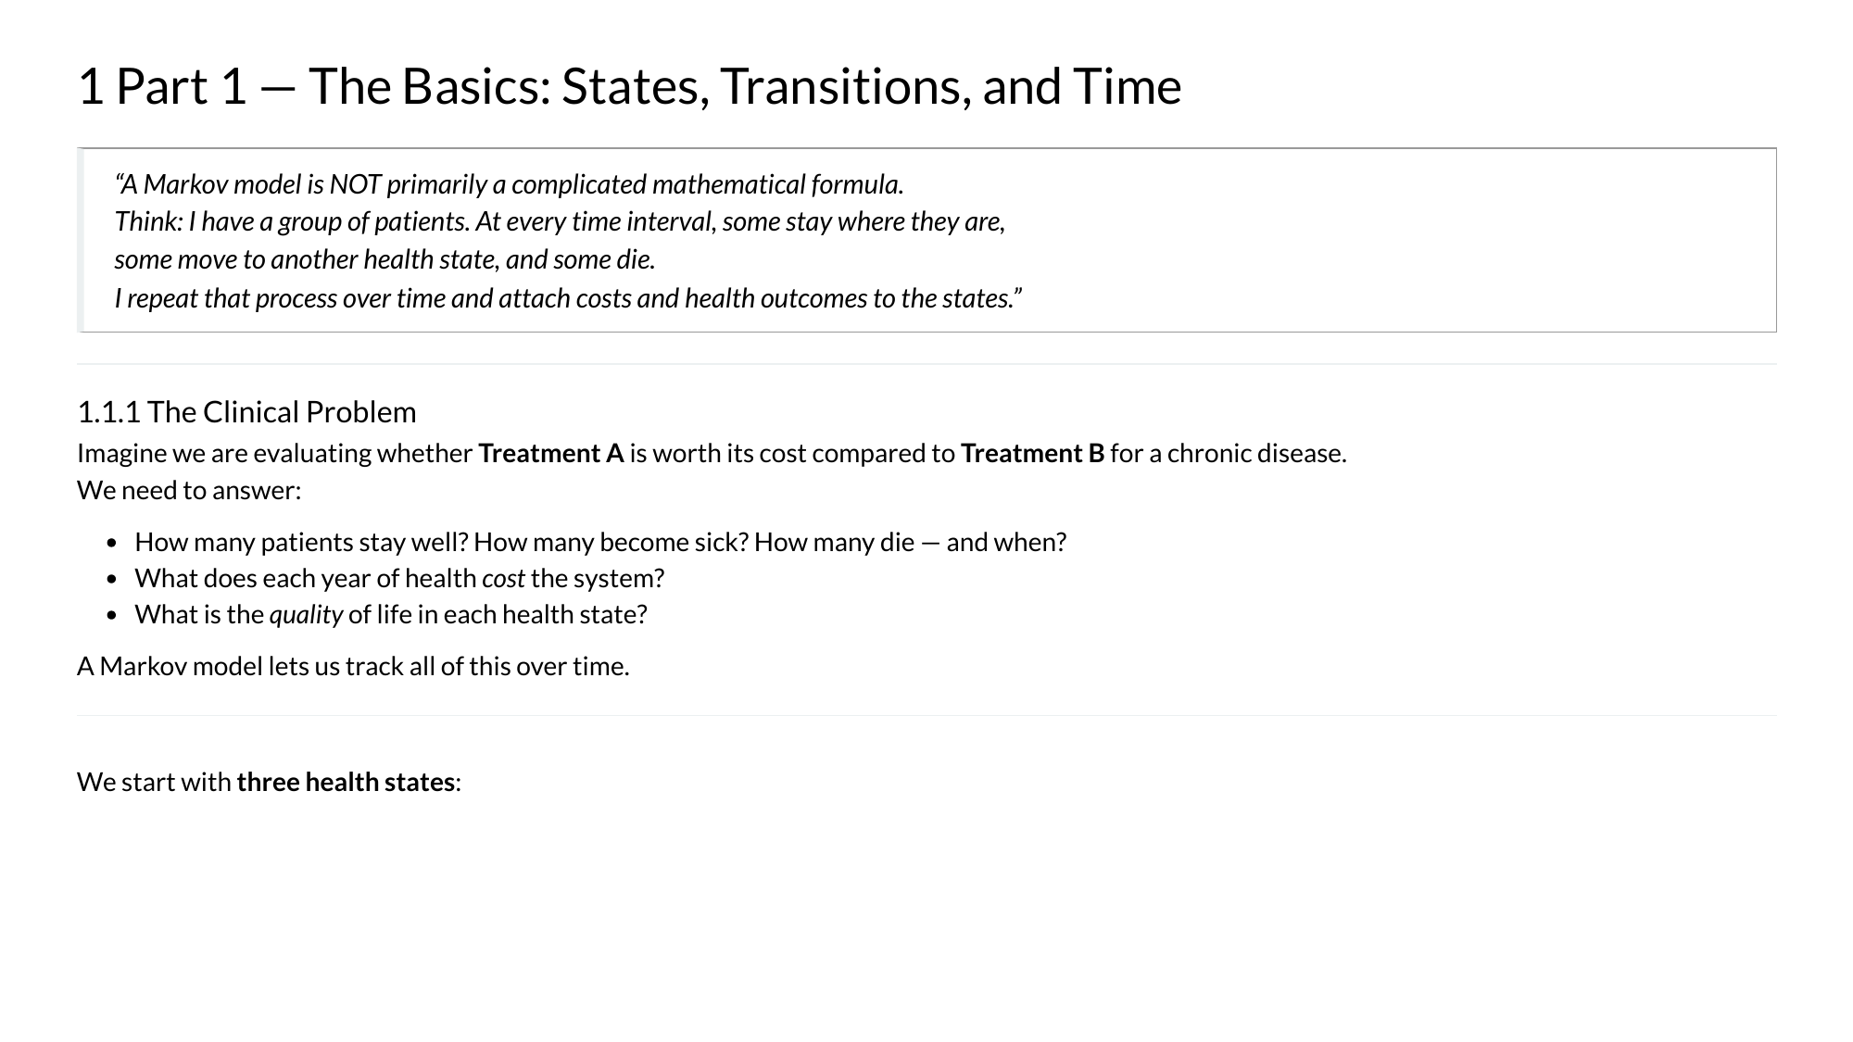
Notes:
Markov Modelling in Health Economics, a deep dive. Page 2 of 43. Rendered from the R Markdown teaching resource; the live HTML version has the foldable code and the tabbed sections.

Slide 3
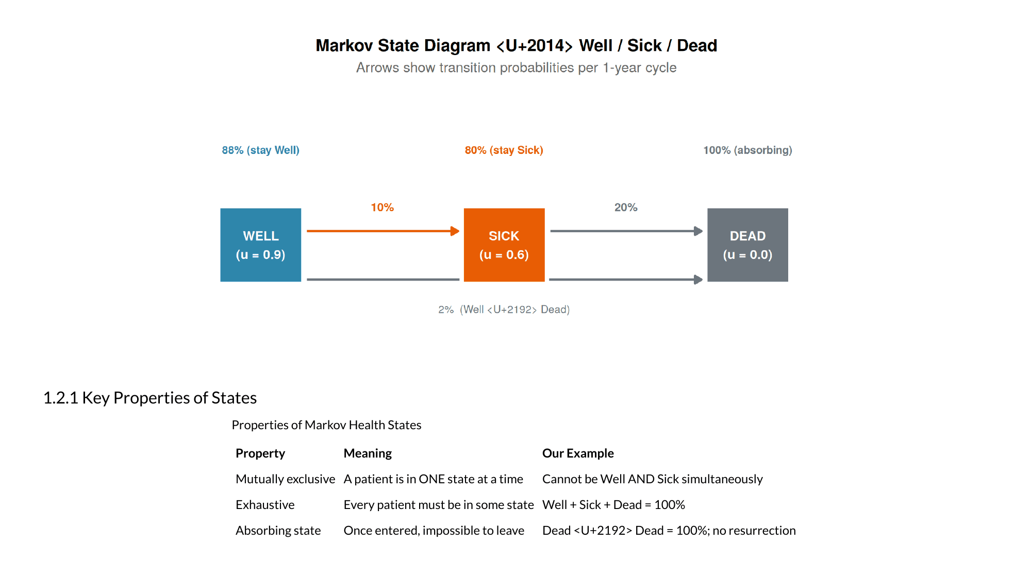
Notes:
Markov Modelling in Health Economics, a deep dive. Page 3 of 43. Rendered from the R Markdown teaching resource; the live HTML version has the foldable code and the tabbed sections.

Slide 4
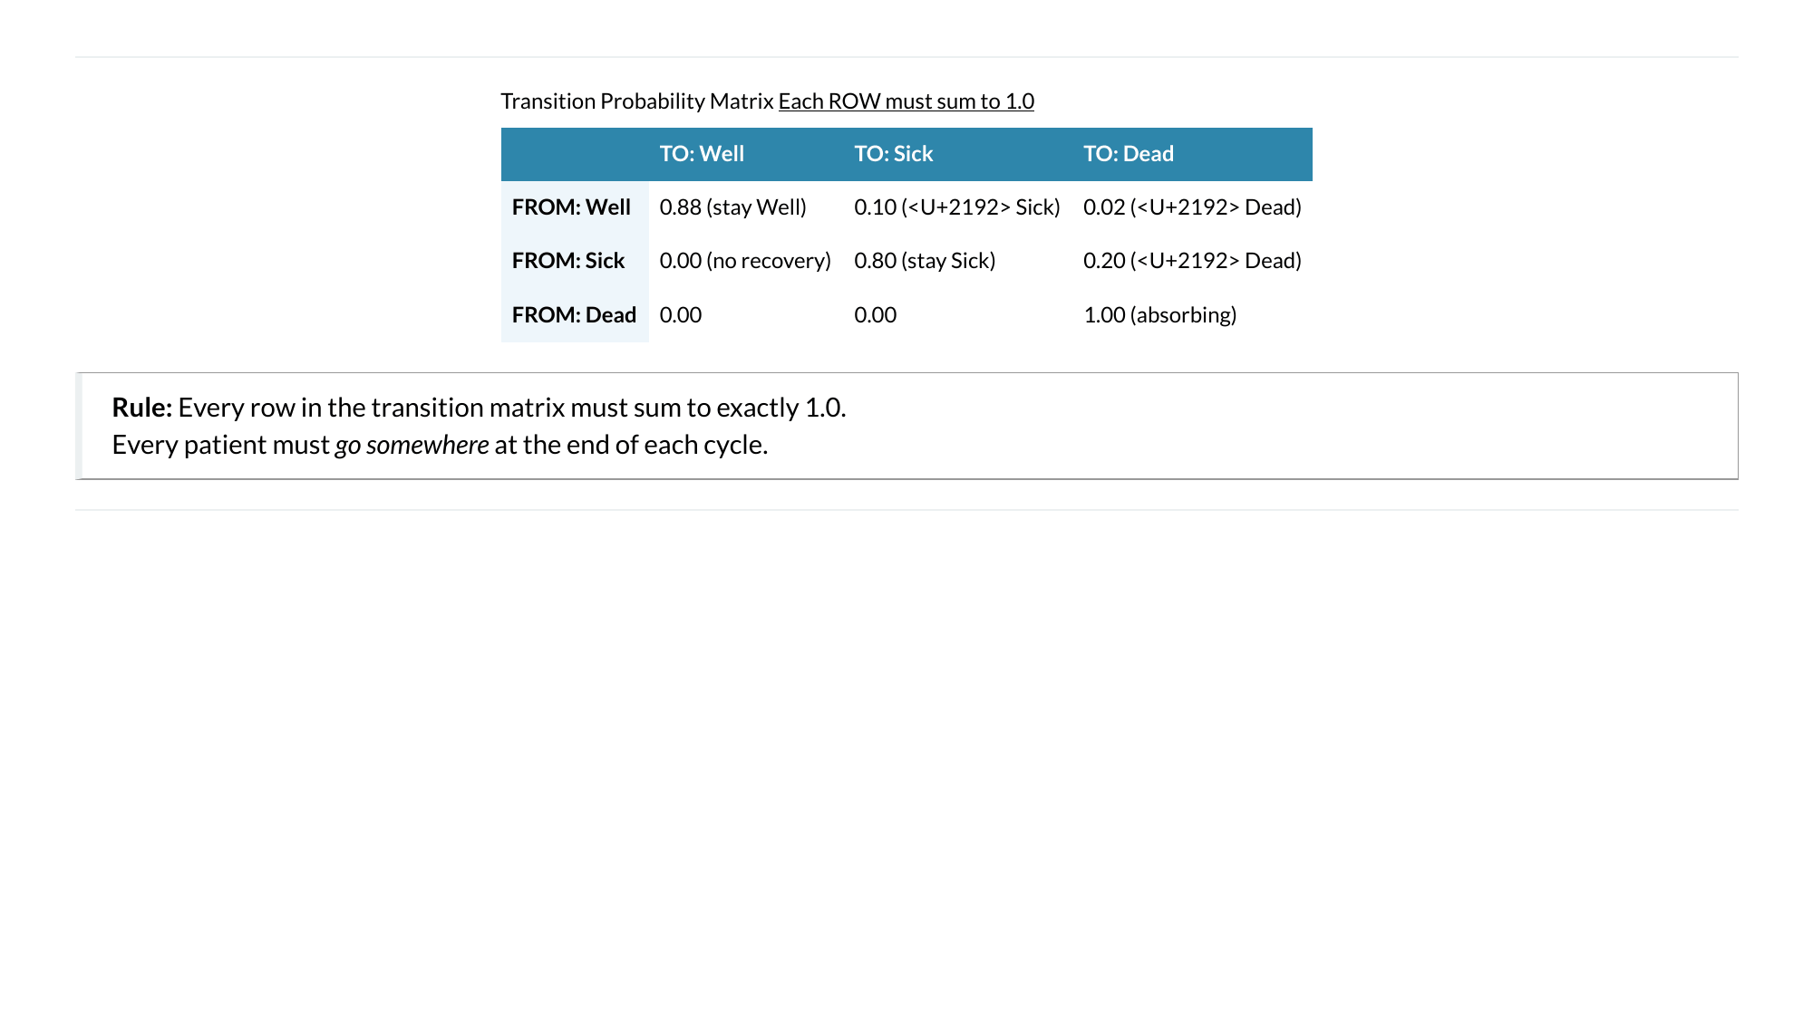
Notes:
Markov Modelling in Health Economics, a deep dive. Page 4 of 43. Rendered from the R Markdown teaching resource; the live HTML version has the foldable code and the tabbed sections.

Slide 5
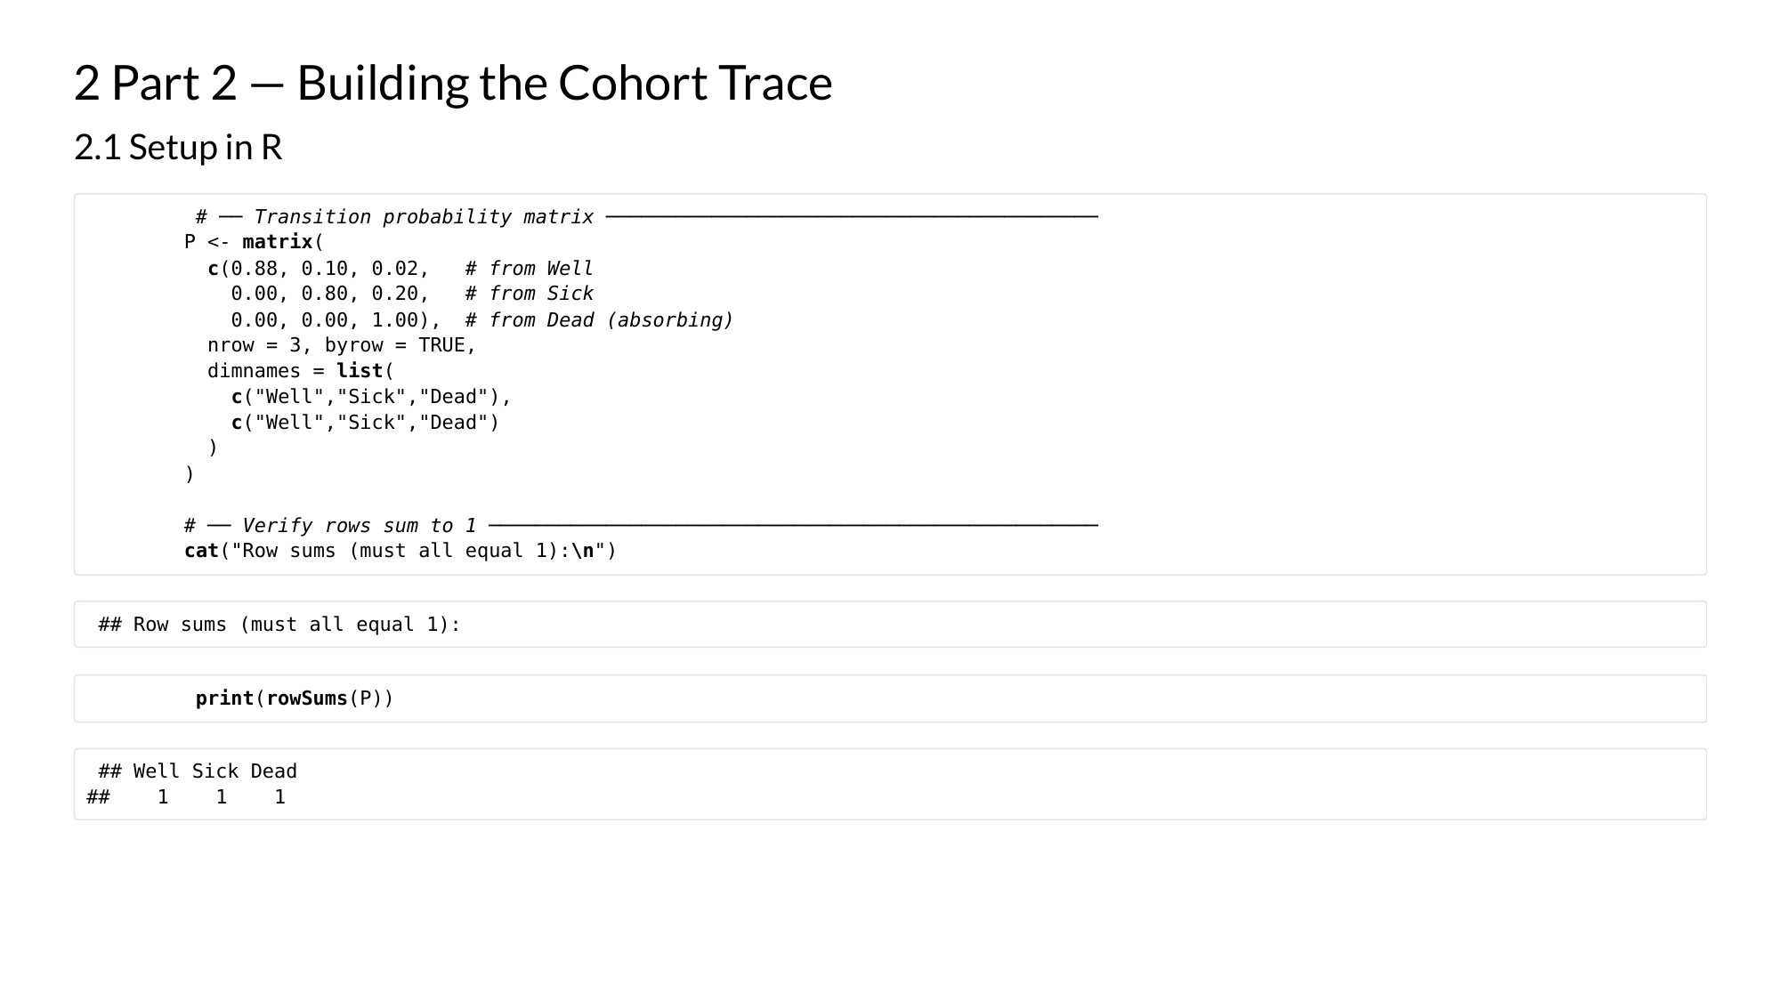
Notes:
Markov Modelling in Health Economics, a deep dive. Page 5 of 43. Rendered from the R Markdown teaching resource; the live HTML version has the foldable code and the tabbed sections.

Slide 6
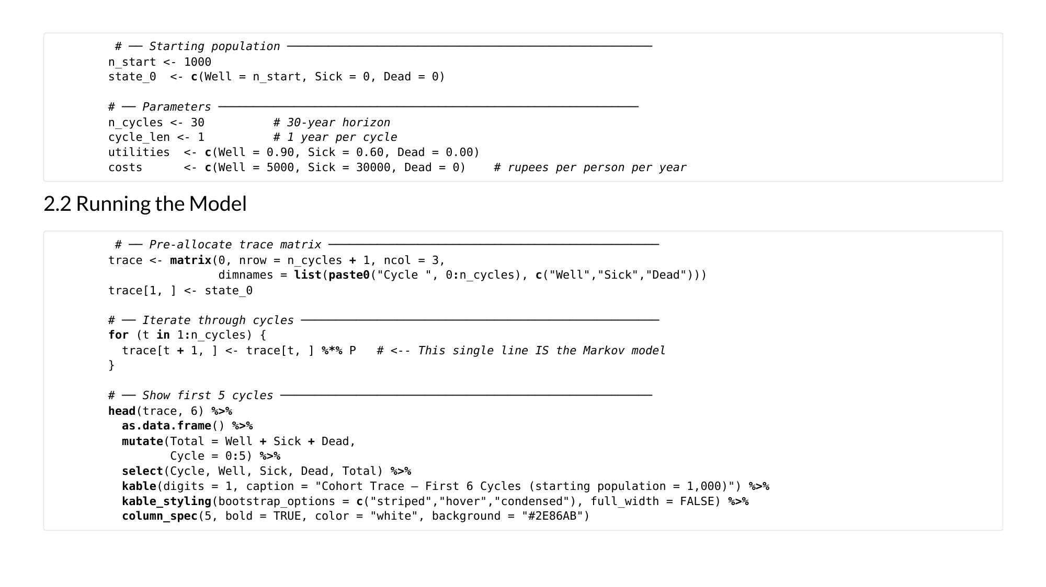
Notes:
Markov Modelling in Health Economics, a deep dive. Page 6 of 43. Rendered from the R Markdown teaching resource; the live HTML version has the foldable code and the tabbed sections.

Slide 7
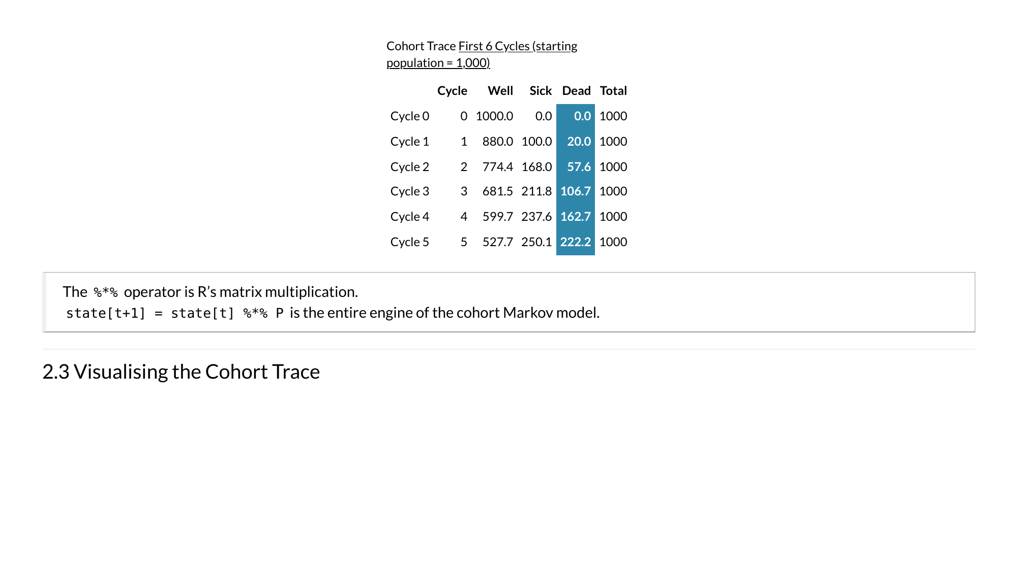
Notes:
Markov Modelling in Health Economics, a deep dive. Page 7 of 43. Rendered from the R Markdown teaching resource; the live HTML version has the foldable code and the tabbed sections.

Slide 8
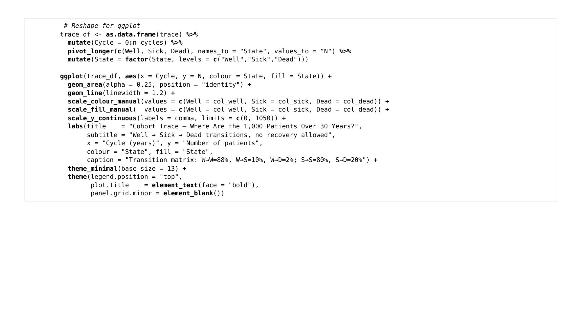
Notes:
Markov Modelling in Health Economics, a deep dive. Page 8 of 43. Rendered from the R Markdown teaching resource; the live HTML version has the foldable code and the tabbed sections.

Slide 9
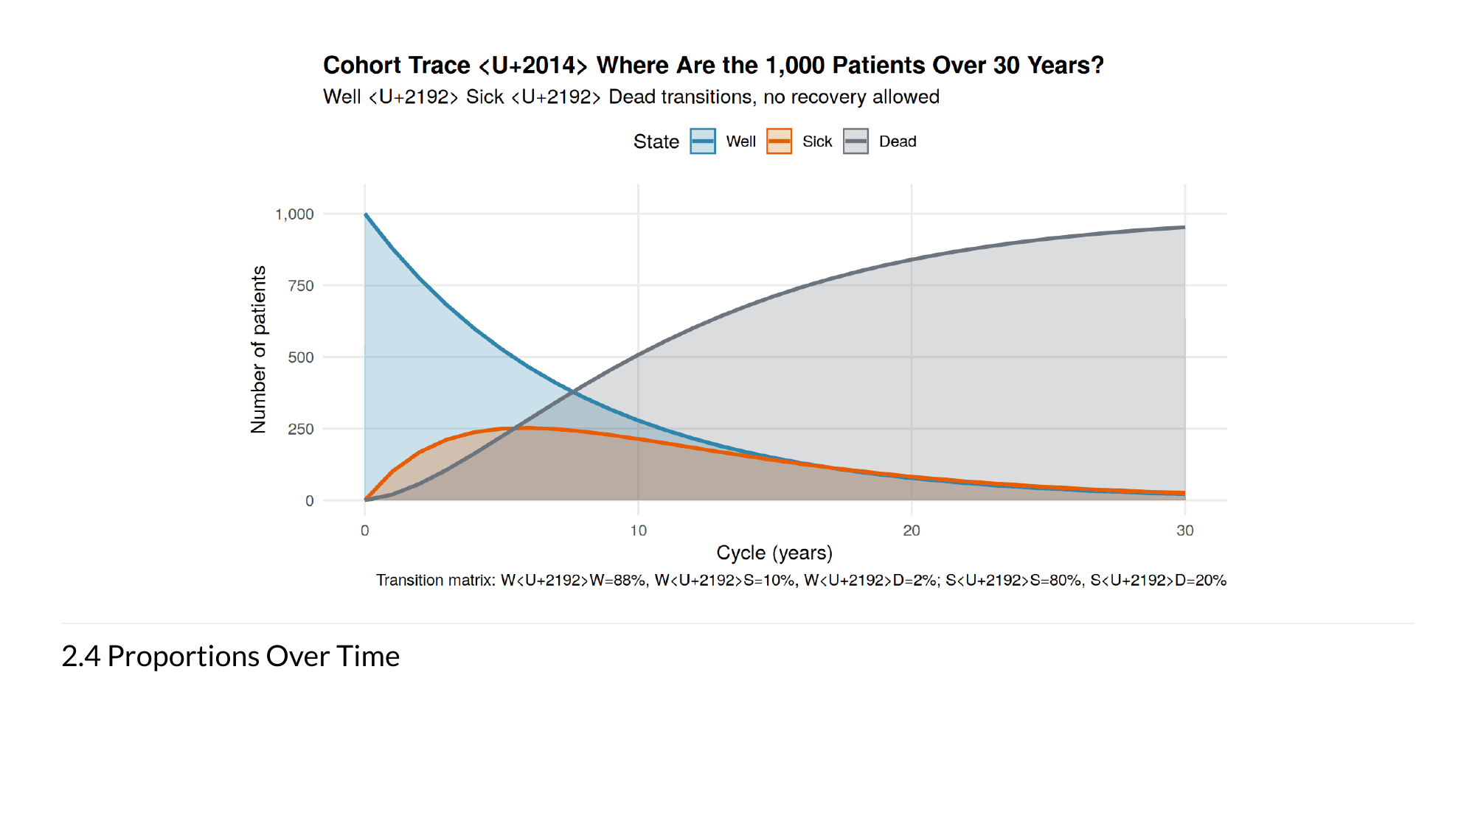
Notes:
Markov Modelling in Health Economics, a deep dive. Page 9 of 43. Rendered from the R Markdown teaching resource; the live HTML version has the foldable code and the tabbed sections.

Slide 10
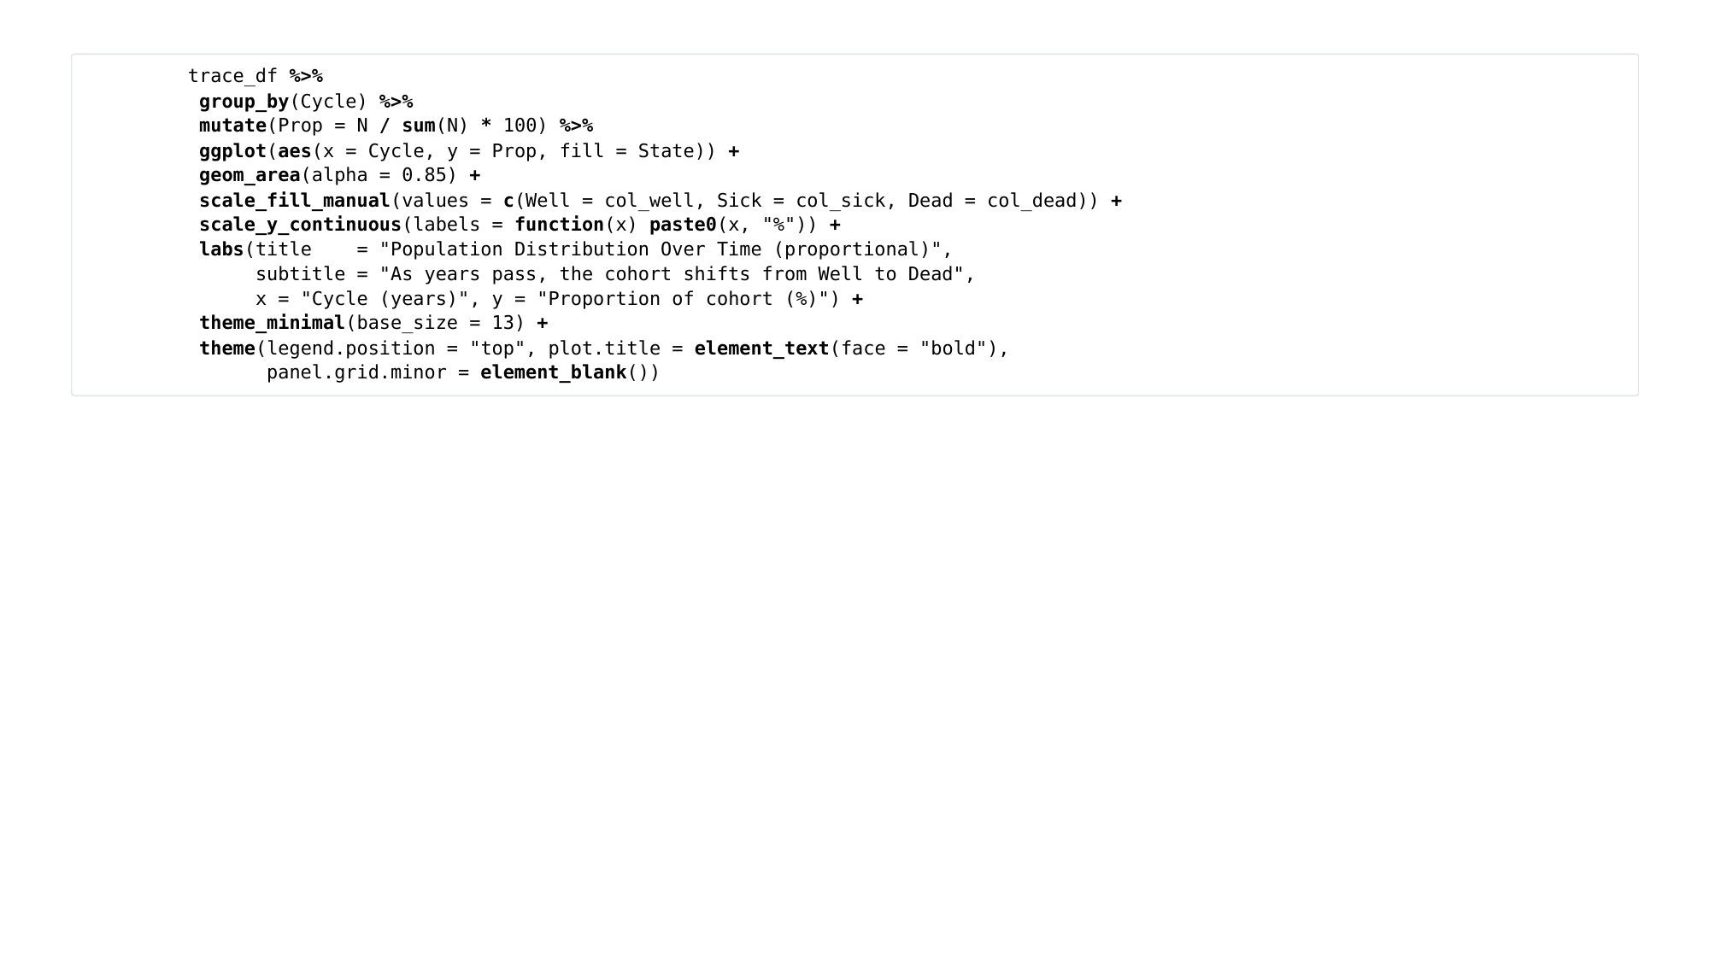
Notes:
Markov Modelling in Health Economics, a deep dive. Page 10 of 43. Rendered from the R Markdown teaching resource; the live HTML version has the foldable code and the tabbed sections.

Slide 11
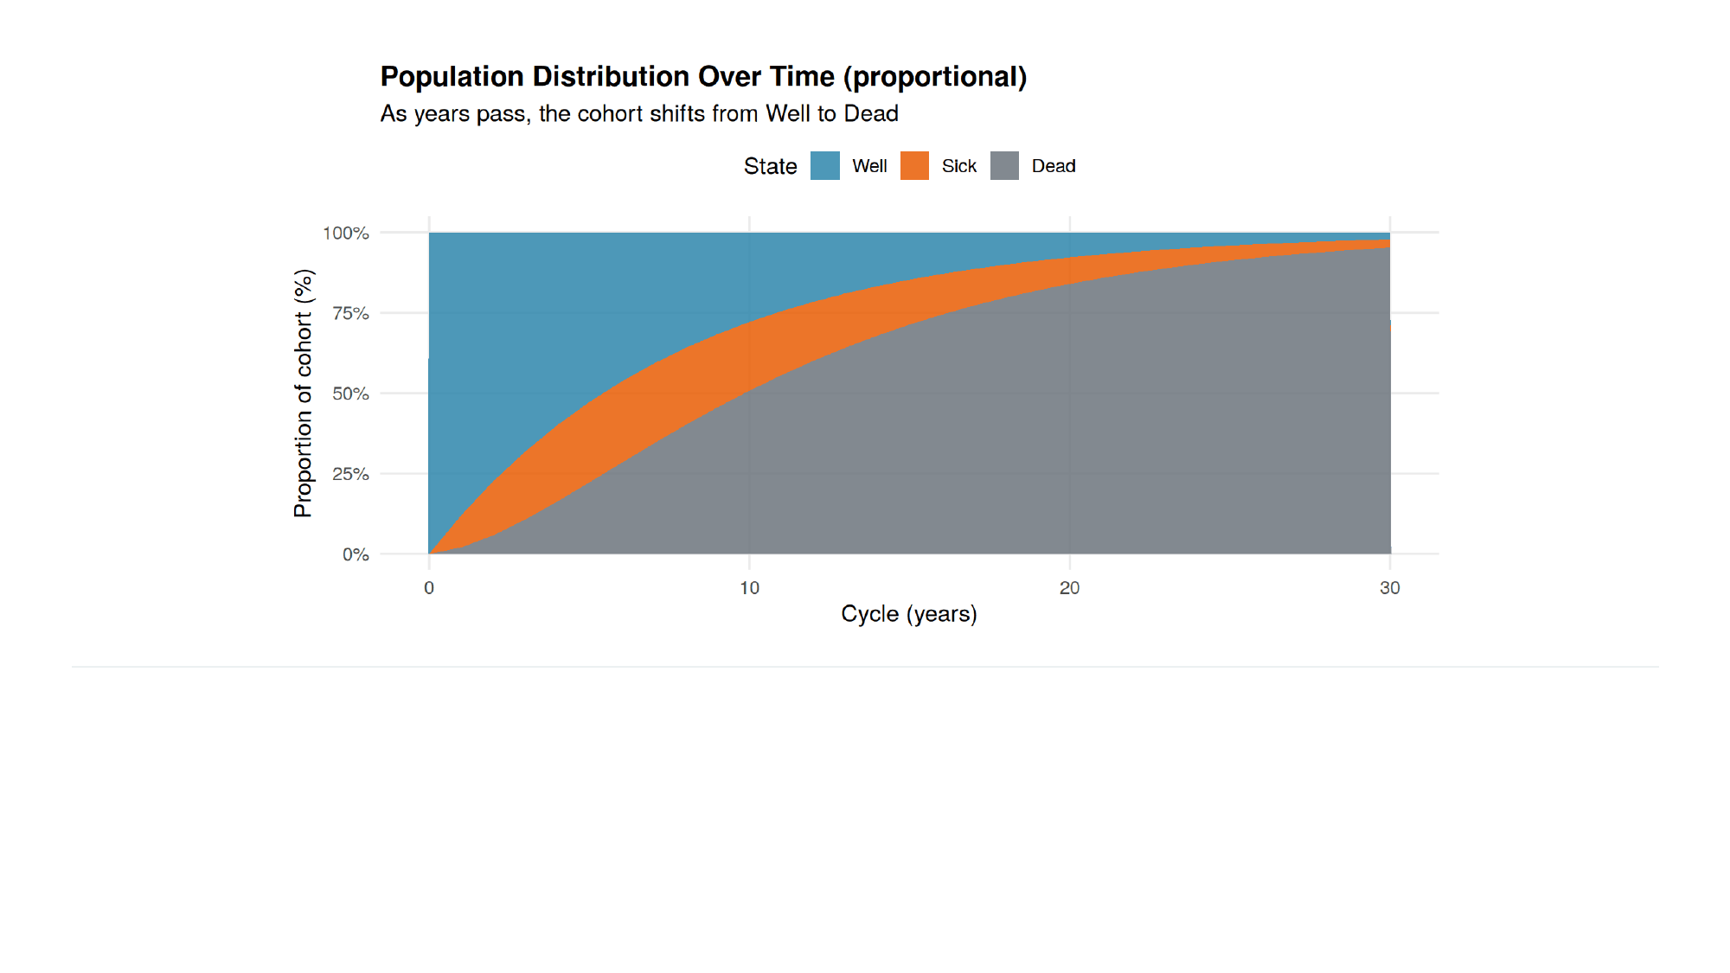
Notes:
Markov Modelling in Health Economics, a deep dive. Page 11 of 43. Rendered from the R Markdown teaching resource; the live HTML version has the foldable code and the tabbed sections.

Slide 12
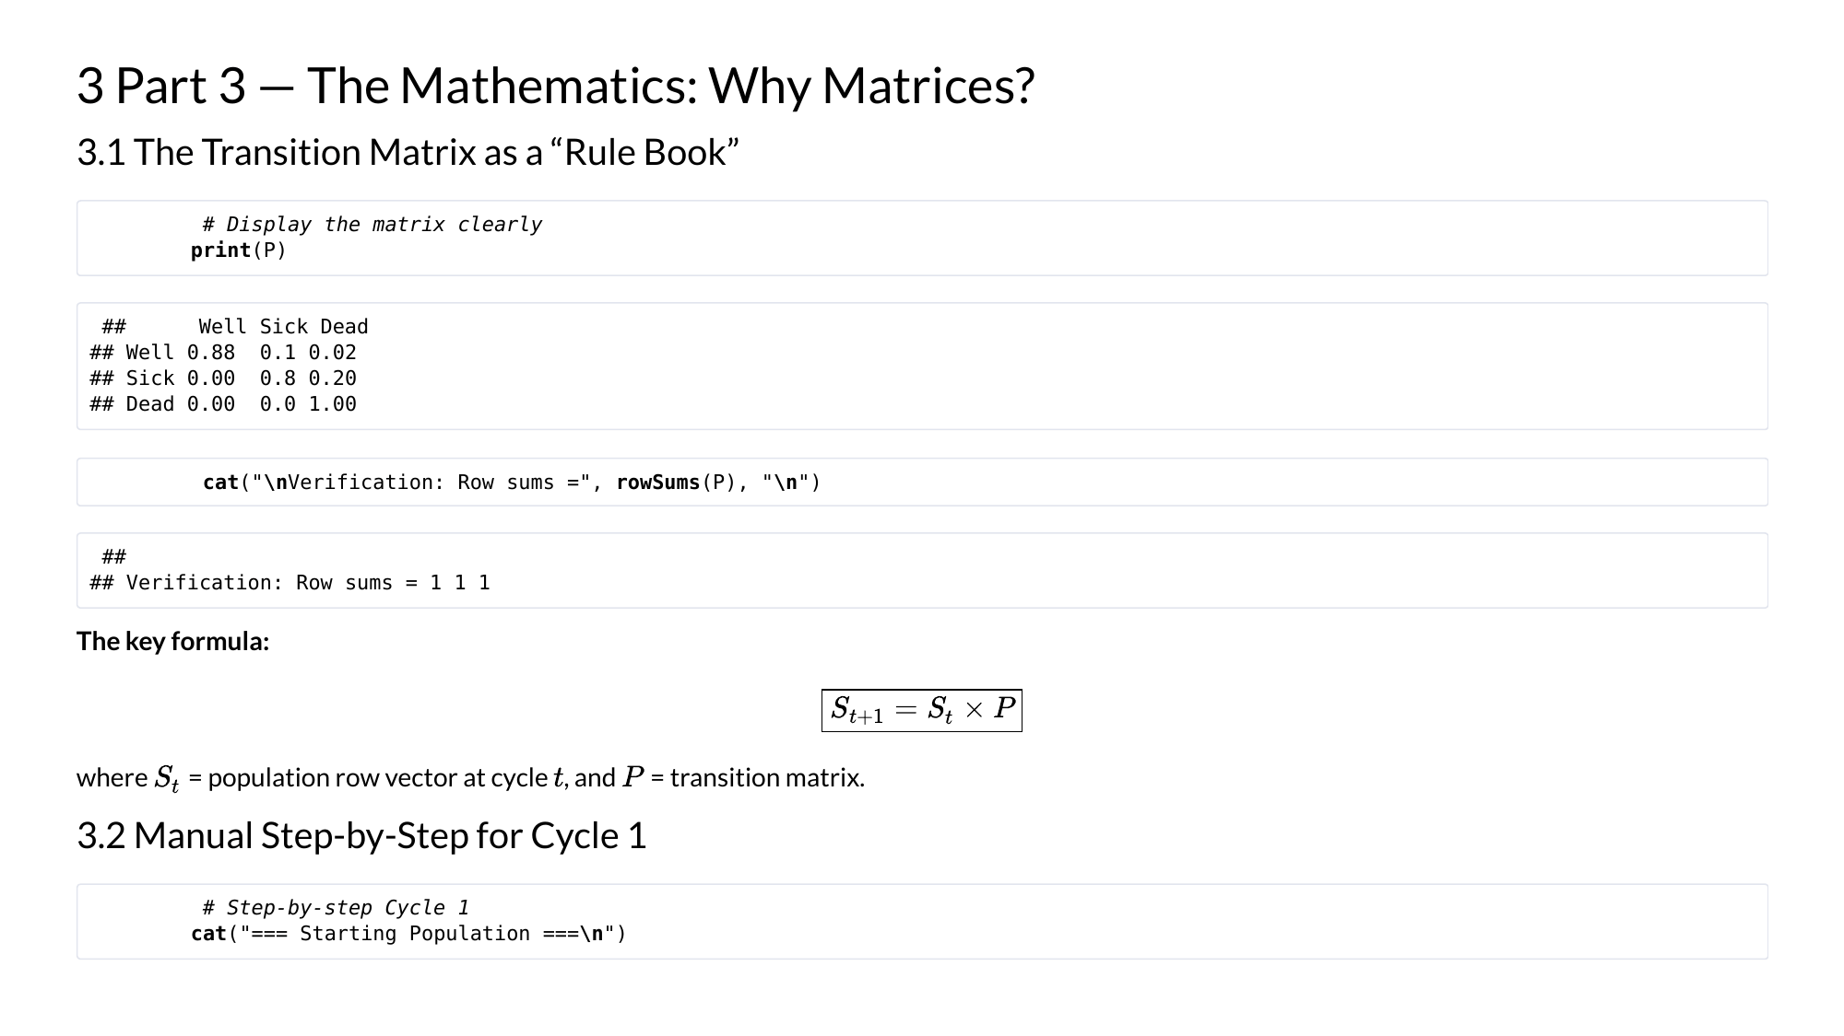
Notes:
Markov Modelling in Health Economics, a deep dive. Page 12 of 43. Rendered from the R Markdown teaching resource; the live HTML version has the foldable code and the tabbed sections.

Slide 13
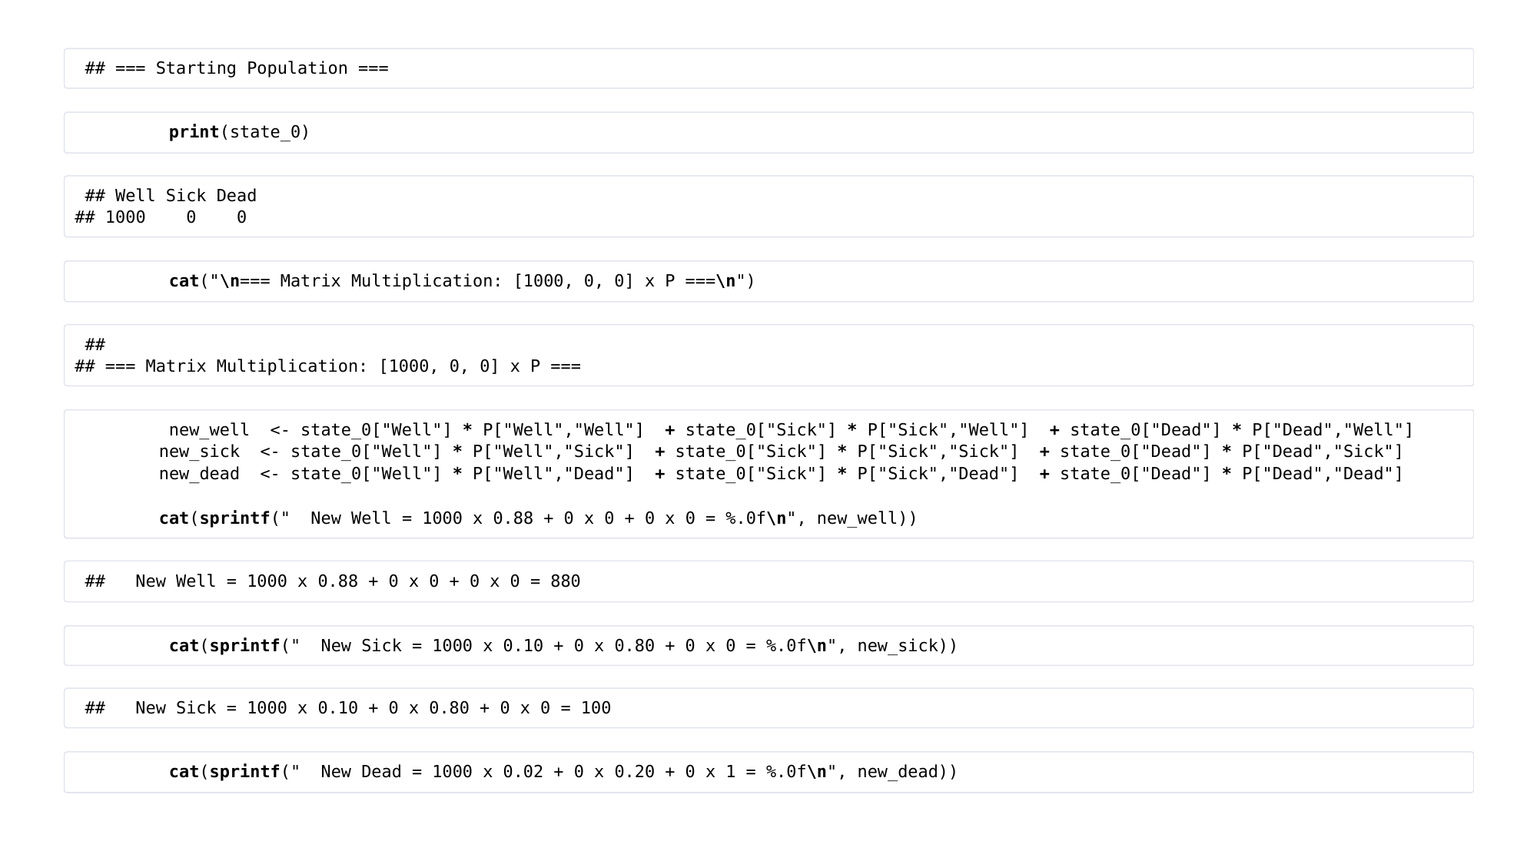
Notes:
Markov Modelling in Health Economics, a deep dive. Page 13 of 43. Rendered from the R Markdown teaching resource; the live HTML version has the foldable code and the tabbed sections.

Slide 14
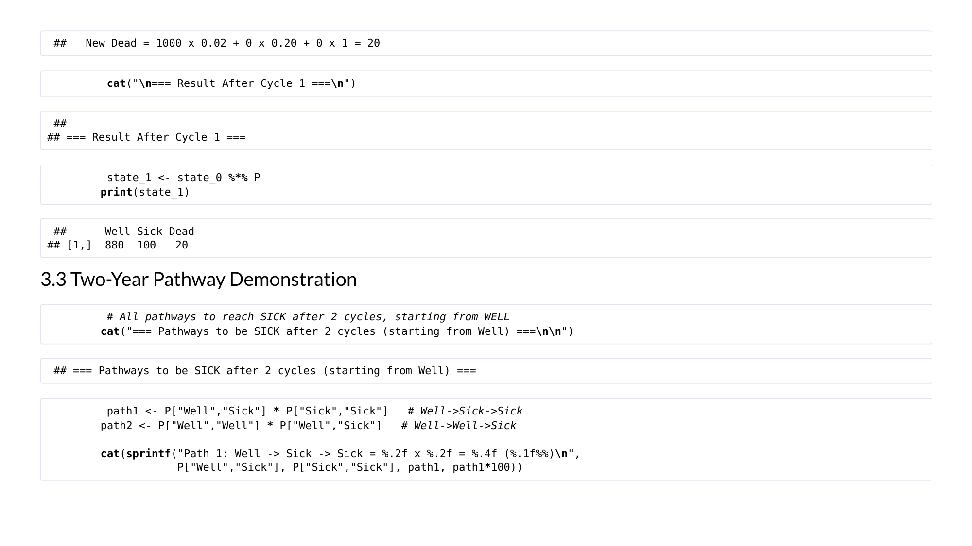
Notes:
Markov Modelling in Health Economics, a deep dive. Page 14 of 43. Rendered from the R Markdown teaching resource; the live HTML version has the foldable code and the tabbed sections.

Slide 15
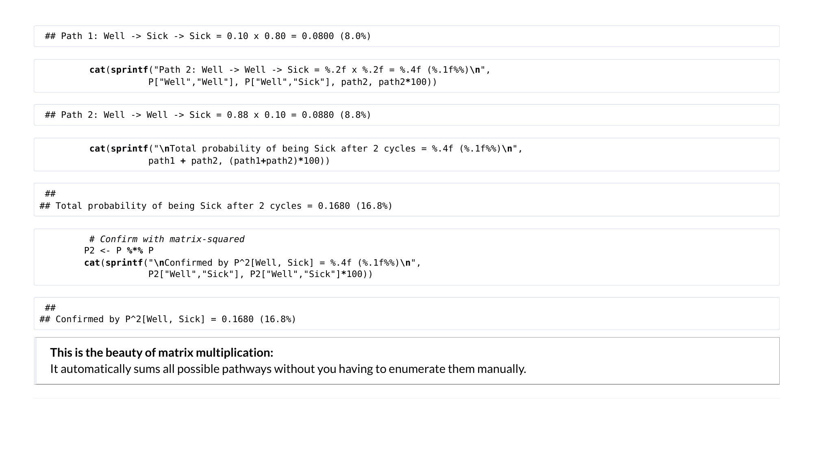
Notes:
Markov Modelling in Health Economics, a deep dive. Page 15 of 43. Rendered from the R Markdown teaching resource; the live HTML version has the foldable code and the tabbed sections.

Slide 16
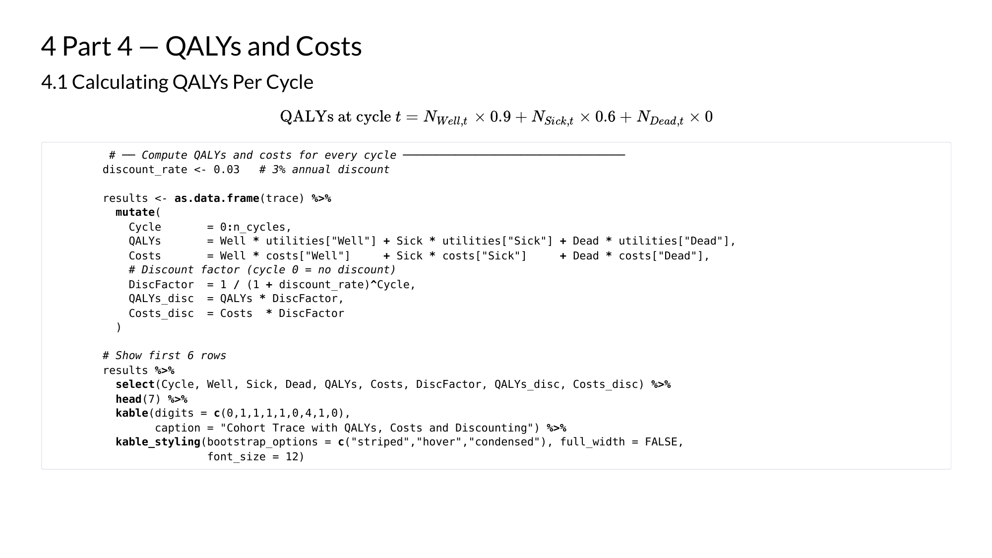
Notes:
Markov Modelling in Health Economics, a deep dive. Page 16 of 43. Rendered from the R Markdown teaching resource; the live HTML version has the foldable code and the tabbed sections.

Slide 17
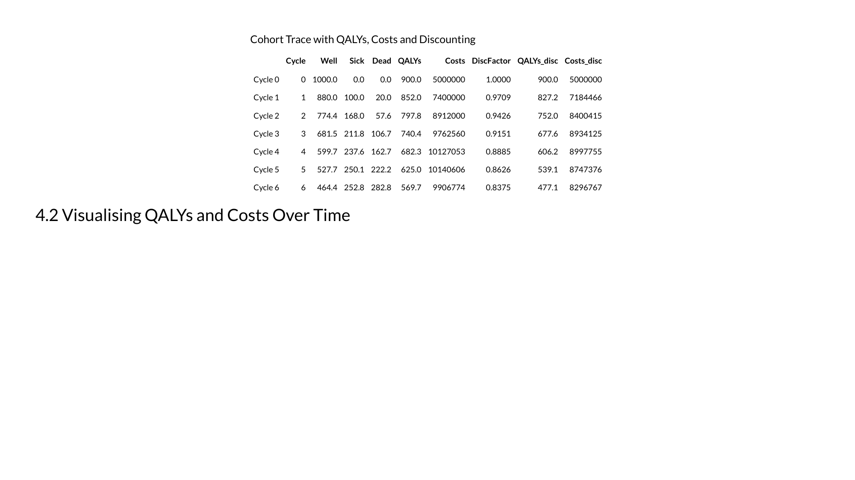
Notes:
Markov Modelling in Health Economics, a deep dive. Page 17 of 43. Rendered from the R Markdown teaching resource; the live HTML version has the foldable code and the tabbed sections.

Slide 18
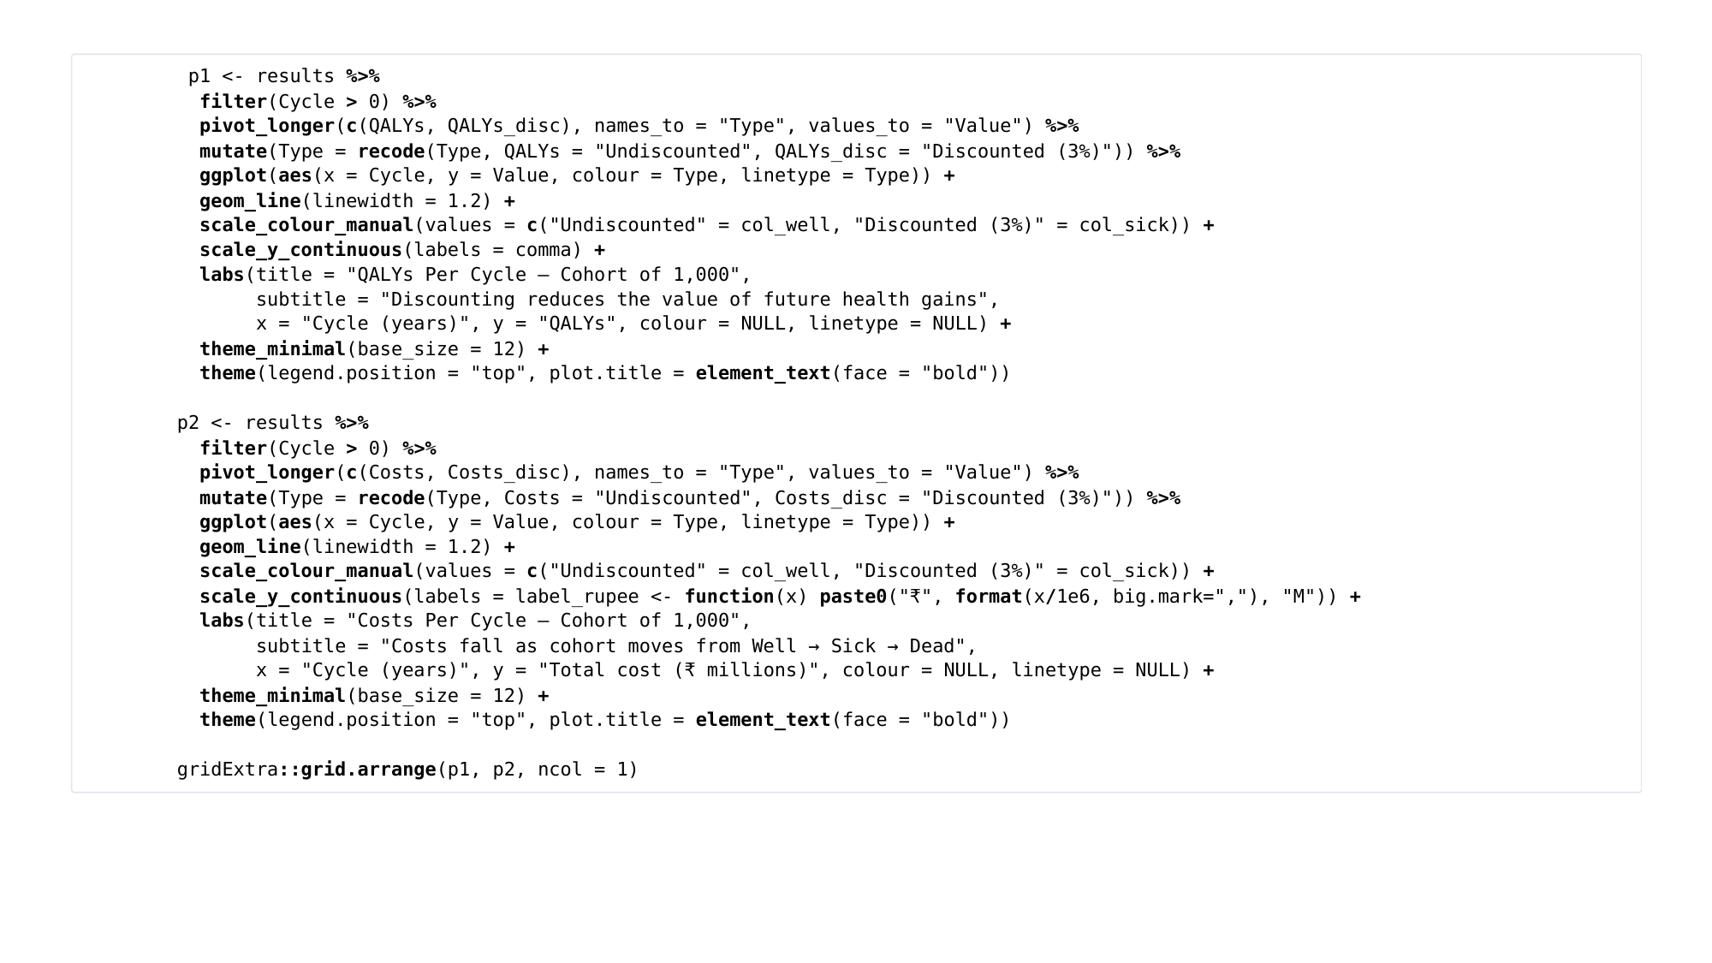
Notes:
Markov Modelling in Health Economics, a deep dive. Page 18 of 43. Rendered from the R Markdown teaching resource; the live HTML version has the foldable code and the tabbed sections.

Slide 19
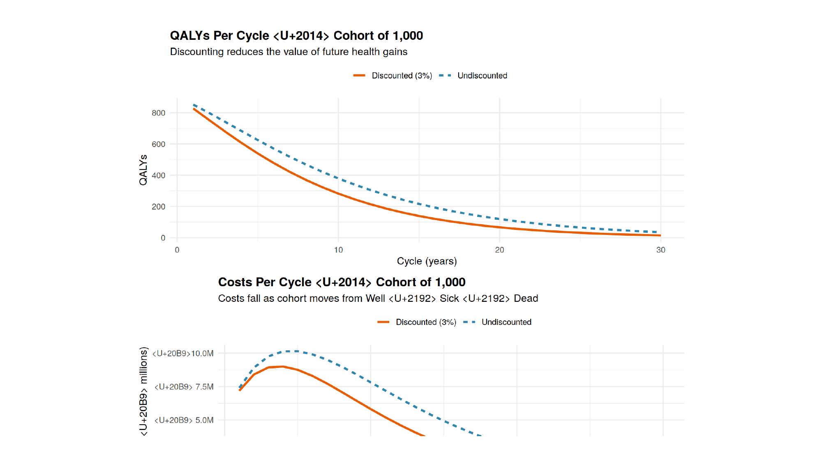
Notes:
Markov Modelling in Health Economics, a deep dive. Page 19 of 43. Rendered from the R Markdown teaching resource; the live HTML version has the foldable code and the tabbed sections.

Slide 20
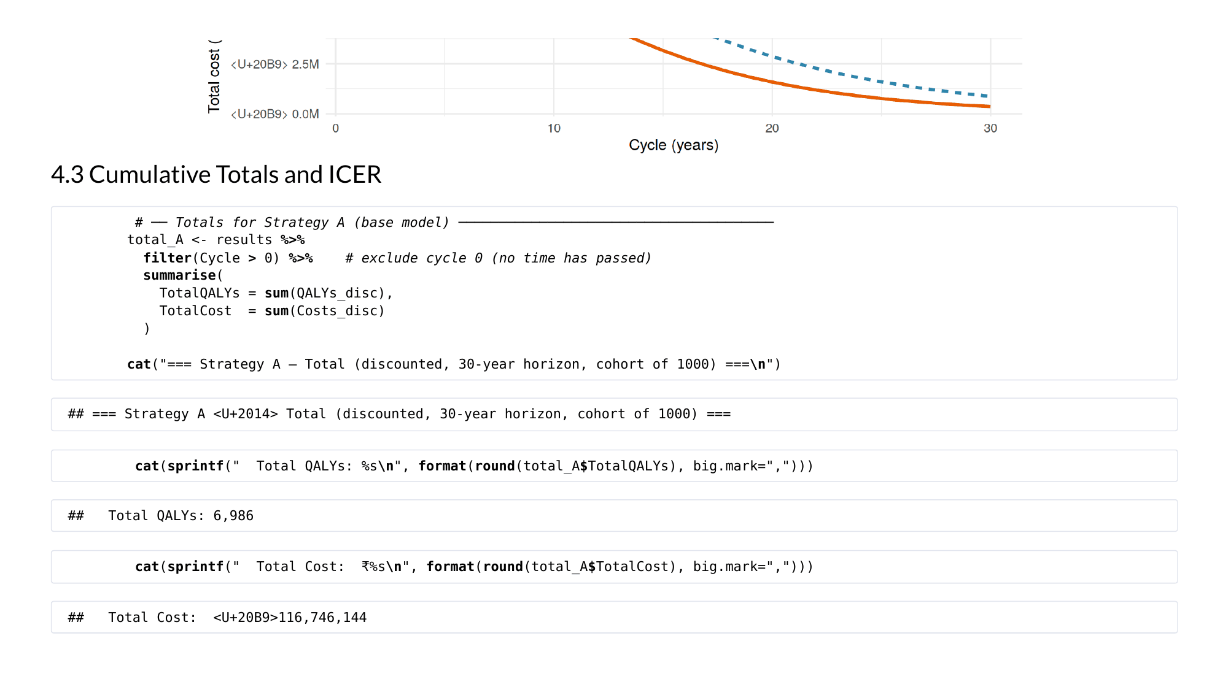
Notes:
Markov Modelling in Health Economics, a deep dive. Page 20 of 43. Rendered from the R Markdown teaching resource; the live HTML version has the foldable code and the tabbed sections.

Slide 21
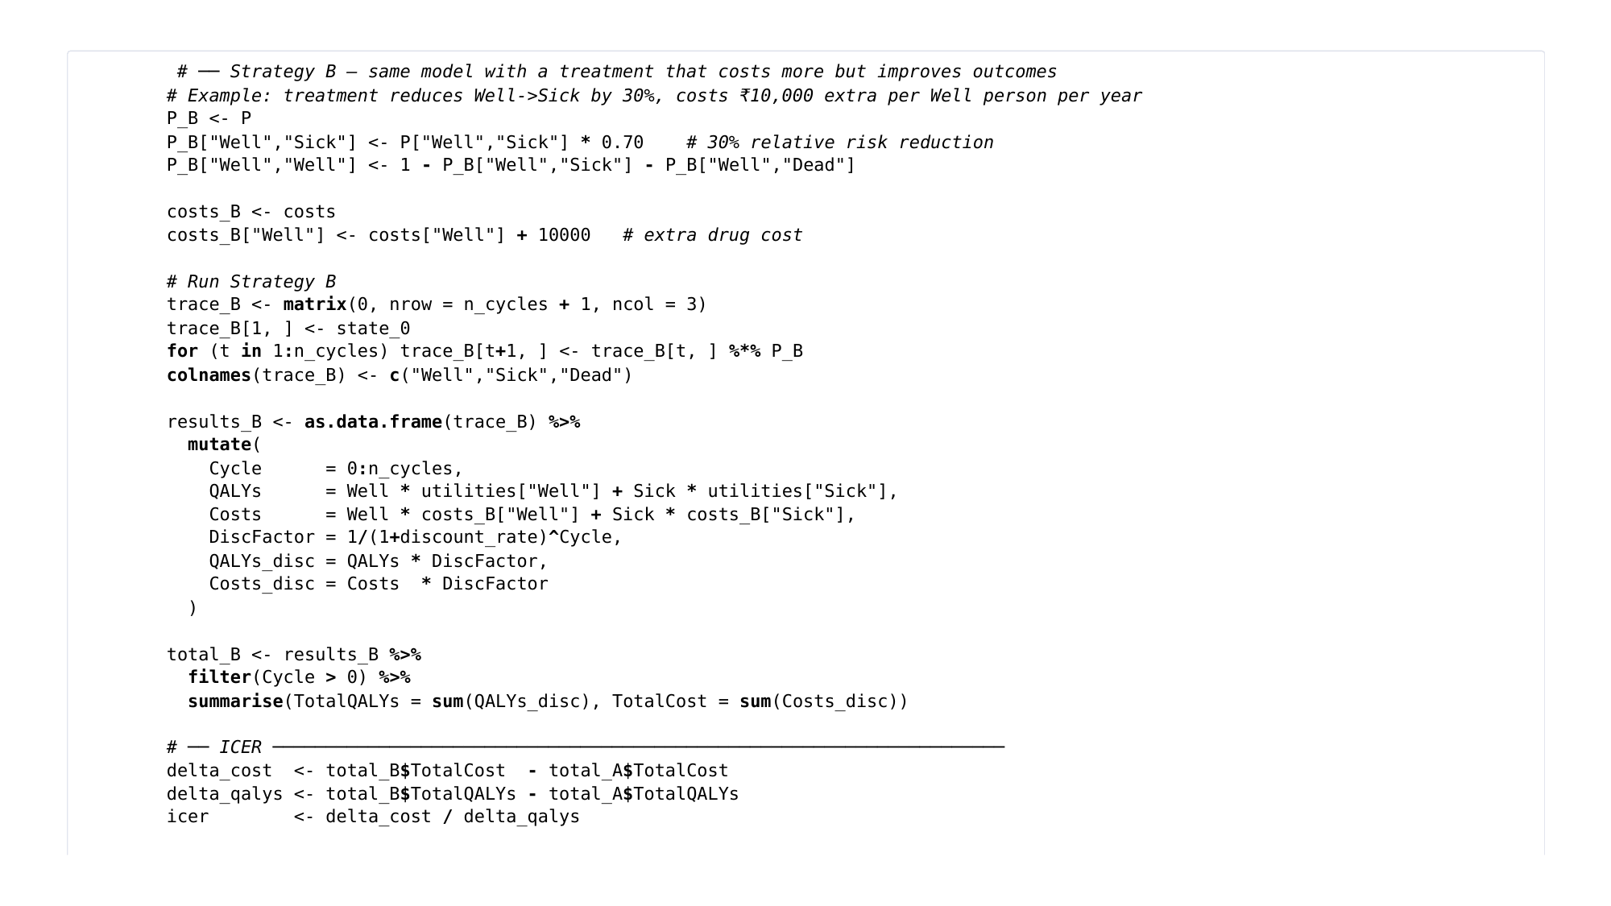
Notes:
Markov Modelling in Health Economics, a deep dive. Page 21 of 43. Rendered from the R Markdown teaching resource; the live HTML version has the foldable code and the tabbed sections.

Slide 22
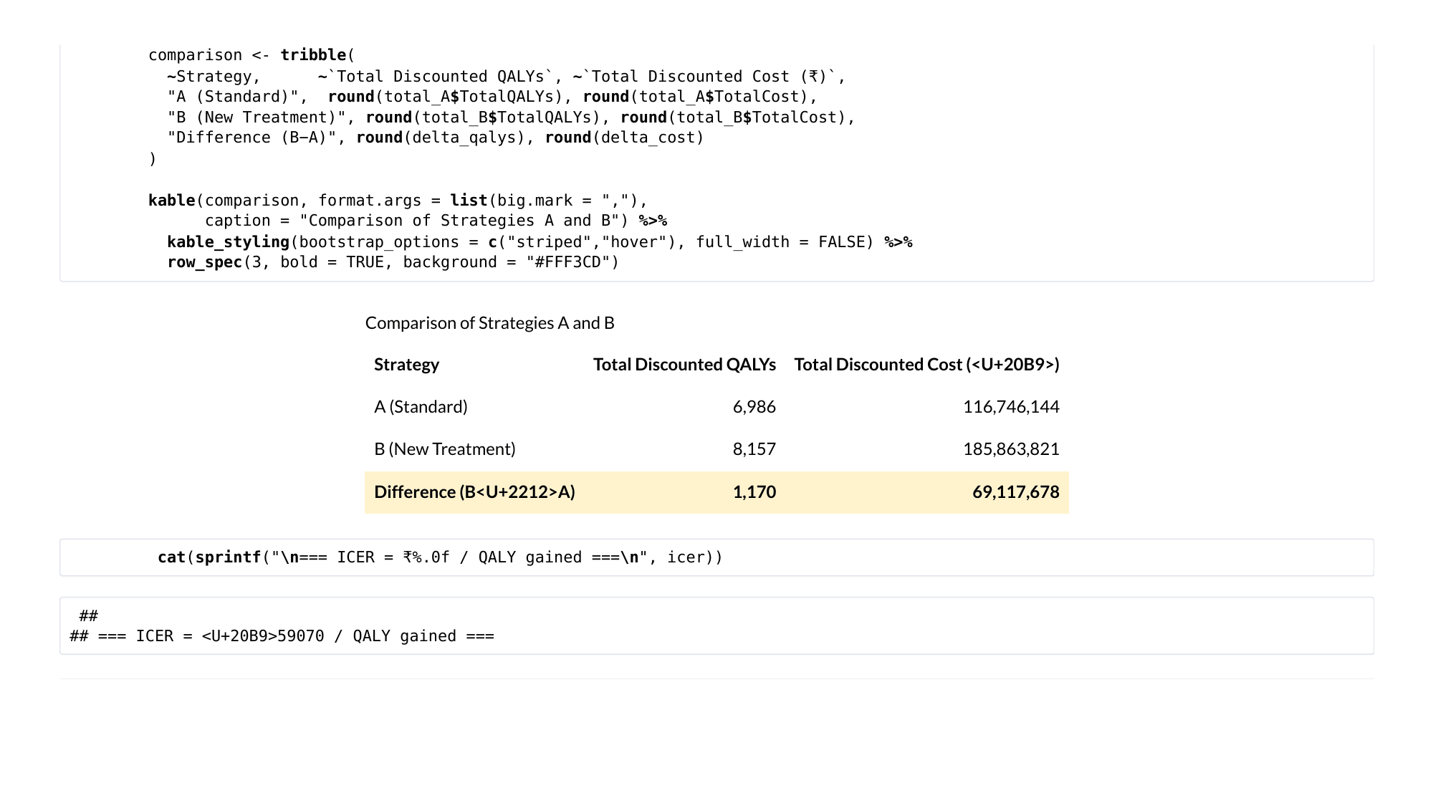
Notes:
Markov Modelling in Health Economics, a deep dive. Page 22 of 43. Rendered from the R Markdown teaching resource; the live HTML version has the foldable code and the tabbed sections.

Slide 23
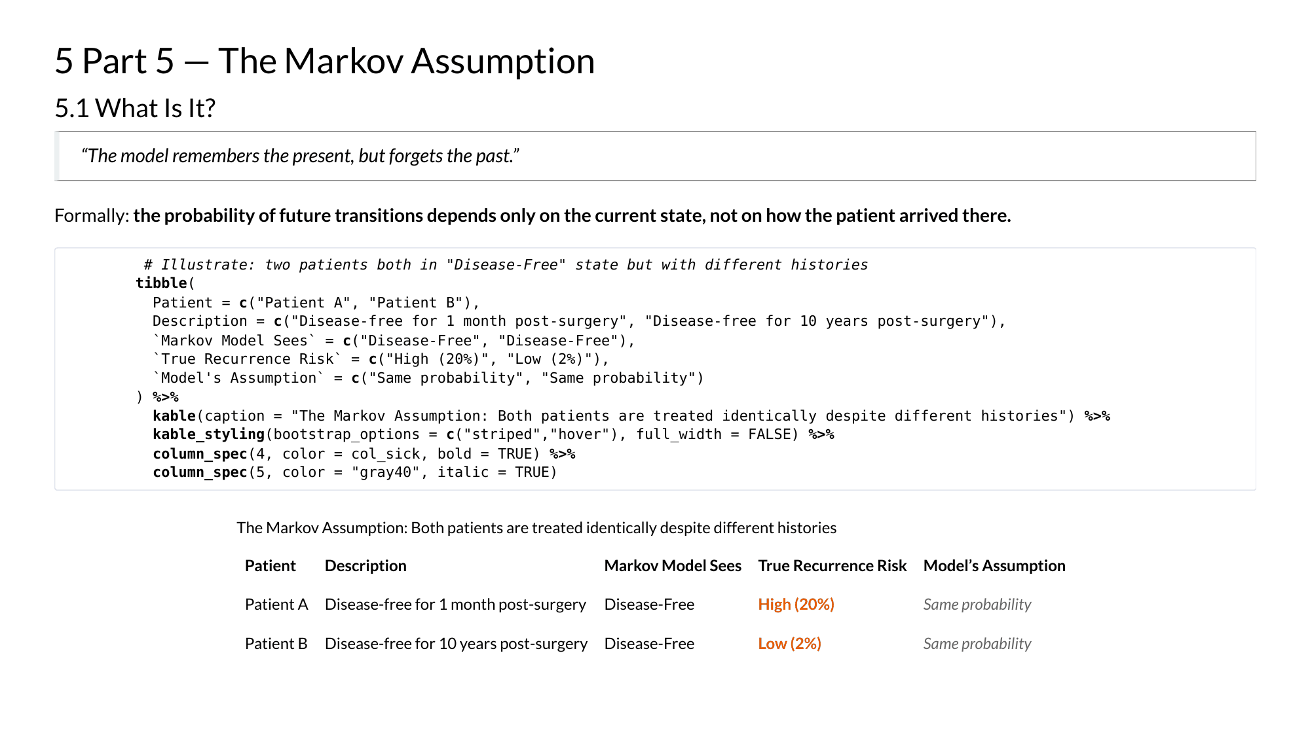
Notes:
Markov Modelling in Health Economics, a deep dive. Page 23 of 43. Rendered from the R Markdown teaching resource; the live HTML version has the foldable code and the tabbed sections.

Slide 24
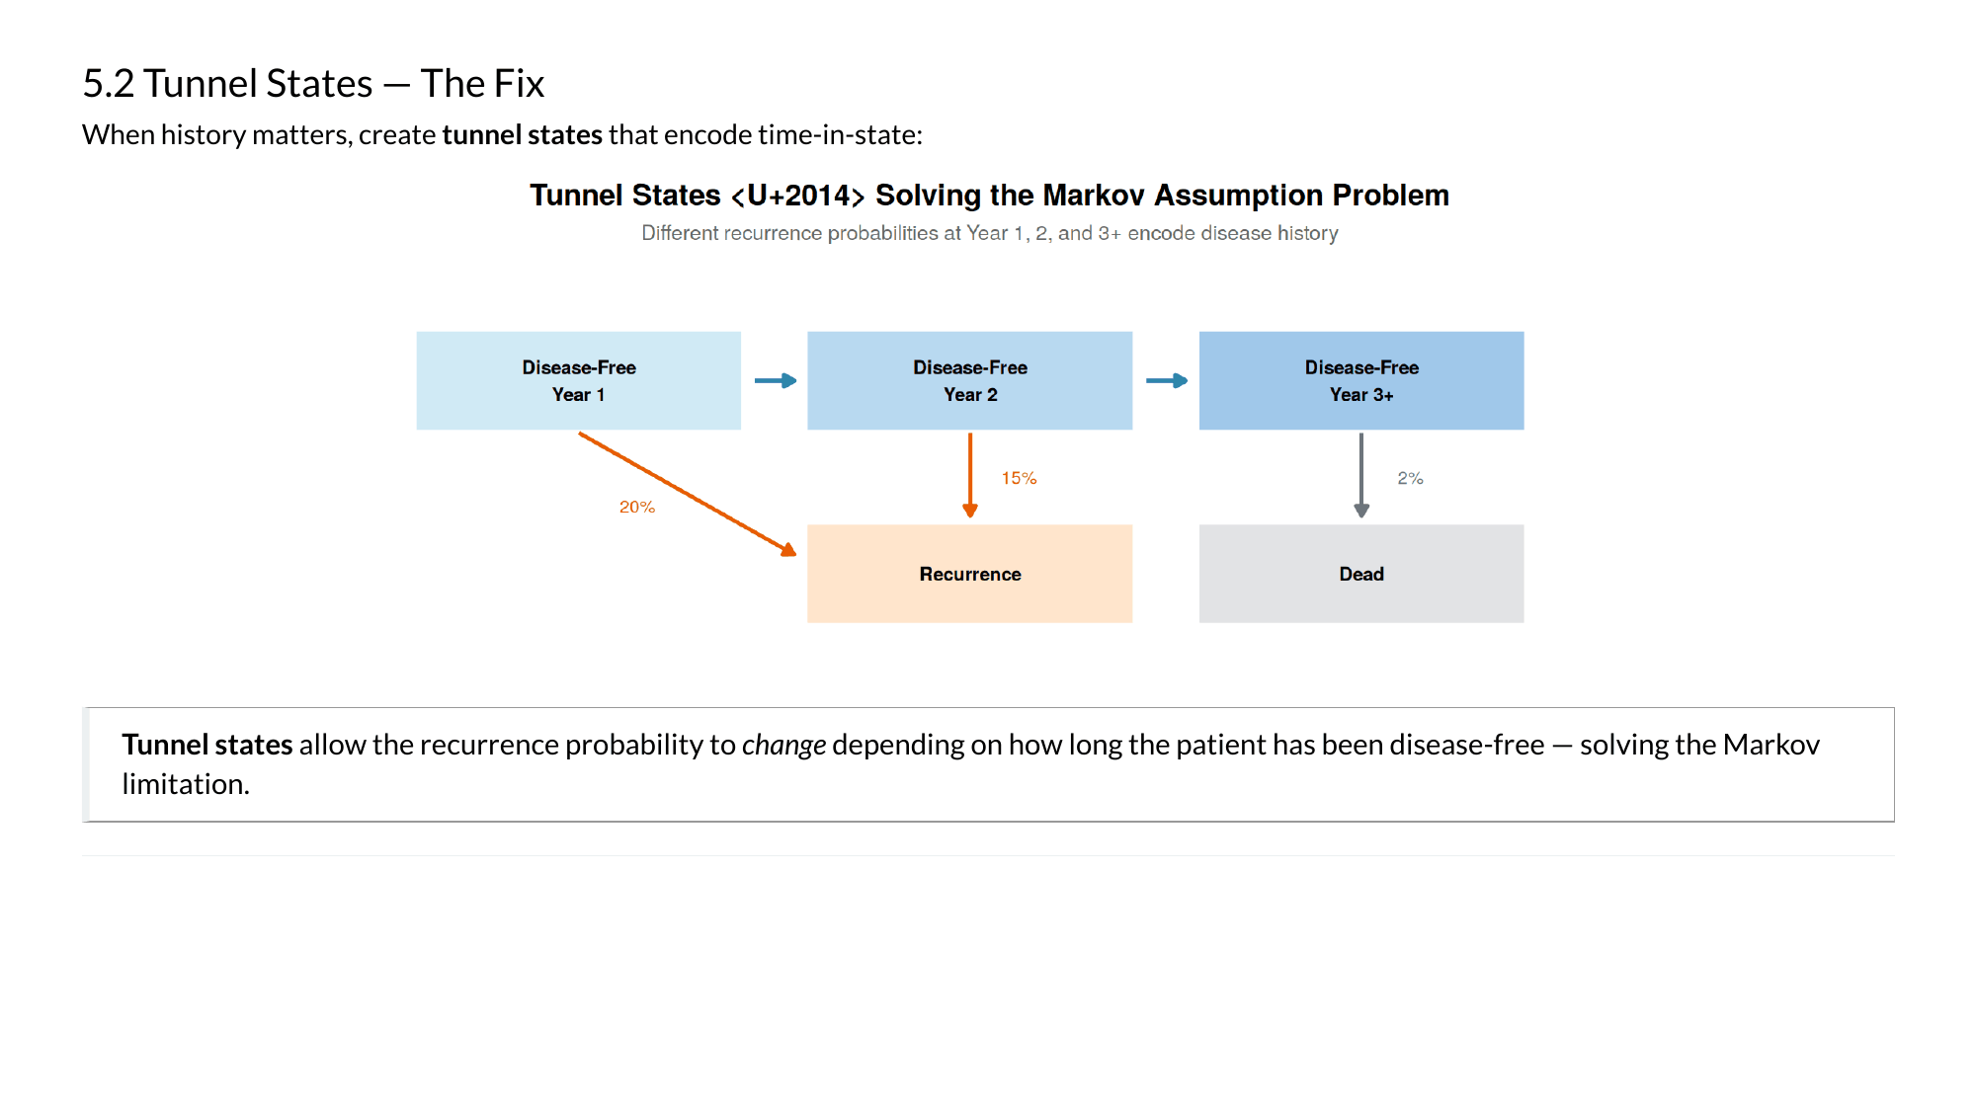
Notes:
Markov Modelling in Health Economics, a deep dive. Page 24 of 43. Rendered from the R Markdown teaching resource; the live HTML version has the foldable code and the tabbed sections.

Slide 25
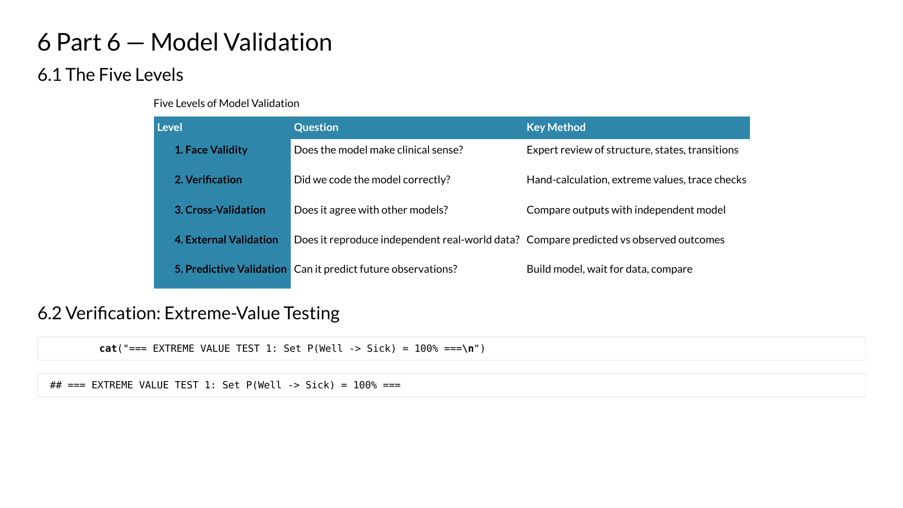
Notes:
Markov Modelling in Health Economics, a deep dive. Page 25 of 43. Rendered from the R Markdown teaching resource; the live HTML version has the foldable code and the tabbed sections.

Slide 26
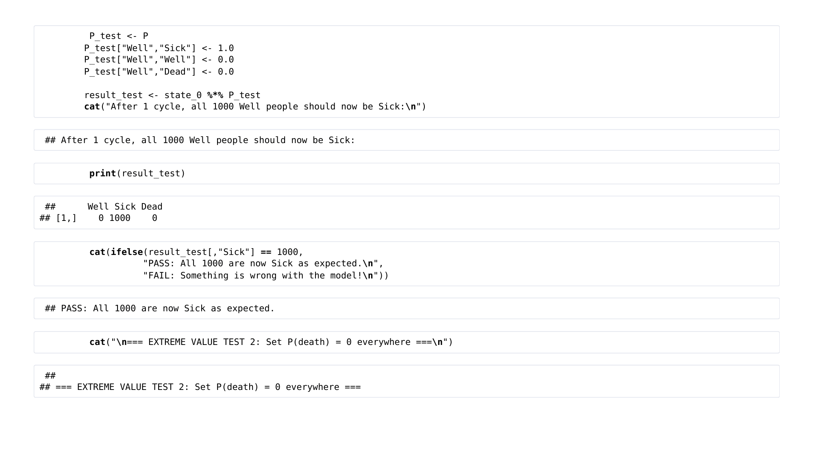
Notes:
Markov Modelling in Health Economics, a deep dive. Page 26 of 43. Rendered from the R Markdown teaching resource; the live HTML version has the foldable code and the tabbed sections.

Slide 27
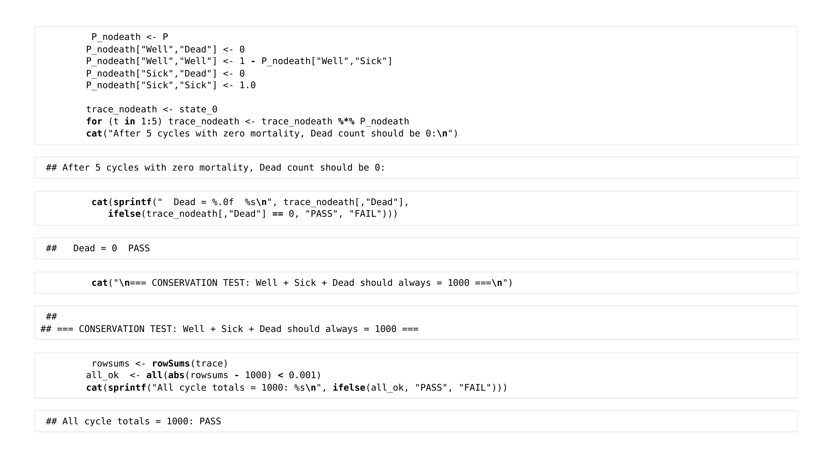
Notes:
Markov Modelling in Health Economics, a deep dive. Page 27 of 43. Rendered from the R Markdown teaching resource; the live HTML version has the foldable code and the tabbed sections.

Slide 28
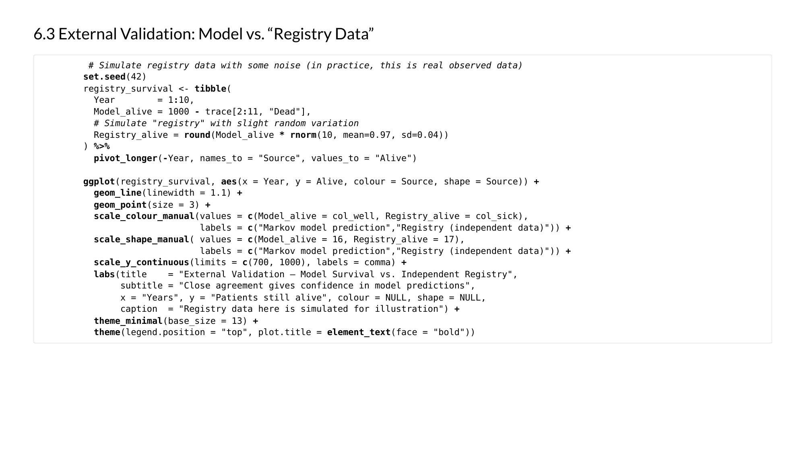
Notes:
Markov Modelling in Health Economics, a deep dive. Page 28 of 43. Rendered from the R Markdown teaching resource; the live HTML version has the foldable code and the tabbed sections.

Slide 29
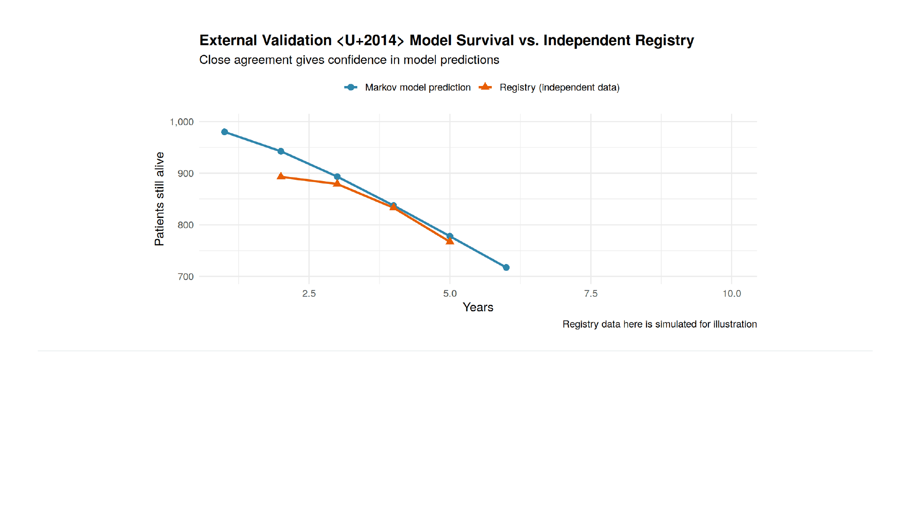
Notes:
Markov Modelling in Health Economics, a deep dive. Page 29 of 43. Rendered from the R Markdown teaching resource; the live HTML version has the foldable code and the tabbed sections.

Slide 30
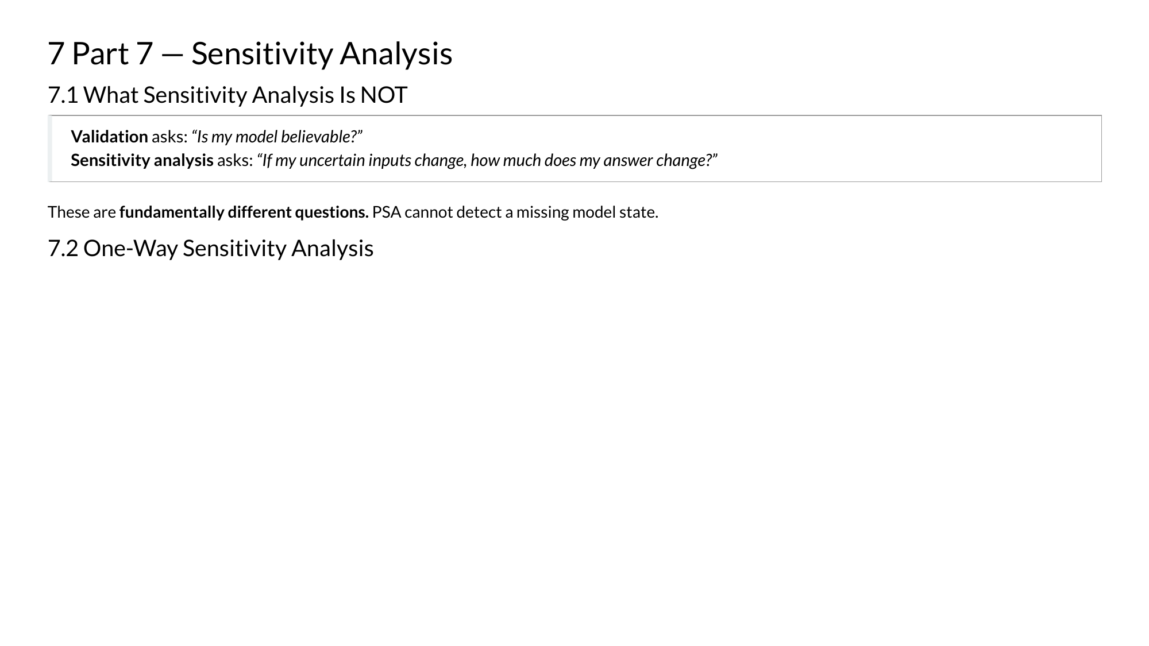
Notes:
Markov Modelling in Health Economics, a deep dive. Page 30 of 43. Rendered from the R Markdown teaching resource; the live HTML version has the foldable code and the tabbed sections.

Slide 31
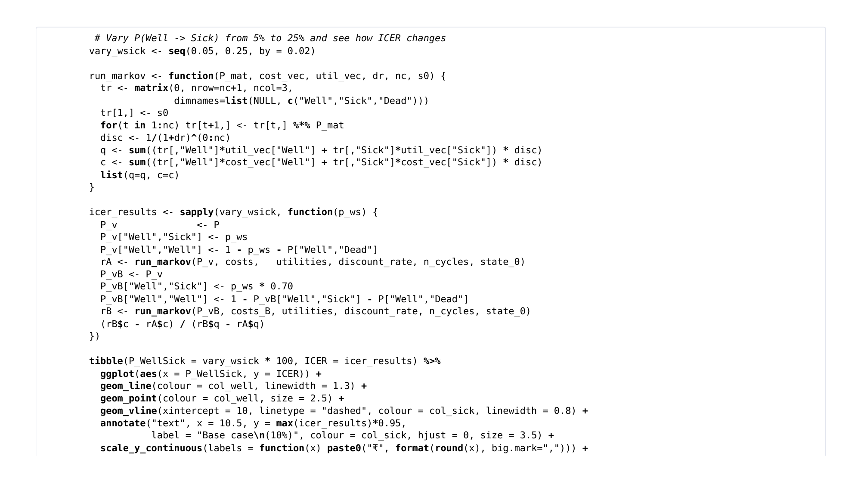
Notes:
Markov Modelling in Health Economics, a deep dive. Page 31 of 43. Rendered from the R Markdown teaching resource; the live HTML version has the foldable code and the tabbed sections.

Slide 32
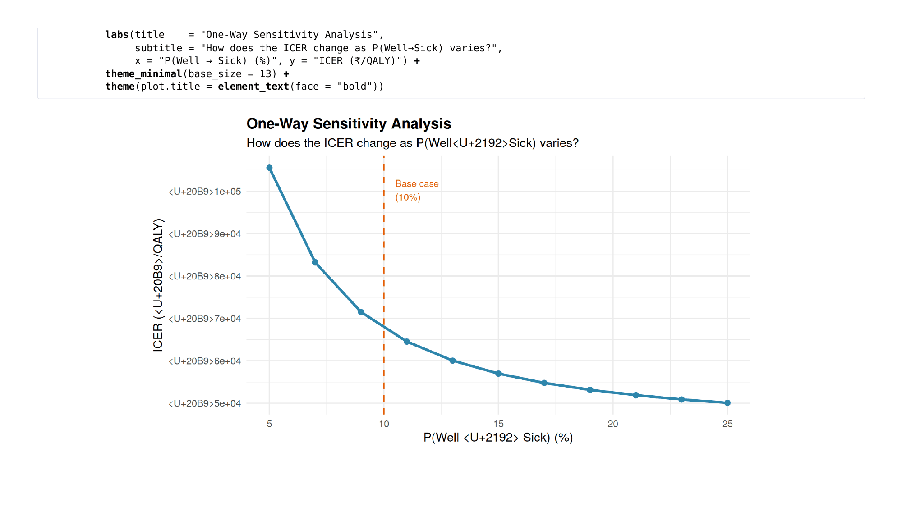
Notes:
Markov Modelling in Health Economics, a deep dive. Page 32 of 43. Rendered from the R Markdown teaching resource; the live HTML version has the foldable code and the tabbed sections.

Slide 33

Notes:
Markov Modelling in Health Economics, a deep dive. Page 33 of 43. Rendered from the R Markdown teaching resource; the live HTML version has the foldable code and the tabbed sections.

Slide 34
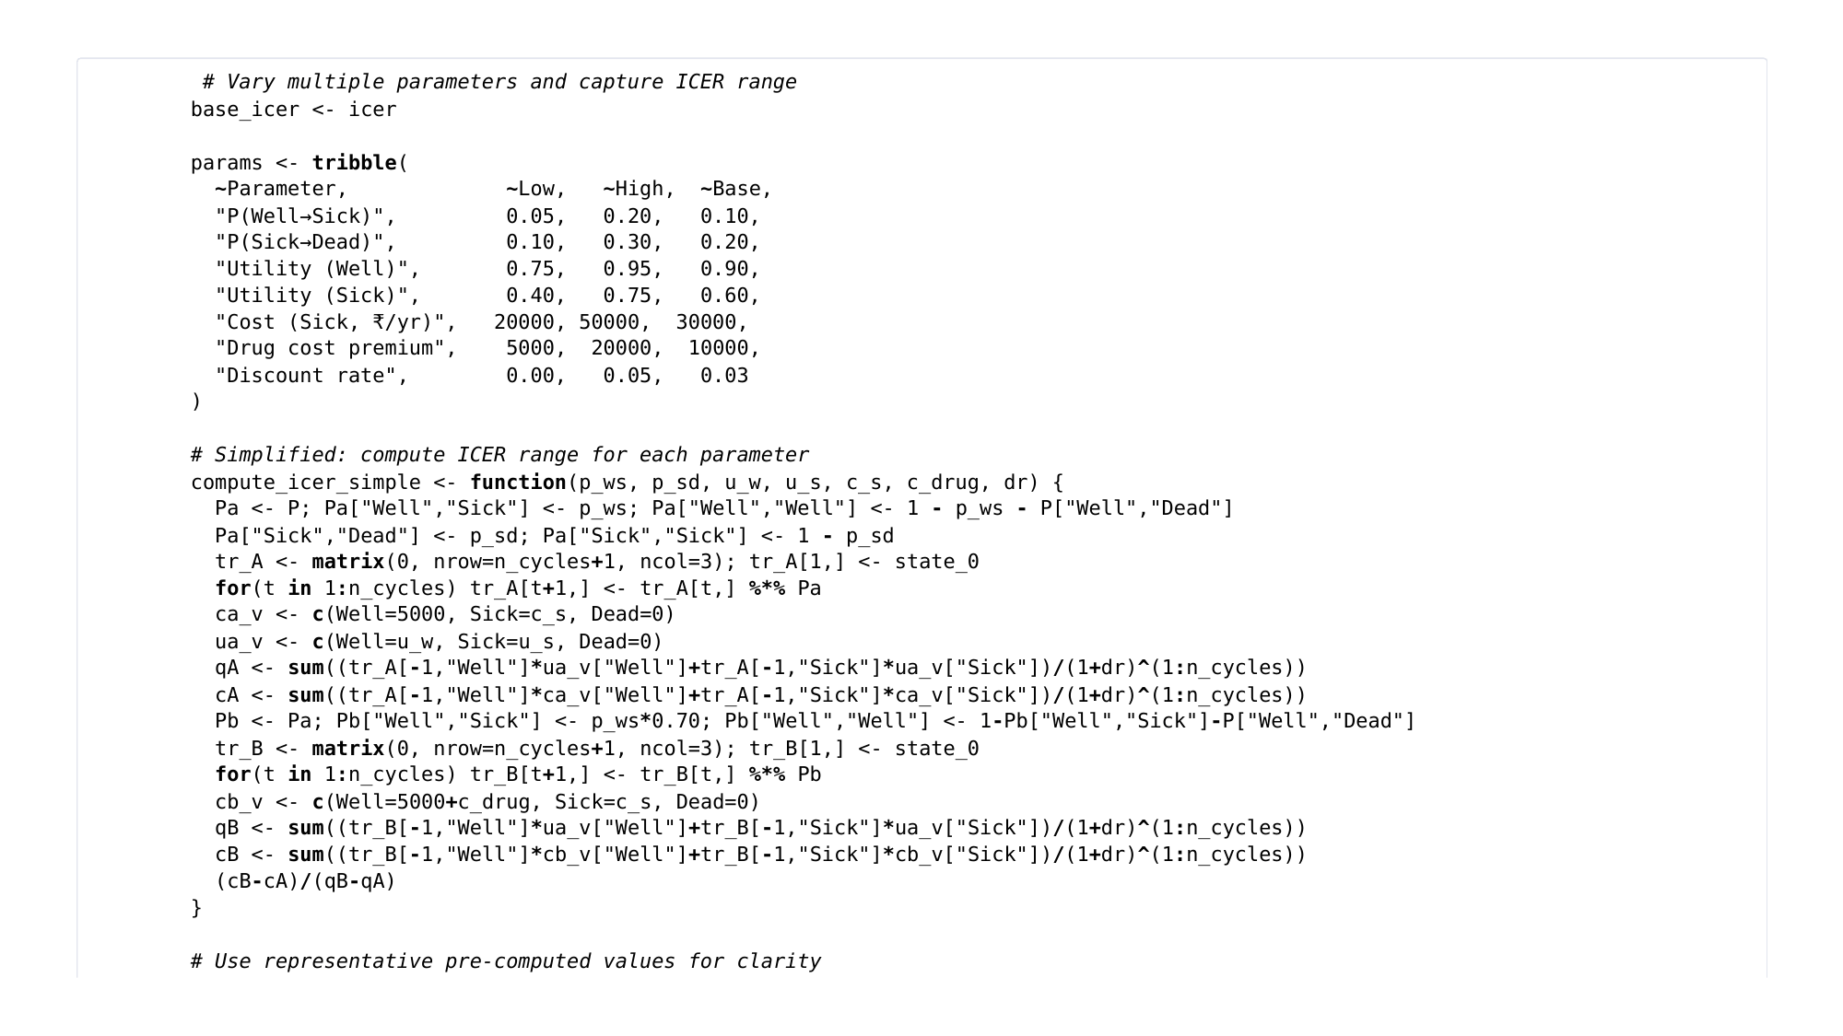
Notes:
Markov Modelling in Health Economics, a deep dive. Page 34 of 43. Rendered from the R Markdown teaching resource; the live HTML version has the foldable code and the tabbed sections.

Slide 35
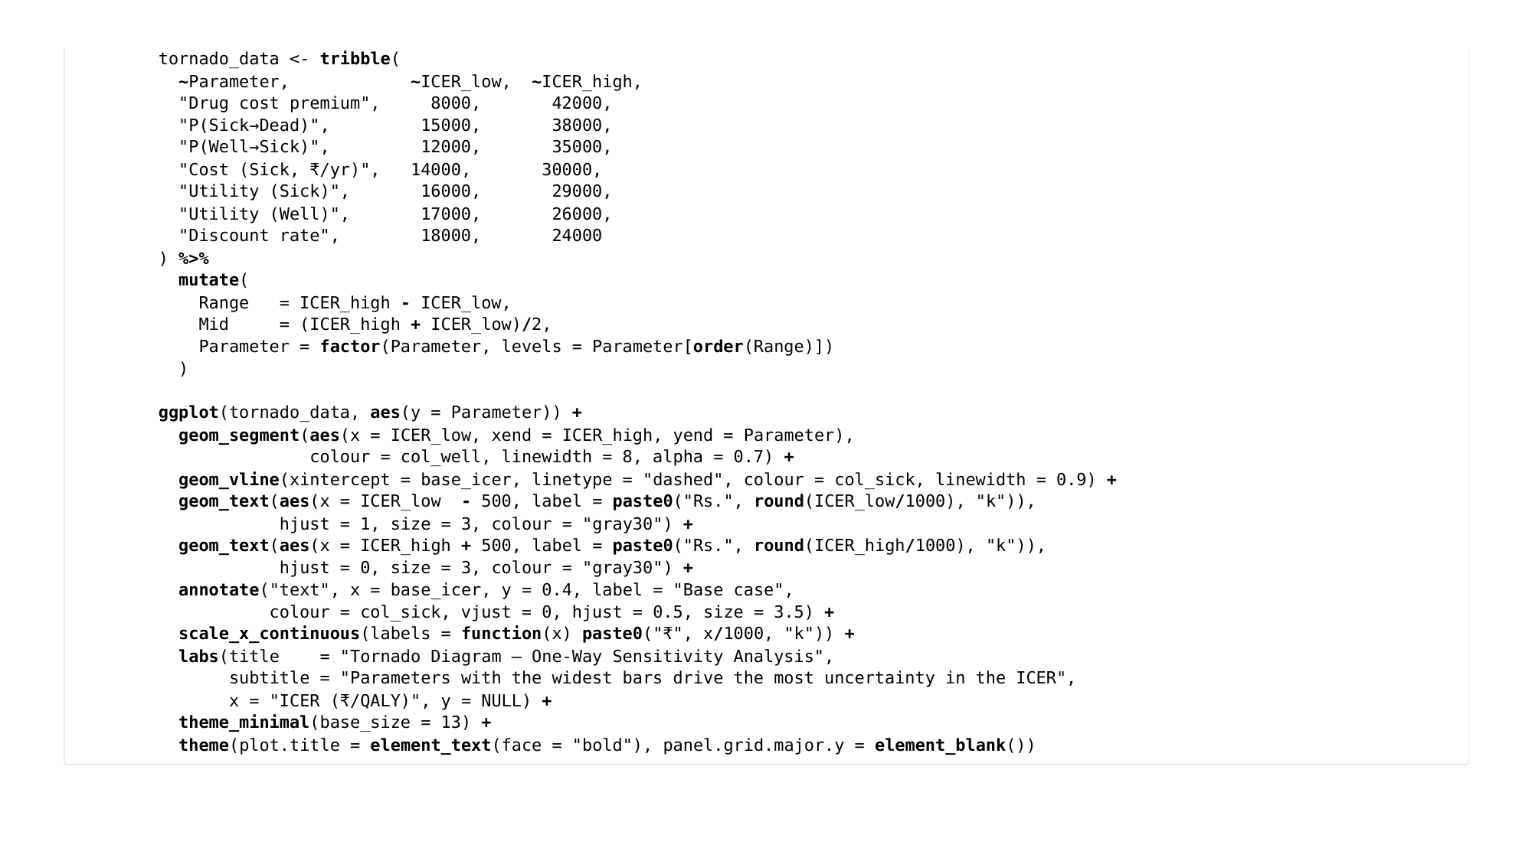
Notes:
Markov Modelling in Health Economics, a deep dive. Page 35 of 43. Rendered from the R Markdown teaching resource; the live HTML version has the foldable code and the tabbed sections.

Slide 36
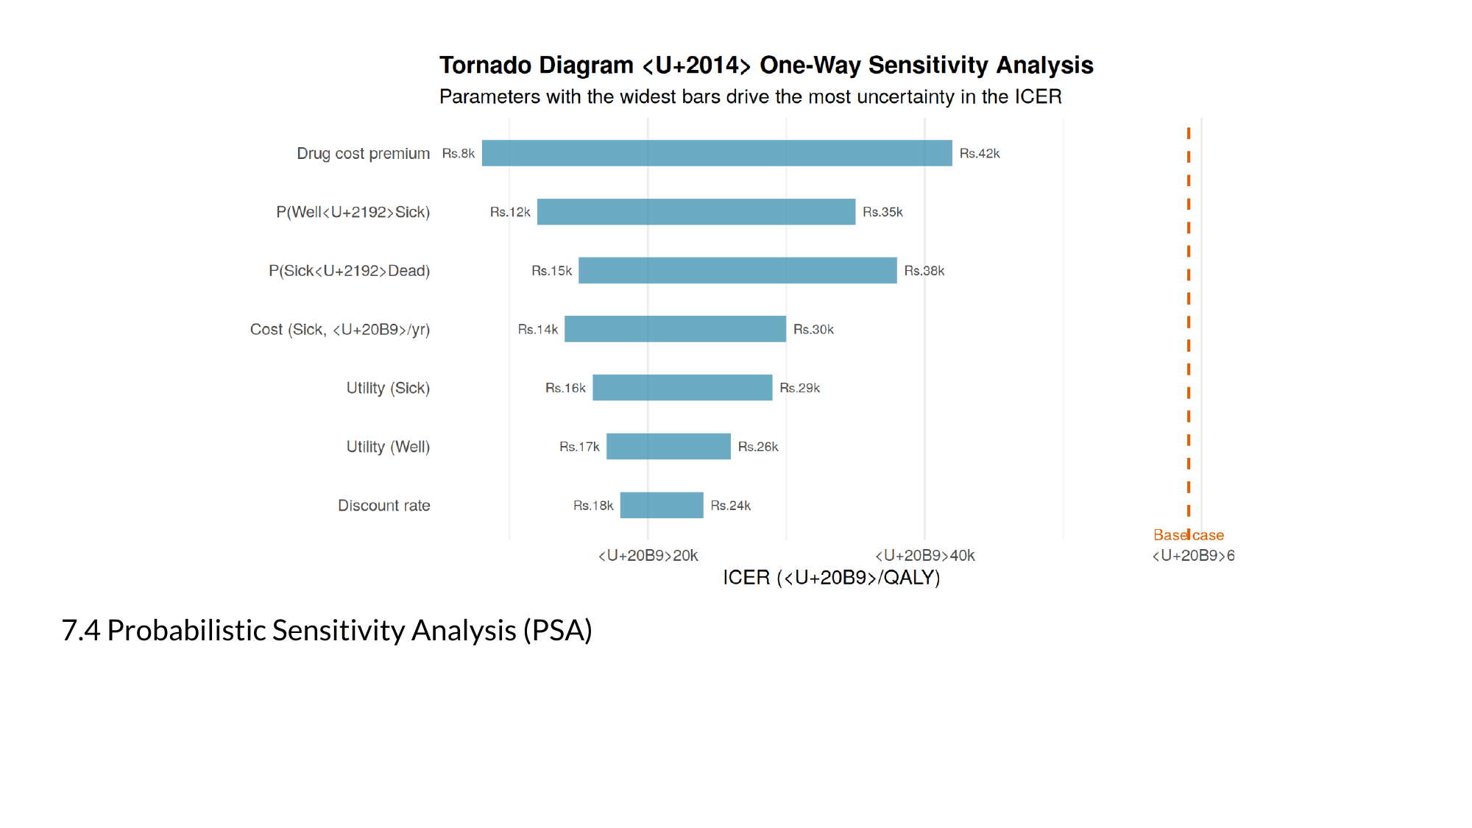
Notes:
Markov Modelling in Health Economics, a deep dive. Page 36 of 43. Rendered from the R Markdown teaching resource; the live HTML version has the foldable code and the tabbed sections.

Slide 37
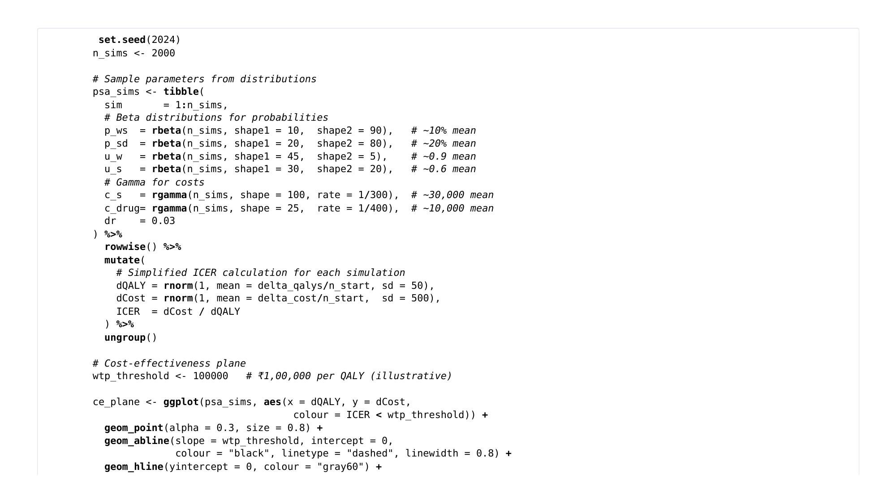
Notes:
Markov Modelling in Health Economics, a deep dive. Page 37 of 43. Rendered from the R Markdown teaching resource; the live HTML version has the foldable code and the tabbed sections.

Slide 38
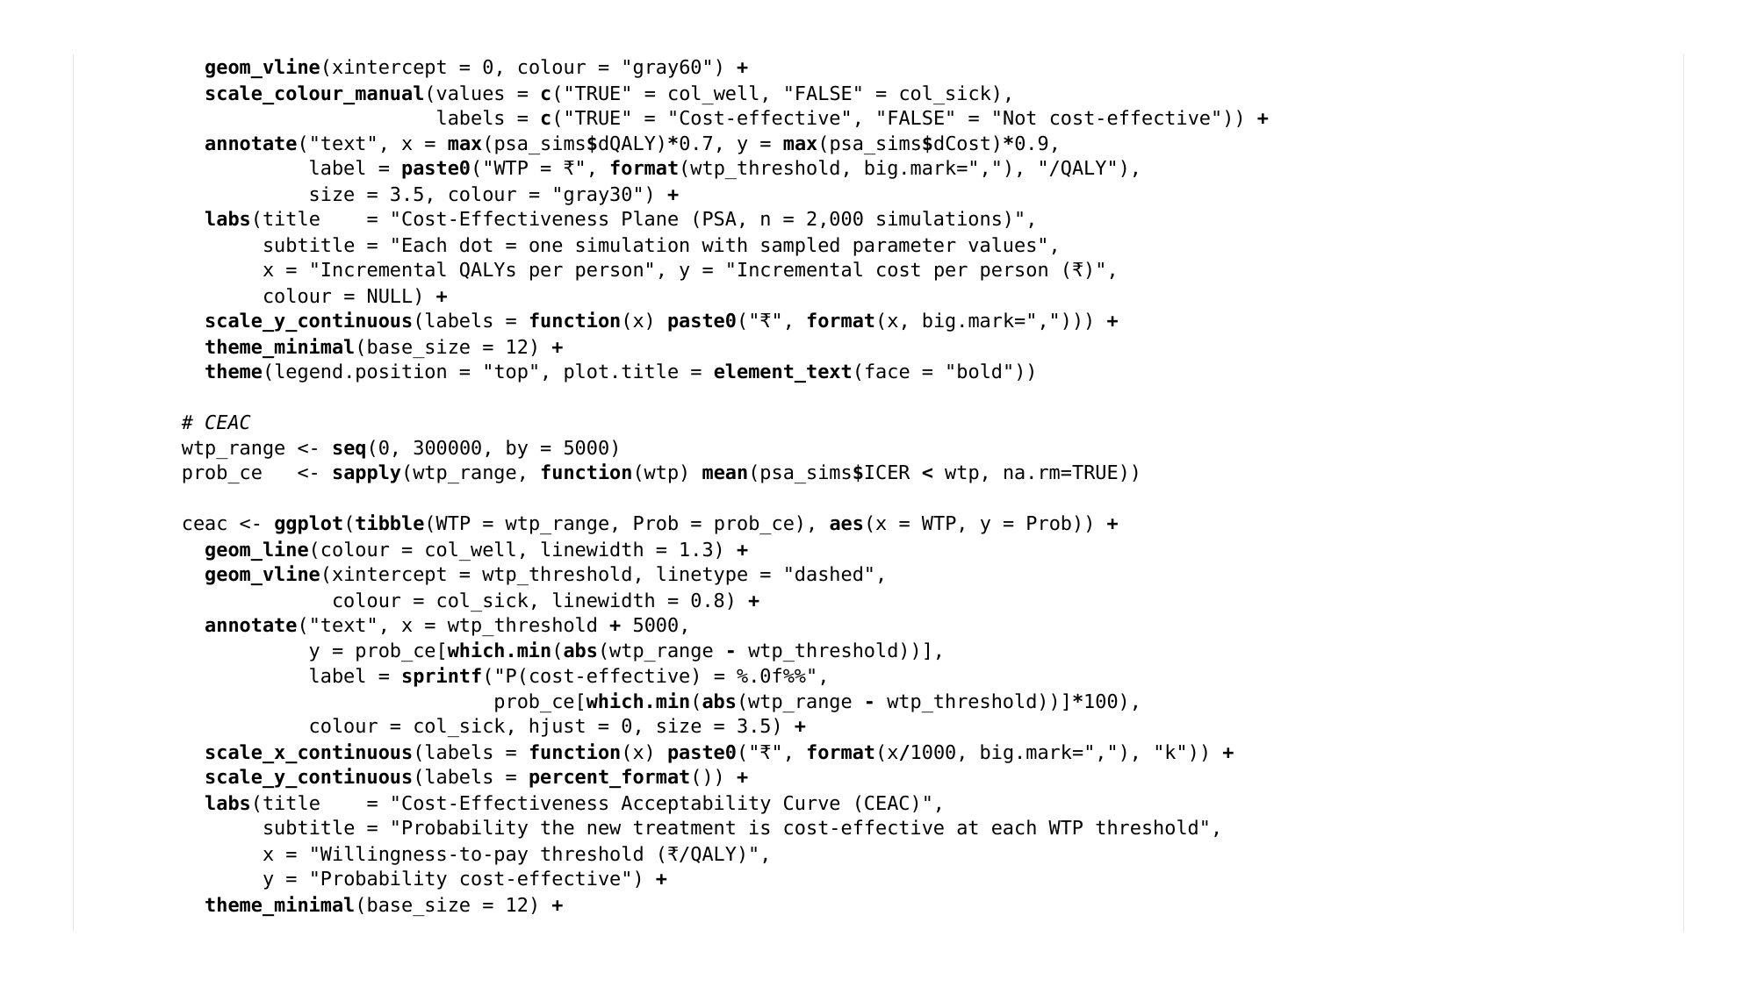
Notes:
Markov Modelling in Health Economics, a deep dive. Page 38 of 43. Rendered from the R Markdown teaching resource; the live HTML version has the foldable code and the tabbed sections.

Slide 39
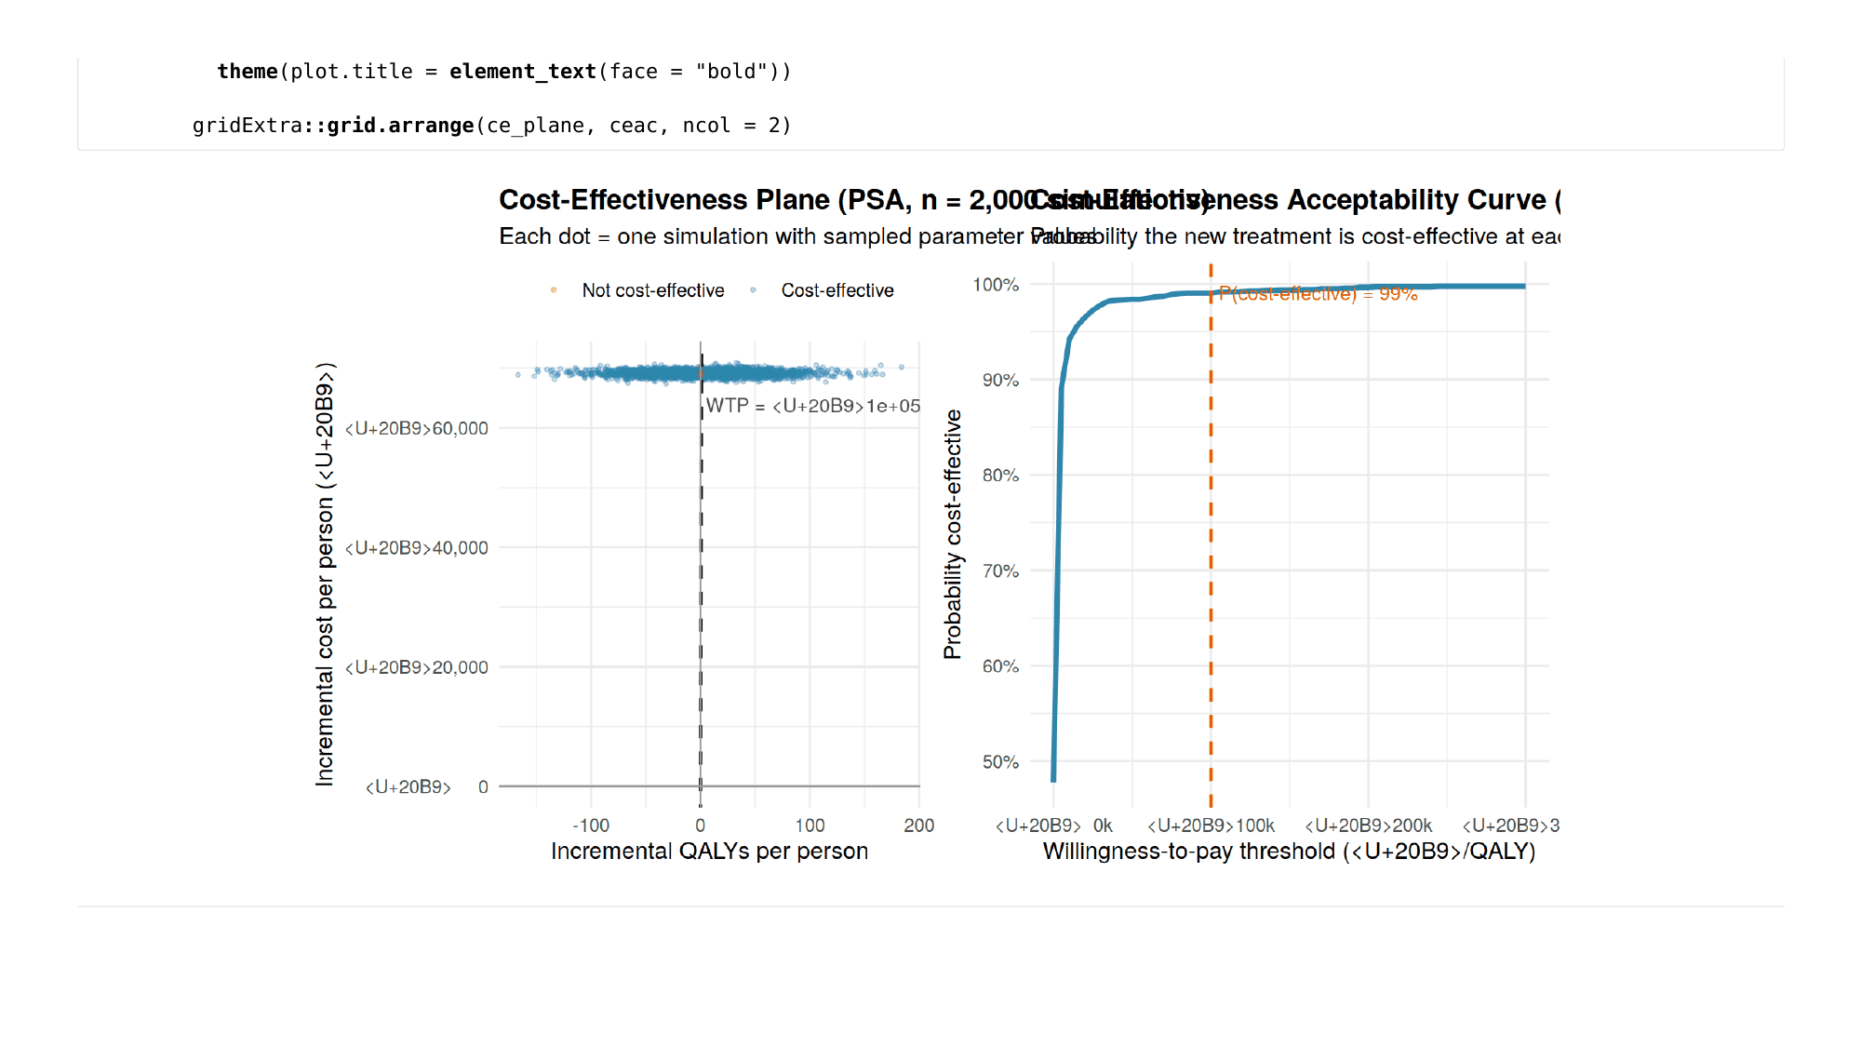
Notes:
Markov Modelling in Health Economics, a deep dive. Page 39 of 43. Rendered from the R Markdown teaching resource; the live HTML version has the foldable code and the tabbed sections.

Slide 40
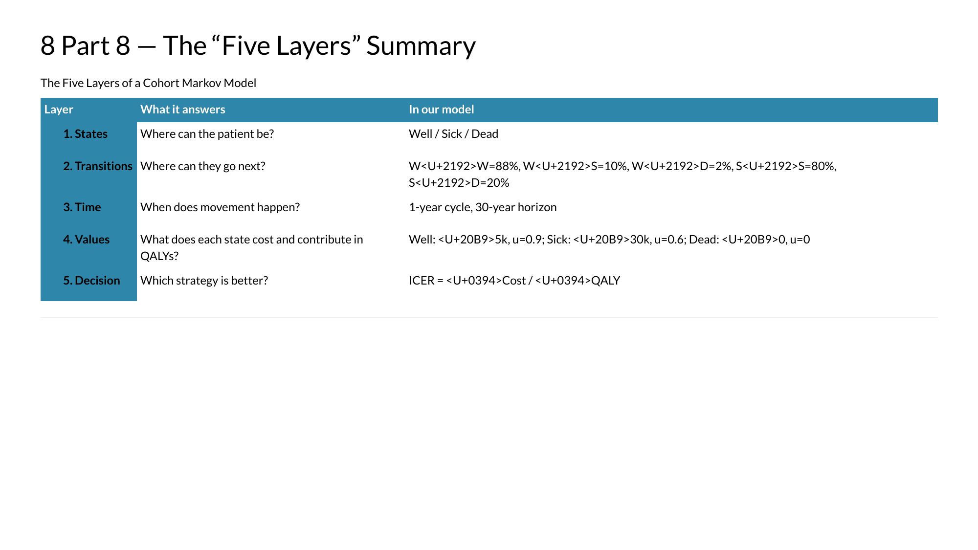
Notes:
Markov Modelling in Health Economics, a deep dive. Page 40 of 43. Rendered from the R Markdown teaching resource; the live HTML version has the foldable code and the tabbed sections.

Slide 41
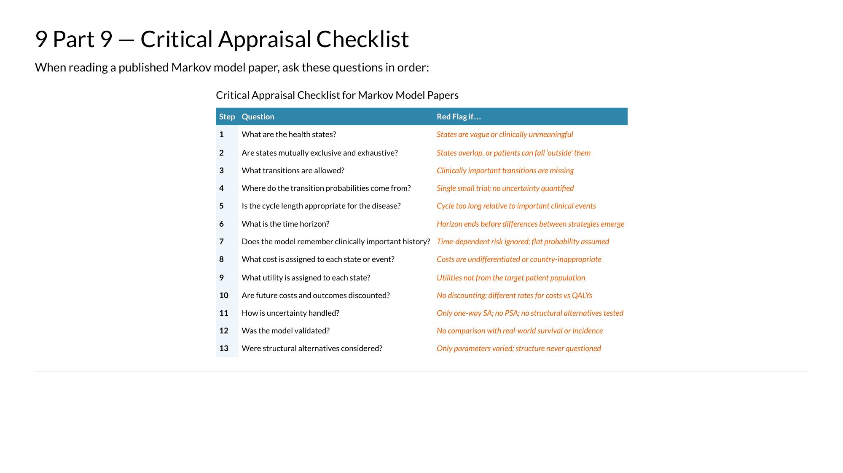
Notes:
Markov Modelling in Health Economics, a deep dive. Page 41 of 43. Rendered from the R Markdown teaching resource; the live HTML version has the foldable code and the tabbed sections.

Slide 42

Notes:
Markov Modelling in Health Economics, a deep dive. Page 42 of 43. Rendered from the R Markdown teaching resource; the live HTML version has the foldable code and the tabbed sections.

Slide 43
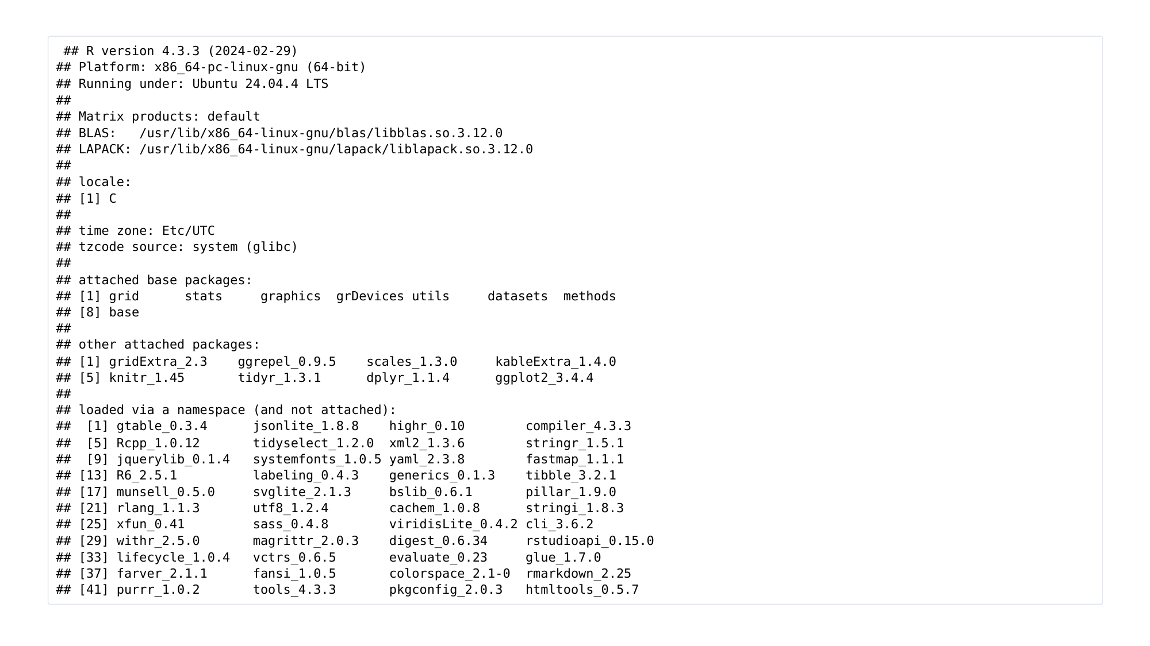
Notes:
Markov Modelling in Health Economics, a deep dive. Page 43 of 43. Rendered from the R Markdown teaching resource; the live HTML version has the foldable code and the tabbed sections.

