Slide 1
ECONOMIC EVALUATION IN HEALTH · FACULTY WORKSHOP · SESSION 2
What economic evaluation is,
and what it is not
Drummond et al., Methods for the Economic Evaluation of Health Care Programmes, 4th ed., 2015.
Chapter 1, pages 1 to 19.
Faculty, residents and research project staff · AIIMS Bhopal, 23 September 2026
Notes:
Open by saying what this block is not. It is not about saving money, and it is not accounting. Set the expectation that in fifty minutes they will be able to pick up any paper with the word "cost" in the title and say precisely what kind of study it is, and whether it can answer an allocation question at all. That is a concrete, testable skill.

Slide 2
By the end of this block
Define economic evaluation and state the two features that make an analysis one
Explain opportunity cost in your own words
Use Drummond's two questions to sort any study into one of six boxes
Tell CMA, CEA, CUA and CBA apart
Say why a costing study is not a cost-effectiveness analysis
Notes:
Read these out. Objective 5 is the one most often got wrong, in print as much as in supervision, so flag it now and again at the end.

Slide 3
28 February 2026, Ajmer
India began vaccinating every 14-year-old girl against HPV.
1.15 croregirls aged 14 every year, in every State and UT
One dosequadrivalent vaccine, Gardasil-4
Freeat government facilities
Press Information Bureau, Government of India, 28 February 2026. Introduced into the routine immunisation schedule with GAVI support.
Notes:
This happened six months ago. Most will have seen it in the news and some will have administered the vaccine. Ask who has given one. Then the real question: somebody decided this. On what basis?

Slide 4
The problem it addresses
1.2 lakhnew cervical cancer cases each year in India
80,000deaths each year, the second commonest cancer in women
25%of the world's cervical cancer deaths happen here
Burden alone does not justify a programme.
Every disease has a burden. Every programme has a cost. The budget did not grow.
GLOBOCAN 2022 estimates, as cited by the Press Information Bureau, 28 February 2026.
Notes:
Push back on the instinct in the room. Everyone accepts that a large burden justifies action. Ask whether India has a bigger burden of anaemia, of TB, of road traffic injury. Yes. So burden cannot be the deciding criterion, or you would fund everything, and you cannot.

Slide 5
It was not the only option
Screen instead of vaccinate
VIA, cytology or HPV DNA testing for women aged 30 to 65
A different vaccine
bivalent, quadrivalent or nonavalent
A different age band or schedule
9 to 14 years; one dose or two
Vaccinate and screen
or spend the money on treatment capacity
Choosing one of these means not choosing the others.
Notes:
Labour this slide. The commonest flaw in the papers they will read is a bad comparator, usually "do nothing" when the real alternative was something else. We return to it hard in Block 3. For now, plant it: an evaluation is only as good as the alternatives it compared.

Slide 6
Start here: resources are scarce
A District Health Society has a fixed envelope this year. Every rupee committed to one thing is a rupee not available for another.
This is not a budgeting inconvenience. It is the reason economic evaluation exists.
Scarcity is not a failure of planning. Even a very rich health system faces it, because demand for health care grows faster than any budget.
Notes:
If someone objects that the government can print money, the constraint is real resources: ANMs, cold-chain capacity, operation theatre hours, oncologists. Money is only the accounting unit for those things.

Slide 7
Opportunity cost
The value of the benefit forgone because a resource was not used in its next best alternative way.
The cost of the HPV programme is not ₹X crore.
The cost is the health that ₹X crore would have produced somewhere else in the Indian health system.
Money is the measuring rod. Forgone health is the thing being measured.
Notes:
The single most important idea in the course, and the one most likely to be recited without being understood. Test it: ask what the opportunity cost of a new machine in their department is. The post, the drug budget or the ward it displaces, and the health that would have produced. Force them to name the alternative. An opportunity cost with no named alternative is not one.

Slide 8
So the question is never…
Is this intervention worth it?
Is it worth it compared with what we would otherwise do with the same resources?
Which is why an economic evaluation always has at least two arms. And why "cost-effective" is an empty phrase unless you can finish the sentence: cost-effective compared with what, at what threshold, from whose point of view?
Notes:
Get them to say the full sentence out loud once. Cost-effective compared with what, at what threshold, from whose perspective. That sentence is worth more to them than any formula here, and it is the fastest way to interrogate a drug representative's slide deck.

Slide 9
Two features define an economic evaluation
1. Inputs and outputs
2. Choice
It deals with both the resources consumed (costs) and the results produced (consequences). Not one or the other.
It compares two or more alternatives. No comparison, no choice. No choice, no economics.
Miss either feature and you have something else. Often something useful, but not an economic evaluation.
Notes:
Everything in the next ten minutes is just these two features turned into a table. Tell them that, so the grid does not feel arbitrary.

Slide 10
Drummond's two questions
Question 1
Are both costs and consequences examined?
Question 2
Is there a comparison of two or more alternatives?
Two yes-or-no questions. Six possible boxes. Only one of them is a full economic evaluation.
Notes:
Ask them to write these two questions inside the cover of whatever they use for notes. They will use them for the rest of their careers. Six boxes and not four, because "costs only" and "consequences only" are separate answers to Question 1.

Slide 11
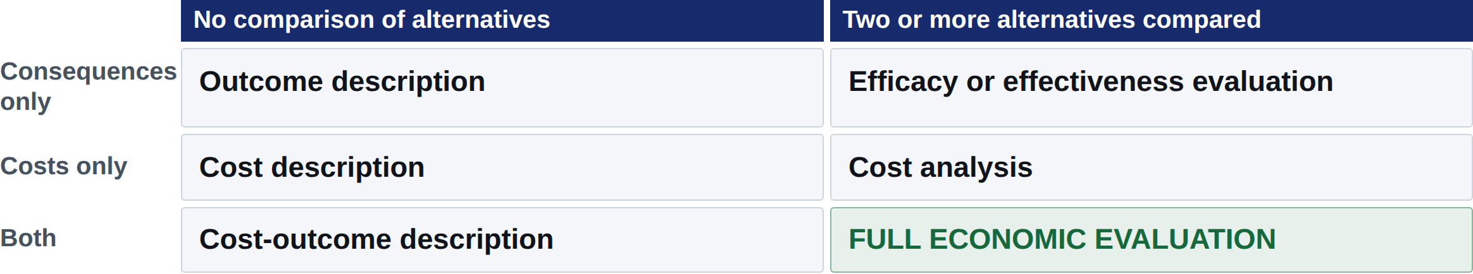
The six boxes
Five of the six are partial evaluations. Not worthless, but none of them can tell you whether to fund the programme.
Notes:
Build this on the board first if you have one, then show the slide. Point out that the randomised trial, the thing they have been taught is the highest form of evidence, sits in a partial box because it says nothing about cost. That usually lands.

Slide 12
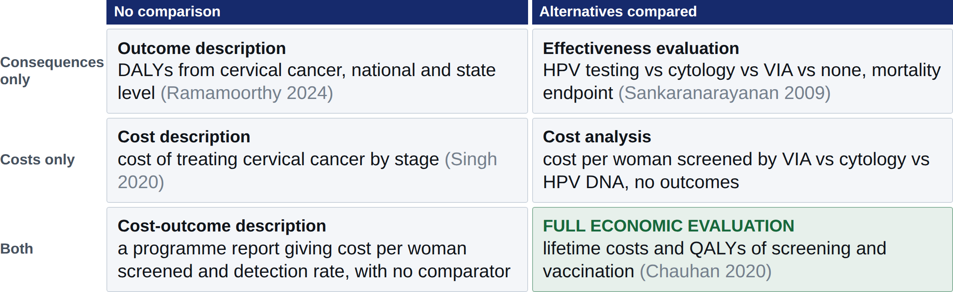
One disease, six study designs
All six are cervical cancer in India. Four are published studies. The two without a citation are the designs you meet in State and district programme reports.
Notes:
The spine of the block. Same disease, same country, six different questions. Emphasise Sankaranarayanan: a landmark Indian trial in 130,000 women showing that a single round of HPV testing cut cervical cancer deaths, and still a partial evaluation in Drummond's scheme because it costed nothing. Being partial is not a criticism. It is a statement about which question a study can answer.

Slide 13
Partial is not useless
Partial study | Answers | Cannot answer
Outcome description | How big is the problem? | What should we do about it?
Cost description | What will this cost us? | Is it worth that cost?
Effectiveness evaluation | Does it work, and how well? | Can we afford what it displaces?
Cost analysis | Which option is cheaper? | Whether the cheaper one is worse
Every full economic evaluation is built from these.
Notes:
Guard against the impression that partial studies are second rate. Most departmental work, and most theses they supervise, will be partial studies, and that is fine as long as they are labelled honestly. The sin is calling a cost analysis a cost-effectiveness analysis.

Slide 14
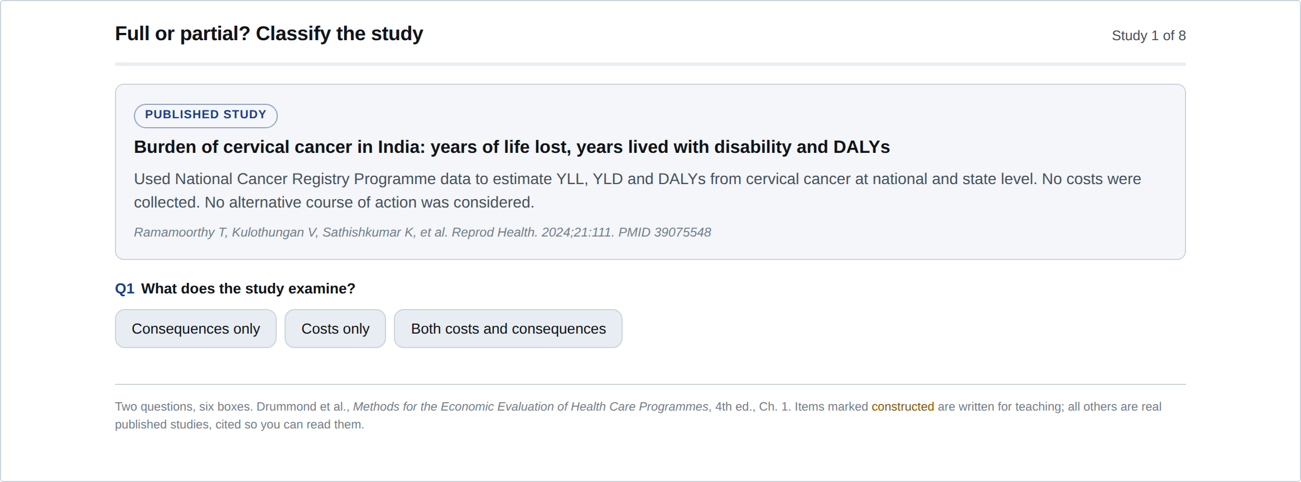
Your turn
Eight real studies, two questions each: does it measure both costs and consequences, and does it compare alternatives? The widget scores you and says why.
Open it on your phone at sph-aiimsbhopal.github.io/intro-economic-evaluation-health, along with five others we will use today.
Notes:
Give them six to eight minutes, in pairs, and let them argue. Walk the room. The two that generate most argument are the randomised trial, because they want to call a good study a full evaluation, and the cost analysis, because it has "cost" in the title. Those arguments are the point. Do not resolve them too quickly.

Slide 15
Inside the green box: four types
In every full economic evaluation, costs are measured in money.
What differs is how the consequences are valued.
That one distinction gives you CMA, CEA, CUA and CBA.
If you remember nothing else about the four types, remember that the difference lives entirely on the consequences side.
Notes:
It is easy to hold four definitions and still not tell the types apart on a real paper. Give the organising principle instead: look at what is in the denominator.

Slide 16
Cost-minimisation analysis
Consequences valued as: nothing. They are shown to be equivalent, then set aside.
The output: which option costs less.
Published example. Ready-made versus custom-made spectacles for school children in India. A non-inferiority trial first established that spectacle wear was equivalent, so the economic analysis reduced to a cost comparison. Cost per child needing spectacles fell from US$26.91 to US$11.15, a saving of 58.6%.
Only legitimate if equivalence was demonstrated, not assumed.
Minakaran et al., Ophthalmic Epidemiology, 2021.
Notes:
A textbook-clean CMA, worth dwelling on because CMA has fallen out of favour. Most agencies now discourage it, since "no statistically significant difference" is not the same as "equivalent". Note that this study earned its CMA: a non-inferiority trial came first. Most papers claiming CMA have not done that.

Slide 17
Cost-effectiveness analysis
Consequences valued as: one natural unit. Deaths averted, cases detected, life-years gained.
The output: cost per unit of effect.
Published example. A national rotavirus vaccination programme for India. At US$1.00 per dose it would cost US$49.8 million and prevent about 44,000 deaths a year, at US$662.94 per life saved. At the GAVI price of $0.15 a dose it was cost-saving.
You can only compare programmes that share the same outcome unit.
Esposito et al., Clinical Infectious Diseases, 2011.
Notes:
Note the vaccine price doing all the work: cost-saving at $0.15, still highly cost-effective at $7.00. Price is almost always the most influential parameter in a vaccine evaluation, which previews one-way sensitivity analysis in Block 3.

Slide 18
Cost-utility analysis
Consequences valued as: a generic, preference-weighted measure. The QALY, or in much LMIC work the DALY.
The output: cost per QALY gained.
Published example. A Markov model from a societal perspective over a lifetime, comparing screening strategies and HPV vaccination for India. Screening with VIA every 5 years: ₹54,881 per QALY gained. HPV vaccination, alone or with later screening: ₹5,693 to ₹31,511 per QALY gained.
A generic unit makes a cancer programme and a cardiac programme comparable.
Chauhan, Prinja et al., PLoS One, 2020.
Notes:
This is the paper that most directly informs the February 2026 decision, and it is Indian, PGIMER-led, societal perspective, with primary Indian cost and quality-of-life data. Point at those ICERs and ask what they should be compared against. Nobody can answer yet, which is exactly the cliff-hanger into Block 2.

Slide 19
Cost-benefit analysis
Consequences valued as: money, through willingness to pay or lost production.
The output: net benefit in rupees, or a benefit-to-cost ratio.
Why you will read very few of these in health. Valuing a life-year in rupees is technically demanding and ethically contested, and most health ministries do not want their decisions framed that way. CBA remains standard in transport, environment and infrastructure.
Its unique strength: it can compare a hospital with a road.
Notes:
Be honest that CBA is rare in health and do not oversell it. But make the theoretical point: CEA and CUA can only rank options within a fixed health budget, and only CBA can question the size of that budget. That is a real limitation of everything else we teach.

Slide 20
The four types, side by side
 | Consequences valued as | Result | Compares across
CMA | equivalent, set aside | which is cheaper | identical outcomes only
CEA | one natural unit | ₹ per unit of effect | the same outcome unit
CUA | QALYs or DALYs | ₹ per QALY gained | any health programme
CBA | money | net benefit in ₹ | anything at all
Read down the second column. That column is the classification.
Notes:
If they photograph one slide in this block it should be this one. Then immediately complicate it with the next slide, so they do not leave thinking classification is mechanical.

Slide 21
A warning: QALYs are not DALYs
QALY, gained
DALY, averted
Health gained. Preference-based utility weights, 1 for full health and 0 for dead, usually elicited from the general public. You maximise it.
Health lost. Disability weights plus years of life lost against a reference life expectancy. You minimise it.
They are not interchangeable, and one is not the arithmetic negative of the other.
You met DALYs first, through burden-of-disease teaching. Most Indian HTA work now reports QALYs, because the Indian Reference Case asks for them. Watch which one a paper uses.
Notes:
This slide exists because they will otherwise conflate the two for the rest of their careers. Concretely: Arora 2024 reports cost per DALY averted, Chauhan 2020 reports cost per QALY gained. Same disease, same country, different currency of health. Those two numbers cannot go in the same league table.

Slide 22
Three errors we will keep catching
Calling a costing study a CEA. "Cost" in the title does not make it an economic evaluation. Ask Question 1.
Calling a CEA a CUA. Cost per case detected is not cost per QALY. Look at the denominator.
Declaring something cost-effective with no threshold and no comparator. The phrase is empty without both.
A systematic review of Indian evaluations found exactly these problems at scale.
Prinja et al., Applied Health Economics and Health Policy, 2015.
Notes:
Tell them plainly: they will meet all three in journal club within the year, and probably in a pharmaceutical presentation within the month. Naming the error politely and precisely is a professional skill.

Slide 23
Why this matters in your job
State PIP
PMJAY package rates
Every activity proposed displaces another. Somebody has to justify the choice.
What a procedure is reimbursed at is a costing and value question, revised using these methods.
HTAIn topic nomination
Work you supervise
Any of you can nominate a technology for assessment. Knowing what evidence is needed is the first step.
Label the study honestly. A good cost analysis beats a mislabelled CEA in any thesis or paper.
Notes:
Make it concrete. Ask who has sat on a purchase or a drug and therapeutics committee, or worked on a State PIP. Get them to describe a choice they saw made and what evidence, if any, supported it.

Slide 24
Recap
Opportunity cost, the health forgone elsewhere, is why any of this exists
An economic evaluation examines both costs and consequences, for two or more alternatives
The two questions sort every study into six boxes. Five are partial
The four full types differ only in how consequences are valued
Nothing so far tells you whether ₹54,881 per QALY is good value.
Notes:
End on the open question deliberately. It is the hook into Block 2, and it is a genuinely unsettled question in India rather than a teaching device.

Slide 25
Sources
Drummond MF, Sculpher MJ, Claxton K, Stoddart GL, Torrance GW. Methods for the Economic Evaluation of Health Care Programmes. 4th ed. Oxford University Press; 2015. Chapter 1, pp. 1–19.
Press Information Bureau, Government of India. Cervical Cancer Vaccination Campaign launched. 28 February 2026. Burden figures from GLOBOCAN 2022.
Ramamoorthy T, Kulothungan V, Sathishkumar K, et al. Burden of cervical cancer in India: YLL, YLD and DALYs at national and subnational levels. Reprod Health 2024;21:111. PMID 39075548
Singh MP, Chauhan AS, Rai B, et al. Cost of treatment for cervical cancer in India. Asian Pac J Cancer Prev 2020;21(9):2639–46. PMID 32986363
Sankaranarayanan R, Nene BM, Shastri SS, et al. HPV screening for cervical cancer in rural India. N Engl J Med 2009;360:1385–94. PMID 19339719
Chauhan AS, Prinja S, Srinivasan R, et al. Cost effectiveness of strategies for cervical cancer prevention in India. PLoS One 2020;15(9):e0238291. PMID 32870941
Minakaran N, Morjaria P, Frick KD, Gilbert C. Cost-minimisation analysis from a non-inferiority trial of ready-made versus custom-made spectacles for school children in India. Ophthalmic Epidemiol 2021;28(5):383–91. PMID 33256485
Esposito DH, Tate JE, Kang G, Parashar UD. Projected impact and cost-effectiveness of a rotavirus vaccination program in India, 2008. Clin Infect Dis 2011;52(2):171–7. PMID 21288839
Prinja S, Chauhan AS, Angell B, et al. A systematic review of the state of economic evaluation for health care in India. Appl Health Econ Health Policy 2015;13(6):595–613. PMID 26449485
Notes:
Do not read this out. It is here so that a photographed slide carries a full reference, and so the deck stands alone as a document. The same list, annotated, is in handouts/reading-list.html.

Slide 26
FACULTY WORKSHOP · SESSION 3 · DRUMMOND 4TH ED., CHAPTER 2
Making decisions
in health care
Budgets, thresholds, and who actually decides. NICE, HTAIn, and the number that turns an ICER into a policy.
Notes:
Before the break, set the pre-read: skim the abstract of Chauhan 2020 and come back with a view on whether ₹54,881 per QALY is affordable for India. That primes the threshold discussion.

