Slide 1
ECONOMIC EVALUATION IN HEALTH · FACULTY WORKSHOP · SESSION 7
Modelling in half an hour
Why a model exists, what a decision tree and a Markov model do, what a cycle is, and what to distrust. For reading models, not building them.
Drummond et al., 4th ed., Chapter 9
Notes:
Twenty-five minutes, straight after the ICER session. Five of the eight papers in the pack are models. The aim is that every group can describe its paper's model in two sentences and name one thing about it they would challenge.

Slide 2
By the end of this session
Say why most economic evaluations are models, not trials
Read a decision tree and roll it back
Say what a Markov model and a cycle are
Name what the Markov assumption forgets
Ask seven questions of any published model
Notes:
No software, no formulas beyond multiplication. If anyone asks how to build one, the answer is Briggs and Sculpher 1998 and a supervisor who has built one.

Slide 3
Why a model at all?
A trial gives you | A decision needs
two or three arms | every relevant option, including current practice
one to three years of follow-up | a lifetime, if survival differs
clinical outcomes | QALYs, costs, Indian prices
a selected population, often abroad | Indian patients in Indian facilities
A model is a framework for combining evidence from many sources to answer a question no single study answered.
Notes:
This is the justification, and also the warning. Every source that goes in brings its own uncertainty and its own setting. The model is only as good as its worst input and its structure.

Slide 4
Two shapes you will meet
Decision tree
Markov model
Branches for choices and chance events, ending in outcomes. Events happen once, over a short period.
A few health states; people move between them in repeated cycles. Events recur over a long period.
A test, a course of treatment, an acute episode.
Chronic disease, cancer recurrence, a lifetime horizon.
Many papers use both: a tree for the first event, a Markov model for what follows.
Notes:
The Kaur screening paper in the pack is exactly this: a decision tree then a Markov model. Group 4 should recognise it.

Slide 5
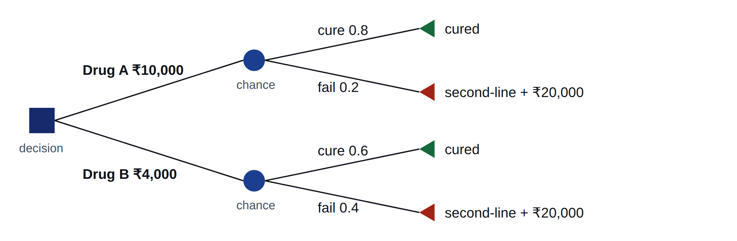
A decision tree
Constructed example. Square: a choice. Circle: chance. Triangle: where a path ends.
Notes:
Walk one path aloud: choose A, pay 10,000, 80% are cured, 20% fail and go to second-line at a further 20,000. Ask them to guess which drug is cheaper overall before the next slide.

Slide 6
Rolling it back
Multiply along each path, then add the paths.
 | Expected cost | First-line cures
Drug A | 10,000 + 0.2 × 20,000 = ₹14,000 | 0.8
Drug B | 4,000 + 0.4 × 20,000 = ₹12,000 | 0.6
A versus B | +₹2,000 | +0.2
Drug A costs six thousand rupees more at the counter but only two thousand more overall, because it avoids second-line treatment.
Constructed example.
Notes:
That last line is the reason models exist: the purchase price is not the cost of the choice. Note the unit: cost per cure is a natural unit, like the hernia paper in the pack. To compare with other programmes you would need QALYs on the branches.

Slide 7
When a tree breaks
Events recur: relapse, re-admission, a second stroke
Risk changes with time: age, years since surgery
The horizon is long, so the tree would need thousands of branches
Then you stop drawing every path and instead track how many people are in each state, year by year.
Notes:
That is the Markov idea: replace an exploding tree with a small set of states and a rule for moving between them.

Slide 8
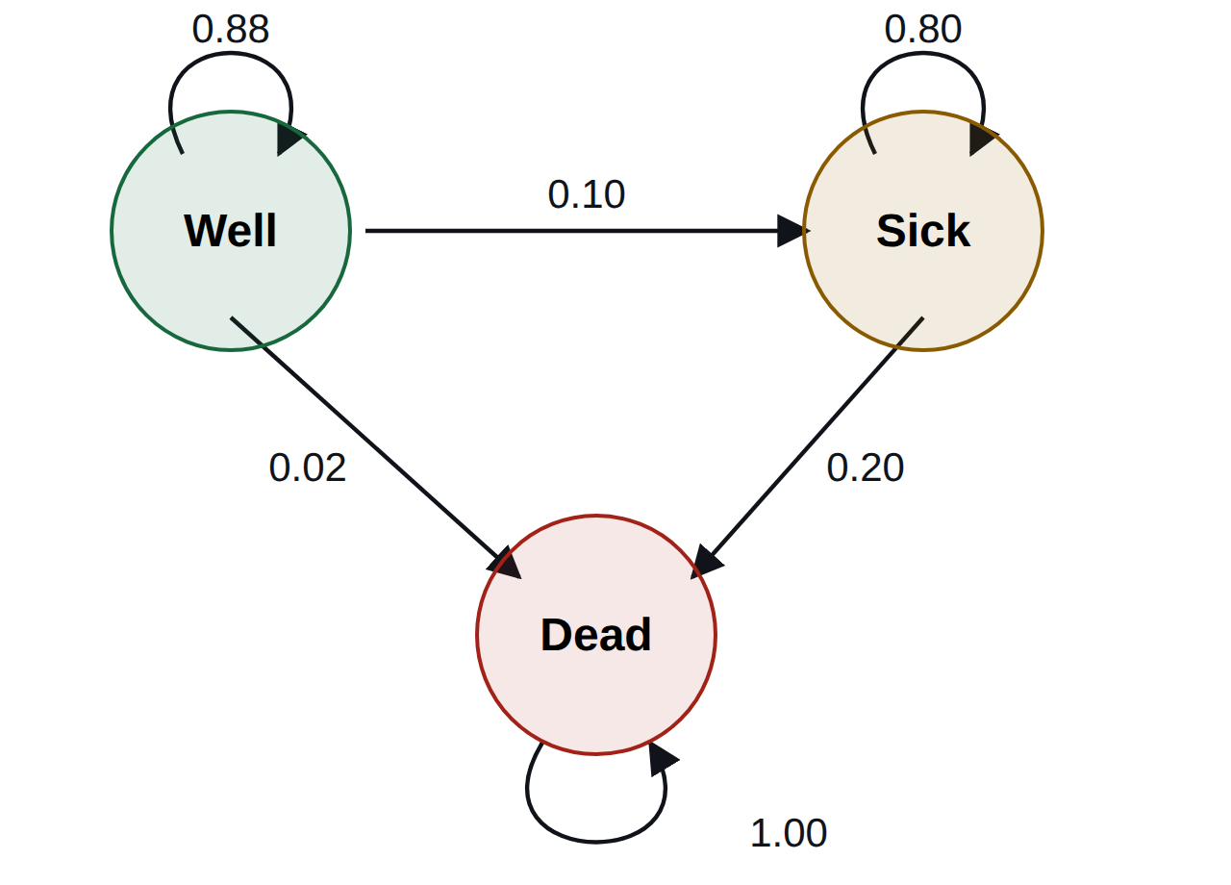
A Markov model
States are exhaustive and exclusive: everyone is in exactly one.
Arrows carry the probability of moving in one cycle. Each state's arrows add to 1.
Dead is absorbing: nobody leaves.
Each state carries a cost and a utility per cycle.
Constructed example.
Notes:
Check they can read the arrows: of people who are Well at the start of a year, 88% stay well, 10% become sick, 2% die. Nobody recovers from Sick here, which is itself an assumption worth naming.

Slide 9
What a cycle is
Start 1,000 people in Well. Apply the arrows once per cycle, here one year.
Cycle | Well | Sick | Dead | QALYs this cycle
0 | 1,000 | 0 | 0 | n/a
1 | 880 | 100 | 20 | 852
2 | 774 | 168 | 58 | 798
QALYs = people × utility (Well 0.9, Sick 0.6). Do the same with costs. Run until nearly everyone is dead, discount, add up. Then do it again for the other option.
Constructed example. Cycle 2: Well 880 × 0.88; Sick 100 × 0.80 + 880 × 0.10; Dead the rest.
Notes:
This is all a Markov cohort model does. A spreadsheet row per cycle. The ICER comes from the difference in the discounted totals between two such spreadsheets.

Slide 10
What the model forgets
The Markov assumption: where you go next depends only on the state you are in now, not on how you got there or how long you have been there.
The problem
The usual fixes
Recurrence after cancer surgery is highest in the first two years. A single "disease-free" state gives everyone the same risk in year 1 and year 10.
Split the state by time since event ("tunnel" states), let probabilities change with age, or simulate individuals instead of a cohort.
If history matters clinically, check that the model remembers it.
Notes:
Groups 1 and 3 have Markov models where time since surgery plausibly matters. Ask them whether their paper handles it. They may not be able to tell from the paper, which is itself a finding.

Slide 11
How long is a cycle?
Short enough that two events rarely happen in one cycle
Matched to the disease: months for cancer on treatment, a year for slow chronic disease
People move at the end of a cycle but really move halfway through on average, so careful models apply a half-cycle correction
You need not compute any of this. You need to find the cycle length in the paper, and notice if it is missing.
Notes:
If a paper does not state its cycle length, the model cannot be reproduced. That alone is a reporting failure.

Slide 12
Where the numbers come from
Input | Usual source | What to ask
Transition probabilities | trials, cohorts, registries | From India? Over what follow-up?
Beyond follow-up | extrapolation | How was it extended, and was it tested?
Utilities | EQ-5D surveys | Indian value set?
Costs per state | costing studies, package rates | The five costing errors
A model built entirely on borrowed numbers can be internally perfect and still answer someone else's question.
Notes:
Group 6's NIV paper is the example: every parameter from the literature. Group 4's screening paper is the counter-example, with primary Indian costs and utilities.

Slide 13
Seven questions for any published model
Is there a diagram of the structure? Could you redraw it?
Do the states include every event that differs between the options?
Is the cycle length stated and sensible?
Where do the probabilities come from, and from which country?
How far does it extrapolate beyond the evidence?
Was it validated: does it reproduce known survival or incidence?
Were structural alternatives tested, or only parameters?
Notes:
Question 7 bridges to the uncertainty session next: probabilistic analysis varies parameters inside a fixed structure. If the structure is wrong, PSA will not find it.

Slide 14
And your paper
Is it a model? A tree, a Markov model, both, or neither?
Name the health states and the cycle length
Which of the seven questions can the paper not answer?
Two sentences on its structure, ready for the report-back.
Notes:
Five minutes at the tables before tea if the session has run to time. Groups 2, 5 and 8 will find they have no model at all; ask them whether their question needed one.

Slide 15
Sources
Drummond MF, Sculpher MJ, Claxton K, Stoddart GL, Torrance GW. Methods for the Economic Evaluation of Health Care Programmes. 4th ed. Oxford University Press; 2015. Chapter 9, Economic evaluation using decision analytic modelling.
Briggs A, Sculpher M. An introduction to Markov modelling for economic evaluation. PharmacoEconomics 1998;13(4):397–409. PMID 10178664
Caro JJ, Briggs AH, Siebert U, Kuntz KM. Modeling good research practices: overview. A report of the ISPOR-SMDM Modeling Good Research Practices Task Force-1. Value Health 2012;15(6):796–803. PMID 22990082
Notes:
Not for reading out. The decision tree, the Markov diagram and the cohort table are constructed examples.

