Slide 1
A practical guide to IP Networking
OSI Model
Layer 1 (Wires)
Layer 2 (MAC Addresses)
Layer 3 (IP addresses)
Layer 4 (IP Services)
Play Time
Trouble

Slide 2
A practical guide to IP Networking
There's no place like 127.0.0.1

Slide 3
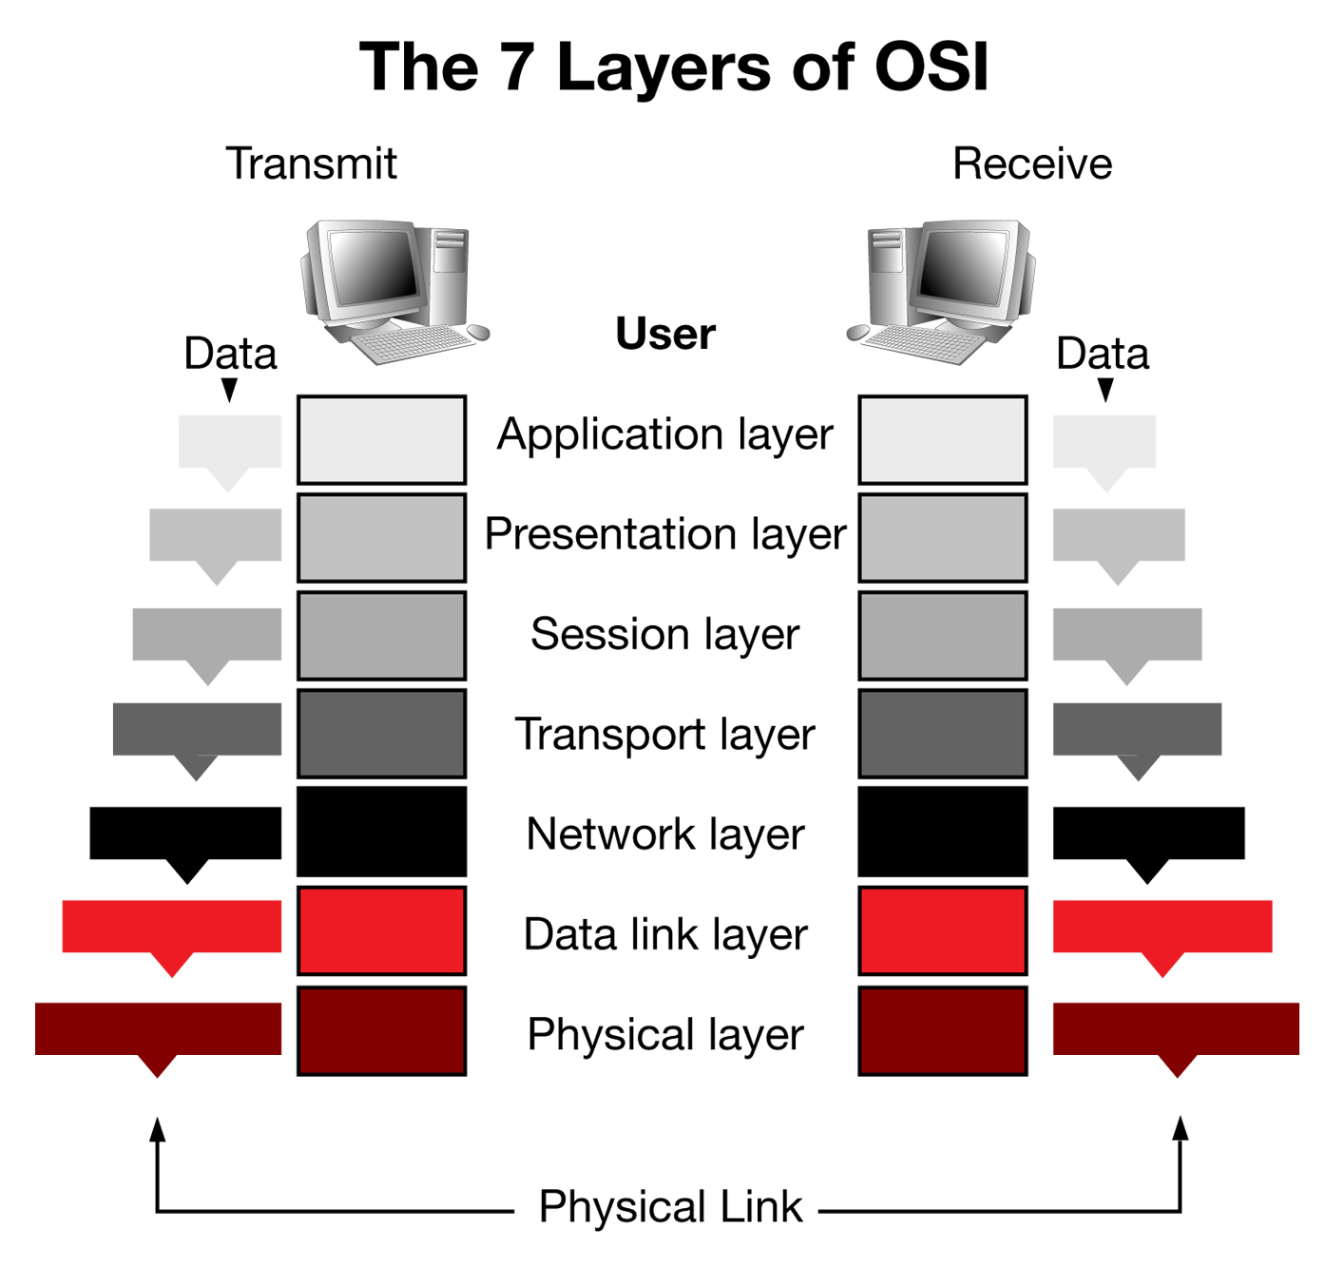
OSI Model

Slide 4
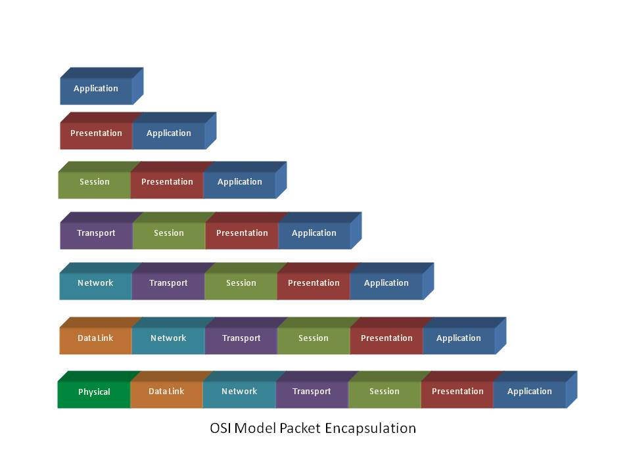
OSI Model

Slide 5
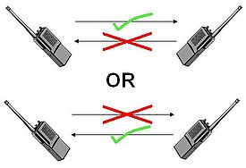

Layer 1
UTP Cables
Fiber optic cables
Wireless
The bits of data!
Full-Duplex/Half Duplex

Slide 6
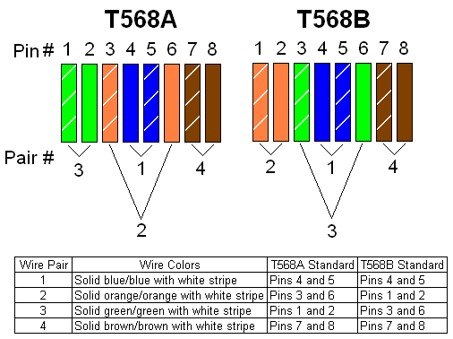
Layer 1
A word about UTP Cables (CAT 5/5e/6/7/etc)
„Twisted pair cabling is a type of wiring in which two conductors of a single circuit are twisted together for the purposes of canceling out electromagnetic interference“
Unshielded Twisted Pair
Shielded Twisted Pair
'Straight-through' or 'Cross'
Wiring according to: T568A/T568B

Slide 7
Layer 1
Grab a UTP cable and connect it to your laptop or computer
Start your computer with a PXE boot
Enter 'ipws' at the prompt
Once booted to the prompt disconnect your UTP cable from the switch

Slide 8
Layer 2
To Know:
MAC Address – a unique 64bit address which identiefies your NIC (Network Interface Card)
MAC first 24bit == manufacterer ID
Happens before routing! (or after)
Subnet / Broadcast domain – often used names for the layer 2 network
Switches and hubs operate at layer 2

Slide 9
Layer 2
Login as root on your computer
Execute 'ifconfig eth0'
Find the 'Hwaddr' value of your NIC
Execute 'ethtool eth0' (check it's output)
Connect your UTP cable to your neighbour or a switch
Execute 'ethtool eth0' again (check it's output)

Slide 10
TCPdump
„a powerful command-line packet analyzer“
„tcpdump - dump traffic on a network“
We'll use tcpdump to sniff the network in order to see what we are doing

Slide 11
TCPdump
Access the second terminal on your computer (ALT+F2)
Login as root
Execute 'tcpdump -i eth0 -ntev'
-i interface
-n no name resolving (DNS)
-t no timestamp
-e show link-level header (layer 2)
-v extra output (verbose)
Execute 'ifconfig eth0 up' to bring your interface up
Execute 'tcpdump -i eth0 -nte'
Switch back and forth to the first (tty1) and second terminal (tty2) (ALT+F1/ALT+F2)

Slide 12
Layer 3
To Know:
IP Address – a 32bit address which identifies your computer
Subnet Mask – identifies the scope of your layer 2 network! (netmask)
ARP – resolve ipaddresses to MAC addresses
Route – a table to find your way out of the layer 2 network/subnet/broadcast domain

Slide 13
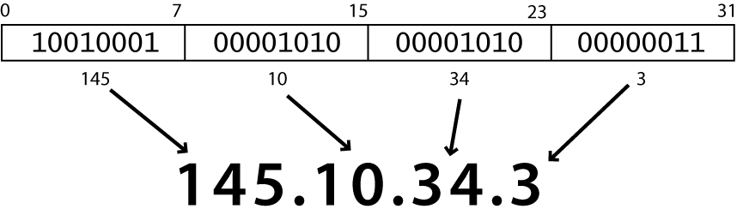
Layer 3
128 64 32 16 8 4 2 1
1 0 0 1 0 0 0 1
128 + 16 + 1 = 145

Slide 14
Layer 3
Private IP adress ranges:
10.0.0.0/255.0.0.0 (/8)
172.16.0.0/255.240.0.0 (/12)
192.168.0.0/255.255.0.0 (/16)
169.254.0.0/255.255.0.0 (/16) used for non dhcp networks/autoconf
Special Ranges
224.0.0.0/240.0.0.0 (/4) multicast address space
127.0.0.1/255.0.0.0 (/8) loopback address space
0.0.0.0/255.0.0.0 (/8) broadcast addresses
255.255.255.255/255.255.255.255 (/32) limited broadcast
All address space is maintained by IANA

Slide 15
Layer 3
Ip address and it's subnet mask???
Imagine 192.168.1.1 with a subnet mask 255.255.255.0 (/24)
In bits
Ip: 1 1 0 0 0 0 0 0 . 1 0 1 0 1 0 0 0 . 0 0 0 0 0 0 0 1 . 0 0 0 0 0 0 0 1
Mask: 1 1 1 1 1 1 1 1 . 1 1 1 1 1 1 1 1 . 1 1 1 1 1 1 1 1 . 0 0 0 0 0 0 0 0
8 bits + 8 bits + 8 bits + 0 bits = 24bits

Slide 16
Layer 3
Ip address and it's subnet mask???
Imagine 192.168.1.1 with a subnet mask 255.255.255.0 (/24)
In bits
Ip: 1 1 0 0 0 0 0 0 . 1 0 1 0 1 0 0 0 . 0 0 0 0 0 0 0 1 . 0 0 0 0 0 0 0 1
Mask: 1 1 1 1 1 1 1 1 . 1 1 1 1 1 1 1 1 . 1 1 1 1 1 1 1 1. 0 0 0 0 0 0 0 0
8 bits + 8 bits + 8 bits + 0 bits = 24bits

Slide 17
Layer 3
On your computer give your NIC an ip address in the 192.168.25.0/24 subnet:
Example for a 10.11.12.0/24 subnet:
ifconfig eth0 10.11.12.100 netmask 255.255.255.0 up
Try a single ping to 192.168.25.250 in your subnet and watch the output of tcpdump
ping -c 1 192.168.25.250
-c count: Stop after sending count ECHO_REQUEST packets.

Slide 18
Layer 3
ARP, Request who-has 192.168.25.250 tell 192.168.25.176, length 28
ARP, Request who-has 192.168.25.250 tell 192.168.25.176, length 28
ARP, Request who-has 192.168.25.250 tell 192.168.25.176, length 28
ARP : Address Resolution Protocol.
Resolves ip addresses to MAC addresses

Slide 19
Layer 3
Try a single ping to a neighbour in your subnet, example for the 10.11.12.0/24 subnet:
ping -c 1 10.11.12.101
Check the output of tcpdump!!!

Slide 20
Layer 3
Check the output of tcpdump!!!
ARP, Request who-has 192.168.25.1 tell 192.168.25.176, length 28
ARP, Reply 192.168.25.1 is-at 00:0f:1f:73:ea:d6, length 46
On your computer execute:
'arp -an'
-a display all
-n numeric, no resolving

Slide 21

Layer 3
On your computer execute:
'ping 8.8.8.8'
Introducing routing

Slide 22
Layer 3
Remember:
When you address a host within your subnet you'll
  use MAC addresses to communicate
  Use ARP to resolve an IP address to a MAC address
When you address a host outside your subnet you'll
  Look in the route table to find who knows how to find the host (most specific)
  Use ARP to find the MAC address of the host who knows
  Send your packet to that MAC address
This process continues untill the host has been reached!

Slide 23

Layer 3

Slide 24
Layer 3
IP packets have a TTL (Time To Live)
This prevents infinite loops!
Whatch the TTL attribute in the tcpdump output!

Slide 25
Layer 3
On your computer display your routing table:
'route -n'
Add the 8.8.8.8 host to the routing table
'route add -net 8.8.8.8 netmask 255.255.255.255 gateway 192.168.25.254'
Try to ping again and watch the tcpdump output
'ping -c 1 8.8.8.8'
Also try a traceroute to see the hops
'traceroute -n 8.8.8.8'

Slide 26
Layer 3
This is all you need to know about how the internet works!!!
Remember internet and the network does not go beyond layer 3!
There are more features:
Routing protocols like BGP/OSPF so your route table is managed
Loop prevention through Spanning Tree, Link Aggregation, etc
More specifics for Wireless networks aka 802.11*
Redundancy and asynchronous routing
But let's focus on what we do on the network/internet
Layer 4

Slide 27
Layer 4
A warning:
Strict comparison between the TCP/IP model and the OSI model should be avoided. Layering in TCP/IP is not a principal design criterion and is in general considered to be harmful.
(wikipedia)

Slide 28
Layer 4
TCP/IP
As referred to very often however it's:
IP = The IPv4 protocol (protocol number 0)
  ICMP = Internet Control Messaging Protocol (protocol number 1)
  UDP = User Datagram Protocol (protocol number 17)
  TCP = Transmission Control Protocol (protocol number 6)
There are way more, see /etc/protocols!

Slide 29
Layer 4
ICMP
It controls the connection
If something goes wrong ICMP will tell you
0 Destination network unreachable
1 Destination host unreachable
2 Destination protocol unreachable
3 Destination port unreachable
4 Fragmentation required, and DF flag set
5 Source route failed
6 Destination network unknown
7 Destination host unknown
Etc
Used by:
Routers
Ping
Traceroute

Slide 30
Layer 4
UDP
It is simple,
It is stateless
„fire and forget“
Usable for broadcast and multicast and very simple protocols
Used by:
DHCP (port 67 and 68)
DNS (port 53)
...

Slide 31
Layer 4
TCP
reliable,
ordered,
error-checked
connection oriented
„it gets the message across reliably“
Not usable for broadcast and multicast, d'uh
Used by:
SSH
HTTP
Lots more...

Slide 32
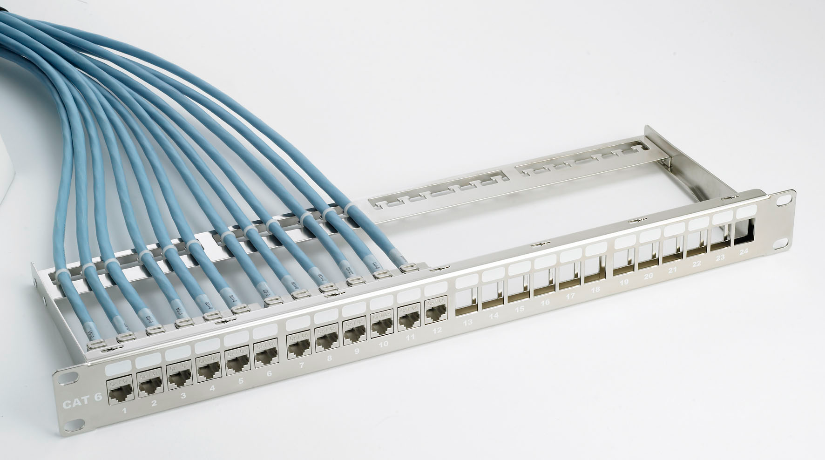
Layer 4
TCP & UDP ports
TCP and UDP have the same port system consisting of 65536 numbered ports
A program can listen on a port on your NIC!
Important port numbers:
0-1023 are reserved: (root only)
TCP:22 = SSH
TCP:23 = Telnet
TCP:25 = SMTP
UDP:53 = DNS
TCP:80 = HTTP
etc, see /etc/services
1024-65535 are unpriviliged
TCP:1194 = OpenVPN
UDP:1194 = OpenVPN
TCP:3306 = MySQL
TCP:3389 = RDP
etc, see /etc/services

Slide 33
Layer 4
On your computer create a program which listens on port 2000
Execute:
'nc -lnp 2000'
-l listen mode
-n numeric (no resolving)
-p port number
Open a new terminal (console) and access your neighbours port
'nc ip.add.re.ss 2000'
Watch the tcpdump output
* Use -u for UDP mode

Slide 34
Layer 4
Important Services for your network:
DHCP: Dynamic Host Configuration Protocol
Uses UDP port 67 (request) and port 68 (reply)
Uses a handshake
  Client broadcasts
  DHCP server replies
  Client request an ip address
  DHCP server replies with an ipaddress
  Client ACK the ipaddress
More options are available through DHCP
  Default gateway
  Extra routes
  Boot server (PXE/TFTP)
  Many more

Slide 35
Layer 4
Important Services for your network:
DNS: Domain Name System
Resolves names to ipaddresses so you don't need the remember every ip address
Your network needs at least 1 DNS resolver. (/etc/resolv.conf)
DNS is big but these are important to know:
Every domain has a authorative name server (NS record)
An hostname to an ip address is an A record
An alias (to an A record) is a CNAME
To find the mailserver of a domain you request an MX record
SRV records are for more complicated services (Jabber/XMMP)

Slide 36
Layer 4
On your computer add the following to /etc/resolv.conf
search ws.z25.lan
nameserver 192.168.25.1
request details on the z25.org domain:
Nameserver: 'dig z25.org NS'
Mail servers: 'dig z25.org MX'
Website: 'dig www.z25.org'
Jabber: 'dig _xmpp-server._tcp.z25.org SRV'

Slide 37
Play time
Try to ping to ping.xs4all.nl
'ping ping.xs4all.nl'
It doesn't work..... why?

Slide 38
Play time
Add a default gateway to your computer by executing:
'route add -net 0.0.0.0 netmask 0.0.0.0 gateway 192.168.25.254'

Slide 39
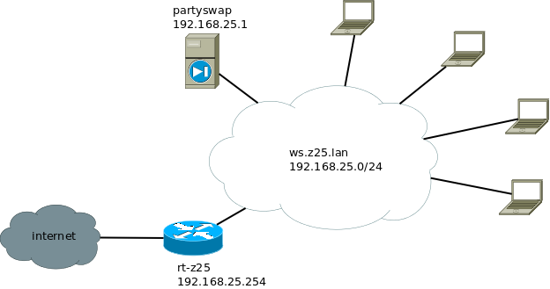
Play time

Slide 40
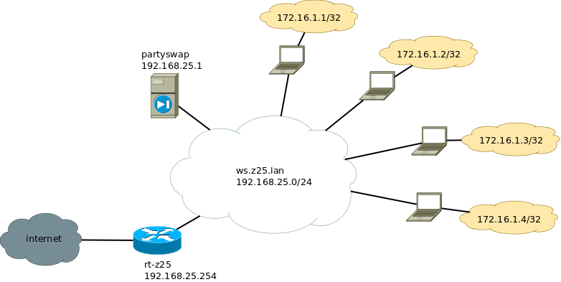
Play time

Slide 41
Play time
ifconfig lo:1 172.16.1.1 netmask 255.255.255.255 up
echo 1 > /proc/sys/net/ipv4/ip_forward
Add route info for other hosts
route add -net 172.16.1.1 netmask 255.255.255.255 gateway 192.168.25.x

Slide 42
Trouble
We can ping to 8.8.8.8... from our host with ip 192.168.25.x
192.168.25.x is a private address, and IP packets addressed by them cannot be transmitted onto the public Internet
But how can 8.8.8.8 reply to us???

Slide 43
Trouble
NAT – Network Address Translation
„it is common to hide an entire IP address space, usually consisting of private IP addresses, behind a single IP address in another address space.
To avoid ambiguity in the handling of returned packets, a one-to-many NAT must alter higher level information such as TCP/UDP ports in outgoing communications and must maintain a translation table so that return packets can be correctly translated back.“ (wikipedia)
NAT:
is a workaround for the exhaustion of IPv4 address space
breaks real end-to-end connectivity across the internet
makes it difficult to accept incoming connections
Requires more capable routers in your home
Imagine a simple phone call....

Slide 44

Trouble
What's the solution.....
IPv6
We'll cover that next time ….

