Slide 1
Digital Taming
Some practical advice for using computer systems in a performance

Slide 2
Collaborating with a computer
DON'T use any spaces in filenames of directory names!
Notes:
And no special characters : ; # $ % & , . ë

Slide 3
Videos
Videocodecs are very diverse
  Use Motion JPEG!
  Use AVI containers
Notes:
Apple programs don't like it sometimes. Other candidates are MOV and MP4
On some platforms it's also useful to use h264 encoding. When filesize matters or when there is a hardware decoder

Slide 4
Videos
Videocodecs are very diverse
  Use Motion JPEG!
  Use AVI containers
Convert to a sane resolution
  Do you need Full-HD on a XGA projector?
  E.g. use Avidemux
Notes:
Old fashion PAL is often enough (720x576)
Pay attention to aspect ratio

Slide 5
Videos
Videocodecs are very diverse
  Use Motion JPEG!
  Use AVI containers
Do you need Full-HD on a XGA projector?
  Convert to a sane resolution
  E.g. use Avidemux
Always keep the original videos!
  You will never get better quality
Notes:
Keep originals in a seperate folder and all converted in an other. Maintain filename but you can include a suffix:
e.g.
Originals/*.mp4
pal/*.avi

Slide 6
Crisp images
Don't use JPEG
Use PNG/BMP/TGA
Do you need 4K images?
Always keep originals

Slide 7
OS Control
Master it!

Slide 8
OS Control
Master it!
Disable power management
Disable screensaver
Disable lock on idle
Especially for Windows!
Notes:
Google it

Slide 9

OS Control
Update your system (before...)

Slide 10
OS Control
Update your system (before...)
Prevent popups:
  Disable apps that launch at boot (skype, java, dropbox, etc)

Slide 11
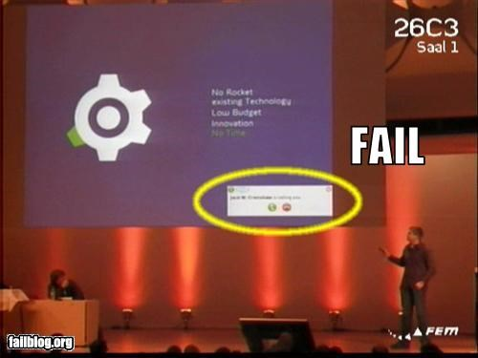

Slide 12
OS Control
Update your system (before...)
Prevent popups:
  Disable apps that launch at boot (skype, java, dropbox, etc)
No system sounds!

Slide 13
OS Control
Update your system (before...)
Prevent popups:
  Disable apps that launch at boot (skype, java, dropbox, etc)
No system sounds!
Don't connect to internet

Slide 14
Projector Control
Create an empty BLACK desktop
  If you can set the projector's default background to black

Slide 15
Projector Control
Create an empty BLACK desktop
  If you can set the projector's default background to black
Always use the projectors native resolution

Slide 16
Projector Control
Create an empty BLACK desktop
  If you can set the projector's default background to black
Always use the projectors native resolution
Firmly attach cables

Slide 17
Computer Communication
Stay away from wireless
  Nothing beats the quality of a cabled connection
  But inspect quality of cables

Slide 18
Computer Communication
Stay away from wireless
  Nothing beats the quality of a cabled connection
  But inspect quality of cables
It's wise to use static ipaddreses

Slide 19
Computer Communication
Stay away from wireless
  Nothing beats the quality of a cabled connection
  But inspect quality of cables
It's wise to use static ipaddreses
Many programs support OSC
  Understand it's limitation

Slide 20
Computer Communication
Use it smart
  E.g don't send videos through the network but copy videofiles locally and tell the computer which file to play through the network

Slide 21
Last but not least
Test, test, test

Slide 22
Last but not least
Test, test, test
Make backups
  Do you have a replacement computer, projector, etc
Notes:
Physical and virtual (files)

Slide 23
Last but not least
Test, test, test
Make backups
  Do you have a replacement computer, projector, etc
Communicate what your doing! (interdisciplinary)
Notes:
show a fast sketch version of you work and when do you demand time to work something out in detail

Slide 24
Digital Taming
http://github.com/sphaero/workshops
arnaud@sphaero.org
arnaud@z25.org

