Slide 1
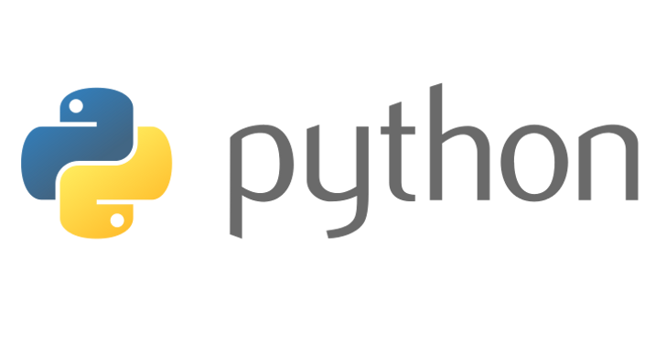
PythonFu
Arnaud Loonstra, 12-08-2016, Amsterdam
Notes:
Welkom voorstel etc

Slide 2
Preparation
Install Python 3 (latest version, comes preinstalled on most Linux distros)
Install virtualenv
Make sure you are connected to the Internet
All used data can be found at http://github.com/sphaero/workshops
Notes:
Favoriete texteditor paraat hebben!!!

Slide 3
Command Line Interface
ls list dir content
cd change current dir
cp copy
rm remove/delete
nano text editor
vi text editor (difficult)
dmesg output kernel messages
tail last contents of a file
more file pager
less file pager (nicer)
cat binary output a file
man manuals
mkdir create a directory
touch update/create a file (access time)
pwd present working dir
ln create (symbolic) link
du disk use
chmod change permission
fg/bg fore-/background a process
CONTROL:
CTRL-C Kill
CTRL-D Exit
CTRL-Z suspend
CTRL-S stop input (undo CTRL-Q)
TAB command completion!!!!
Commands can be put in a file for batching:
#!/bin/bash
pwd
cd /tmp
touch hoi
echo hallo > hoi
tail hoi
cd -
Notes:
We'll be using CLI in Linux
'under the hood'
Sheet with all commands, keep track
Ctrl-C to stop
TAB to complete

Slide 4
Display characterization
print('hello world')
Source code example
$ export PYTHONHOME=“/tmp“
$ python run.py
Shell commands example (terminal)
>>> def log(msg):
... print(msg)
...
>>> log("hello world")
hello world
>>>
Python interpreter example
Notes:
Uitleggen van voorbeeld code in sheets

Slide 5
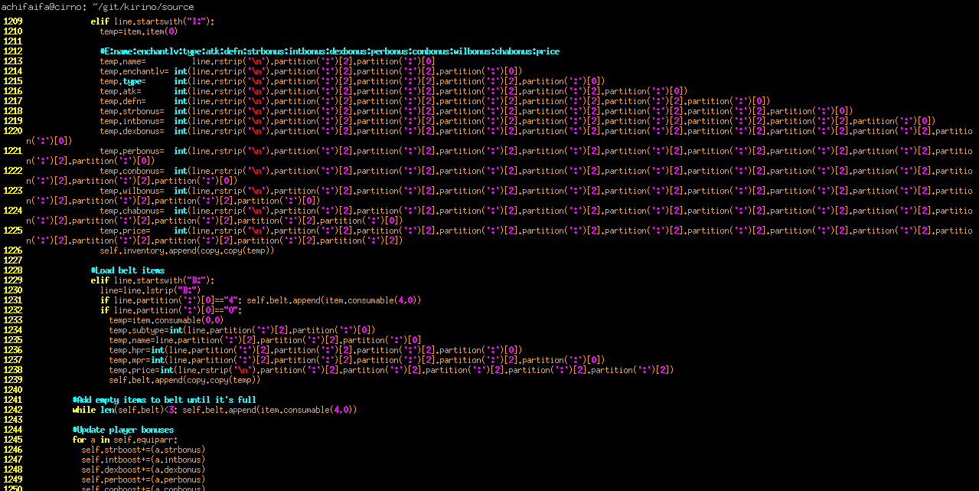
???
Notes:
FOSDEM vorig jaar
Ik snap dit niet... Ik weet niet wat jullie al weten en wat jullie willen weten dus kom met vragen
Ik heb een aantal zaken voorbereid maar ik kan er net zo goed naast zitten qua jullie behoeften

Slide 6
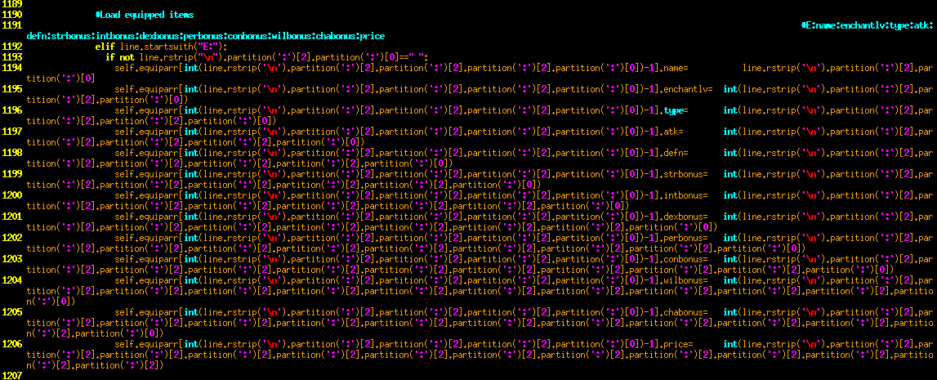
???

Slide 7
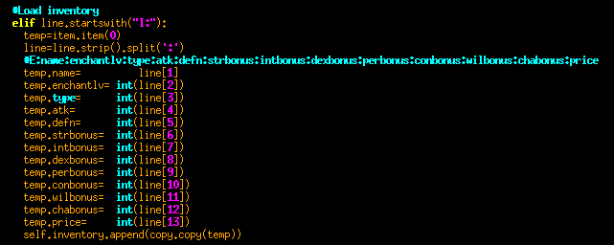
???

Slide 8

Why did this happen?
The documentation lists the functions in alphabetical order
partition() is listed before split()
I stopped reading as soon as I found the first one
“Yuri Numerov @FOSDEM16”
https://archive.fosdem.org/2016/schedule/event/python_mistakes/

Slide 9
Outline
Running and using Python
Object Oriented Programming in Python
Pythonic Thinking
Notes:
3 uur, */50min pauze

Slide 10
Python pros & cons
Easy to code
Code indentation
Embeddable
Batteries included
Huge community
Simple binding to C
Opensource
Code indentation
Slow
Global Interpreter Lock
Python 2 to 3 problem
Dynamic types
Notes:
Pros & cons (eigen mening)

Slide 11
Python version
On unix variants:
$ python --version
On unix variants with 2 and 3 installed
$ python3 --version
On windows:
$ python.exe --version

Slide 12
Python version
Within Python:
>>> import sys
>>> sys.version
'3.4.3+ (default, Oct 14 2015, 16:03:50) \n[GCC 5.2.1 20151010]'
>>> sys.version_info
sys.version_info(major=3, minor=4, micro=3, releaselevel='final', serial=0)
>>> sys.version_info.major
3
>>> sys.version_info.minor
4

Slide 13
Python directory structure
./include
./lib/python-wheels
./lib/python3.4
./lib/python3.4/__pycache__
./lib/python3.4/json
./lib/python3.4/site-packages
./bin
headers for C compilers
wheels will replace eggs
this is where your modules reside
bytecode versions of python code (ignore)
the included json module (example)
extra installed non native modules
the python executables

Slide 14
Python module lookup (path)
From within Python
>>> import sys
>>> sys.path
['', '/usr/local/lib/python3.4/dist-packages/python_axolotl-0.1.35-py3.4.egg', '/usr/local/lib/python3.4/dist-packages/protobuf-3.0.0b2.post2-py3.4.egg', '/usr/local/lib/python3.4/dist-packages/pycrypto-2.6.1-py3.4-linux-x86_64.egg', '/usr/lib/python3/dist-packages', '/usr/lib/python3.4', '/usr/lib/python3.4/plat-x86_64-linux-gnu', '/usr/lib/python3.4/lib-dynload', '/home/aloonstra/.local/lib/python3.4/site-packages', '/usr/local/lib/python3.4/dist-packages']
>>> print("\n".join(sys.path))

Slide 15
Python module lookup (path)
>>> print("\n".join(sys.path))
/usr/local/lib/python3.4/dist-packages/python_axolotl-0.1.35-py3.4.egg
/usr/local/lib/python3.4/dist-packages/protobuf-3.0.0b2.post2-py3.4.egg
/usr/local/lib/python3.4/dist-packages/pycrypto-2.6.1-py3.4-linux-x86_64.egg
/usr/lib/python3/dist-packages
/usr/lib/python3.4
/usr/lib/python3.4/plat-x86_64-linux-gnu
/usr/lib/python3.4/lib-dynload
/home/aloonstra/.local/lib/python3.4/site-packages
/usr/local/lib/python3.4/dist-packages

Slide 16
Python module lookup (path)
Adding a module search directory within Python:
>>> import sys
>>> sys.path.append('/tmp/my_path')
Adding a module search directory from the terminal:
$ export PYTHONPATH=”/tmp/my_path”
$ python
Or a oneliner:
$ PYTHONPATH=”/tmp/my_path” python
In case PYTHONPATH was already set:
$ PYTHONPATH=”$PYTHONPATH:/tmp/my_path” python
Notes:
Installeren van modules pip of apt-get??? waar komen ze terecht

Slide 17
Python home
Location of Python files (prefix or home)
>>> import sys
>>> sys.prefix
'/usr'
Setting the Python prefix (home) from the terminal:
$ export PYTHONHOME=”/usr”
$ python
>>> import sys
>>> sys.prefix
'/usr'
Or a oneliner:
$ PYTHONHOME=”/usr” python -c "import sys; print(sys.prefix)"

Slide 18
Virtualenv
see: $ virtualenv --help
$ virtualenv testing
Running virtualenv with interpreter /usr/bin/python2
New python executable in testing/bin/python2
Also creating executable in testing/bin/python
Installing setuptools, pip...done.
$ virtualenv -p python3 testing_py3
Already using interpreter /usr/bin/python3
Using base prefix '/usr'
New python executable in testing_py3/bin/python3
Also creating executable in testing_py3/bin/python
Installing setuptools, pip...done.
--system-site-packages
Give the virtual environment access to the global
site-packages.
Notes:
$ PYTHONPATH="/usr/lib/python2.7/dist-packages/" PYTHONHOME=/home/aloonstra/Documents/projects/workshops/AdvancedPython/test/test2/ gimp

Slide 19
Virtualenv
activate
$ source testing/bin/activate
[testing] $ python
>>> import sys
>>> sys.prefix
'/home/aloonstra/Documents/projects/workshops/AdvancedPython/testing'
deactivate (in the same terminal)
$ [testing] $ deactivate
$
Notes:
$ PYTHONPATH="/usr/lib/python2.7/dist-packages/" PYTHONHOME=/home/aloonstra/Documents/projects/workshops/AdvancedPython/test/test2/ gimp

Slide 20
shebang
Under {Unix}, if the first two bytes of an {executable} file are "#!", the {kernel} treats the file as a script rather than a {machine code} program. The word following the "!" (i.e., everything up to the first {whitespace}) is used as the {pathname} of the {interpreter}.
#!/usr/bin/python
import ...
better
#!/usr/bin/env python
import ...

Slide 21

Let's code
Notes:
Koffie

Slide 22
Outline
Object Oriented Programming
Classes & Inheritance
Tips & Tricks

Slide 23

Classes in Python
class Apple(Fruit):
vitamins = 10
weight = 13
_sourness = 5
_sweetness = 20
_bitterness = 2
rot():
_freshness -= 4
class Fruit:
vitamins = 0
weight = 0
_freshness = 100
_sourness = 1
_sweetness = 1
_bitterness = 1
rot():
_freshness -= 1
getTaste():
return (_sweetness,
_sourness,
_bitterness)
class Lemon(Fruit):
vitamins = 20
weight = 10
_sourness = 20
_sweetness = 2
_bitterness = 5
rot():
_bitterness += 1
_freshness -= 2

Slide 24
Fruit Class
class Fruit(object):
def __init__( self, vit, weight):
self.vitamins = vit
self.weight = weight
self._freshness = 100
self._sourness = 1
self._sweetness = 1
self._bitterness = 1
def rot(self):
self._freshness -= 1
def get_taste(self):
return ( self._sweetness,
self._sourness,
self._bitterness )

Slide 25
Apple Class: DIY0
class Apple(Fruit):
def __init__( self, *args, **kwargs ):
super().__init__(*args, **kwargs)
self._sourness = 5
self._sweetness = 20
self._bitterness = 2
def rot(self):
self._freshness -= 4
Notes:
Maak zelf een Lemon class
Zorg dat python geen syntax error geeft

Slide 26
Apple & Lemon Class
class Apple(Fruit):
def __init__( self, *args, **kwargs ):
super().__init__(*args, **kwargs)
self._sourness = 5
self._sweetness = 20
self._bitterness = 2
def rot(self):
self._freshness -= 4
class Lemon(Fruit):
def __init__( self, *args, **kwargs ):
super().__init__(*args, **kwargs)
self._sourness = 20
self._sweetness = 2
self._bitterness = 5
def rot(self):
self._bitterness += 1
self._freshness -= 2
Notes:
super() is anders in Py2

Slide 27
Instantiation
Class instances
a = Apple(20, 10)
l = Lemon(vit=30, weight=10)
l2 = Lemon(30, weight=11)
l3 = Lemon(weight=11, 30)
l3 = Lemon(weight=11, vit=30)
SyntaxError: non-keyword arg after keyword arg

Slide 28
DIY 1
Create a Nature manager which rots all available fruits until there are no fruits left
instantiate fruits into a collection
pass this collection of fruits to the manager
the manager will call the rot() method of fruits
remove fruits from the collection if it is rotten
exit when all fruits have rotten
Notes:
Maak een Nature manager

Slide 29
DIY 1
class Nature(object):
def __init__(self, fruits):
self.fruits = fruits
def decay(self):
to_delete = []
for fruit in self.fruits:
fruit.rot()
if fruit.is_rotten:
to_delete.append(fruit)
for fruit in to_delete:
print("fruit {0} has rotten".format(fruit))
self.fruits.remove(fruit)
def run(self):
while len(self.fruits):
self.decay()
fruits = [ Apple(20,20) for x in range(20) ]
for x in range(20):
fruits.append( Lemon( 30, 10) )
Nature(fruits).run()
Notes:
Run DIY0 met print statements, is een bende
Toon DIY1+ met repr methoden

Slide 30
Standard methods
Syntax
Python calls
x = MyClass()
del x
for i in x:
print(x)
x()
len(x)
y in x:
x + y
x - y
x * y
x == y
x != y
x > y
x >= y
if x:
__init__
__del__
__iter__ / __next__
__repr__
__call__
__len__
__contains__
__add__
__sub__
__mul__
__eq__
__ne__
__lt__
__le__
__bool__
https://docs.python.org/3/reference/datamodel.html#basic-customization

Slide 31
DIY 2
Add methods to determine the fruits 'tastiness'.
Make sure you can compare the fruits taste or mix them
For example what taste do we get if we sum an Apple and a Lemon
a = Apple()
l = Lemon()
a + l

Slide 32
(multiple)Inheritance & MixIns
class TastyMixin(object):
"""
This class provides taste comparison operators
"""
def __lt__(self, other):
st = self._sourness + self._sweetness + self._bitterness
ot = other._sourness + other._sweetness + other._bitterness
return st < ot
def __le__(self, other):
st = self._sourness + self._sweetness + self._bitterness
ot = other._sourness + other._sweetness + other._bitterness
return st <= ot
def __eq__(self, other):
st = self._sourness + self._sweetness + self._bitterness
ot = other._sourness + other._sweetness + other._bitterness
return st == ot
def __ne__(self, other):...
def __gt__(self, other):...
def __ge__(self, other):...
Notes:
Een oplossing is om een MixIn class te gebruiken
- voorkom multiple inheritance (circular dependencies & diamond deps etc)
Als je er nog niet aan toe bent: AVOID!
Een oplossing is om een MixIn class te gebruiken
- voorkom multiple inheritance (circular dependencies & diamond deps etc)
Als je er nog niet aan toe bent: AVOID!
class Fruit(TastyMixin, object):

Slide 33
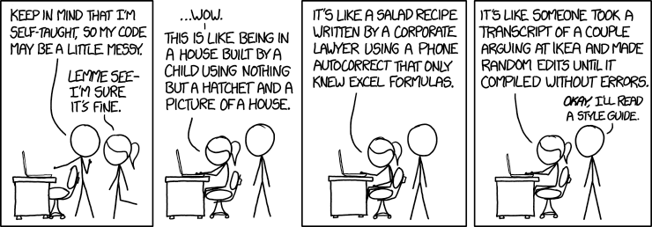
Coding Style
Notes:
Koffie? of na coding style?

Slide 34
Coding Style
>>> import this
The Zen of Python, by Tim Peters
Beautiful is better than ugly.
Explicit is better than implicit.
Simple is better than complex.
Complex is better than complicated.
Flat is better than nested.
Sparse is better than dense.
Readability counts.
Special cases aren't special enough to break the rules.
Although practicality beats purity.
Errors should never pass silently.
Unless explicitly silenced.
In the face of ambiguity, refuse the temptation to guess.
There should be one-- and preferably only one --obvious way to do it.
Although that way may not be obvious at first unless you're Dutch.
Now is better than never.
Although never is often better than *right* now.
If the implementation is hard to explain, it's a bad idea.
If the implementation is easy to explain, it may be a good idea.
Namespaces are one honking great idea -- let's do more of those!

Slide 35
PEP8: Python Style Guide
Indentation: use 4 spaces (Spaces are preferred!)
Align with opening delimiter:
multi-line constructs line up
Limit all lines to a maximum of 79 characters.
Surround top-level function and class definitions with two blank lines.
Method definitions inside a class are surrounded by a single blank line.
Always use UTF-8 for source files (Python3)
For core source only use ASCII characters
# Aligned with opening delimiter.
foo = long_function_name(var_one, var_two,
var_three, var_four)
my_list = [
1, 2, 3,
4, 5, 6,
]
http://www.python.org/dev/peps/pep-0008/

Slide 36
PEP8: Python Style Guide
imports on seperare lines
imports always at the top of a file before globals and constants
imports should be grouped as follows
  standard lib imports
  third party lib imports
  local imports
avoid wild card imports (from <module> import *)
import os
import sys
# No import os, sys
from subprocess import Popen, PIPE
import numpy
from myclass import MyClass
from foo.bar.yourclass import YourClass
http://www.python.org/dev/peps/pep-0008/

Slide 37
PEP8: Python Style Guide
bad comments are worse than no comments!!!
use inline comments sparingly
indent block comments to the same level as the code
x = x + 1 # Increment x (this is bad)
x = x + 1 # Compensate for border
# Use the log() method instead of print() to
# align with debug levels
def log(msg):
...
http://www.python.org/dev/peps/pep-0008/

Slide 38
PEP8: Python Style Guide
modules should have all-lowercase names
Class names should use CapWords
Exceptions should use the Error suffix
Function/method names should be lowercase with words seperated by _
Use one leading underscore only for non-public methods and instance variables.
Contstants all capital letters with underscores separating words
import foo.bar
BLA = 0
class CapWord(object):
“””
Write docstrings for all public classes
“””
_internal_var = 3
def do_bla(self):
if False:
raise CapWordError(“d'oh”)
http://www.python.org/dev/peps/pep-0008/

Slide 39
DIY3
Install pep8
$ pip install pep8
Or through the distro package management
$ sudo apt-get install pep8
Run pep8 on your .py file containing the previous classes until no more errors
$ pep8 diy1.py
diy0.py:13:1: W293 blank line contains whitespace
diy0.py:22:1: W293 blank line contains whitespace
diy0.py:24:1: W293 blank line contains whitespace
diy0.py:25:18: E201 whitespace after '('
diy0.py:25:40: E202 whitespace before ')'

Slide 40
:)
Install autopep8
$ pip install autopep8
$ autopep8 --in-place diy1.py
Notes:
koffie

Slide 41
Pythonic Thinking
all your pseudo code are belong to us

Slide 42
Raw Strings
>>> "I'm a string,\nm'kay"
"I'm a string,\nm'kay"
>>> r"I'm a string,\nm'kay"
"I'm a string,\\nm'kay"
>>> b"I'm a string,\nm'kay"
b"I'm a string,\nm'kay"
>>> u"I'm a string,\nm'kay"
"I'm a string,\nm'kay"
>>> """
... I'm a string
...
... m'kay"""
"\nI'm a string\n\nm'kay"
>>> "I'm a string,\nm'kay".upper()
"I'M A STRING,\nM'KAY"
>>> "I like the numbers {0} and {1}".format(3, 4**2)
"I like the numbers 3 and 16"

Slide 43
Looping/Iterators
a = [0, 1, 2, 3, 4, 6]
for x in range(len(a)):
print(a[x])
a = [0, 1, 2, 3, 4, 6]
for x in a:
print(x)
pythonic
a = [0, 1, 2, 3, 4, 6]
for i,x in enumerate(a):
print(i, x, a[i])

Slide 44
Looping (dangerous)
a = [0, 1, 2, 3, 4, 6]
for x in range(len(a)):
print(a[x])
if x == 3:
a.remove(a[x])
a = [0, 1, 2, 3, 4, 6]
for x in a:
print(x)
if x == 3:
a.remove(x)
a = [0, 1, 2, 3, 4, 6]
for i,x in enumerate(a):
print(i, x, a[i])
if x == 3:
a.remove(x)

Slide 45
Looping/Iterators
a = { 0: 1, 2: 3, 4: 6}
for k in a:
print(k, a[k])
a = { 0: 1, 2: 3, 4: 6}
for k in a.keys():
print(k, a[k])
a = { 0: 1, 2: 3, 4: 6}
for v in a.values():
print(v)
pythonic
a = { 0: 1, 2: 3, 4: 6}
for k,v in a.items():
print(k,v)

Slide 46
Looping?
a = { 0: 1, 2: 3, 4: 6}
for k,v in a.items():
print(k,v)
if k == 2:
del a[k]

Slide 47
Looping/Iterators
q = ['name', 'quest', 'favorite color']
a = ['lancelot', 'the holy grail', 'blue']
for i, v in enumerate(q):
print('What is your {0}? It is {1}.'.format(v, a[i]))
q = ['name', 'quest', 'favorite color']
a = ['lancelot', 'the holy grail', 'blue']
for v1, v2 in zip(q, a):
print('What is your {0}? It is {1}.'.format(v1, v2))

Slide 48
Slicing
>>> a = [ x for x in range(16) ]
>>> a
[0, 1, 2, 3, 4, 5, 6, 7, 8, 9, 10, 11, 12, 13, 14, 15, 16]

Slide 49
Slicing
>>> a = [ x for x in range(16) ]
>>> a
[0, 1, 2, 3, 4, 5, 6, 7, 8, 9, 10, 11, 12, 13, 14, 15, 16]
>>> a[:1]
[0]
>>> a[:2]
[0, 1]
>>> a[:3]
[0, 1, 2]

Slide 50
Slicing
>>> a = [ x for x in range(16) ]
>>> a
[0, 1, 2, 3, 4, 5, 6, 7, 8, 9, 10, 11, 12, 13, 14, 15, 16]
>>> a[3:]
[3, 4, 5, 6, 7, 8, 9, 10, 11, 12, 13, 14, 15]
>>> a[2:]
[2, 3, 4, 5, 6, 7, 8, 9, 10, 11, 12, 13, 14, 15]
>>> a[1:]
[1, 2, 3, 4, 5, 6, 7, 8, 9, 10, 11, 12, 13, 14, 15]
>>> a[0:]
[0, 1, 2, 3, 4, 5, 6, 7, 8, 9, 10, 11, 12, 13, 14, 15]
>>> a[-1:]

Slide 51
Slicing
>>> a = [ x for x in range(16) ]
>>> a
[0, 1, 2, 3, 4, 5, 6, 7, 8, 9, 10, 11, 12, 13, 14, 15, 16]
>>> a[3:]
[3, 4, 5, 6, 7, 8, 9, 10, 11, 12, 13, 14, 15]
>>> a[2:]
[2, 3, 4, 5, 6, 7, 8, 9, 10, 11, 12, 13, 14, 15]
>>> a[1:]
[1, 2, 3, 4, 5, 6, 7, 8, 9, 10, 11, 12, 13, 14, 15]
>>> a[0:]
[0, 1, 2, 3, 4, 5, 6, 7, 8, 9, 10, 11, 12, 13, 14, 15]
>>> a[-1:]
[15]
Notes:
Live in python pielen

Slide 52
Slicing
>>> a = [ x for x in range(16) ]
>>> a
[0, 1, 2, 3, 4, 5, 6, 7, 8, 9, 10, 11, 12, 13, 14, 15, 16]
>>> a[3:8]
[3, 4, 5, 6, 7]
>>> a[-10:-1]
[6, 7, 8, 9, 10, 11, 12, 13, 14]
>>> a[6:15]
[6, 7, 8, 9, 10, 11, 12, 13, 14]
Notes:
Live in python pielen

Slide 53
Slicing + strides
>>> a = [ x for x in range(16) ]
>>> a
[0, 1, 2, 3, 4, 5, 6, 7, 8, 9, 10, 11, 12, 13, 14, 15, 16]
>>> a[6:15:2]
[6, 8, 10, 12, 14]
>>> a[6:15:3]
[6, 9, 12]
>>> a[6::3]
[6, 9, 12, 15]
>>> a[::3]
[0, 3, 6, 9, 12, 15]
Notes:
Live in python pielen

Slide 54
Slicing + strides
>>> for v in a[::2]: v & 1
...
0
0
0
0
0
0
0
0
>>> for v in a[::2]: bool(v & 1)
...
False
False
False
False
False
False
False
False
>>> for v in a[1::2]: bool(v & 1)
...
True
Notes:
Live in python pielen

Slide 55
Exceptions
cupcakes = 9
def yo_mama():
global cupcakes
cupcakes -= 1
if cupcakes:
return cupcakes
# implicit return None
for x in range(9):
print(yo_mama())

Slide 56
Exceptions
def yo_mama2():
global cupcakes
cupcakes -= 1
if cupcakes < 3:
return cupcakes, "We need moa"
elif cupcakes:
return cupcakes
# implicit return None
cupcakes = 9
for x in range(9):
print(yo_mama2())

Slide 57
Exceptions
class OutOfCupCakesError(Exception):
pass
def yo_mama3():
global cupcakes
cupcakes -= 1
if cupcakes < 3:
raise OutOfCupCakesError
elif cupcakes:
return cupcakes
# implicit return None
cupcakes = 9
for x in range(9):
try:
print(yo_mama3())
except OutOfCupCakesError:
print("we need moa")

Slide 58
DIY4
Add exceptions to the fruit classes and nature managers
make the nature fruit class iterable by taste?
or anything you picked up today

Slide 59
Python goodies
$ python -m http.server
from flask import Flask
app = Flask(__main__)
@app.route(“/”)
def hello():
return “Hello World”
if __name__ == “__main__”:
app.run()

