Slide 1
Video Streaming
..with low latency in mind...
Notes:
Welcome
Talk about videostreaming
Sending video data from one source to another
Special

Slide 2
Outline
Video streaming operating principles
Video compression methods
Introducing the Gstreamer Framework
Example pipelines
Final thoughts

Slide 3
Video Streaming Example
Notes:
The video won't play with hwaccel enabled so start libreoffice as follows:
LIBVA_DRIVER_NAME=null libreoffice VideoStreaming.odp

Slide 4
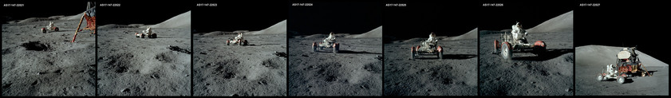
Video Streaming

Slide 5
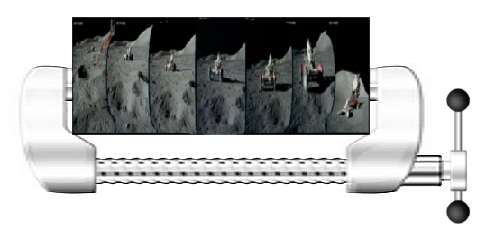
Video Streaming

Slide 6
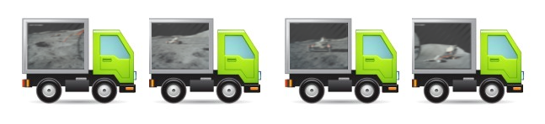
Video Streaming

Slide 7
Video Streaming
Video Frames:
Webcam, Camera,
Images, etc
Video Compression:
Motion-JPEG, H.264
Transport:
UDP, RTP

Slide 8
Frame Based Compression
High Data rate
Good for seeking
Can be fast
Example: Motion-JPEG

Slide 9
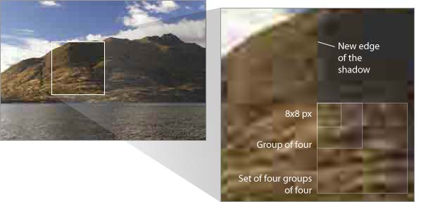
Frame Based Compression

Slide 10
Interframe Based Compression
Better data rate
Bad for seeking
Can be cpu intensive
Rocket science
Example: H.264

Slide 11
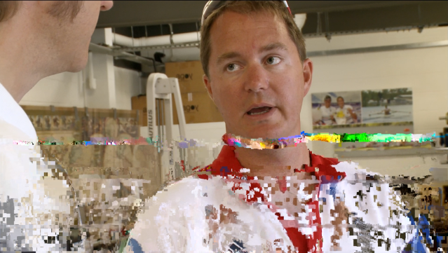
Interframe Based Compression

Slide 12

Introducing Gstreamer
GStreamer is a cross-platform pipeline-based multimedia framework
GStreamer allows a programmer to create a variety of media-handling components
Gstreamer is opensource (LGPL)
Written in C with bindings to any language

Slide 13
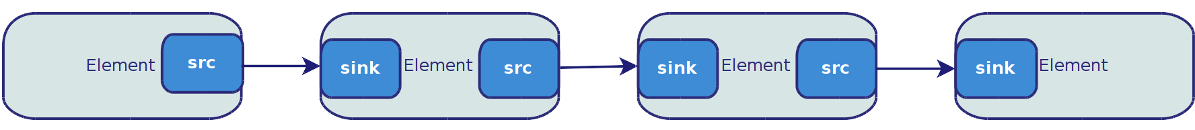
Gstreamer Pipelines

Slide 14

Test Pipeline

Slide 15
Constructing a pipeline
gst-launch-1.0 videotestsrc ! autovideosink

Slide 16
Available Elements
The Good, The Bad & The Ugly
Good: well supported in a preferred license
Bad: missing code review, docs etc
Ugly: distributions problems? (legal)
http://gstreamer.freedesktop.org/documentation/plugins.html

Slide 17
Querying available elements
gst-inspect-1.0 # lists all elements
gst-inspect-1.0 udpsrc # lists all details of
# the udpsrc element

Slide 18
Motion Jpeg Streaming Pipeline
Sender

Slide 19
Motion Jpeg Streaming Pipeline
Receiver

Slide 20
Constructing the MJPG pipeline
gst-launch-1.0 videotestsrc ! \
jpegenc ! \
rtpjpegpay ! \
udpsink host=127.0.0.1 port=5000

Slide 21
Constructing the MJPG pipeline
gst-launch-1.0 udpsrc port=5000 ! \
rtpjpegdepay ! \
jpegdec ! \
autovideosink

Slide 22
Error?
WARNING: erroneous pipeline: could not link udpsink0 to rtpjpegdepay0

Slide 23
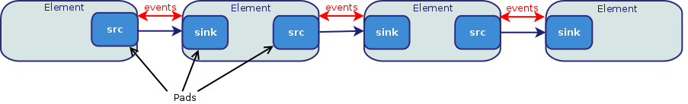
Gstreamer Events & Pads
Capsfilter (capabilities filter)
Used to describe the type of data that is streamed between two pads
Usefull for limiting mediatypes and setting requirements!

Slide 24
Corrected MJPG pipeline
gst-launch-1.0 udpsink port=5000 ! \
application/x-rtp,\
encoding-name=JPEG,\
payload=26 ! \
rtpjpegdepay ! \
jpegdec ! \
autovideosink

Slide 25
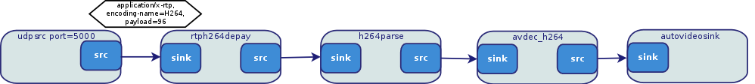
H264 Pipeline
Sender
Receiver

Slide 26
H264 Pipeline
Sender
gst-launch-1.0 videotestsrc ! \
x264enc ! \
h264parse config-interval=1 ! \
rtph264pay ! \
udpsink host=127.0.0.1 port=5000

Slide 27
H264 Pipeline
Receiver
gst-launch-1.0 -v udpsrc port=5000 !\
application/x-rtp,encoding-name=h264,\
payload=96 ! \
rtph264depay ! H264parse ! \
avdec_h264 ! \
autovideosink

Slide 28
Webcam shows latency
Sender
gst-launch-1.0 v4l2src ! video/x-raw,\
width=640, height=480 ! X264enc \
tune=zerolatency byte-stream=true \
bitrate=3000 threads=2 ! H264parse\
config-interval=1 ! Rtph264pay ! \
udpsink host=127.0.0.1 port=5000

Slide 29
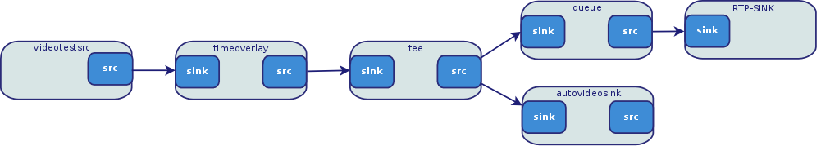
Latency Testing Pipeline
Difficult between 2 systems

Slide 30
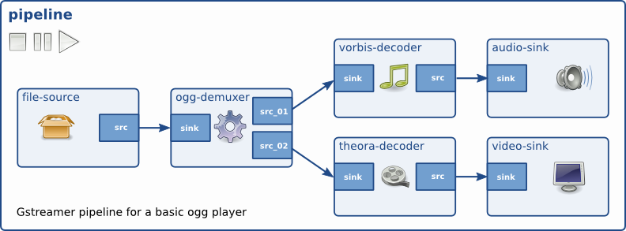
Final Thoughts
There's much more to tell
  Muxers
  HTTP
Code examples in the paper

Slide 31
Final Thoughts
Arnaud Loonstra:
arnaud@sphaero.org
twitter.com/sphaero
References:
https://github.com/sphaero/workshops
http://www.z25.org/static/_rd_/videostreaming_intro_plab/index.html
http://gstreamer.freedesktop.org/

