Slide 1
Workshop Spatial Projection
- Wie is z25
- WTF?
- Demo
(Linie in Lichterlaaie)
- Tools Howto
- Theme
*Lunch*
- Play

Slide 2
Stichting z25.org

Slide 3
What is it?
Your projector is the camera of the virtual world.
The projector opens a window to this virtual world.
You can mix with reality if you do it right.
Stop thinking about your screen or canvas etc.

Slide 4
Demo
...

Slide 5
How can you use this
Blender
Gimp
Opensource, right?

Slide 6
Blender
USE THE TEMPLATE!
Create a plane
Unwrap
Add material and texture (use UV coordinates)
Set the image
Animate using keyframes

Slide 7
Blender
Properties bar on the bottom!
Send Mesh: send data to RPI's
Mute Broadcasting: Stops sending data to the RPI's
Prepend: SET YOUR INITIALS!!!!
Data path: set to the PartySwap share!!!!

Slide 8
Blender
Online shortcuts:
http://waldobronchart.be/blenderkeyboard/

Slide 9
GIMP
Crawl google for images!
Open Image
Create a mask (if needed)
Scale to 256x256
Save as PNG!!!
Load PNG in Blender and use on your mesh!

Slide 10
Current features and limitations
- use fog, no lights
- use textures, no mesh colors
- small textures please (ie. 256X256)
- only keyframe animations
- no special fx! just a plane with 1 texture (+alpha)

Slide 11
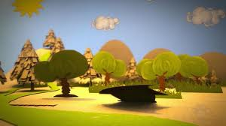
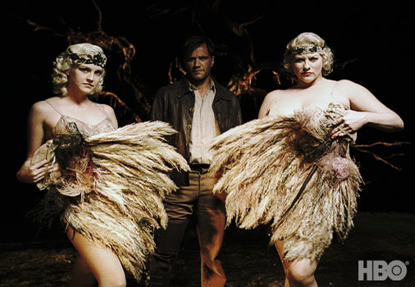
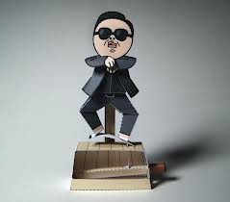
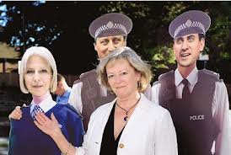
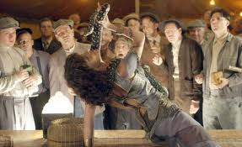

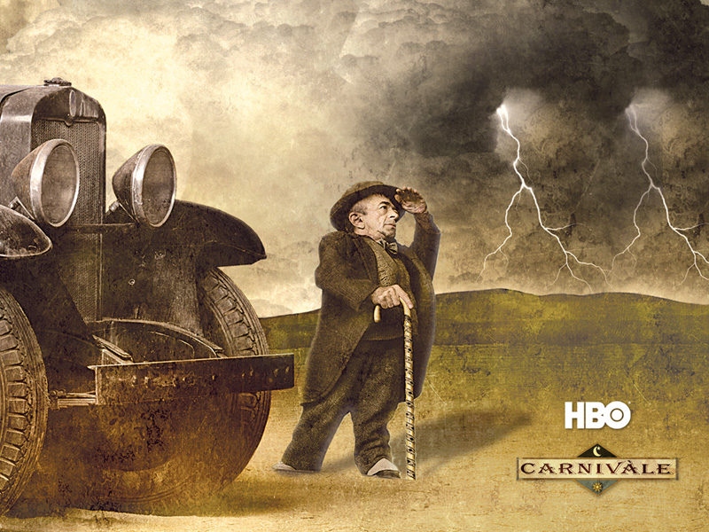
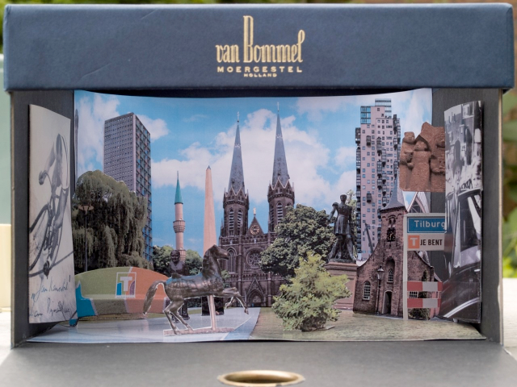
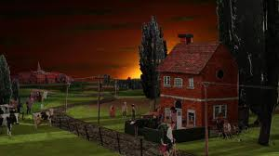
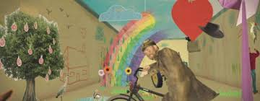
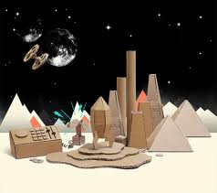
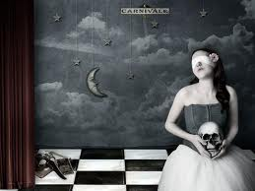

Theme

