Slide 1
Lecture 10: Cyber Threats CS 07351: Cyber Security: Fundamentals, Principles and Applications Dr. Vahid Heydari

Slide 2
What is tradecraft?
Techniques used by adversaries.
Cyber adversaries can be evaluated by the sophistication of their tradecraft.

Slide 3
Tradecraft
Script kiddies – unskilled hackers who use code and research from others
Hackers – skilled and experienced users who use hacking tools
Malware developers– research, develop, and publish hacks
Security researchers and white hats – bug hunters, exploit coders
Professional black hats – hire out for evil

Slide 4
Hacking is a craft
You don’t have to be a genius,
You have to be persistent
You have to be able to learn
You have to be motivated
Like everything practice is required
Hackers have specializations
Some develop hacks
Some are good at using them
Hackers work in teams
Hackers share information with one another

Slide 5

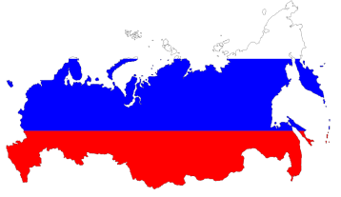
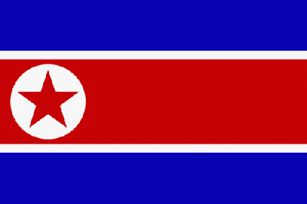

Cyber adversaries
National governments
Goal: weaken, disrupt, destroy another gov’t
Espionage
disruption of infrastructure to damage economy, full scale attack on infrastructure
Propaganda, low level nuisance
Tradecraft: high level of technical expertise
Willing to invest large amounts
Cost is relative, much less than physical attack

Slide 6
Cyber adversaries
Cyber-attacks are much cheaper than kinetic weapons.
Enables relatively poor countries to developed sophisticated cyber-attack tradecraft.
North Korea thought to have cyber army of 2000-6000
Important research area: malware attribution
Notes:
Malware attribution – find malware, do rigorous engineering (reverse), use some algorithm to check source code with other source code malware similarities to find out which groups are behind the attack

Slide 7
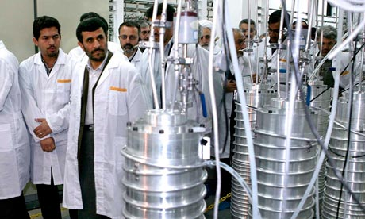
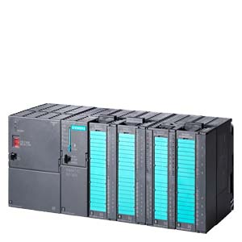
Stuxnet, the world's first digital weapon
Cyber-attack specifically targeted Iranian centrifuges used for Uranium enrichment.
Nation state level attack.
Penetrated islanded network.
Destroyed 1/5th of centrifuges in secret Iranian facility.
Notes:
Uranium was dangerous b/c having enough could make a dangerous nuclear bomb, so governments (likely US) wanted to do something about it to stop it. Instead of a physical war or risk that danger, use a cyberattack.

Slide 8
Stuxnet
4 zero day exploits
print server vulnerability
USB thumb drive autorun vulnerability
Exploit fixed database password
file execution when icon viewed in Windows Explorer
Stolen software publisher keys
Sign software from legitimate vendor to avoid user warnings
Command and control server for malware updates
Searched for specific software install (WinCC, Siemens HMI)
Monitored network traffic to detect specific control system
Infected connected programmable logic controller (PLC)
Altered PLC firmware and program
Spun centrifuge too fast -> broke glass lining of centrifuge
Notes:
Zero-day exploits – no patch for those exploits, no one can detect them
#2, they could put malware on USB to make it autorun
#4, they can do something with the icon of the file, so as soon as windows wanted to show the icon, it would run the program (no need to run anything, just open the window and it’ll execute)
Hacked trusted company with a digital signature to find the private key of it, so it goes undetected by antiviruses since it’s trusted. They used this to sign malware.
It looked legit because they would send updates and patches.

Slide 9
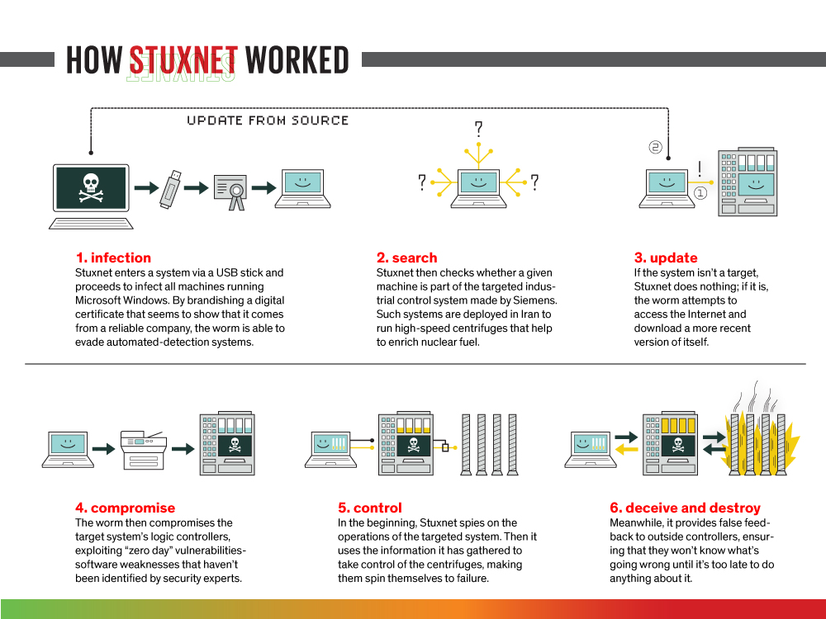
Notes:
Able to infect to printer, which infected all printers, then to hdmi = the display (Printers vulnerable to infection)
Got busted after 2 years, the centrifuges got broken over and over again. Stuxnet slowed the performance of the infected computers, and some company who had customers in Iran thought there was something wrong so they started working with antivirus companies to find it out. Then they replaced all equipment.

Slide 10
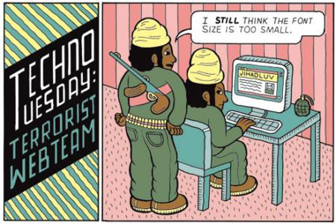
Cyber adversaries
Terrorists
Goal: spread terror throughout the civilian population
Bombs still work better than bytes
Expect more cyber attacks from terrorists in the future
Most examples have been website defacements, denial of service attacks
Tradecraft: generally low sophistication to date, but, low cost of cyber attack development could lead to more sophisticated incidents in future
Notes:
Social media

Slide 11

Cyber adversaries
Industrial spies
Goal: theft of trade secrets, disrupt competition
Tradecraft: varies, increasingly sophisticated
Increasing cyber-attacks
Insider threat

Slide 12
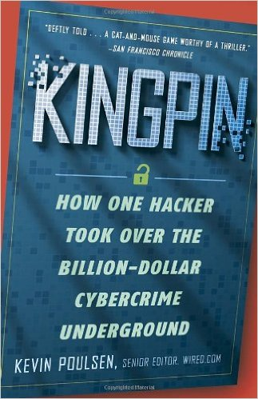
Cyber adversaries
Organized crime
Goal: monetary gain
Credit card, phishing scams, theft from business, laundering stolen goods, identity theft, …
Tradecraft: can be very sophisticated
Max Ray Vision (alias Iceman) is a former computer security consultant and hacker who is serving a 13-year prison sentence. He was convicted of two counts of wire fraud, including stealing nearly 2 million credit card numbers and running up about $86 million in fraudulent charges

Slide 13
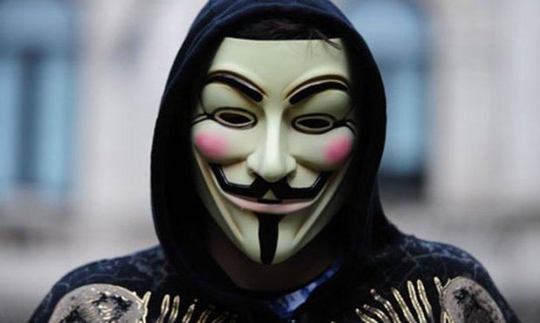
Cyber adversaries
Hactivists
Goal: politically active hackers, often propaganda rather than damage to critical infrastructures (but not always), want to make a statement
Example: Anonymous
Tradecraft: varies, can be significant, big gest threat is organizing many hackers to work together
Anonymous
Lots of DDOS, website defacements, leaking private information
https://en.wikipedia.org/wiki/Timeline_of_events_associated_with_Anonymous

Slide 14
Cyber adversaries
Insiders
Goal: revenge, profit
Very dangerous due to access
Employees; also includes vendor, 3rd parties with access
Examples
Time bombs to destroy data after firing
Exfiltration of private information
Maroochy

Slide 15
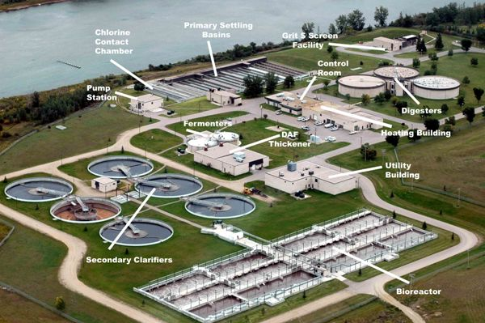
Maroochy – Insider Attack
Vitek Boden worked for Hunter Watertech, an Australian firm that installed SCADA radio-controlled sewage equipment for Maroochy
Quit Hunter, applied (and denied) for job from municipality

Slide 16
Maroochy – Cont’d
On at least 46 occasions issued radio commands to the sewage equipment
Caused 800,000 liters of raw sewage to spill into local waterways
Marine life died, the creek water turned black and the stench was unbearable for residents
Leveraged insider knowledge
Used stolen laptop and radios
Obfuscated attacks – engineers thought system was malfunctioning
Notes:
Always assume bad employees

Slide 17
Types of attacks
Can classify in many ways
Attack vector
Network, email, software install, malware, virus, social engineering, insider access
Impact
Misuse of resources, user compromise, root compromise (privilege escalation), web compromise, installed malware, denial of service
Target
OS, network, application, client, server

Slide 18
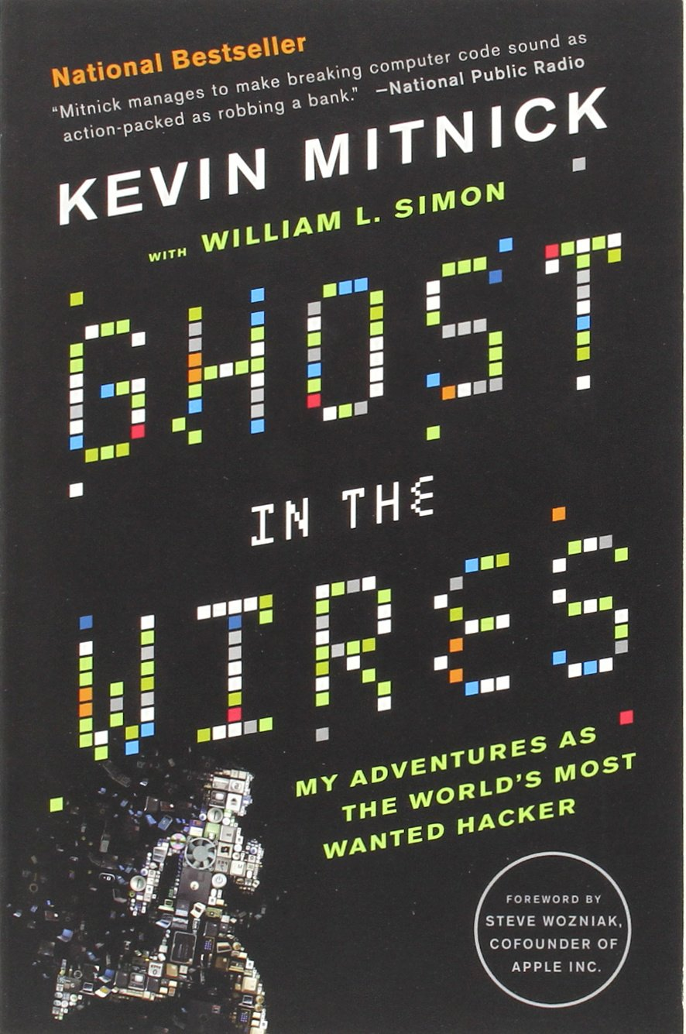
Social Engineering
non-technical method of intrusion hackers use that relies heavily on human interaction and often involves tricking people into breaking normal security procedures
Notes:
Important to train employees

Slide 19
Social Engineering
At age 13, Mitnick used social engineering to bypass the punch card system used in the Los Angeles bus system
Ticket punch for "a school project”
Unused transfer slips in a dumpster next to the bus company garage
First gained unauthorized access to a computer network in 1979, at 16
In 1999, Mitnick pleaded guilty to four counts of wire fraud, two counts of computer fraud and one count of illegally intercepting a wire communication
Now runs Mitnick Security Consulting LLC, a computer security consultancy

Slide 20
Social Engineering
Kevin Mitnick examples
Call help desk have account created for himself
Call back office phone numbers have phone lines established, traced, not traced, etc.
Call engineers query about technologies
Pose as reporter steal birth certificates from country registrar in person

Slide 21
Social Engineering
Familiarity
Hang around so your mark becomes familiar with your face. Familiarity leads to trust.
Fabricated hostile situation
Appear in an argument with a friend as you walk past security.
Gather and use information
Learn about the company, lingo (internet, dumpster diving, etc)
Sound like you must work at the company when asking for something

Slide 22
Social Engineering
Pretexting – make up an incident and exploit it
Diversion – talk a delivery person into delivering a package to wrong person, talk person into sending package to you
Phishing – fake emails masking as a company or person
Baiting – drop an infected thumb drive
Quid pro quo – exchange favors
Tail gaiting – sneak into guarded area – walk in behind legit employees
Sex – men will often do things for women they won’t do for another man
Notes:
Pretexting is a form of social engineering in which an individual lies to obtain privileged data. A pretext is a false motive. Pretexting often involves a scam where the liar pretends to need information in order to confirm the identity of the person he is talking to.
Quid pro quo: a favor or advantage granted or expected in return for something.

Slide 23
Insider threat
Pure insider
Employee w/
Physical entry (badged)
Compute credentials
Super pure insider
Employee with full access
IT support
Management
Minimize threat
Principle of least privilege
Monitor employee behavior
Watch for behavior changes
Personal financial issues
Monitor network outflows
Awareness training
Background checks
Notes:
Do not give them access to something they don’t need (minimum access)
Background checks (should do this at least every year)

Slide 24
Insider threat
Insider associate – limited access to facility or network
Contractor
Cleaning crew
Authorized visitors
Threat minimization
Limit access (least privilege again)
Awareness training
Train employees to detect problems
Background checks
Contractual liability for vendors

Slide 25
Insider threat
Inside affiliate
spouse, child, friend or client of an employee who uses an employee’s credentials to gain access
Threat minimization
Control affiliate behaviors
When they can be onsite
Where they can go
Training
Train employees to limit access to account credentials
Train employees to limit physical access to compute assets.
Auto signoff from accounts.
Notes:
Containerizing (isolation, independence to prevent widespread damage and infection)

Slide 26
Insider threat
Outside affiliate
untrusted outsiders who use open access, such as wireless service, to gain access to a company’s resources.
Open WIFI in lobby?
Visitor WIFI?
WIFI w/ fixed keys
Threat mitigation
Be aware of these issues
Consider these threat in security assessments
Limit access to these networks
Change the passphrase daily.
Segregate the visitor network from the business enterprise and operations network.

Slide 27
Insider threat example
3rd party paid call center employees to
Steal customer account information: names and SSN
68000 accounts accessed
Used information to unlock stolen cell phones
$25M fine to AT&T
http://www.govinfosecurity.com/insider-breach-costs-att-25-million-a-8089

Slide 28
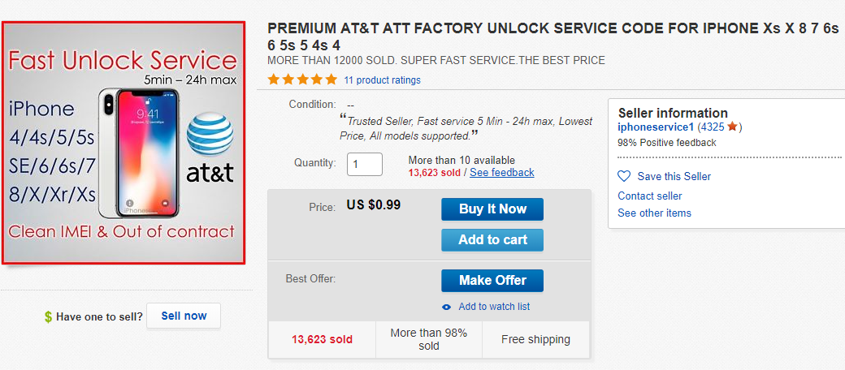

Slide 29
Cyber attack motivations
Top 5 criminal motives in 2013 (Kapersky Lab)
Force financial losses
Denial of service
Company can’t function with out service -> looses money
Damage company reputation
Website defacement
Hacked social media accounts
Steal money
Malwares to steal banking credentials: Zeus, SpyEye, NeverQuest
Stealing credit card info
Etc

Slide 30
Cyber attack motivations
Ransomware
Block users access to data; require ransom to release access
Cryptolocker
Stealing information
Steal intellectual property
Steal credentials
Credit card information

Slide 31
Attack stages
Reconnaissance and Enumeration
Find the victim (IP address, open ports)
Fingerprint the victim (software vendor, make, model, version)
Cross check against Common Vulnerabilities and Exposures (CVE) databases
Vulnerability exploitation
Execute an attack
Develop exploit
Leverage script kiddie
Zero day
Metasploit

Slide 32
Attack stages
Access
Gain access to a system
Privilege Escalation
Achieve administrator or root privilege
Implants
Leave code behind
Botnet
Key logger
Clean-up

Slide 33
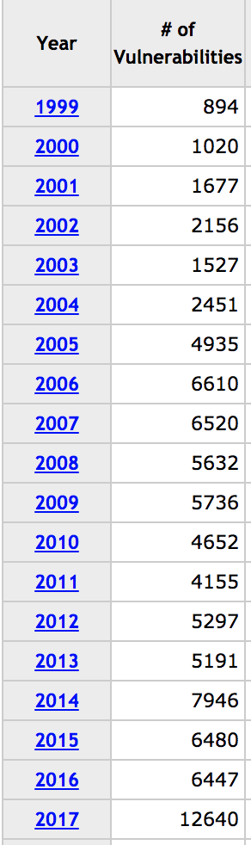
Number of Vulnerabilities per year

Slide 34
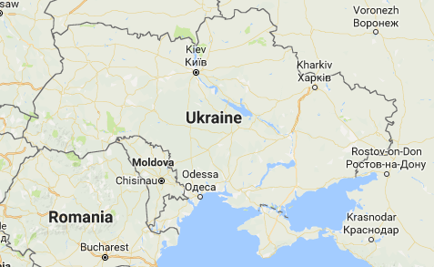
Ukrainian Electric Grid Attack
3 Ukrainian regional electricity distributors attacked within 30 minutes of each other
225,000 customers lost power
Utilities forced to move to manual operation post attack.
December 24, 2015
* http://www.nerc.com/pa/CI/ESISAC/Documents/E-ISAC_SANS_Ukraine_DUC_18Mar2016.pdf

Slide 35
Ukrainian attack
Penetration
Spear phishing emails
Malware embedded in MS Office documents
Access
Black Energy 3 malware
Theft of credentials (username, passwords)
Remote desktop
Network discovery
Destroy host
Remote update

Slide 36
Ukrainian Attack
Exploitation
Via remote desktop: Used operators Human Machine Interface (HMI) tools to control execute attack (open circuit breakers, etc.)
Cover tracks
Erased Master Boot Record (MBR) of impacted systems
Targeted erasure of some logs
Notes:
MBR – when you turn on computer, it’ll read this and choose which OS it is
Can remove access

