Slide 1
Lecture 2 CS 07351: Cyber Security: Fundamentals, Principles and Applications Dr. Vahid Heydari
you will have access to slides during midterm/final

Slide 2
Risks, Threats, and Vulnerabilities
Risk
Likelihood that something bad will happen to an asset
Threat
Any action that could damage an asset
Vulnerability
A weakness that allows a threat to be realized or to have an effect on an asset

Slide 3
What Is Information Systems Security?
Information system
Hardware, operating system, and application software that work together to collect, process, and store data for individuals and organizations
Information system security
The collection of activities that protect the information system and the data stored in it

Slide 4
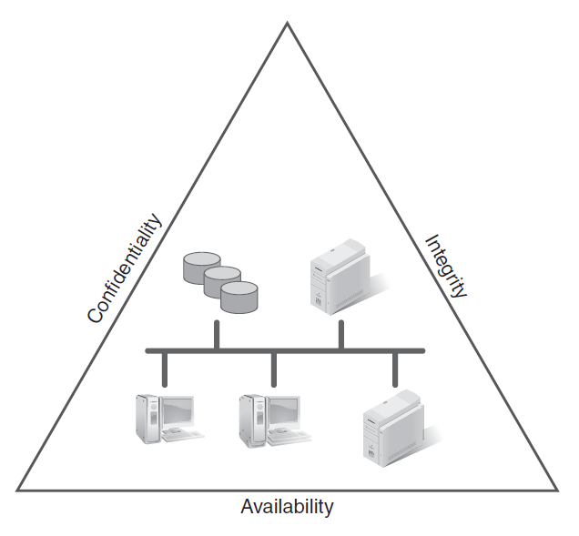
Tenets of Information Systems Security
Authenticity is a part of integrity
Attack against availability example: DDOS; very difficult to prevent,
Some websites even offer services to do this for payment
Notes:
Confidentiality: Only authorized users can view information.
Integrity: Only authorized users can change information.
Availability: Information is accessible by authorized users whenever they request the information.

Slide 5
Availability
In the context of information security
The amount of time users can use a system, application, and data

Slide 6
Availability Time Measurements
Uptime
Downtime
Availability [A = (Total Uptime)/(Total Uptime + Total Downtime)]
Mean time to failure (MTTF)
Mean time to repair (MTTR)
Notes:
• Uptime: The total amount of time that a system, application, and data are accessible. Typically measured in units of seconds, minutes, and hours within a given calendar month. Often expressed as a percentage of time available, e.g., 99.5 percent uptime.
• Downtime: The total amount of time that a system, application, and data are not accessible. Measured in units of seconds, minutes, and hours for a calendar month.
• Availability: A mathematical calculation where A = (Total Uptime) / (Total Uptime + Total Downtime).
• Mean time to failure (MTTF): The average amount of time between failures for a particular system.
• Mean time to repair (MTTR): The average amount of time it takes to repair a system, application, or component. The goal is to bring the system back up quickly.

Slide 7
Integrity
For ex. Sending a data packet over a computer
network, make sure no one’s going to change
that packet; receiver should receive exact same
packet
Maintain valid, uncorrupted, and accurate information
Authenticity is a special case of integrity
Authentication is about making sure that a given entity (with whom you are interacting) is who you believe it to be.
Simplest way to check is password (since only
Certain people are accessing things

Slide 8
Authentication
Pattern is something you do (fingerprint???),
perhaps to unlock the phone or smthg
Authentication:
Identify who (or what) is attempting to do something
Verify identity
Use one or more of the following:
Something you know (a secret)
Something you have (ex. your cellphone)
Something you are (ex. your finger print or retinal pattern)
Two-factor authentication
Use two or more of the above
user
password
Duo mobile
Two or more above as in not of the same
“category” (like you shouldn’t use pass and pin)
Another way is geolocation checking (checking the
location using IP address)
Notes:
Something you know: passwords and pins
Something you have: access card, key, smart card
Something you are: biometrics, handwriting

Slide 9
Biometrics
Retina Scan
Thumbprint/fingerprint
Hand print
Voice print
Hand Vascular Pattern Recognition
Handwritten signatures
Face Recognition

Slide 10
Password Guidelines (Old)
Should be at least 8-14 characters
Use characters from each of the following four classes:
English upper case letters
English lower case letters
Westernized Arabic numerals (0,1,2,…)
Non-alphanumeric (special) characters such as punctuation symbols.
Don’t use any part of the account identifier
Don’t use a proper name or any word in the dictionary without misspelling it in some way
Don’t use a word with numbers before or after it
Don’t use obvious phrases or sequences such as “GOEagles” or “123456” or “aaa111”
OLD

Slide 11
NIST Password Security Recommendations
National Institute of Standards and Technology
Three substantial changes (June 2017):
1- Do not require that memorized secrets be changed arbitrarily (e.g., periodically) unless there is a user request or evidence of authenticator compromise.
Don’t put deadline on when a password should be changed after a certain # of days;
Attackers are using social engineering attacks so it doesn’t matter how often you change
your password, we’re used to that kind of email to change the password, it could be
a phishing attacks

Slide 12
NIST cont’d
2- No more arbitrary password complexity requirements needing mixtures of upper case letters, symbols and numbers.
- Like frequent password changes, it’s been shown repeatedly that these types of restrictions often result in worse passwords.
- Keystroke logging, phishing, and social engineering attacks are equally effective on lengthy, complex passwords as simple ones.
Attackers know what kind of passwords we’re going to do, like Password1!, since
they’re human like us
Notes:
Highly complex memorized secrets introduce a new potential vulnerability: they are less likely to be memorable, and it is more likely that they will be written down or stored electronically in an unsafe manner.
Research has shown, however, that users respond in very predictable ways to the requirements imposed by composition rules. For example, a user that might have chosen “password” as their password would be relatively likely to choose “Password1” if required to include an uppercase letter and a number, or “Password1!” if a symbol is also required.

Slide 13
NIST cont’d
3- Require screening of new passwords against lists of commonly used or compromised passwords.
So instead of asking you to fulfill password requirements, there should be a
database of well-known passwords; if the password is there, it shouldn’t be
accepted
Notes:
It is recommended that passwords chosen by users be compared against a “black list” of unacceptable passwords.

Slide 14
Password Cracking
1 complex password
1 equation;
This prevents problems like writing down
passwords or memorizing many
Why a password should be complex
Password Length | Numeric only | Alphabetic upper-case only | Alpha-numeric Upper and lower | Alpha-numeric + Special Chars.
4 | .001 sec | .046 sec | 1.48 sec | 8.49 sec
6 | .1 sec | 30.9 sec | 94.7 min | 21.7 hrs
7 | 1 sec | 13.4 min | 4.08 days | 87 days
8 | 10 sec | 5.80 hrs | 253 days | 22.9 yrs
10 | 16.7 min | 163 days | 26.6 centuries | 2110 centuries
12 | 27.8 hrs | 303 yrs | 102k centuries | 19.5m centuries
Note: Table based on being able to generate 10 million cracks per second

Slide 15
Password Hygiene
Don't use a weak password just because it is easier to remember
Don't write down your password; remember it
If you can’t remember your passwords, write down clues and keep them in a secure place where you’ll know right away if they have been stolen
Do not write your account ID and password on a sticky note and post it on your workstation or desktop
Don't give your password to anyone
You are responsible for ANY activity done with your accounts
Don't let anyone observe you entering your password
If your password has been changed and you didn‘t request it, let your system administrator know immediately

Slide 16
How are passwords stored?
Passwords should never be stored
As plaintext
With a reversible function
Use a hash to hide the password
Hash = one way function
By definition X cannot be derived from H(X)
Where X is the plain text and H(X) is the hash of X.
Salt the password
Defeat rainbow tables
Encryption can be
decrypted

Slide 17
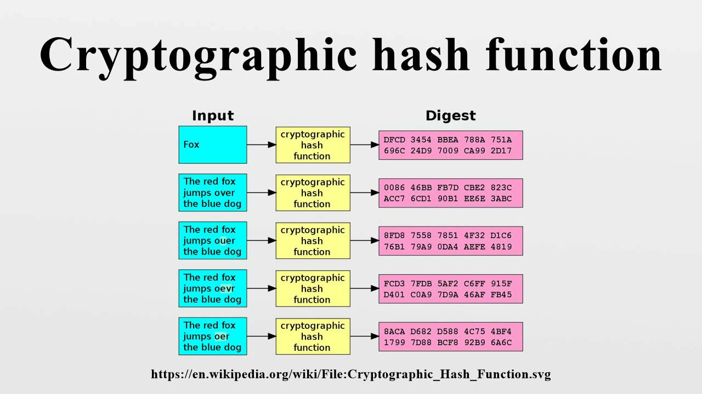
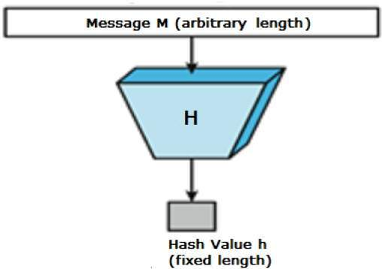
Hash Function
Hash doesn’t have a key; can go from plain
text to hash value but no way to go the other
way around; cannot decrypt
Cannot use hash for secret writing; hash
is used to give integrity
Change one bit in message, hash value will be different
Hash values will change if something is modified

Slide 18
Rainbow Tables
Faster than dictionary attack because the hashes need to be added and then compared
Tables listing hashes of values
Plaintext | H(X) (H = MD5)
dog | 06d80eb0c50b49a509b49f2424e8c805
cat | d077f244def8a70e5ea758bd8352fcd8
zebra | 69c459dd76c6198f72f0c20ddd3c9447
zebra1 | d85fb95cb761f5874f35ce32c305739b
How can you crack hash? Get the hash function and put in millions of inputs
and compare the output with the stolen hash, then you have access to plaintext
if your password is inside the attacker’s tables, it’ll make it easy. Users won’t care

Slide 19
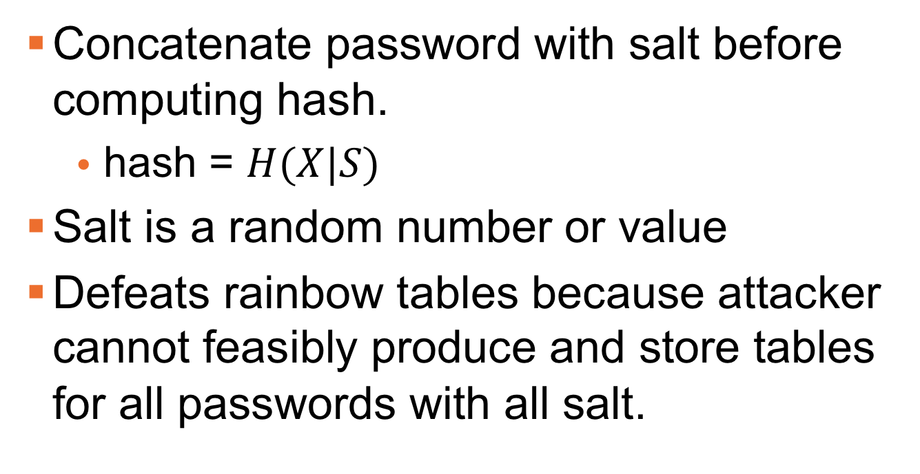
Salting
Linux (Unix-based machines) generates random number after your password called “salt” and then create a hash out of that, doesn’t trust users and makes it complex that way
Linux stores the salt (based on username), username, hash
Concatenate password with salt before computing hash.
hash = $H(X|S)$
Salt is a random number or value
Defeats rainbow tables because attacker cannot feasibly produce and store tables for all passwords with all salt.
Two users w/ same password will have different salts != hash values
Salt is plaintext, we can’t encrypt it (no point). Attackers cannot use the rainbow table with Linux passwords. If they wanted to, they would have to create larger tables with all possible salts, it’s impossible – more cpu and memory needed

Slide 20
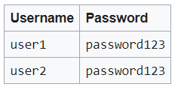
Salt Example

Slide 21
Password files
Don’t give admin access
Passwords are stored on systems in files.
Password files should be protected. They are a favorite target of hackers.
General format:
username:h(x):salt:uid:…
h(x) hashed password
User id

Slide 22
Dictionary Attack
Brute force attack in which passwords are guessed from a list of dictionary words
Most systems lock an account after n (3-5) incorrect password attempts.
Hackers steal password files for offsite attacks.
Lots of variations of dictionaries and lots of tools use automated mangling algorithms to defeat simple variations.
Does salt defeat a dictionary attack?

Slide 23
Dictionary Attacks
Does salt defeat a dictionary attack?
No. Salt is stored as plaintext in the password file.
Salt will just be added to each password and then generate random things, the attacker has access

Slide 24
Microsoft Windows Passwords
LANMAN (old hash, also called LM)
Still around for older computers.
Disabled in Windows 7.
14 character max.
Uses DES to encrypt fixed words with the 2 halves of the password.
These are the easiest passwords to crack.
No salt.
NTLM (LANMAN disabled)
127 character max.
Uses MD4 hash.
No salt.
L0phtCrack can generate 1,200,000 cracks per second (on a 900MHz computer)
Jason:502:aad3c435b514a4eeaad3b935b51304fe:c46b9e588fa0d112de6f59fd6d58eae3:::
Format: Username: UserID: LM: NTLM:::
b/c no salt on windows
Notes:
NTLM v2 uses a random value to act as a salt so that hashes are different when two users use the same password.

Slide 25
What’s wrong with NTLM?
No salt. Two accounts with same password have same hash.
Based on MD4 which was compromised in 1995.
Collision attack. Can find two different messages m1 and m2 such that hash(m1) = hash(m2).
Kept for backward compatibility.

Slide 26
Linux Passwords
Linux Passwords
Can be longer than 8 characters
Uses the MD5/SHA256/SHA512 Checksum algorithm for encryption
There is a field in the shadow file to specify the hash algorithm.
Uses 8-character “salts”
John-the-Ripper can generate 118,000 cracks per second (on a 750 MHz computer)
You can choose

Slide 27
Risks with Passwords
Social Engineering
Eavesdropping / shoulder surfing
Fake login prompt
Attacks on password storage
Attacks via audit trail
One-way encryption
Multi-use passwords
Ex. Username, maybe plaintext of password on the audit logs; it says what user ___ logged in or logged out

Slide 28
Mitigation of Password Risks
Account lockout
Use “good” passwords
Protect one-way hashes
Protect syslogs, event logs
Good use of error messages
Brute force is surely going to work no matter how strong your password is
Error messages could show attackers what was right and wrong
Dictionary attacks mostly have access to password file or hash, and they could move the hash to their own computer and try whatever
Notes:
Good use of error messages:
Do not use a different message for “bad user name” and “bad password” and “account locked out”
Example - Solaris 7, if username was bad, there was a period at the end of the error message, and if the username was good and the password bad, the period was missing.

Slide 29
Using passwords over a network
Should passwords be sent as plaintext?
Should the password file be stored at the client or server?
Should the password file be transmitted over the network?
Not client b/c someone could just send the hash over to the server and gain access
Notes:
Should passwords be sent as plaintext?
Never.
Should the password file be stored at the client or server?
Server.
Should the password file be transmitted over the network?
No.

Slide 30
Using passwords over a network
How is the password transmitted. In a nutshell.
Client
User enters password (x)
Client computer h(x|S)
transmit h(x|S) to server
Server
Compare h(x|S) to stored hash for user.
NOTE: if building a password verification system, follow a standard not the template above. Above is for illustration only.

Slide 31
Other Attacks
Pass the hash.
Authenticate with stolen hash rather than a password.
Key logging.
Phishing.
For example thumb drive that logs keys and sends back to the server
Emails where you click something

