Slide 1
Lecture 4 CS 07351: Cyber Security: Fundamentals, Principles and Applications Dr. Vahid Heydari

Slide 2
Security Models

Slide 3
Bell–LaPadula Model
Access control in government and military applications
Focuses on data confidentiality and controlled access to classified information
Security properties:
The Simple Security Property states that a subject at a given security level may not read an object at a higher security level. Read Down.
The * (star) Property states that a subject at a given security level may not write to any object at a lower security level. Write Up.
The Discretionary Security Property uses an access matrix to specify the discretionary access control.

Slide 4
Bell–LaPadula Model
Aka unclassified can’t read confidential, but confidential can read unclassified

Slide 5
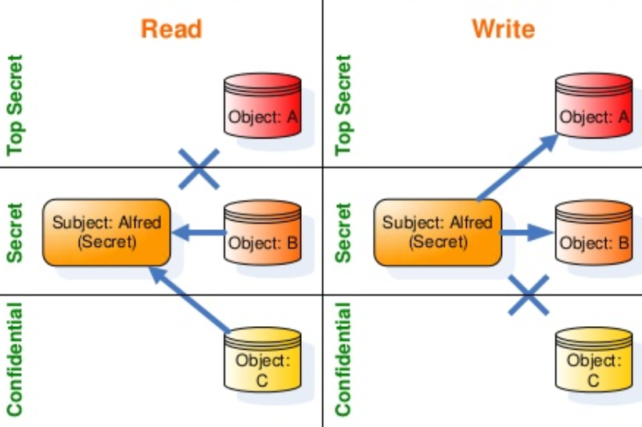
Bell–LaPadula Model
Cannot share secret info to lower levels (confidentiality)

Slide 6
Biba Model
Address integrity as the core principle, which is the direct inverse of the Bell–LaPadula model.
Security properties:
The Simple Integrity Property states that a subject at a given level of integrity must not read data at a lower integrity level (no read down).
The * (star) Integrity Property states that a subject at a given level of integrity must not write to data at a higher level of integrity (no write up).
Invocation Property states that a process from below cannot request higher access; only with subjects at an equal or lower level.
Notes:
Military chain of command:
A General may write orders to a Colonel, who can issue these orders to a Major. In this fashion, the General's original orders are kept intact and the mission of the military is protected (thus, "read up" integrity). Conversely, a Private can never issue orders to his Sergeant, who may never issue orders to a Lieutenant, also protecting the integrity of the mission ("write down").

Slide 7
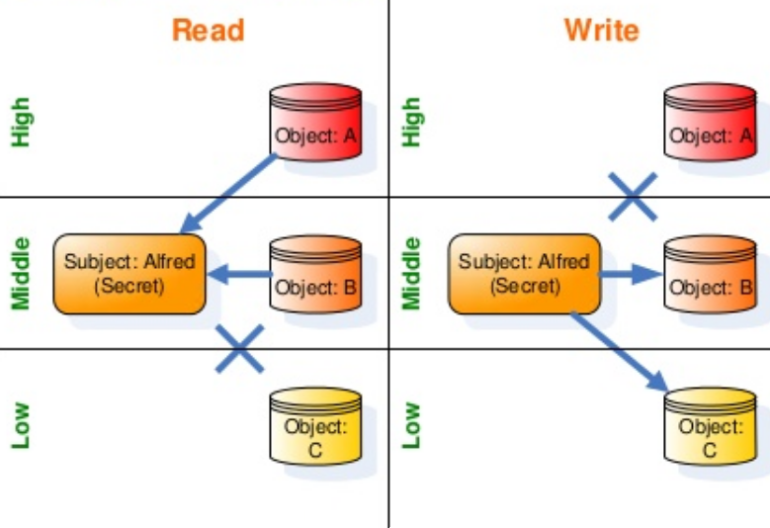
Biba Model
Think things like receiving feedback from boss (higher)
Cannot give comment to someone on the top
Notes:
Military chain of command:
A General may write orders to a Colonel, who can issue these orders to a Major. In this fashion, the General's original orders are kept intact and the mission of the military is protected (thus, "read up" integrity). Conversely, a Private can never issue orders to his Sergeant, who may never issue orders to a Lieutenant, also protecting the integrity of the mission ("write down").

Slide 8
Other Models
Clark–Wilson model:
Provides a foundation for specifying and analyzing an integrity policy for a computing system.
The model uses security labels to grant access to objects via transformation procedures and a restricted interface model.
Brewer and Nash model (Chinese wall):
Provide information security access controls that can change dynamically.
No information can flow between the subjects and objects in a way that would create a conflict of interest.

Slide 9
Device Protection

Slide 10
Key Definitions
Checkout Policy: A policy that ensures that hardware doesn’t leave an organization's premises without prior approval.
Screen Filter: A panel or filter that is placed over a display to make it difficult or impossible for someone to see the screen without being directly in front of the display.

Slide 11
Security Measures
Have a checkout policy Lock up high-value assets Install screen filters Use cable locks Create secure backups
Cannot connect cable to other devices

Slide 12
Backup and Restore

Slide 13
Key Definitions
Backup: The process of copying data to a second form of storage, such as tape, recordable optical media (CD-R and DVD-R), removable hard disk, flash drive, or solid state drive in order to protect data by providing a second copy that can be available in case the original data is lost, modified, or corrupted.
Copy Backup: A backup of all files regardless of the archive bit status. Daily Backup: A backup of all files modified that day, regardless of the archive bit status. Restore: The process of copying backup data to its original storage location.
Notes:
In Windows and OS/2, when a file is created or modified, the archive bit is set (i.e. turned on), and when the file has been backed up, the archive bit is cleared (i.e. turned off). Thus, the meaning of the archive bit is "this file has not been archived".

Slide 14
Key Definitions
Online Tape Vaulting: The transmission of tape backups to an offsite location by the primary data processing center. Remote Journaling: The transmission of data journals and logs to an offsite location. Database Shadowing: The transmission of a production database to an offsite location.
Hierarchical Storage Management: The process of keeping the most current, necessary items on the fastest media devices.
Notes:
In Windows and OS/2, when a file is created or modified, the archive bit is set (i.e. turned on), and when the file has been backed up, the archive bit is cleared (i.e. turned off). Thus, the meaning of the archive bit is "this file has not been archived".

Slide 15
Key Definitions
If you just remove the address from the table, the file is there in the hard drive (when you delete a file)
Ex. All files and folders in C drive
Doesn’t matter if it’s already been backed up
Full Backup: A backup of all files regardless of the archive bit. Image Backup: A copy of a disk or partition where individual files are not examined, so all data is copied regardless of the archive bit.
Incremental Backup: A backup of files on which the archive bit is set, backing up only the data changed since the last full or incremental backup. Differential Backup: A backup of files on which the archived bit is set to back up only the data changed since the last full backup.
Ex. Hard drive, etc., a partition in C drive; whole partition/hidden somewhere in disk, files can be written there (forensics purposes, like if crime was done on a computer)
Full format = 0 all bits since it’s under a certain value but you can still see it was originally 1 for some → recovery

Slide 16
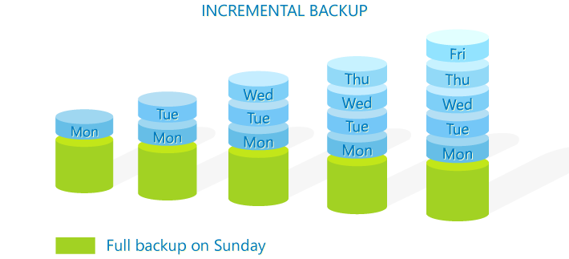

Incremental vs.
Differential backup
Backup what has been changed only on Tuesday; if we haven’t changed a file on Monday, the file isn’t there on tuesday
While an incremental backup only includes the data that has changed since the previous backup, a differential backup contains all of the data that has changed since the last full backup.
Restores once, safer
Faster, less storage, but backups are tied together (restores multiple backups, more time) and if smthg goes wrong, one of the things we can’t restore; Monday backup broken, Tuesday can’t restore
Full backup Sunday so it’ll store everything that has been changed since Sunday
https://www.codetwo.com/admins-blog/difference-differential-incremental-backup/
Notes:
Suppose full backup every week.

Slide 17
Incremental vs.
Differential backup
Incremental Backup:
+ Faster
+ Needs less storage
- All iterations are needed for data restoration
Longer restore process
Incremental method is more popular specifically for Cloud storage
Make sure all backups work (ransomware is a problem since it “infiltrates”? the backup)
https://www.codetwo.com/admins-blog/difference-differential-incremental-backup/

Slide 18
Data Loss Prevention (DLP)

Slide 19
Key Definitions
Data Loss Prevention (DLP): A system that attempts to detect and stop breaches of sensitive data within an organization. Network DLP: A software or hardware solution that is typically installed near the network perimeter that analyzes network traffic in an attempt to detect sensitive data that is being transmitted in violation of an organization's security policies. Endpoint DLP: DLP Software that runs on end-user workstations and servers. File-Level DLP: DLP software that is used to identify sensitive files in a file system and then to embed the organization's security policy within the file so that it travels with the file when it is moved or copied.
Cloud DLP: A software solution that is typically on cloud-based systems that analyzes traffic to and from cloud systems in an attempt to detect sensitive data that is being transmitted in violation of an organization's security policies. Unified Threat Management (UTM): A security system related to DLP that can be implemented as a single network appliance or as a service on the network.

Slide 20
Network DLP
Analyzes network traffic Determines if traffic adheres to security policies
Sees if bad stuff is on data packets?

Slide 21
Endpoint DLP
Runs on servers and workstations Monitors and controls access Provides application controls Gives immediate feedback to users
Sometimes we can’t find data breaches on network (ex. encryption)
On each devices (network is one)

Slide 22
File-level DLP
Flags files as containing sensitive information Embeds security policies within files Provides continual control and access to files
Prevents unauthorized access

