Slide 1
Lecture 5: Communication Protocols CS 07351: Cyber Security: Fundamentals, Principles and Applications Dr. Vahid Heydari

Slide 2

Protocols
What is a protocol ?
How are they used ?
What makes protocols vulnerable ?
How do you secure a protocol ?
Notes:
A formal description of message formats and the rules two computers must follow to exchange those messages.
Protocols can describe low-level details of machine-to-machine interfaces (e.g., the order in which hits and bytes are sent across wire) or high-level exchanges between application programs (e.g., the way in which two programs transfer a file across the Internet).
www.comptechdoc.org/independent/networking/protocol/protnet.html
One of the weaknesses of the original Internet Protocol is that it lacks any sort of general purpose mechanism for ensuring the authenticity and privacy of data as it is passed over the internetwork. Since IP datagrams must usually be routed between two devices over unknown networks, any information in them is subject to being intercepted and even possibly changed.

Slide 3
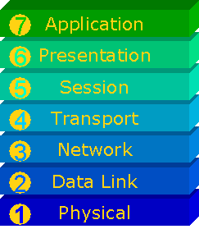
Network Protocols
OSI Model
A conceptual model composed of seven layers, each specifying particular network functions
Layering
Each layer hides its implementation details from the layers below and the layers above
Each layer on the transmitting machine has a logical peer-to-peer connection with the corresponding layer in the receiving machine
Application data is encapsulated by each successive layer until it is transmitted onto the physical medium
OSI -- abstract
> multiple layers -- standards needed to accommodate different stuff; has interfaces, we want independent software to manage each one (so interpreters can correctly take away/add each layer as needed)
Notes:
OSI model was published after many other protocols, including TCP/IP, were already in production. Its purpose was to create a standard for new protocols to be developed to so that applications and OS’s could utilize new protocols without the need for modifications to the OS to support new protocols.
Layering means that the application doesn’t care what physical medium is being used – that’s handled by the NIC & it’s drivers. The application can make use of lower level protocols, such as the state of TCP, sequence #s & ACKs in TCP, etc.
Layer 2 is tricky because it is really 2 layers in one …
The Media Access (MAC) portion adds it’s own encapsulation based upon the network protocol being used.
The Link portion, is the physical NIC and encompasses the propagation algorithms specific to the transport media.

Slide 4
Network Protocols … continued
TCP/IP Stack
A suite of protocols for heterogeneous network communication
Real demonstration of OSI
Notes:
TCP/IP is composed of many different protocols that work at different levels within the stack.
Data in an IP internetwork is sent in blocks referred to as packets or datagrams (the terms are basically synonomous in IP).
The Internet Protocol provides an unreliable datagram service (also called best effort); i.e. it makes almost no guarantees about the packet. The packet may arrived damaged, it may be out of order (compared to other packets sent between the same hosts), it may be duplicated, or it may be dropped entirely. If the application needs reliability, this is added by the Transport layer.
There are 2 camps: (1) says it’s 4 layers, and (2) say its 5 layers
Some camps combine layers 1&2 and exclude the application layer to arrive at a 4-layer stack
Its 4 layers if you don’t count the application layer which should be considered protocol independent…
Its 5 layers because so many applications are written to take advantage of the lower level protocols that the apps become protocol dependent.
TCP/IP is not dependent upon the transport media, therefore that layer is not included in the STACK.
See www.lex-con.com/osimodel.htm to see a comparison of different network stacks to the OSI model

Slide 5
Encapsulation
Notes:
Flow:
Client requests file from server, server sends requested file
The Session layer adds a session envelope onto the data
The Transport layer adds an envelope with src & dest port numbers & state information
The Network layer adds an envelope with the src & dest IP addresses, fragmentation requirements, etc.
The MAC layer adds an envelope with the Ethernet src & dest address, and then adds padding if necessary to meet the propagation requirements of the transport media
The NIC card then transmits the datagram onto the media
Each layer on the receiving end reads the appropriate envelope, and if all criteria are satisfied (eg. Checksums, Seq.#s, etc,) strips off the envelope & passes the remaining data to the next higher level.
Finally, the application receives the data and presents it to the user as per the rules of the particular app.

Slide 6
Encapsulation
encapsulation
> application requests data for example
> send to TCP/UDP layer (adds header to packet)
> each layer has their own header (some info, like source/dest) and add them to that og data and send it to the next one, etc.
> think data inside an envelope, inside an envelope, etc.
> when client receives it, it'll receive the whole thing and check the headers (ensure it's for you), open that envelope and take out the smaller thing and send it to the upper layer
> how can we figure out who needs to receive it? port number is basically who in your house needs to receive it (the home address may be IP)

Slide 7
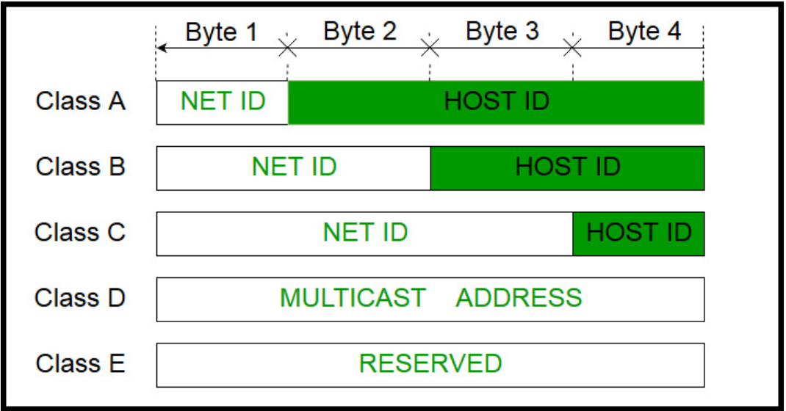
IPv4 Addresses
All computers connected to same router is NET ID, last number is HOST ID
Definition:
An identifier for a computer or device on a TCP/IP network
Classful (old, pre 1993): Organizations own a block of addresses by class.
Class-A: (001 – 127) 001.zzz.zzz.zzz (z=host portion)
Class-B: (128 – 191) 128.yyy.zzz.zzz (z=host portion)
Class-C: (192 – 223) 192.xxx.yyy.zzz (z=host portion)
Class-D: (224 – 239) Multicast networks
Class-E: (240 – 254) Reserved / test
Private IP Addresses: (RFC-1918)
Private IP Addresses:
127.0.0.0 local loopback address
10.0.0.0 - 10.255.255.255
172.16.0.0 - 172.31.255.255
192.168.0.0 - 192.168.255.255
Notice 3 bytes are in blue for Class C = NET ID
Private: only works inside a network, unique to a device; all servers have public IP address unique to the internet (assigned by internet provider, router)
Notes:
The IP address is usually expressed as four decimal numbers, each representing eight bits, separated by periods. This is sometimes known as the dotted quad notation.
Class-A begins with Binary 0, supports 16 million hosts - useful for big company (accommodate lots of hosts), NET ID is 256
Class-B begins with Binary 10, supports 65,000 hosts
Class-C begins with Binary 110, supports 254 hosts
Class-D begins with Binary 1110
Note:
the 1st possible address within a network range (typically the “zero” address (eg. 1.0.0.0) is the network number, and is used by routers to determine where a particular packet needs to be sent
The last possible address within a network range (eg. 1.255.255.255) is the broadcast address and is used to send a message to all hosts within the network range.
These two address can never be assigned to a host

Slide 8

IPv4 Addresses … continued
Classless IP Addresses – Internet Service Provider allocates addresses. No classes. Allocate any size (any whole number of bits)
Classless InterDomain Routing (CIDR)
Uses netmask to designate how many bits of the IP Address designate the network address – the remaining bits are the host address
192.168.128.222 / 255.255.255.0 or 192.168.128.222 / 24
A 25 bit netmask divides a class-C sized network into 2 sub-networks
192.168.128.0 / 25 and 192.168.128.128 / 25
Each network contains 126 hosts
Supernetting
Use netmask to combine smaller nets into a larger network
192.168.1.1 /22
First 24 bits are NET ID
255.255.255 (mask) represents the first 3 bytes is NET ID and last is HOST ID
Notes:
192.168.1.1 /22 = 1022 hosts

Slide 9
IP
IP Packets encapsulate UDP, ICMP?, and TCP packets.
IP packets may be fragmented. Which means IP payload may also be fragmented.

Slide 10
Internet Protocol
Packet in hex, each digit is 4 bits, each 4 is 2 bytes
Start from IP header, somewhere is the end of IP header, and then TCP header, etc. and then actual data
45c0 005c e857 0000 3f01 5a93 aa81 3534
5804 003d 0303 4a7d 0000 0000 4500 002c
79a4 0000 1c06 329d 5804 003d c08a d9bf
4374 0017 7025 c3d1 0000 0000 6002 00a4
32d7 0000 0204 0052 3220 7309 0000 0000
0000 0000 0000 0000 0000 0000
(Rest of numbers + their descriptions in speaker notes)
Version: 4 → IPv4
Length of IP header → 5 * 32 bits (4 bytes) = 20 bytes
Blue indicates IP header (notice it is 20 bytes, 10 groups)
Total length → 005c (convert to decimal) is 92 bytes (check using “programmer calculator” option in calculator pc app
RES, DF, MF → 0 (no more fragments for this packet, just 1)
Ex. For MF, if something is split into 3 fragments (0 to 99, 100 to 199, 200 to 250), the first 2 have MF = 1 and the last is 0. Also absolutely no guarantee of the order receiving the fragments (purpose of fragment offset from beginning, each is 0, 100, 200).
Source IP of this packet→ aa813534 (in decimal, split that into bytes (aa, 81, 35, 34) and get the IP: 170.129.53.52
Destination IP → works the same way
Notes:
Version: 0x4 = IPv4, 0x6=IPv6
H_Length is the number of 32-bit words in the header
# bytes in Header = H_length* 4 (bytes) eg. 5 *4 = 20 Bytes
Minimum length is 0x5, max length is 0xF (60 bytes)
TOS has different meanings for different vendors
T_Length is the # of bytes for the entire datagram
IP Ident #: The IP Identification field will increase by ‘1’ for every packet from the sender. If the packets get fragmented they will have the same IP ID number.
RES: this flag is reserved, not used in IPv4 currently
DF: Don’t Fragment = if set, this datagram cannot be fragmented
MF: More Fragments = set if this packet is part of a fragmented datagram, and more fragments follow, is not set when it is the last packet in a fragment train.
Frag_Offset: What byte number the data in this packet begins at, this number tells the receiver where the data should be placed when reconstructing the original packet
Firewall must attach the fragments to see if it’s good or bad
Hackers use fragmentation and keep the last packet, but it can’t be sent and the packets sent must be kept on the buffer
Buffer, router, etc. can be overwhelmed and stop the firewall?
TTL: The maximum TTL value is 255, the maximum value of a single octet. A recommended initial value is 64.
A packet may exist being inside a loop
Time to leave, when router receives packet, if TTL > 0, decrease by 1 and send to the next one
No packet will not be on the internet forever (useful, it’s 3f)
Protocol: 01=ICMP, 06=TCP, 11=UDP, 32=ESP, 33=AH, 73=L2TP → the 01 in this slide after 3f shows is an ICMP (open template of ICMP and continue with that)
Checksum is only for the IP header – not the entire packet

Slide 11
Internet Protocol … continued
45c0 005c e857 0000 3f01 5a93 aa81 3534
5804 003d 0303 4a7d 0000 0000 4500 002c
79a4 0000 1c06 329d 5804 003d c08a d9bf
4374 0017 7025 c3d1 0000 0000 6002 00a4
32d7 0000 0204 0052 3220 7309 0000 0000
0000 0000 0000 0000 0000 0000
4500 0046 e858 0000 3f11 a2f1 ab31 1248
3f58 d40b 05ab 0035 0032 2dc1 ba39 0000
0001 0000 0000 0000 0673 7461 7473 650d
7765 6274 7265 6e64 736c 6976 6503 636f
6d00 0001 0001
4500 05dc 0cc7 0000 f606 a7e1 cca2 60d7
da21 4218 0050 f428 bfd6 f97d 011d 15cf
2032 3030 204f 4b0d 0a4d 494d 452d 5665
7273 696f 6e3a 2031 2e30 0d0a 4461 7465
3a20 4d6f 6e2c 2030 3420 4465 6320 3230
3030 2030 373a 3531 3a31 3120 474d
Packet #1
Packet #2
Packet #3
Do speaker notes questions later?
Notes:
Packet #1
What is the IP version ? 4
How long is the packet header in bytes ? 5*4=20B
What is the total packet length ?5C = 92B
What is the destination IP Address (in hex) ? In decimal ? 5804 003d , 88.4.0.61
Packet #2
What is the IP ID# (in hex) ? e858
Is fragmentation allowed in this packet ? No
How do you know ? Because the IP ID #s don’t match for any of the packets.
What is the source IP Address (in hex) ? In decimal ? ab31 1248, 171.49.18.72
What protocol is this packet ? UDP
How do you know ? The protocol is 11.
Packet #3
Is the packet length for this packet correct ? The total length comes out to 05dc = 1500 bytes. Each set of 4 digits is 2 bytes. 1500/2 = 750 groups of 4; thus the packet length is incorrect.

Slide 12
IPV6
IPV4 has address exhaustion problems
IPV6 has IP address with 128-bits vs. 32 for IPV4
2¹²⁸ vs 2³² possible addresses
IPSEC built in! (extra security)
Globally unique addresses. Bad for privacy. ☹
IPv4 has private IP, but with IPv6, everyone can have a public IP

Slide 13
What is a network socket?
A network socket is an endpoint of an inter-process communication across a computer network. Today, most communication between computers is based on the Internet Protocol; therefore most network sockets are Internet sockets.
Typically servers advertise a service, listen for connections, and respond to requests.
TCP and UDP provide support internet sockets.
Bind to a port – IANA well known port (TCP/UDP use these)
Listen on a port – wait for connection
Accept, Connect – establish a connection (socket)
Ex. 192.168.1.2:80
Before colon: IP
After colon: port #
Whole thing: socket
When you run an app, it will open a port and bind it, sending packets; whatever is received by pc, if port # matches, the os will send that packet to that app
Notes:
Sockets are determined by an IP address and port number.

Slide 14

Port Numbers
Internet Assigned Numbers Authority (IANA) operates the Service Name and Transport Protocol Port Number Registry
Registry for common services
Well known ports: 0-1023 (related to servers applications)
Registered ports (User Ports): 1024 to 49151
Dynamic, private or ephemeral ports: 49152–65535 (never assigned)
Small #’s normal by default related to server application (SSH, web, etc.)
To use google, you need a port, it will use a big number and assign that port to you and send that packet to that port

Slide 15
Establishing a connection
Phone call Alice to Bob
Socket (Alice to Bob via FTP)
Bob has phone, shares #.
Alice dials Bob’s number.
Bob hears ring, answers.
Connection is established.
Communication occurs.
Bob runs FTP server.
Bind (to a port) and listen.
Bob shares IP or URL.
Alice uses FTP client. Starts connection.
Bob’s server answers, connection established.
Connection is handled by TCP.

Slide 16
TCP
Establishing a connection.
TCP Syn ->
(Ring)
<- TCP Syn/Ack
(Hello?)
TCP Ack ->
(Hi this is …)
Connection complete.
Notes:
1st packet w/ no previous connection: Syn packet (the flag is set), send it to server
Server sends a Syn, but for each packet, there is an Ack as well
Need to confirm that you received the Syn packet so you send Ack
(“TCP handshake”)

Slide 17
Transport Control Protocol
4500 05dc 0cc7 0000 f606 a7e1 cca2 60d7
da21 4218 0050 f428 bfd6 f97d 011d 15cf
5012 3030 204f 4b0d 0a4d 494d 452d 5665
7273 696f 6e3a 2031 2e30 0d0a 4461 7465
3a20 4d6f 6e2c 2030 3420 4465 6320 3230
3030 2030 373a 3531 3a31 3120 474d 540d
0a43
TCP Options
(if Any)
Where does the TCP packet start in the example above? (the red)
What is the source port in decimal? 80
What is the destination port in decimal?
Always start in IP header to know where the start is (look at prev slide)
For each TCP address, unique IP?
Must say ACK
How it know URG, ACK, SYN? 012 → 0000 0001 0010 (first 6 are RES, don’t care), they’re both on
Notes:
Source port # is usually greater than 1024 for a client
Dest port # is the src_port_# of the recipient
Seq_#: should be randomly generated to start a session, thereafter is the original number incremented by the number of bytes sent
ACK_#: If the ACK bit is set, this field contains the value of the next sequence number the sender of the segment is expecting to receive. Once a connection is established this is always sent.
H_Length: The number of 32 bit multiples (4 octets, 8 hex characters) in the TCP header including any 'options' fields.
Here, the “5” from “5012” shows that there are 5 pairs of four numbers (0050 f428 is a pair for example)
Reserved bits: great place for Stegonagraphy info
Urgent: allows the sending application to indicate the presence of high-priority data that should be processed ASAP (e.g., drop what you are doing and read all the input).
ACKnowledgement:
Push: Flush any data buffered in the sender or receiver's queues and hand it to the remote application.
RESET: kill session, usually sent when state is lost
Synchronize: set when a new session is being requested
Finish: set when performing “clean” end of session
Window: used for flow control; negotiate how much data each host can accept in a single packet,
Checksum: This is computed as the 16-bit one's complement of the one's complement sum of a pseudo header of information from the IP header, the TCP header, and the data, padded as needed with zero bytes at the end to make a multiple of two bytes.
Options: 0 – 44 bytes
include the TCP echo request & TCP echo reply

Slide 18
Transport Control Protocol … continued
Packet #1
Packet #2
Packet #3
4500 0030 0ff4 4000 7406 8682 c6aa cd22
ca82 1233 fbd9 0050 bd51 a0f4 0000 0000
7002 4000 785d 0000 0204 05b4 0101 0402
4500 0028 08b9 4000 ff06 999a 8b85 d96e
8b85 e902 9005 0017 7214 f115 9431 1028
5010 2238 1c80 0000
4500 05dc 0cc7 0000 f606 a7e1 cca2 60d7
da21 4218 0050 f428 bfd6 f97d 011d 15cf
2012 3030 204f 4b0d 0a4d 494d 452d 5665
7273 696f 6e3a 2031 2e30 0d0a 4461 7465
3a20 4d6f 6e2c 2030 3420 4465 6320 3230
3030 2030 373a 3531 3a31 3120 474d
Review packet 2 and 3 answers
Start on IP header; 5 * 4 = 20 bytes, so from start to e902 is IP header. To check what type of header it is, check after 32-ish bytes. Thus, the 06 means TCP.
Notes:
Packet #1
How long is the TCP header ? 28B (7 * 4 bytes), 7 pairs of 4 numbers
Is there any data in this packet ? No
How do you know ? There are no additional bytes after TCP header if we count length.
What flags are set ? 002 = 0000 0010, so SYN is on.
What does this tell you about the “state” of the conversation ? It’s at the 1st stage.
Is the ACK # correct ? The ACK # is 0000 0000, and this is correct because ACK isn’t sent yet.
Packet #2
Total length = 0028, convert to decimal, count total number of bytes = 40
What # is the packet? 3rd since ACK is set
What flag is set? ACK (due to 010)
What is the source port (in hex) ? In decimal ? 9005 - 36869
What is the destination port (in hex) ? In Decimal ? 0017 - 23
What kind of traffic is this ? 06 (TCP) on port 23 (telnet, port 23 normally assigned to this)
Is the client or server sending this packet ? Client
How do you know ? Because of port numbers (source > destination, source is a big # so it’s client since it assigns port #s)
Packet #3
Is a client or server sending this packet ? server
How do you know ? Src port = 80
What flags are set ? Ack & syn
What does this tell you ? This is an answer to a SYN packet from client
Is anything wrong with this packet ? 05dc in IP hdr means 92B packet length but it is 94B

Slide 19
TCP – Prank call #1
Port scan.
TCP Syn ->
(Ring)
<- TCP Syn/Ack
(Hello?)
…
Check if you are home. Break in later.
Burglar may try every house on the block. Hacker may try every port on every IP address in a block.
Notes:
If you get syn/ack, that port is open

Slide 20
Ports are like doors
Do you close and lock your door?
Its more secure to remove the door completely.
The lock is access control on an open port.
An open port is one advertising a service.
A closed port has no service listening, rejects all connections, cannot establish a connection.
Close your unused ports.
Don’t let your computers advertise services where you don’t want connections.
Shutdown unused services.

Slide 21
UDP
UDP – User Datagram Protocol
Connectionless
No Acks
Less overhead. Faster (less latency).
No specific packet order.
No checksum (error checking)
Application → sending a file, you need to send it by TCP (so you don’t miss anything)
sending a video, you’re missing one frame, you’re not missing anything (used for music, videos, etc)

Slide 22
User Datagram Protocol
Always start in IP header to know where the start is, you see the “11” in the first blue to see the size
4500 0046 e858 0000 3f11 a2f1 ab31 1248
3f58 d40b 05ab 0035 0032 2dc1 ba39 0000
0001 0000 0000 0000 0673 7461 7473 650d
7765 6274 7265 6e64 736c 6976 6503 636f
6d00 0001 0001
Header is small, no overhead cuz UDP is fast
Notes:
Source port number
Destination port number
Length: Number of bytes in entire datagram including header, min value=8
Common UDP Well-Known Server Ports
7 echo 138 netbios-dgm
19 chargen 161 snmp
37 time 162 snmp-trap
53 domain 500 isakmp
67 bootps (DHCP) 514 syslog
68 bootpc (DHCP) 520 rip
69 tftp 33434 traceroute
137 netbios-ns

Slide 23
User Datagram Protocol … continued
Packet #1
Packet #2
Packet #3
4500 004e 64a7 0000 6d11 33e8 d3df 08d6
20f5 a14f 0402 0000 0089 003a 0696 0100
0010 0001 0000 0000 0000 2043 4b41 4141
4141 4141 4141 4141 4141 4141 4141 4141
4141 4141 4141 4141 4141 4100 0021
4500 0046 e858 0000 3f11 a2f1 ab31 1248
3f58 d40b 05ab 0035 0032 2dc1 ba39 0000
0001 0000 0000 0000 0673 7461 7473 650d
7765 6274 7265 6e64 736c 6976 6503 636f
6d00 0001 0001
4500 004e 0312 0000 8011 4ec6 9420 6007
9420 607f 0089 0089 003a 42be 8272 0110
0001 0000 0000 0000 2046 4545 4646 4446
4543 4143 4143 4143 4143 4143 4143 4143
4143 4143 4143 4142 4c00 0020 0001
Notes:
Packet #1
How do you know this is a UDP packet ? The protocol in the IP header is 11 (UDP).
How long is the UDP header in bytes ? 0089 → 137 bytes? (CHECK)
What is the total packet length ? 78 bytes
What is the destination Port Address (in hex) ? In decimal ? 0000, 0
Packet #2
Is the total packet length for this packet correct ? Total: 70 bytes; yes (2 hexa = 1 byte)
Is fragmentation allowed in this packet ? No?
How do you know ? There is no fragmentation offset?
What is the source Port Address (in hex) ? In decimal ? 05ab, 1451
Packet #3
What can you deduce from the Source & destination Port numbers ? It is sending the packet to itself (same source and destination port numbers).

Slide 24
ICMP
Internet Control Message Protocol (ICMP)
Control and error messages
Encapsulated by IP packet
https://en.wikipedia.org/wiki/Internet_Control_Message_Protocol#Control_messages

Slide 25
Internet Control Message Protocol
45c0 005c e857 0000 3f01 5a93 aa81 3534
5804 003d 0303 4a7d 0000 0000 4500 002c
79a4 0000 1c06 329d 5804 003d c08a d9bf
4374 0017 7025 c3d1 0000 0000 6002 00a4
32d7 0000 0204 0052 3220 7309 0000 0000
0000 0000 0000 0000 0000 0000
20 bytes long, the 01 signals ICMP
Message type: 03
Message code: 03
ICMP Checksum: 4a7d
Ex. If a port is unreachable (closed)

Slide 26
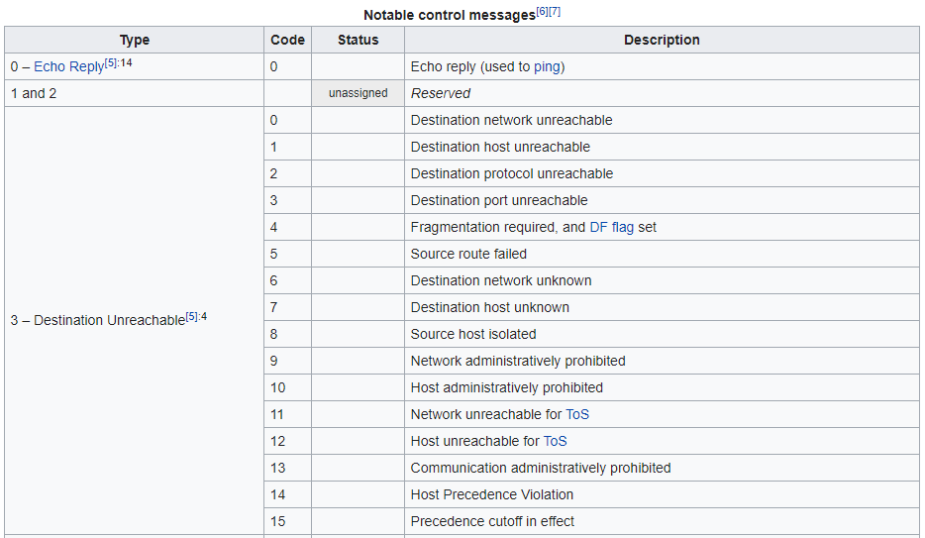
ICMP Message Type & Code

Slide 27
ICMP
Echo Request
For Ping
Often disabled due to Ping Flood
Ping flood = Send lots ICMP Echo requests to a machine without waiting for a reply.
Principle of least privilege: No reason to answer ping (most people cannot stop the attacks so no use)

Slide 28
ICMP … continued
45c0 005c e857 0000 3f01 5a93 aa81 3534
5804 003d 0303 4a7d 0000 0000 4500 002c
79a4 0000 1c06 329d 5804 003d c08a d9bf
4374 0017 7025 c3d1 0000 0000 6002 00a4
32d7 0000 0204 0052 3220 7309 0000 0000
0000 0000 0000 0000
4500 0046 e858 0000 3f01 a2f1 ab31 1248
3f58 d40b 0000 0035 0032 2dc1 ba39 0000
0001 0000 0000 0000 0673 7461 7473 650d
7765 6274 7265 6e64 736c 6976 6503 636f
6d00 0001 0001
4500 055e 0cc7 0000 f601 a7e1 cca2 60d7
da21 4218 1200 f428 bfd6 f97d 011d 15cf
2032 3030 204f 4b0d 0a4d 494d 452d 5665
7273 696f 6e3a 2031 2e30 0d0a 4461 7465
3a20 4d6f 6e2c 2030 3420 4465 6320 3230
3030 2030 373a 3531 3a31 3120 474d
Packet #1
Packet #2
Packet #3
Notes:
Packet #1
Why is this message being sent ? Type 3 — Destination Unreachable Code 3 – Port Unreachable
Is this packet being sent by a host or client ? HELP
Packet #2
What is the purpose of this packet ? Echo reply
What protocol is this packet ? ICMP
How do you know ? 01 is the code
Packet #3
What is the purpose of this packet ? Type 1 and 2 (reserved) (CHECK)
Is it a stimulus or response ? HELP
How do you know ?

Slide 29
ARP
Address Resolution Protocol
Map network layer address (IP address) to Physical layer address (MAC address)
Broadcast message on network layer Who has address 192.168.1.1?
No security/protocol, and all packets will go to the computers that claim “I am this”, be careful what you’re doing when you connect to public networks b/c it’s easy for someone to be there in the connection
Computer will say, this is my address and this is the physical address

Slide 30
DHCP
Dynamic Host Configuration Protocol
Provide unused IP address to computer joining a network.
IP addresses can be static, in which case the IP address is fixed in your computer and at the switch.
Or IP addresses can be dynamic. DHCP is used for dynamic IP addresses.
Assign IP address

Slide 31
DNS
Associate URL with IP address.
Queries asking for IP address for given URL
DNS is implemented by series of servers.
Attackers can disguise as your DNS (doesn’t matter what you put, it’s easy as long as you’re in the same network)
Domain name server, provides IP addresses
It will send back the IP address if you request it and your computer can talk to for example rowan.edu; if you need to change the IP, you can just change it in one place and it’ll change it for all

