Slide 1
Lecture 7: Malicious Attacks and Vulnerabilities CS 07351: Cyber Security: Fundamentals, Principles and Applications Dr. Vahid Heydari

Slide 2
Copyright Note
All slides used in this class are provided by Jones & Bartlett Learning (Fundamentals of Information Systems Security, Third Edition, by David Kim and Michael G. Solomon, 2018)
Note: The slides are modified by the instructor.

Slide 3
Learning Objective(s)
Describe how malicious attacks, threats, and vulnerabilities impact an IT infrastructure.

Slide 4
Key Concepts
Malicious software and countermeasures
Common attacks and countermeasures

Slide 5
Malicious Activity on the Rise
Examples of the malicious attacks are everywhere
Data breaches occur in both public and private sectors
In 2013, China was top country of origin for cyberattacks, at 41 percent
United States was second at 10 percent
Doesn’t mean the people of that country are the ones initiating that attack, they can use IP addresses in another country
Notes:
Yahoo Hack – 500 million - 2014
Marriot – 500 million - 2018
Equifax – 145 million – 2018
Linkedin – 100 million – 2012

Slide 6
What Are You Trying to Protect?
Notes:
Customer Data – name, address, phone #, SSN, DOB, healthcare info --
IT and Network Infrastructure – Hardware, software, other devices (ransomware, crypto locker and armored viruses, polymorphic malware)
IP – Patents, source code, formulas etc – competitive advantage
Drug company – a vs b stealing their data
Financial Data – bank accounts, credit card data, financial transaction data, loss due to attacks is a worst-case scenario. Loss of trust. Credit cards are good – abstraction
22% of cyber attacks in the united states were in the banking sector
Service availability -- ability of computing software and services to support productivity – downtime is loss of money – causes productivity loss and loss of money and time
Recently, Amazon, Reddit, Spotify and Twitter and Netflix, attacked by a botnet
Reputation – Corporate compliance and brand image

Slide 7
Customer Data
Name, address, phone, SSN, DOB, credit card data etc.
Could be used to impersonate an individual – identity theft
Notes:
Everything is vulnerable

Slide 8
IT and Network Infrastructure
Hardware – servers, workstations, switches, routers
Software
Notes:
Ransomware – locks everything up and forces people to pay money to unlock the files
Hardware and Software intrusion can affect operability in the organization and cause theft of critical data

Slide 9
Intellectual Property
Asset of an organization
Patents, drug formulas, scientific formulas, recipes, engineering plans etc.
Sets the business apart from it’s competitors
Theft or loss of IP causes financial and brand damage to the organization
Notes:
Company A spends 2 Billion on R&D on a new drug
Company B got Company A’s research and rushed
Samsung vs Haewai Foldable Phone

Slide 10
Finances and Financial Data
Highest-profile assets
Bank accounts, credit cards, debit cards, direct sources of money etc.
Worst case scenario if stolen
Significant physical loss and long-term brand image problems

Slide 11
Service Availability and Productivity
Important for services to be available for use
Downtime can cause loss of profit and productivity

Slide 12
Reputation
Reputation is critical because it retains customers and brings in new ones
Reputation, once lost, is extremely hard to build up
Notes:
Do you want to do business with a organization that looses your data?

Slide 13
Whom Are You Trying to Catch?
Hackers
Black-hat
White-hat
Gray-hat
“hey I’m here” vs “I do bad things”
Crackers
Hackers aren’t that bad guys, it’s really crackers
Notes:
Black-hat hacker: Tries to break IT security and gain access to systems with no authorization in order to prove technical prowess. Black-hat hackers generally develop and use special software tools to exploit vulnerabilities. May exploit holes in systems but generally do not attempt to disclose vulnerabilities they find to the administrators of those systems.
White-hat hacker: Also called an ethical hacker, is an information systems security professional who has authorization to identify vulnerabilities and perform penetration testing. Difference between white-hat hackers and black-hat hackers is that white-hat hackers will identify weaknesses for the purpose of fixing them, and black-hat hackers find weaknesses just for the fun of it or to exploit them.
Gray-hat hackers: A hacker who will identify but not exploit discovered vulnerabilities, yet may still expect a reward for not disclosing the vulnerability openly.
Cracker: Has a hostile intent, possesses sophisticated skills, and may be interested in financial gain. Crackers represent the greatest threat to networks and information resources.
Script Kiddie – A person with little to no skill who wants to be a hacker. They use premade tools and procedures – like a cookbook – to approach and carry out cyber attacks without fully understanding what’s going on

Slide 14
Attack Tools
Notes:
Protocol Analyzers – Wireshark
Port Scanners – Nmap, Zenmap
OS Fingerprint Scanners – Nmap, Zenmap
Exploit Software – Metasploit
Wardialers – Computer programs which dials telephone numbers looking for a computer on the other end. Less common now days due to VoIP, and IP telephony
Password crackers – programs which crack passwords by either brute force or password attack. Used to recover forgotten or unknown passwords
Brute Force Attacks – Try everything under the sun
Password attack – Try the common ones first

Slide 15
Protocol Analyzers
Referred to as “sniffers”
Sniff network traffic
Ex: Wireshark
Packet analysis & extract info (you); if you’re connected to the same wifi router, others can see your packets
Notes:
Promiscuous mode – makes a copy of the network packets, dissects them and displays them (tell the network “I’m interested in what you see”)
Unencrypted protocol, you see everything (or like which websites)

Slide 16
Port Scanners
Tool used to scan hosts for open ports
Provides attackers with which services are enabled on the host
Ex: Nmap, Zenmap (better Nmap)
Makes attackers target the open ports
Can grab banner information
Sending one synced packet to SSH service, packet will say “hello I’m ssh2.5.4-Ubuntu” (which provides info for attackers just by 1 packet), which is what we don’t need it at all but we have it on different services
Notes:
HTTP – Port 80
FTP – Port 21
SSH – Port 22
Telnet – Port 23

Slide 17
OS Fingerprint Scanners
Allows attackers to classify what type of OS a host uses by evaluating the responses from sending different IP packets to hosts
Ex: Nmap, Zenmap (better Nmap)
Can send fake packets (turn on SYN and FIN packets)
Famous port could be a specific Windows one so the attacker can tell. Then using the banner, the target is running SSH and version, what’s the next step in the example? Google ssh 5.4 and there’s a specific exploit for it out there so some attacks are so easy

Slide 18
Vulnerability Scanners
Used to identify different software vulnerabilities on target host machines
Common Vulnerabilities & Exposure (CVE) – database of vulnerabilities for public knowledge – www.cve.mitre.org
Ex: Aircrack, Microsoft Baseline Security Analyzer (MBSA), Nessus Professional(very good) etc.
Free version to scan for all vulnerabilities
Test all devices, shut down your computer or whatever to close ports

Slide 19
Exploit Software
Firewalls, ?? Detection, some yellow flag
Incorporates known software vulnerabilities, data, and scripted commands to exploit vulnerabilities in a target host device
Used for many attacks
Ex: Metasploit, Burp Suite (Web Application Security), Armitage, THC-Hydra (Password & Protocol cracking), Aircrack-ng (Wi-Fi PenTesting)
Access to biggest exploit database (Metasploit); notice that most recent versions don’t have exploits made for them yet but in most cases, you’re gonna find something in these. Also see how we didn’t even have to write a single line of code in these things so far
Notes:
Attacks used for: Dos, brute force password, buffer overflow, unauthorized access and others

Slide 20
Wardialers
Computer program that dials telephone numbers, looking for a computer on the other end
Not used too much now days because of IP Telephony, VoIP etc.

Slide 21
Password Crackers
Used to uncover forgotten or unknown passwords
Brute Force – Try all combos – takes a long time but 100% effective
Dictionary Password Attack – Try the most common passwords

Slide 22
Keystroke Loggers
Spyware – surveillance software or hardware
Logs keystrokes
Used to harvest credentials
Easy to write a program to do that, lots of online tools available; silently capture whatever on your keyboard for example

Slide 23
What Is a Security Breach?
Any event that results in a violation of any of the C-I-A security tenets
Some security breaches disrupt system services on purpose
Some are accidental and may result from hardware or software failures
Confidentiality, integrity, vulnerability for example
Notes:
Humans are a big factor in these kinds of security breaches because they are the weakest link

Slide 24
Activities that Cause Security Breaches
Denial of service (DoS) attacks
Distributed denial of service (DDoS) attacks
Unacceptable web-browsing behavior
Wiretapping
Use of a backdoor to access resources
Accidental data modifications

Slide 25
Denial of Service Attack
A coordinated attempt to deny service by occupying a computer to perform large amounts of unnecessary tasks
Logic attacks
Flooding attacks
Protect using
Intrusion prevention system (IPS)
Intrusion detection system (IDS)
Attacks launched using
SYN flood
Smurfing
Ex. Flaw in webserver code: able to send packet and use that flaw, server is down (logic attack)
Ex. Sending several packets (flooding attack)
→ Your responsibility to fix it when they tell you
Notes:
DoS – Affects the availability of the C-I-A. Coordinated attack to deny service by occupying a computer to perform large amounts of unnecessary tasks.
Logic attacks – Use software flaws to crash or hinder the performance of remote servers.
Buffer Overflow -- inv
Flooding attack – Overwhelm the victims computer’s CPU, memory, or network resources by sending a ton of requests
IPS is a control system – can detect and do something about it
IDS is a monitoring tool – monitors network traffic, compares it to known cyber attack signatures and warns the network admin about it

Slide 26
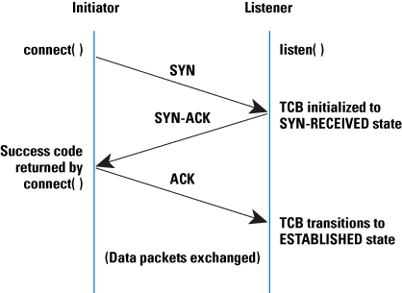
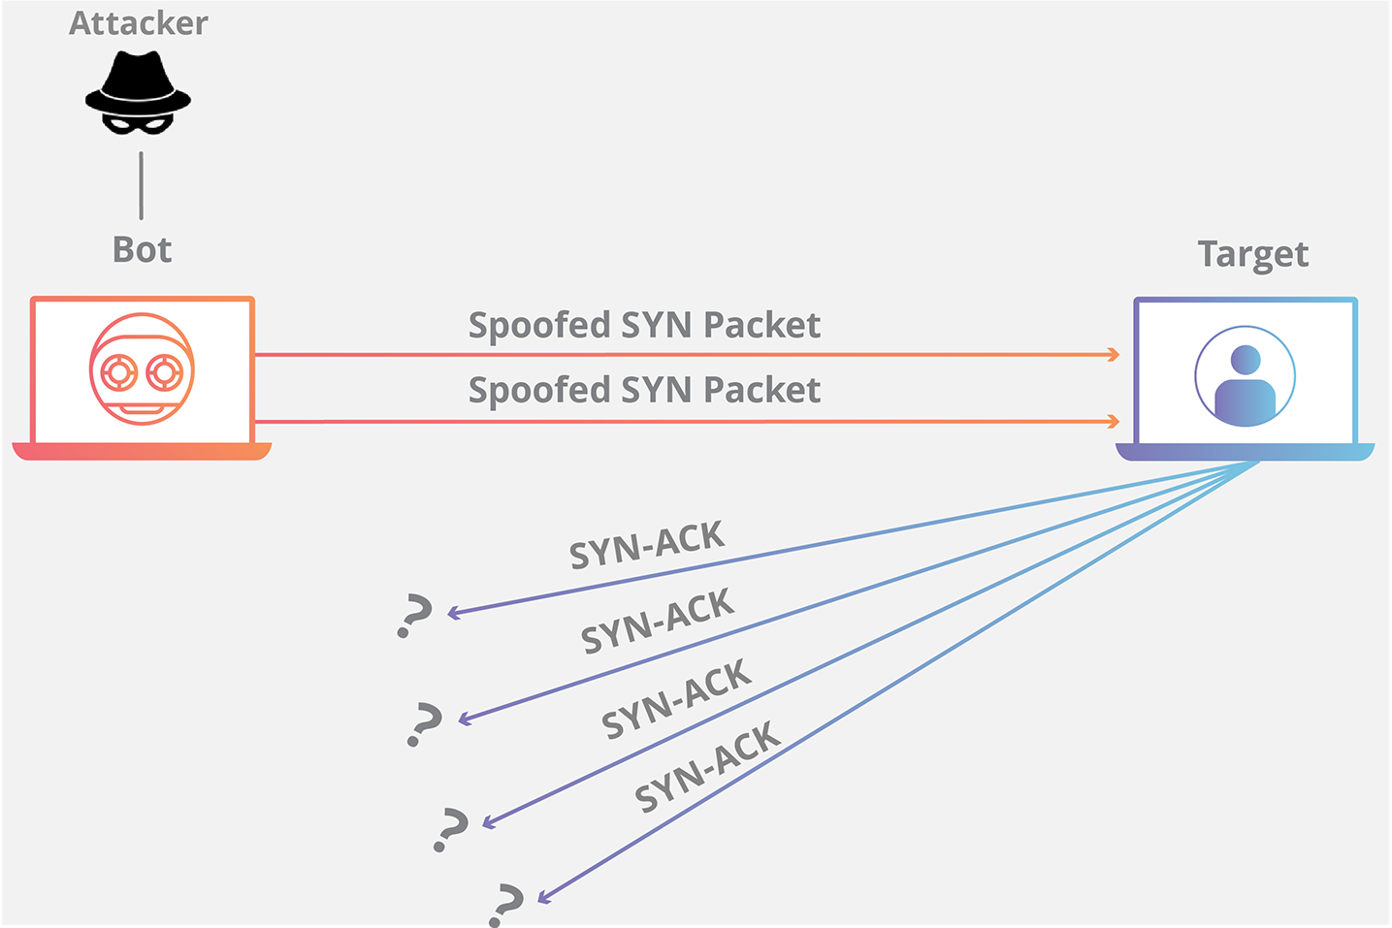
SYN Flood Attack (DDoS version)
Source is random, destination is target
Attackers send SYN packets with fake source IPs, server think 1mil users want to use it, keeps answering SYN-ACKs to all the randoms (not easy to find attacker because of fake IPs); innocent users receive these without knowing
Notes:
DOS – single attacker talks to the server
DDOS – Multiple machines (botnet, IOT), or spoofed packets with different IP addresses. Very hard to trace

Slide 27
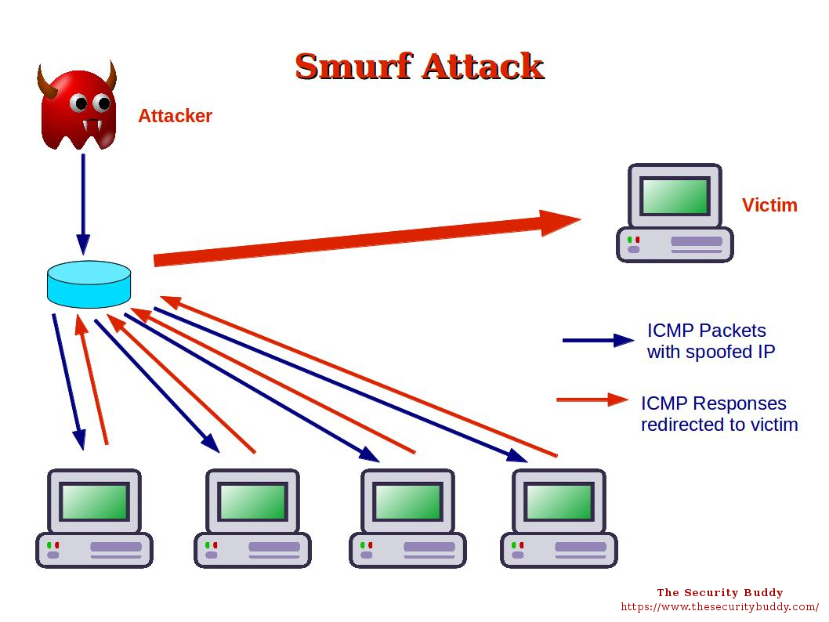
Smurf Attack (DDoS version)
Attacker sends ping packets (source IP: IP of the target), destination is random, cannot easily detect who the attacker is
Notes:
A Smurf Attack is a DDoS attack where a large number of ICMP packets are sent to a computer network (via the broadcast address – all devices receive the data). The computers on the network by default send the reply packets back to the source IP address (which is the spoofed IP address)
DDOS – strength in numbers – hundreds of thousands of requests at a time vs. DOS’s single or double machines. More difficult to stop – originating from different sources
Mirai botnet

Slide 28
Unacceptable Web Browsing
Define acceptable web browsing in an acceptable use policy (AUP)
Unacceptable use can include:
Unauthorized users searching files or storage directories
Users visiting prohibited websites
For example, not allowed to use BitTorrent
Notes:
Phishing campaigns – to see if employees are actually doing their job

Slide 29
Wiretapping
Ex. Promiscious mode enabled and installed wireshark and captured data packet. Passive since you didn’t do anything.
Ex. Captured data packet and I modified, dropped, added packets. Active since you did something.
Active
Between-the-lines wiretapping
Piggyback-entry wiretapping
Passive
Also called sniffing
Just listening to the contents without changing them
Modify, insert, disrupt packets
Notes:
Between-the-lines wiretapping: This type of wiretapping does not alter the messages sent by the legitimate user but inserts additional messages into the communication line when the legitimate user pauses.
Piggyback-entry wiretapping: This type of wiretapping intercepts and modifies the original message by breaking the communications line and routing the message
to another computer that acts as a host.

Slide 30
Backdoors
Hidden access included by developers
Attackers can use them to gain access
Data Modifications
Ex. nc IP Port# and you’ll connect there
→ Create backdoor so next time easier access
Data that is:
Purposely or accidentally modified
Truncated
Ex. nc –L –p2345 –e/bin/bash → creates backdoor on server,
whoever contact you provide
terminal??? Easy tho
-L → keep the backdoor open forever
netcat
Notes:
Example: nc -l -p 6996 -e /bin/bash – netcat utility – set up a listener on port number 6996, and execute the shell whenever someone connects to it
nc ipofserver 6996 → user uses this to connect to the backdoor on the ip address of the server and the port number
Rootkits – RKs are the worst because they are hard to detect. They go all the way down to the kernel level and control the OS. Typically include backdoors
Data Modifications – Impact the integrity of the C-I-A. Best way to avoid data modifications is the validate the data. C sucks at it – overwrite memory without checking. Also, prone to SQL injection attacks if not validated

Slide 31
Additional Security Threats
Spam
Hoaxes
Cookies
Ex. Automatic login
Capturing all cookies of your targets can give you access to usernames and passwords and keys
Notes:
Spam mail – Unwanted mail. Annoying as hell and it never stops. Phishing is a type of email which is fake and designed to trick the recipient into clicking on an embedded URL link or opening up email attachments
Hoaxes – Often emails contain fake warnings about devastating new viruses. Might ask you to sign up for a service to protect yourself
Cookies – Text files with user history from a website visit. Usually contains info about the user – name, CC #, etc
They store sensitive information in cleartext on the user’s hard drive
Can compromise privacy and security

