Slide 1
Lecture 8: Dyn DDOS Attack & Port Scan Attacks CS 07351: Cyber Security: Fundamentals, Principles and Applications Dr. Vahid Heydari

Slide 2
Content
What is the Dyn attack?
What is DNS?
What is IoT?

Slide 3
What is DNS?
Domain Name System (DNS)
Query: What is IP for URL (www.google.com, www.rowan.edu, www.help.com, etc.)
Response: IP associated with the URL
Internet critical infrastructure
Without it cannot use URLs.
Vulnerable to poisoning, DDOS attacks

Slide 4
What is Dyn?
What is Dyn?
Dyn.com
DNS Infrastructure provider.
Hired by companies to provide DNS service including monitoring, load balancing, geographic balancing, and security.
On Oct 21, 2016, Dyn was the victim of a large scale DDoS attack which slowed user access to many internet sites ( Twitter, Reddit, GitHub, Amazon.com, etc).

Slide 5
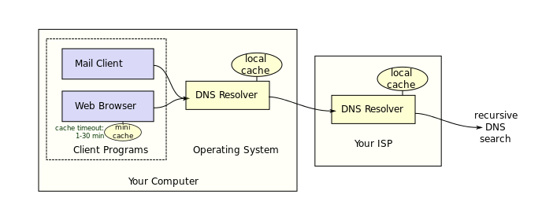
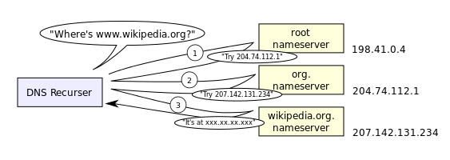
DNS Function
Caches are used to speed DNS resolution.
Time to live (TTL) field is used to keep cached records fresh.
Notes:
If IP address is not there, web browser will ask the OS
Attackers might poison caches (fake IP addresses) so it won’t ask the server at all?
Looking for Wikipedia…
DNS server asks root nameserver
Doesn’t know nameserver but does know .org and ask the .org name server since it should have it
It’ll search for that and then return it to DNS

Slide 6
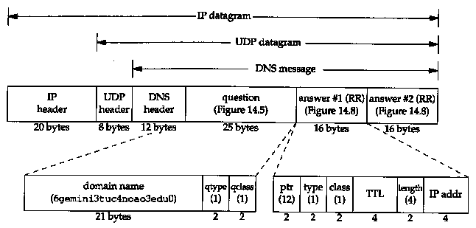
DNS Packet Format
Notes:
Not going into detail, but DNS uses UDP
Question ex. Is this Wikipedia?
There can be one or more answers (possibility of 1+ IP address to one server cuz servers use mirrors)
Which is why we can use the internet despite multiple DDOS attacks a day

Slide 7
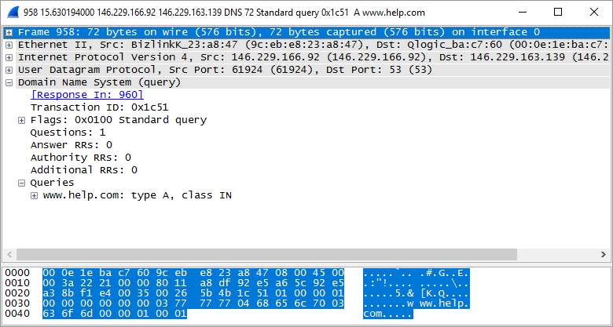
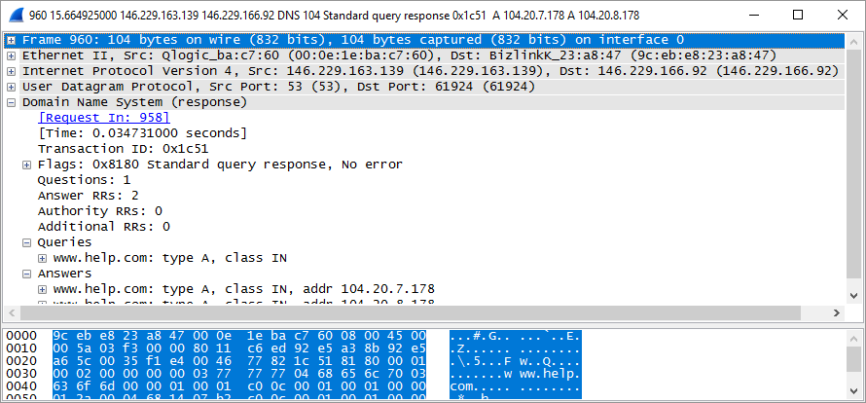
Notes:
Wireshark mirrors of the same server
Lots of IP addresses they can overwhelm

Slide 8
DNS Spoofing
Poison DNS server cache
Cause incorrect IP address to be returned for query.
Route traffic to incorrect IP.
Hackers can put up fake pages, steal customers, etc.
Notes:
Inside, you can say “rowan.edu” 1 2 3 4
If you add this to your host file, your computer isn’t going to ask the DNS server at all for the rowan IP address since you manually added it
Every time you type in rowan.edu and press enter, you’ll send packet??? (missed this part)
An app will create some way to poison your DNS and add something like this
If you put this one in the file and copy the face of rowan.edu, you can poison something and you can go to that fake website when you type in rowan.edu
There are easy way to bypass multi authentication, read text messages of someone else, etc.
It’s a little harder since the hacker must log on the same time as you (on these authentications)
This kind of poisoning does work tho
Not just for attackers, but governments

Slide 9
Notes:
Seen in Iran, blocked sites in Iran example
Poisoning the DNS and send the IP of this page when you want to visit facebook for example
Used for censorship

Slide 10
Dyn Traffic Director
Move traffic based on Geolocation
Geo locate requesting IP address
Respond with DNS result in same part of globe
Minimize latency
Move traffic to nearby geolocation if current location is too busy
Dyn has 18 geographic locations to improve DNS response time.
Notes:
Always have a lot of mirrors on the server to prevent DDOS attacks
If one server is busy, switch to another
We don’t want to transfer data to different locations, so mirrors are everywhere in different countries so they don’t get mixed up
Will look at which server is suitable for the location → fast connection, move to nearby if too busy
18 mirrors of their DNS server to provide services on the internet since it’s critical service

Slide 11
Dyn DDOS
Flood of queries from 10’s of millions of different IP addresses against Dyn DNS servers in all 18 regions.
3 waves of attacks
How to mitigate?
Very fast packet filters, monitor, detect, and drop DDOS packets.
With enough devices can always overwhelm packet filters.
Redundant architecture
move traffic to a different system, region
Notes:
No way to mitigate DDOS when they’re overwhelming you, no one can come in
Some cases, we can talk to router that transferring the packet and stop that, but also stopping good users as well
Best solution is redundant architecture (the mirrors) but attackers can overwhelm all mirrors
They don’t have 10s of millions of devices, but any device on the internet can be used to attack

Slide 12


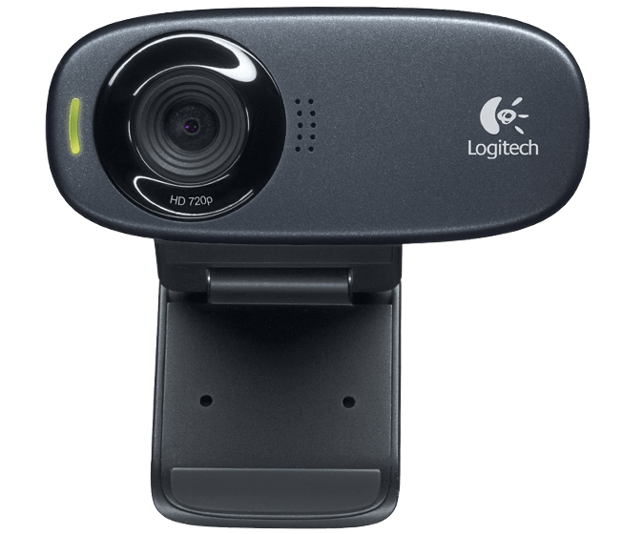
What is IoT?
Year | # of IoT Devices
2016 | 6.4B
2020 | 20.8B
Internet of Things
All those other things connected to the internet?
Notes:
Cameras, smartdevices, speakers, headphones, thermostats. All of these use IP addresses
These are reproduceable and cheap. There’s not even a team to program these cheap things, so there’s no concern for their security (too expensive for patches)
Devices like these don’t have much security, and we’re trusting these devices to bring them home and connect to the internet (not safe)
If something is connected to the internet, attackers can attack it, no way to 100% secure these devices
Some routers automatically connect port thing??? that can allow others to breach your cameras, etc.
A trojan could be hidden in an app, a kid could install it, and that can give access to everything else on the IoT
(“I’m now your soldier, waiting for your orders” and it’s infected)

Slide 13
Why IoT?
IoT devices are internet facing.
Operate as web servers on your LAN.
May open other ports.
Answer your queries from anywhere on the web.
Will also answer anyone else's.
There are lots of IoT.
Fast network (fast enough to transport video).
Many setup with default passwords.
Easy to find, fingerprint, and Pwn.
Notes:
Pwn: totally defeat or dominate

Slide 14
Mirai Botnet
Scans the Internet for IoT devices with
factory default passwords or
hardcoded user names and passwords
Yes. In many cases, IoT users cannot change security credentials even if they want to.
Vulnerable devices seeded with malicious software
Command and control
DDOS
Bashlight is another IoT Botnet
Notes:
1. Attackers can give orders to start DDOS attacking. It doesn’t matter if you have access to big $20k server or a $50 thing, they have access to the same network and can generate the same amount of traffic. It’s not secure but has exact same access.

Slide 15
Why DDoS? Who cares?
Companies who provide service via the internet can loose money from DDOS.
Some speculation this was a warm up/trial to disrupt US elections?
Internet voting: 32 states offer internet voting

Slide 16
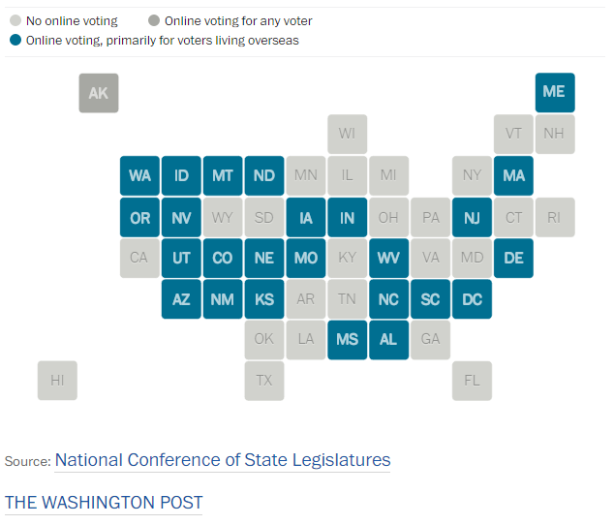
Online voting
Alaska: all voters can submit absentee ballots from home.
Missouri: electronic ballots for soldiers in “hostile zone”
North Dakota: overseas citizens can vote online.
DC and 20 states: submit ballots via email or fax.

Slide 17
Swing States
2016 election closest states:
Michigan 0.3 percent
New Hampshire 0.4 percent
Wisconsin 1 percent
If you delay/disrupt internet voting and our ballot requests from overseas citizens of these states, can you alter the election outcome?

Slide 18
Port Scan Attacks
Notes:
More detail of nmap, portscanning
Cybersecurity software idea: Train machine learning product to prevent attacks where it would check for open ports and flag them so they can be closed.
Cybersecurity is easier to create money, it’s started more recently rather than other older subjects like physics where you have to learn absolutely everything

Slide 19
Port Scanning
Port Scans are used by hackers and network administrators alike to search for network ports which have an active server process running waiting for connections.
Hackers use port scans to search for victims.
System administrators use port scans to find open ports (and close them) before hackers do.
Notes:
Ex. Government, since mirai, there’s some part of the government that tries to scan of everyone in the US and find vulnerabilities before attackers
In some cases, they may hack “for good reason” (IP addresses of US citizens just to close them so bad guys cannot find them)
Very controversial, but it works since many citizens don’t have knowledge on cybersecurity and the vulnerabilities they have

Slide 20
NMAP
NMAP (network map) is a tool which can execute many types of port scans. It is capable of finding open ports and even reporting specific details about the port such as host operating system, port server version number, etc.
The developers of NMAP offer an overview of various port scan methods at http://nmap.org/nmap_doc.html

Slide 21
Scan Types
Connect Scan
Half open scan
Fin Scan
Null Scan
xmas Scan
UDP Scan
ICMP Echo
Notes:
Why do we have different types? They’re doing the same thing, looking for open TCP ports. But, there are different kinds because cat and mouse game depending on defenses? of the server.

Slide 22
Connect Scan
TCP establishes a connection before transmitting data. The connect scan attempts to establish TCP connections with many IP addresses.
Example: scan all addresses 192.168.1.* to find all open TCP ports on home network.
NMAP -> connect 192.168.1.1 port 1
NMAP -> connect 192.168.1.1 port 2
NMAP -> connect 192.168.1.1 port 3
NMAP -> connect 192.168.1.1 port 4
…
NMAP -> connect 192.168.1.2 port 1
NMAP -> connect 192.168.1.2 port 2
NMAP -> connect 192.168.1.2 port 3
NMAP -> connect 192.168.1.2 port 4
…
Typically NMAP will walk through all the IP addresses and ports you specify. You can specify as few as 1 port or as many as all 65K. You can specify as few as 1 IP address or as many as all 4B.
If the connection is successful NMAP would note that IP address/port pair as open.
The signature of a connect scan is many TCP connection requests in a short period of time.
IDS in a router or gateway device can easily detect connect scans and not allow them through.
Attackers can space out connection requests, send requests from many IP address sources(botnet) to avoid detection.
Notes:
Feed in range of IP addresses and range of ports. There are 65k ports. If looking at server, it’s 1k to 2k.

Slide 23
TCP Connect
TCP uses a 3 step hand shake to open a connection.
SYN, SYN-ACK, ACK indicate TCP packets with these flags set.
Detection of a connection handshake is not indicative of a port scan. This happens for normal traffic all the time.
Client | Server
SYN ->
 | <- SYN-ACK
ACK ->
Connection open
Notes:
Sends FIN to finish the connection.
If the port is closed and you send a SYN, you’re going to receive RST flag

Slide 24
Closed port
A closed port on a valid IP address responds as follows:
Client | Server
SYN ->
 | <- RST

Slide 25
Half Open Scan or Stealth Scan
In this scan the client starts opening the port, but does not complete the request. This attack is a response to detection tools developed to detect the connect scan.
Client | Server
SYN ->
 | <- SYN-ACK
RST ->
Connection open
Notes:
Instead of setting ACK, sending RST (since we know SYN-ACK is sent, the port is open)
We don’t want to send ACK back so that the connection isn’t established (which can risk detection)

Slide 26
FIN Scan
The FIN scan closes ports instead of opening them!
If a port is closed.
If the port is open or a Microsoft box…
Client | Server
FIN ->
 | <- RST
Client | Server
FIN ->
 | Nothing happens
Notes:
Let’s ignore sending SYN packets. How about sending FIN packet to all ports?
You’ll get nothing since you haven’t established a connection with the port (if the port is open)
Haven’t used SYN flags (prevent detection)
On the good side countermeasure: if there’s a FIN packet that we haven’t seen SYN for that connection, this is a port scan.

Slide 27
NULL Scan
The scanner send a TCP packet with no flags set.
A closed port responds with a RST.
An open port does not respond.
Notes:
Don’t use SYN, FIN, nothing
Could bypass detection systems but the patch is “if someone is sending SYN or FIN or packets w/o flags to different ports, we can block them”

Slide 28
Xmas Scan
Christmas tree packets!
The Xmas scan sends a TCP packet with the FIN, URG, & PUSH flags set.
A closed port responds with a RST.
An open port does not respond.
Notes:
Just try everything (don’t use SYN or FIN so there’s no detections)
Can play with speed of port scanning on nmap b/c speed could be considered normal traffic
If you go slower sometimes, you might not be detected
Detection: “if it’s going slow and/or a lot of packets to different ports from one unique source IP address, block that IP”
Bypass → use multiple IP addresses. IP header there’s a unique IP id number.
Send random ping packet and write down the IP in the response
During the time, you can see if someone’s not talking to any device
So an attacker can use that device to avoid detection and use that IP as the source on the packet
But first, before doing that, send ping to the thing and receive something back
Send packet to TCP port with the IP address from the packet
If it was closed, respond with RST
If that source IP receives the RST, it will try to communicate since it’s weird that there’s no previous connection
Like this, there’s no trace if the port is open
Some OS use random numbers in IP identification to prevent this

Slide 29
ICMP Echo
You can ping every IP address and see which IP addresses respond!
Most system administrators disable ping!
Notes:
Not relate to TCP port.
Just want to see if it’s on (sending ping packet)

Slide 30
UDP Scan
You can attempt to communicate with UDP ports to learn if they are open as well.
If you send a message to a UDP port which is closed it may respond with a ICMP_PORT_UNREACH error message.
If it is open it will not respond.
NMAP sends packets with no data so there definitely will not be a response from open ports.
Notes:
Nmap just sends one UDP packet to the port, it’s empty. If the port’s open, we won’t get anything b/c data part of UDP was empty. If the port is closed, UDP protocol will say nothing but in the network later, ICMP will send you a packet “port unreachable” and we can figure it out that way.
GUI on windows for nmap (which can mean that people besides cybersecurity-centered people can use it, and you can learn to port scan your things themselves). If you type “my ip” in google, you’ll get your public ip. You can scan on that IP from home and here. You should see nothing (if you see something, figure it out and try to close that part).
The admin GUI of the router, there’s a setting to make it accessible to the Internet. You can remotely connect to admin port of home router to solve the issue but it’s a big risk since your admin port could have access to the internet, and never trust any user/pass login pages or NFAs or authentication. If you have a port open to the internet, you’ll be immediately targeted by attackers. Attackers scanning for devices, as soon as they find it, they’ll take that opportunity.
No reason your browser should answer ping. Back out, it’s home, not server. Like someone knocking on your door, you’re not going to answer. We should not expect anyone to knock on the door. You can disable answering pings which can solve lots of problem (most attackers send first ping to see open ports and then they’ll go attack).

