Slide 1
Lecture 9: Cryptography CS 07351: Cyber Security: Fundamentals, Principles and Applications Dr. Vahid Heydari

Slide 2
What is Cryptography?
Cryptography means “secret writing”
Encryption means to alter using a secret code so as to be unintelligible to unauthorized parties
Plaintext is a message in its original form
Ciphertext is a message in its encrypted form
Decryption is the activity of converting from ciphertext to plaintext

Slide 3
Why is Cryptography Important?
Cryptography helps solve a lot of security issues
Cryptography is an essential component of:
Ecommerce
Confidential communications
Strong authentication over untrusted networks
Defense in depth
The Black Hats are using it
Everyone working in security should understand cryptography

Slide 4
Pitfalls with Cryptography
Security by Obscurity
Beware of over-confidence
Simplicity is a “good thing”

Slide 5
Goals of Cryptography
Confidentiality
Secret writing
Authentication
If you can decode a message, you know the secret (possess a key). Possession of a secret key only provided to one person or system proves you are who you say you are.
Integrity of data
Data did not change
Non-repudiation
If I make you sign everything you do, then you can’t say you didn’t do something later.
Notes:
Cannot use hash for this because confidentiality isn’t used at all (unable to get the message back), though it’s part of this family

Slide 6
Arbitrary Substitution
Uses a one-to-one substitution of characters
For example:
A B C D E …
W Y Q Z R …
So BED becomes YRZ
Very easy to break using character frequency analysis
Notes:
Character frequency analysis – can see how often a certain letter occurs can make it easier to guess, comparing it with frequently used words

Slide 7
Rotation Substitution
Rotate the alphabet by N characters
Easy to remember: For example:
A B C D E …
D E F G H …
So CAB becomes FDE
Caesar cipher was “ROT-3”
ROT-13
Notes:
What is the significance of ROT-13?
Symmetric and used by USENET

Slide 8
Permutation
Uses the same characters, but changes the order
For example:
Change 1 2 3 4 5 to 3 1 5 2 4
So APPLE becomes PAEPL
Very easy to break
Hybrid would be to combine substitution and permutation
Notes:
Like a word scramble

Slide 9
Types of Cryptosystems
Secret Key
Symmetric
Single or 1-key encryption
Public Key
Asymmetric
Dual or 2-key encryption
Hash
One-way transformation
No key encryption
Notes:
Symmetric-key is:
Fast
Requires secure key distribution channel
No technical non-repudiation
Same key for locking and unlocking (encryption and decryption)
Examples: DES, Triple-DES, RC4, IDEA, AES
Asymmetric-key:
Slow
Private and public key; the only way to unlock is public key
Public keys distributed within digital certificates
Technical non-repudiation via digital signatures
Examples: RSA, El Gamal, ECC, SSL, PGP
Hash functions:
No key
Plaintext is not recoverable from ciphertext
Primary use is message/data integrity, NOT confidentiality
MD2, MD4, MD5, SHA (Secure Hash Algorithm)

Slide 10
Hash
One way function
C = H(P)
P ≠ H(C)
Mathematically infeasible to find P from C.
Uses
Generate keys (hash a pass phrase)
Hide passwords (without no way to get password from hash)
Confirm an input has not changed (eg. Source code) → integrity

Slide 11
Cryptographic Hash
it is easy to compute the hash value for any given message
it is infeasible to generate a message from its hash
it is infeasible to modify a message without changing the hash
it is infeasible to find two different messages with the same hash.

Slide 12
Hash
Collision attack
Find 2 hash input with the same hash
H(m1) = H(m2)
Should be mathematically difficult
It is possible
Notes:
Ex. If H(cat) = H(xyz) and the password is cat, if you type xyz, you can log in because the hashes are the same.
No-one should be able to easily find xyz that can create the same hash as cat. Impossible to create a hash that prevents this because the hash size is limited, so it’s always possible. But we need to make sure no one can find the mathematical way to generate the same hash.

Slide 13
Symmetric cipher
C = E (K, P)
P = D (K, C)
Where
E = encryption function
D = decryption function
C = cipher text
P = plain text
K = key

Slide 14
DES (symmetric)
Data Encryption Standard
64-bit block
56-bit key + 8 parity bits
Older
Insecure due to small block and key size => can be brute forced
Notes:
Nothing is wrong with the algorithm
2 groups started with new symmetric to stop security issues

Slide 15
Triple DES (symmetric)
Apply DES 3 times on each block.
Key bundle is 3 56-bit keys
ciphertext = E_{K3}(D_{K2}(E_{K1}(plaintext)))
plaintext = D_{K1}(E_{K2}(D_{K3}(ciphertext)))
Considered secure
K1, K2, K3 must not be the same.
Notes:
K1 = K2 = K3, then we have a standard DES
Encrypt with k1, decrypt that with k2, and encrypt that with k3.
To decrypt this, notice the first thing we do is the opposite of the last thing we did to get the ciphertext.

Slide 16
AES (symmetric)
Usage:
The AES algorithm was developed to replace DES
Considered secure
Vulnerabilities:
So far so good …
AES was made the new encryption standard on May 26, 2002
Notes:
Very strong because finding the key doesn’t matter
It’s open source, still vulnerabilities can’t be found ig?

Slide 17
Symmetric cipher Limitations
Alice wants to send a message to Bob. They have not had previous contact.
How can they share a symmetric key?
Assume Alice and Bob have a shared key. Now, Eve finds the key.
How can Alice and Bob update the key?
Cannot be used for origin authentication.
Notes:
How can we share the key?
Symmetric uses pre-shared key.
Attackers can find the key, but the key needs to be updated and shared again to prevent attacks.
Keys can be found out and used.
No way to know where messages come from since keys are known by you and the attacker, no way to tell the difference.

Slide 18
Asymmetric Cipher
The greatest and perhaps the only true revolution in the entire history of cryptography.
Rivest, Shamir, Adleman (1977)
Diffie-Hellman (1976), Ellis (1970), NSA …
Asymmetric: uses two keys – a public key and a private key
Based on mathematical functions rather than on substitution and permutation
Uses clever application of number theory
Notes:
No real idea who invented it.
No substitution and permutation at all, just based on prime numbers and math.

Slide 19
Asymmetric Cipher cont’d
Public-key/two-key/asymmetric cryptography involves the use of two keys:
A public-key, which may be known by anybody, and can be used to encrypt messages, and verify signatures
A private-key, known only to the recipient, used to decrypt messages, and sign (create) signatures
Is asymmetric because
Those who encrypt messages or verify signatures cannot decrypt messages or create signatures
Notes:
Ex. Our computers know public key of Google, Google knows its private key.
If we encrypt our message with private key, who can read that? Anyone, no confidentiality, but what is the application? They know that it’s you who wrote the message (authentication), because it comes from you and only you, no one else because only you have that private key (signature).
If confidentiality is needed, what key should be used to send from B to A? Public key of A

Slide 20
Asymmetric Cipher cont’d
Two functions encrypt (E), decrypt (D)
C = E(P, Pr)
P = D(C, Pu)
Or
C = E(P, Pu)
P = D(C, Pr)
Where
C = cipher text
P = plain text
Pu, Pr = Public, Private Keys respectively
Notes:
If you encrypt with private, you need public to decrypt. → Ensures authentication? (Ensures the message comes from you)
If you encrypt with public, you need private to decrypt. → Ensures confidentiality? (Ensures a message is only for you)

Slide 21
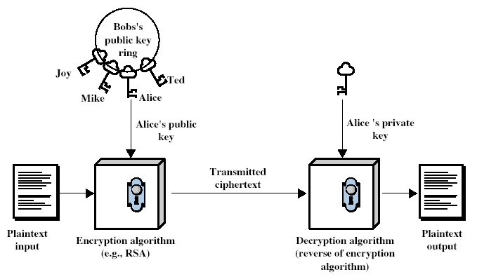
Asymmetric Cipher cont’d

Slide 22
Misconceptions
Public-key encryption is more secure than symmetric encryption (WRONG)
Depends on the length of the key and the computational work involved in breaking a cipher
Public-key encryption is a general-purpose technique that has made symmetric encryption obsolete (WRONG)
High computational overhead of current public-key encryption schemes. Suitable for Key management and signature applications.
NIST key length recommendation:
Date | Minimum security level (in bits) | Symmetric algorithm | RSA key size (in bits)
2016 - 2030 & beyond | 128 | AES-128 | 3,072
2016 - 2030 & beyond | 256 | AES-256 | 15,360
Notes:
(depends on key size and implementation)
Public key is so slow and symmetric is so fast compared to that. For the same security level, the key size is 128 for symmetric vs 3k+ for asymmetric.
Asymmetric gives good authentication and confidentiality.
When we want to start conversation w/o a shared key, we use asymmetric (or update the key/authentication), and switch back to symmetric
Hackers can get into your OS and attack because they would have access to keys there (admin access)

Slide 23
Public-Key Applications
Can classify uses into 3 categories:
Encryption/decryption (provide secrecy)
Digital signatures (provide authentication)
Key exchange (of session keys)
Some algorithms are suitable for all uses, others are specific to one.

Slide 24
RSA (asymmetric)
Asymmetric cipher
Usage:
Wide-spread support in major web clients
Came off patent protection in 2000
Vulnerabilities:
Cracking RSA generally means compromising poor implementations, or those using small key lengths
So far, there have been no public reports claiming to have compromised the RSA algorithm

Slide 25
Elliptic Curve Cryptosystem (ECC) (asymmetric)
Asymmetric encryption
Usage:
Where high speed, low power consumption, low storage requirements, and high security at small key lengths is critical, such as, in wireless communications, electronic cash, and ATMs
Vulnerabilities:
Cracking ECC generally means compromising poor implementations, or those using small key lengths
So far, there have been no public reports claiming to have compromised the ECC algorithm
Notes:
1985 – 2005
New but not popular yet (can provide everything in RSA like confidentiality and authentication, and it’s so much faster)
NOT based on number theory
Asymmetric problem: too much CPU and memory, takes a lot of time
This one is faster → less CPU, less memory

Slide 26
Public Key Distribution
1976 Whitfield Diffie and Martin Hellman
All principals generate a private key
From the private key, compute a public key
Exchange public keys
Compute a message key from public key and their own private key
Allows users to exchange a secure key over a non-secure channel
Notes:
Diffie Hellman
Cannot be used for confidentiality, but it’s for if you just want to share a key?

Slide 27
Pretty Good Privacy (PGP)
Public key cryptography (DH/DSS, RSA) to encrypt/sign email and files
Developed by Philip Zimmermann (1991)
Confidentiality: CAST, IDEA, Triple-DES
Integrity: MD5
Authentication: Knowledge of private key
Non-Repudiation: Digital signature
Notes:
packages

Slide 28
Secure Socket Layer (SSL)
Encryption at the TCP/IP transport layer
Used by more than just web browsers
Confidentiality: Triple-DES, RC4
Integrity: MD5, SHA-1
Authentication: RSA, Diffie-Hellman
Non-repudiation: Digital signature
Notes:
https://
Packaging these as protocols?
Many handshakes and deals behind starting SSH connections for example depending on what your machine? can handle

Slide 29
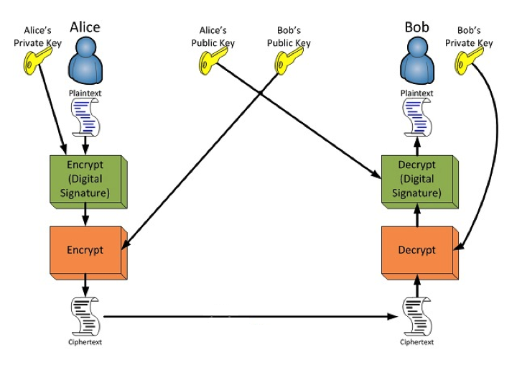
Confidentiality and Authentication using RSA
Notes:
Everyone can read Alice’s green, and then Alice encrypts that with Bob’s public key (confidentiality), two levels of encryption
What could go wrong? Alice encrypts with Bob’s public key first before her private key → attackers know Bob’s public key, so they can open the first one, which means they can change the lock (the “envelope” that uses the public key) with a new one
This is an example of poor implementation.

