Slide 1
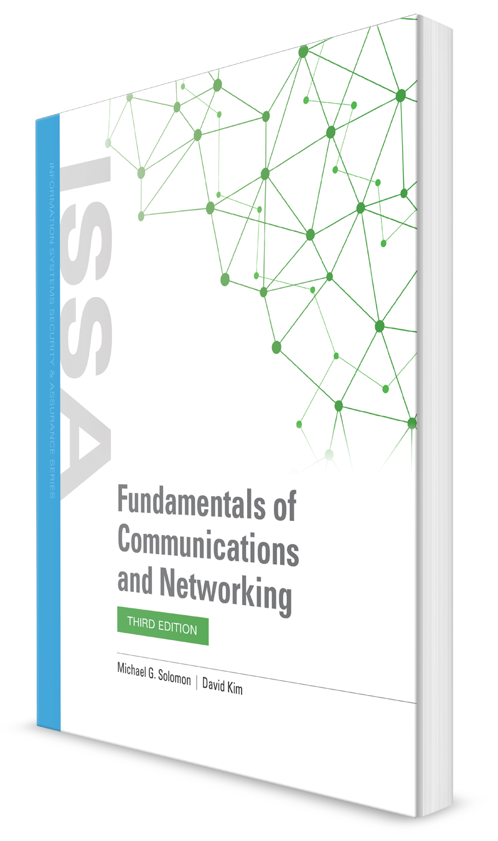
The Session, Presentation, and Application Layers
CHAPTER 6

Slide 2
Learning Objective(s) and Key Concepts
Learning Objective(s)
Key Concepts
Differentiate between the standards, specifications, technologies, and infrastructure that drive current LAN connectivity.
The Session, Presentation, and Application layers of the OSI model
How application architectures affect network traffic
Network ports and sockets
How the web defines the core of today’s online interactions
Network communications and their impact on security

Slide 3
Session Layer: OSI Layer 5 (1 of 2)
Modes of communication
Full duplex
Half duplex
Simplex
Notes:
Modes of communication
Full duplex—In the full-duplex mode, both ends of a connection can communicate simultaneously. Telephones use full-duplex communications.
Half duplex—In the half-duplex mode, both ends of a connection can communicate, but only one at a time. Two-way radios (where you have to push a button to talk) operate in half-duplex mode.
Simplex—In the simplex mode, the source can only send data to the destination. The destination cannot respond.

Slide 4
Session Layer: OSI Layer 5 (2 of 2)
Common Protocols that Explicitly Operate at OSI Layer 5
H.254
Layer 2 Tunneling Protocol (L2TP)
Network Basic Input/Output System (NetBIOS)
Remote Procedure Call (RPC)
Server Message Block (SMB)
SOCKS
Notes:
Common protocols that explicitly operate at OSI Layer 5 include:
H.254—H.254 is a call control protocol used in multimedia communication.
L2TP—A tunneling protocol that supports virtual private networks (VPNs). Layer 2 Tunneling Protocol (L2TP) operates like a Layer 2 protocol, but actually operates at Layer 5.
NetBIOS—Network Basic Input/Output System (NetBIOS) allows applications on different computers to communicate over a local area network (LAN) and share files.
RPC—Remote Procedure Call (RPC) is a protocol that supports a user or process on one computer running a program (or procedure) on a remote computer.
SMB—Server Message Block (SMB) is a protocol that allows remote and shared access to files, printers, and serial ports across a network.
SOCKS—A protocol that serves as a proxy server, sending and receiving network traffic using a well-known port (generally 1080), and then redirecting traffic to another port. The SOCKS protocol is often used to bypass ports a firewall blocks and has even been used to create a simple VPN.

Slide 5
Presentation Layer: OSI Layer 6 (1 of 2)
Provides the interface between the Application Layer and the Session Layer
On the sending computer, Presentation Layer is responsible for formatting and coding Application Layer data (i.e., high-level data that comes from applications) into a form that is acceptable for transmitting on the network
On the receiving computer, Presentation Layer translates data it receives from the Session Layer into a format that is acceptable to the Application Layer

Slide 6
Presentation Layer: OSI Layer 6 (2 of 2)
Common Protocols that Operate at the Presentation Layer
Internet Message Access Protocol (IMAP)
Secure Shell (SSH)
Secure Sockets Layer (SSL)
Transport Layer Security (TLS)
Notes:
Common protocols that operate at the Presentation Layer include:
IMAP—One of the most popular standards for retrieving email via an email client from an email server. Internet Message Access Protocol (IMAP) supports server-based email access from multiple clients by leaving email storage up to the server. (The older POP protocol downloaded email messages and put the burden of management on the client.)
SSH—A cryptographic protocol for interacting and executing network services over an unsecured network segment. Secure Shell (SSH) can provide a secure command line prompt on a remote computer as well as secure remote command execution.
SSL—Secure Sockets Layer (SSL) is a protocol that uses asymmetric cryptography (i.e., private/public encryption key pairs) to encrypt connections between network nodes.
TLS—The successor to SSL. The newer Transport Layer Security (TLS) versions are significantly more secure and fix many vulnerabilities present in SSL.

Slide 7
Internet Message Access Protocol (IMAP)
An Internet standard protocol used by email clients to retrieve email messages from a mail server over a TCP/IP connection.
IMAP was designed with the goal of permitting complete management of an email box by multiple email clients, therefore clients generally leave messages on the server until the user explicitly deletes them.
An IMAP server typically listens on port number 143.
IMAP over SSL/TLS (IMAPS) is assigned the port number 993
Virtually all modern e-mail clients and servers support IMAP, which along with the earlier POP3 (Post Office Protocol) are the two most prevalent standard protocols for email retrieval.
Many webmail service providers such as Gmail and Outlook.com also provide support for both IMAP and POP3.

Slide 8
Secure Sockets Layer (SSL)
SSL fundamentally works with the following concepts:
Asymmetric Cryptography
Symmetric Cryptography

Slide 9
Asymmetric Cryptography
Asymmetric cryptography (also known as Asymmetric Encryption or Public Key Cryptography) uses a mathematically-related key pair to encrypt and decrypt data.
In a key pair, one key is shared with anyone who is interested in a communication.
This is called Public Key.
The other key in the key pair is kept secret and is called Private Key.
Public and private keys are mathematical related and were created using cryptographic algorithms which are based on mathematical problems termed one-way functions.
These keys are used to encrypts or decrypts the data.

Slide 10
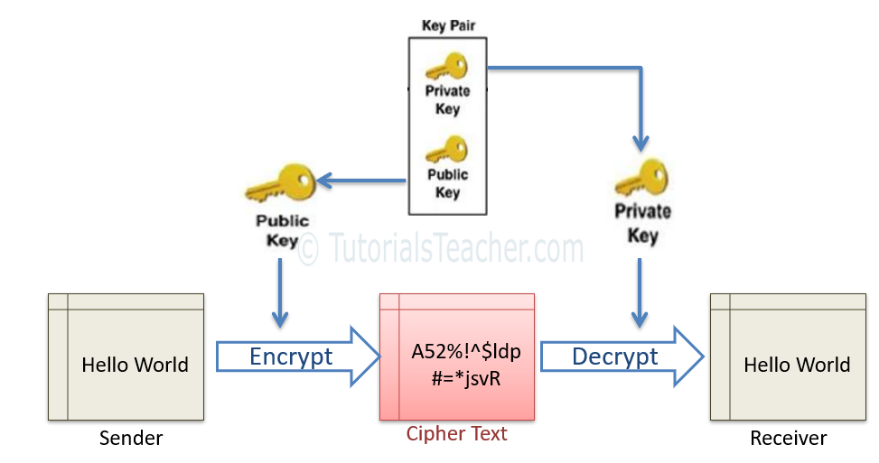
Asymmetric Cryptography
In the asymmetric cryptography, the sender encrypt data with the receiver's public key and send it to the receiver.
The receiver decrypts it using the related private key.

Slide 11
Asymmetric Cryptography
SSL uses asymmetric cryptography to initiate the communication which is known as SSL handshake.
Most commonly used asymmetric key encryption algorithms include EIGamal, RSA, DSA, Elliptic curve techniques and PKCS.

Slide 12
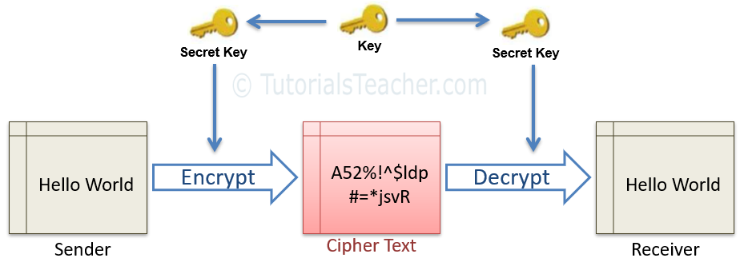
Symmetric Cryptography
In the symmetric cryptography, there is only one key which encrypts and decrypts the data.
Both sender and receiver should have this key, which is only known to them.

Slide 13
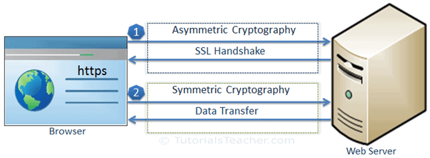
Data Transfer over SSL
SSL protocol uses asymmetric and symmetric cryptography to transfer data securely.

Slide 14
Data Transfer over SSL
SSL communication between the browser and the web server (or any other two systems) is mainly divided into two steps:
The SSL handshake and the actual data transfer.
SSL Handshake
The communication over SSL always begins with the SSL handshake.
The SSL handshake is an asymmetric cryptography which allows the browser to verify the web server, get the public key and establish a secure connection before the beginning of the actual data transfer.

Slide 15
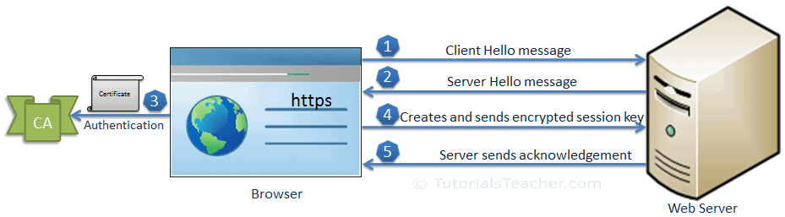

Slide 16
The client sends a "client hello" message.
This includes the client's SSL version number, cipher settings, session-specific data and other information that the server needs to communicate with the client using SSL.
The server responds with a "server hello" message.
This includes the server's SSL version number, cipher settings, session-specific data, an SSL certificate with a public key and other information that the client needs to communicate with the server over SSL.

Slide 17
The client verifies the server's SSL certificate from CA (Certificate Authority) and authenticates the server.
If the authentication fails, then the client refuses the SSL connection and throws an exception.
If the authentication succeeds, then proceed to step 4.
The client creates a session key, encrypts it with the server's public key and sends it to the server. If the server has requested client authentication (mostly in server-to-server communication), then the client sends his own certificate to the server.
The server decrypts the session key with its private key and sends the acknowledgement to the client encrypted with the session key.

Slide 18
Thus, at the end of the SSL handshake, both the client and the server have a valid session key which they will use to encrypt or decrypt actual data.
The public key and the private key will not be used any more after this.

Slide 19
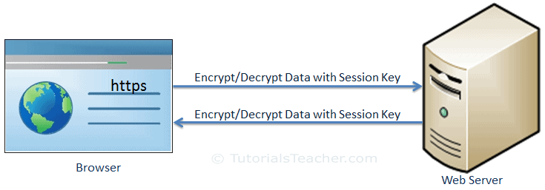
Actual Data Transfer
client and the server now use a shared session key to encrypt and decrypt actual data and transfer it.
This is done using the same session key at both ends and so, it is a symmetric cryptography.
The actual SSL data transfer uses symmetric cryptography because it is easy and takes less CPU consumption compared with the asymmetric cryptography.

Slide 20
Transport Layer Security (TLS)
TLS evolved from a previous encryption protocol called Secure Sockets Layer (SSL), which was developed by Netscape.
TLS version 1.0 actually began development as SSL version 3.1, but the name of the protocol was changed before publication in order to indicate that it was no longer associated with Netscape.
Because of this history, the terms TLS and SSL are sometimes used interchangeably.

Slide 21

Application Layer: OSI Layer 7 (1 of 2)
Is generally the only layer that interacts directly with the human being
Is where the front-end software interfaces with the computer user, often referred to as the user interface
The process to exchange a message with another computer generally starts with a Layer 7 software call
Serves as the primary interface for application software to interact with networks

Slide 22
Application Layer: OSI Layer 7 (2 of 2)
Common Protocols that Operate at Layer 7
Dynamic Host Configuration Protocol (DHCP)
File Transfer Protocol (FTP)
Hypertext Transport Protocol (HTTP)
Network File System (NFS)
Real-Time Transport Protocol (RTP)
Session Initiation Protocol (SIP)
Simple Mail Transfer Protocol (SMTP)
Simple Network Management Protocol (SNMP)
Telnet
Notes:
Common protocols that operate at Layer 7:
Dynamic Host Configuration Protocol (DHCP)—Automatic IP address configuration protocol for networks.
File Transfer Protocol (FTP)—Protocol used to transfer files between network nodes.
Hypertext Transport Protocol (HTTP)—Primary protocol used on the web to deliver hypertext documents. Data is sent in plain text, so Hypertext Transfer Protocol Secure (HTTPS) is now recommended.
Network File System (NFS)—A distributed file system that allows multiple computers to share files and directories with remote computers and users. Using Network File System (NFS), users can interact with remote files as if they are accessing local storage.
Real-Time Transport Protocol (RTP)—Real-Time Transport Protocol (RTP) defines standard packets for handling streaming media on a network.
Session Initiation Protocol (SIP)—Protocol used to control multimedia communication using networks.
Simple Mail Transfer Protocol (SMTP)—Protocol for sending and receiving email messages between message transfer agents. Email clients mostly use IMAP or Post Office Protocol 3 (POP3) for sending and receiving email messages, but the servers that handle transferring those messages throughout networks to reach the destination (where the receiving client can get to it) use SMTP.
Simple Network Management Protocol (SNMP)—Protocol used for transferring network management information about IP network devices.
Telnet—An application protocol to support a remote virtual terminal session. Telnet allows a user on one computer to log in and use a command line on a remote computer. Because all text is sent “in the clear” (i.e., not encrypted), Telnet is dangerous to use from a security perspective. Best practices discourage any Telnet use and recommend SSH instead.

Slide 23
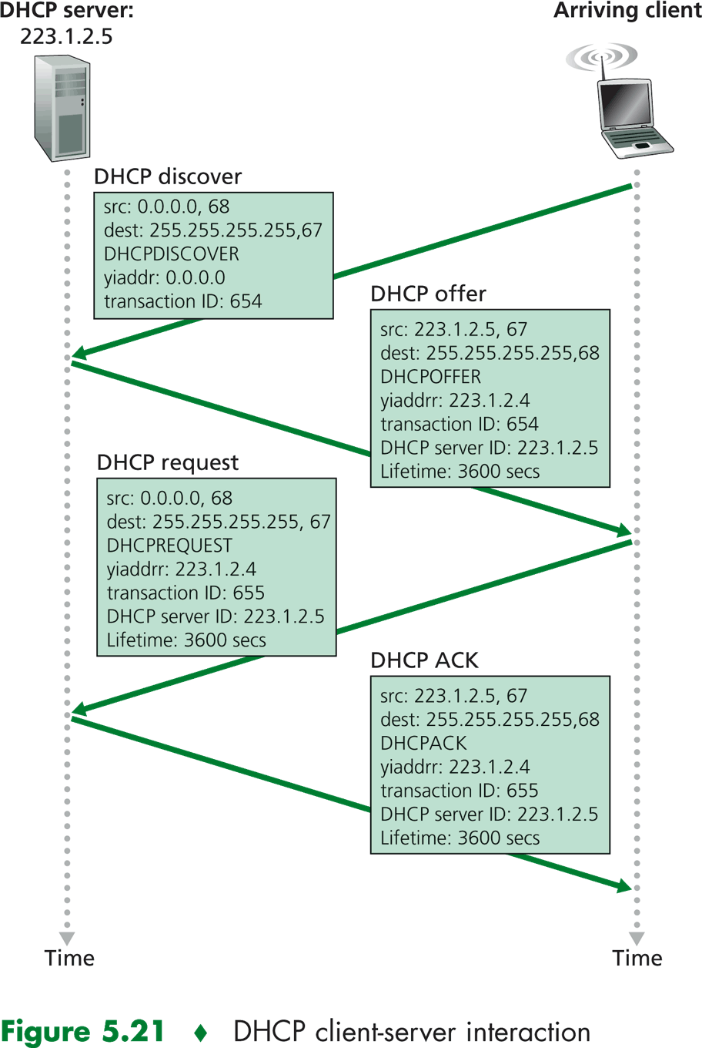
DHCP
The DHCP client broadcasts a DHCPDISCOVER message on the network subnet using the destination address 255.255.255.255 (limited broadcast) or the specific subnet broadcast address (directed broadcast)

Slide 24
FTP
The File Transfer Protocol (FTP) is a standard communication protocol used for the transfer of computer files from a server to a client on a computer network.
FTP is built on a client–server model architecture using separate control and data connections between the client and the server
FTP may run in active or passive mode, which determines how the data connection is established.
(This sense of "mode" is different from that of the MODE command in the FTP protocol.)
In active mode, the client starts listening for incoming data connections from the server on port M.
It sends the FTP command PORT M to inform the server on which port it is listening.
The server then initiates a data channel to the client from its port 20, the FTP server data port.

Slide 25
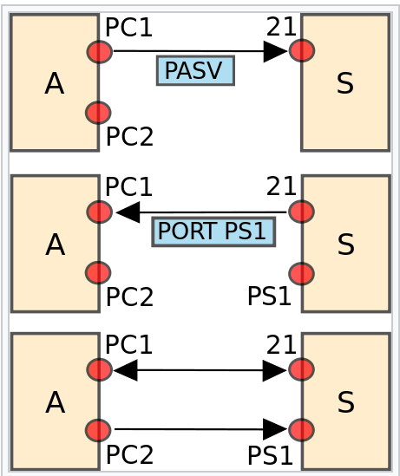
FTP
In situations where the client is behind a firewall and unable to accept incoming TCP connections, passive mode may be used.
In this mode, the client uses the control connection to send a PASV command to the server and then receives a server IP address and server port number from the server, which the client then uses to open a data connection from an arbitrary client port to the server IP address and server port number received.

Slide 26
NFS
NFS, or Network File System, was designed in 1984 by Sun Microsystems.
This distributed file system protocol allows a user on a client computer to access files over a network in the same way they would access a local storage file.
Because it is an open standard, anyone can implement the protocol.
NFS started in-system as an experiment, but the second version was publicly released after the initial success.

Slide 27
NFS
To access data stored on another machine (i.e. a server) the server would implement NFS daemon processes to make data available to clients.
The server administrator determines what to make available and ensures it can recognize validated clients.
From the client's side, the machine requests access to exported data, typically by issuing a mount command.
If successful, the client machine can then view and interact with the file systems within the decided parameters.
mount [OPTION...] NFS_SERVER:EXPORTED_DIRECTORY MOUNT_POINT
sudo mount -t nfs 10.10.0.10:/backups /var/backups

Slide 28
RTP
RTP is designed for end-to-end, real-time transfer of streaming media.
The protocol provides facilities for jitter (variance in latency) compensation and detection of packet loss and out-of-order delivery, which are common especially during UDP transmissions on an IP network.
RTP allows data transfer to multiple destinations through IP multicast.
RTP is regarded as the primary standard for audio/video transport in IP networks and is used with an associated profile and payload format.
The design of RTP is based on the architectural principle known as application-layer framing where protocol functions are implemented in the application as opposed to the operating system's protocol stack

Slide 29
SIP
The Session Initiation Protocol (SIP) is a signaling protocol used for initiating, maintaining, and terminating communication sessions that include voice, video and messaging applications.
SIP is used in Internet telephony, in private IP telephone systems, as well as mobile phone calling over LTE (VoLTE).
The protocol defines the specific format of messages exchanged and the sequence of communications for cooperation of the participants.
SIP is a text-based protocol, incorporating many elements of the Hypertext Transfer Protocol (HTTP) (such is uniform resource identifier i.e., the endpoint) and the Simple Mail Transfer Protocol (SMTP) (The fact its text based).

Slide 30
SMTP
Simple Mail Transfer Protocol (SMTP) is based on end-to-end message delivery.
A Simple Mail Transfer Protocol (SMTP) client contacts the destination host's Simple Mail Transfer Protocol (SMTP) server on well-known port 25, to deliver the mail.
The client then waits for the server to send a 220 READY FOR MAIL message.
Upon receipt of the 220 message, the client sends a HELO command.
The server then responds with a "250 Requested mail action okay" message.
After this, the mail transaction will begin with a MAIL command that gives the sender identification as well as a FROM: field that contains the address to which errors should be reported.

Slide 31
SMTP
After a successful MAIL command, the sender issues a series of RCPT commands that idenclfy recipients of the mail message.
The receiver will the acknowledge each RCPT command by sending 250 OK or by sending the error message 550 No such user here.
After all RCPT commands have been acknowledged, the sender issues a DATA command to inform the receiver that the sender is ready to transfer a complete mail message.
The receiver responds with message 354 Start mail command with an ending sequence that the sender should use to terminate the message data.
The termination sequence consists of 5 characters: carriage return, line feed, period, carriage return, and line feed (<CRLF>.<CRLF>).
The client now sends the data line by line, ending with the 5-character sequence <CRLF>.<CRLF> line, upon which the receiver will acknowledge with a 250 OK, or an appropriate error message if anything went wrong.

Slide 32
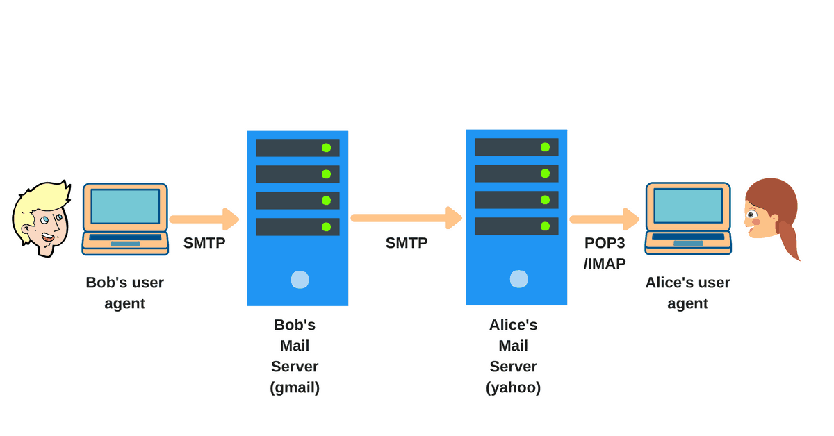
SMTP

Slide 33
SNMP
https://www.youtube.com/watch?v=vWZefoGNk5g
Get ready for some MIBs and OIDs!!

Slide 34
Application Architecture Types and Examples (1 of 2)
Data storage
Data access
Processing logic
User interface
Application architecture classification by function

Slide 35
Application Architecture Types and Examples (2 of 2)
Host-based applications
Client-based applications
Cloud computing/n-tier applications
Peer-to-peer applications

Slide 36
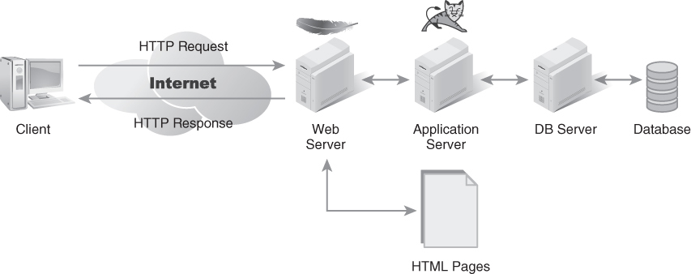
N-Tier Application Architecture
FIGURE 6-2 N-tier application architecture.

Slide 37
Features and Benefits of Each Architecture Type (1 of 2)
Architecture | Benefits | Drawbacks
Host-based | Superior security controls Easy to manage data concurrency Simple software deployment | Not scalable Single point of failure Difficult to expand
Client-based | Leverages workstation processing Reduces local storage cost | Excessive network I/O Not scalable Performance tied to network bandwidth
Client/server | Leverages workstation processing Balances network I/O Separates processing functions from data | Performance related to how much data analysis is required More complex to code; must separate user interface and processing logic Complex software deployment

Slide 38
Features and Benefits of Each Architecture Type (2 of 2)
Architecture | Benefits | Drawbacks
Cloud computing/ N-tier | Maximizes data and processing distribution Scalable Easy to add components on demand | More complex to code for distributed infrastructure Administration and security tasks are partially outsourced/split Operations and recovery planning are more complex with more components
P2P | Fault tolerant Reduced need for central authority Scalable | No central authority Conflict resolution must be negotiated Difficult to provide confidentiality

Slide 39
Aligning Architecture with Business Requirements
Understand your business problems
Identify a business solution to the problem
Identify a technical solution/application architecture (if possible)
Notes:
Never adopt a technical solution and then decide how to apply it to a problem. Always start with the business problem.
Regardless of what decision you eventually make with respect to an application architecture, always choose the option that will best satisfy the requirements provided to you by the business unit. All technical solutions should support your business.

Slide 40
Application Layer Ports and Sockets
In addition to sending a request to a web server, a service requester (i.e., a client) also provides a port number with the request
A port is a number that tells the server what type of service the client is requesting
On the server, many programs run as services, which are programs that monitor a specific port for requests
When a server receives a request for a service at a specific port, the Application Layer passes the request to the service listening on the specified port. An instance of a service listening for traffic on a specific port is called a socket
You should practice the deny-all principle and enable just those ports that are needed instead of memorizing each port and deciding whether or not to block it

Slide 41
Examples of Computer Ports, Services, and Protocols
Port | Service | Protocol
20/21 | File Transfer Protocol (FTP) data/FTP command | TCP
22 | SSH/Secure File Transfer Protocol (SFTP) | TCP
53 | Domain Name Service (DNS) | TCP/UDP
80 | Hypertext Transfer Protocol (HTTP) | TCP
161 | Simple Network Management Protocol (SNMP) | UDP
443 | Hypertext Transfer Protocol Secure (HTTPS) | TCP
445 | Server Message Block (SMB) over IP | TCP/UDP

Slide 42
From the Internet to the Web: How the World Wide Web Works
Web browser is an application that downloads and interprets webpages
Webpages are formatted in the common language of the web, Hypertext Markup Language (HTML)
HTML documents can contain text, media, and links to external resources on the web, called hyperlinks
Hyperlinks, along with the ability to locate remote resources using a Uniform Resource Locator (URL)

Slide 43
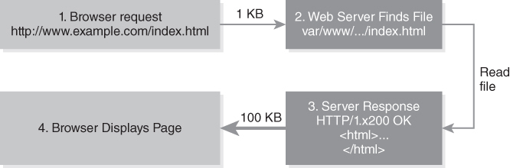
HTTP: The Web’s Workhorse
FIGURE 6-3 HTTP request and response.
Notes:
Each HTTP message starts with a request to the server and results in a response from the server.
Once the web browser receives the HTTP response from the web server, the cycle is complete.
Any further communication would be a new HTTP message sequence.

Slide 44
HTTP Request Methods
GET
The GET method requests a representation of the specified resource. Requests using GET should only retrieve data.
HEAD
The HEAD method asks for a response identical to a GET request, but without the response body.
POST
The POST method submits an entity to the specified resource, often causing a change in state or side effects on the server.
PUT
The PUT method replaces all current representations of the target resource with the request payload.
DELETE
The DELETE method deletes the specified resource.
CONNECT
The CONNECT method establishes a tunnel to the server identified by the target resource.
OPTIONS
The OPTIONS method describes the communication options for the target resource.
TRACE
The TRACE method performs a message loop-back test along the path to the target resource.
PATCH
The PATCH method applies partial modifications to a resource.

Slide 45
Impact on Security: Application Layer Threats
Trojan horse
Spyware
Virus
Worm
Ransomware
Denial of service (DoS) attack
Distributed DoS (DDoS) attack
Botnets

Slide 46
Impact on Security: Application Layer Controls
Malware scanners
Secure Shell (SSH)
Pretty Good Privacy (PGP)
Secure/Multipurpose Internet Mail Extensions (S/MIME)

Slide 47
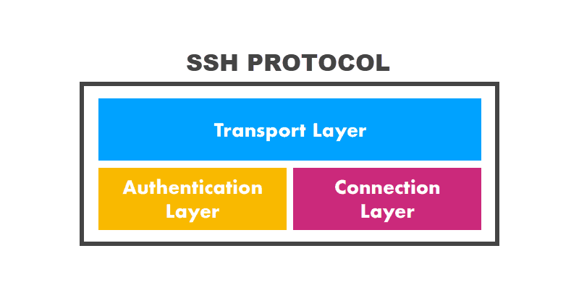
SSH
The SSH protocol was designed as a secure alternative to unsecured remote shell protocols.
It utilizes a client-server architecture, in which clients and servers communicate via a secure channel.
The SSH protocol has three layers:
The transport layer. Ensures secure communication between the server and the client, monitors data encryption/decryption, and protects the integrity of the connection. It also performs data caching and compression.
The authentication layer. Conducts the client authentication procedure.
The connection layer. Manages communication channels after the authentication.

Slide 48
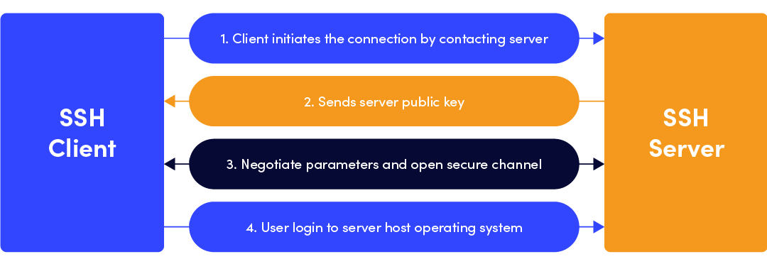
SSH
The channel created by SSH uses public-key cryptography to authenticate the client.
Once the connection is established, SSH provides an encrypted way to exchange information safely regardless of the underlying network infrastructure.

Slide 49
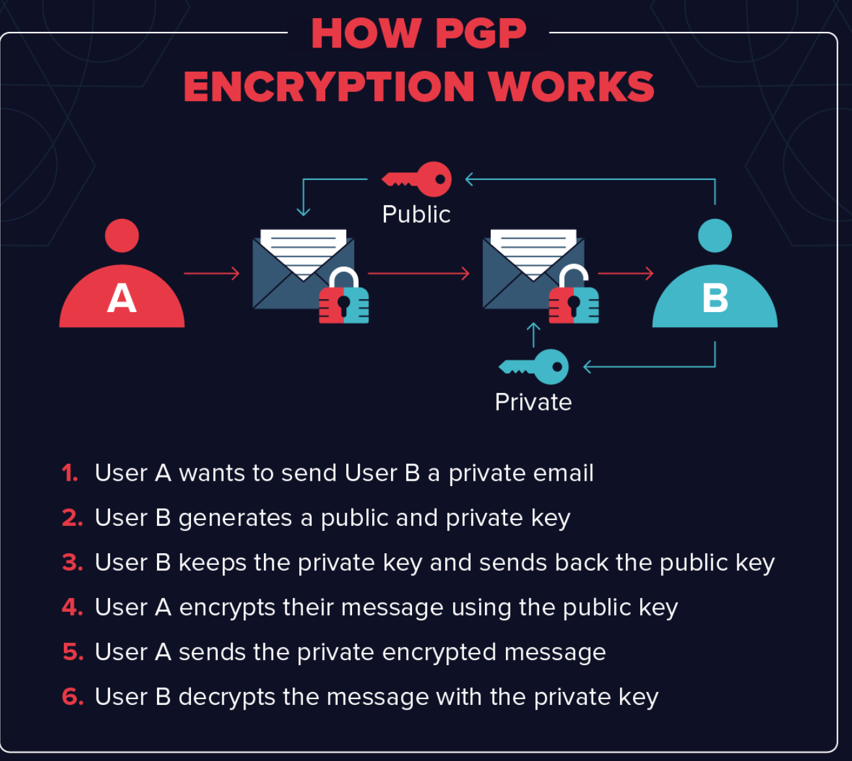
PGP
First, PGP generates a random session key using one of two (main) algorithms.
This key is a huge number that cannot be guessed and is only used once.
Next, this session key is encrypted. This is done using the public key of the intended recipient of the message.
The public key is tied to a particular person’s identity, and anyone can use it to send them a message.
The sender sends their encrypted PGP session key to the recipient, and they are able to decrypt it using their private key.
Using this session key, the recipient is now able to decrypt the actual message.

Slide 50
PGP
Why would we encrypt the encryption key itself?
Public key cryptography is much, much slower than symmetric encryption (where both the sender and recipient have the same key).
Using symmetric encryption requires, though, that a sender share the encryption key with the recipient in plain text, and this would be insecure.
So, by encrypting the symmetric key using the (asymmetric) public-key system, PGP combines the efficiency of symmetric encryption with the security of public-key cryptography

Slide 51
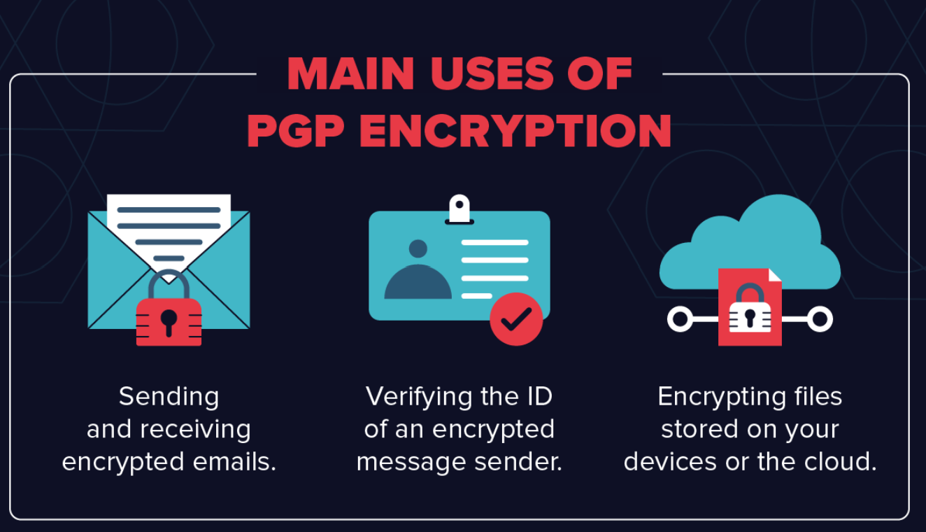
PGP

Slide 52
Encrypting Emails
Most people use PGP to send encrypted emails.
In the early years of PGP, it was mainly used by activists, journalists, and other people who deal with sensitive information.
The PGP system was originally designed, in fact, by a peace and political activist named Phil Zimmermann, who recently joined Startpage, one of the most popular private search engines.
Today, the popularity of PGP has grown significantly.
As more users have realized just how much information corporations and their governments are collecting on them, huge numbers of people now use the standard to keep their private information private.

Slide 53
Digital Signature Verification
A related use of PGP is that it can be used for email verification.
If a journalist is unsure about the identity of a person sending them a message, for instance, they can use a Digital Signature alongside PGP to verify this.
Digital signatures work by using an algorithm to combine the sender’s key with the data they are sending.
This generates a “hash function,” another algorithm that can convert a message to a block of data of fixed size.
This is then encrypted using the sender’s private key.

Slide 54
Digital Signature Verification
The recipient of the message can then decrypt this data using the sender’s public key.
If even one character of the message has been changed in transit, the recipient will know.
This can indicate either the sender is not who they say they are, that they have tried to fake a Digital Signature, or that the message has been tampered with.

Slide 55
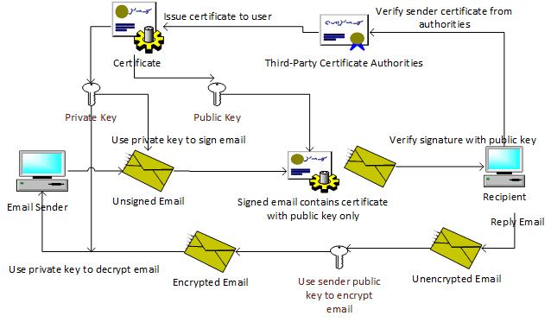
S/MIME

Slide 56
Summary
The Session, Presentation, and Application layers of the OSI model
How application architectures affect network traffic
Network ports and sockets
How the web defines the core of today’s online interactions
Network communications and their impact on security

