Slide 1
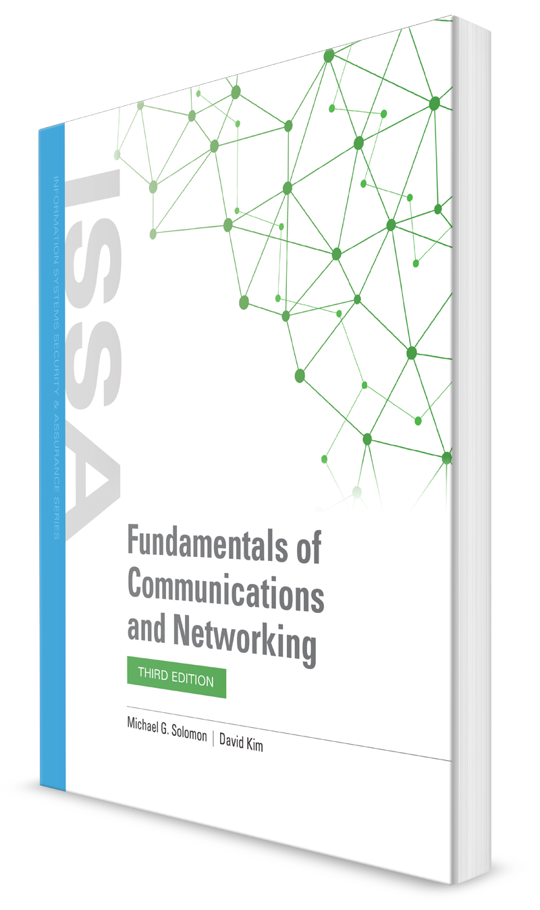
Layer 2 Networking
CHAPTER 7

Slide 2
Learning Objective(s) and Key Concepts
Learning Objective(s)
Key Concepts
Analyze how Layer 2 networking technology is used for endpoint connectivity and network segmentation to meet business requirements.
Layer 2 networking
Ethernet LAN topologies and VLANs
Redundancy and resilience
Link aggregation
Layer 2 network business solutions for small offices/home offices (SOHOs), small- and medium-sized businesses (SMBs), and enterprises

Slide 3
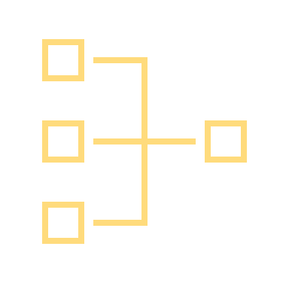
Layer 2 Networking Basics
A LAN can operate completely on Layer 2 (the Data Link Layer) with help from Layer 1 (the Physical Layer)
A LAN does not require an Internet connection
Layer 2 works closely with Layer 1 to transport frames around a LAN
When a message is addressed to a destination outside the LAN, all other OSI Reference Model layers become involved
Protocols control access to a shared medium (copper, fiber, radio waves)

Slide 4
Physical Media Requirements
Availability
Usability
Affordability
Installability
Value

Slide 5
Topologies
Bus
Mesh
Ring
Star
Notes:
Bus—Thicknet (10Base5) and Thinnet (10Base2) use a physical coaxial cable. This cable acts as a physical bus network in which transceivers must physically tap into the coaxial cable.
Mesh—A point-to-point configuration in which network switches are interconnected with redundant or multiple connections.
Ring—A logical ring in which the network utilizes the IEEE 802.5 Token-Ring LAN (former 4- or 16-Mbps LAN standard made famous by IBM prior to Ethernet taking over) technology or Fiber Distributed Data Interface (FDDI) in which a 100-Mbps ring is established.
• Star—A physical star wiring configuration, but a logical bus is enabled (e.g., an Ethernet collision domain is created).

Slide 6
Topologies
Bus—Thicknet (10Base5) and Thinnet (10Base2) use a physical coaxial cable. This cable acts as a physical bus network in which transceivers must physically tap into the coaxial cable.
Mesh—A point-to-point configuration in which network switches are interconnected with redundant or multiple connections.
Ring—A logical ring in which the network utilizes the IEEE 802.5 Token-Ring LAN (former 4- or 16-Mbps LAN standard made famous by IBM prior to Ethernet taking over) technology or Fiber Distributed Data Interface (FDDI) in which a 100-Mbps ring is established.
• Star—A physical star wiring configuration, but a logical bus is enabled (e.g., an Ethernet collision domain is created).

Slide 7
What Layer 2 Networking Means
[7] Application Layer
[6] Presentation Layer
[5] Session Layer
[4] Transport Layer
[3] Internet Layer
[2] Data Link Layer
[1] Physical Layer
Layer 2 networks operate at the Data Link Layer
The Data Link Layer is where the Ethernet II and IEEE 802.3 carrier sense multiple access with collision detection (CSMA/CD) frame formats are defined
Layer 2 networks examine and make forwarding or filtering decisions based on information in the Data Link header or protocol data unit (PDU)
The maximum transmission unit (MTU) size is the remaining number of bits and bytes after Layer 2 headers are enabled

Slide 8
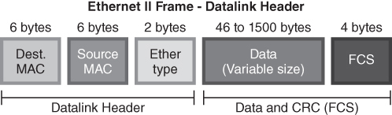
Ethernet II Frame Format
FIGURE 7-1 Ethernet II frame format.

Slide 9
Ethernet II Frame Format
This field is 2 bytes long.
This field stores information about the protocol of the upper layer (network layer).
The Data Link layer of the source computer prepares, packs and loads the Ethernet frame in the media.
The Data link layer of the destination computer picks the Ethernet frame from the media.
After picking the Ethernet frame, the Data link layer of the destination computer unpacks, processes, and hands over that Ethernet frame to the upper layer for further processing.
If multiple protocols are running in the upper (network) layer of the destination computer, the data link layer will fail to hand over the received frame to the upper layer as it does not know to which protocol it should give the received frame.

Slide 10
Ethernet II Frame Format
FCS (Frame Check Sequence)
This field is 4 bytes long. This field stores a 4 bytes value that is used to check whether the received frame is intact or not.
The sender device takes all fields of the frame except the FCS field, and runs them through an algorithm, known as the CRC (Cyclic Redundancy Check).
The CRC algorithm generates a 4-byte result, which is placed in this FCS field.
The mathematical procedure for performing a CRC is specified by the International Telecommunication Union (ITU) and involves applying a 16-bit polynomial to the data being transmitted by the packet for packets of 4 KB of data or less, or a 32-bit polynomial for packets larger than 4 KB.
https://www.scadacore.com/tools/programming-calculators/online-checksum-calculator/

Slide 11
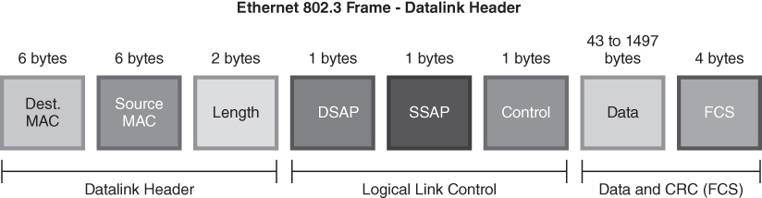
IEEE 802.3 CSMA/CD Frame Format
FIGURE 7-2 IEEE 802.3 CSMA/CD frame format.

Slide 12
IEEE 802.3 CSMA/CD Frame Format
The Destination Service Access Point (DSAP), is a 1 byte field that simply acts as a pointer to a memory buffer in the receiving station.
It tells the receiving network interface card in which buffer to put this information.
This functionality is crucial in situations where users are running multiple protocol stacks, etc...
The Source Service Access Point (SSAP) is analogous to the DSAP and specifies the Source of the sending process.

Slide 13
Ethernet LAN Topologies
Star-wired networks
Broadcast domains and collision domains
LAN with centralized hubs
LAN with centralized switches

Slide 14
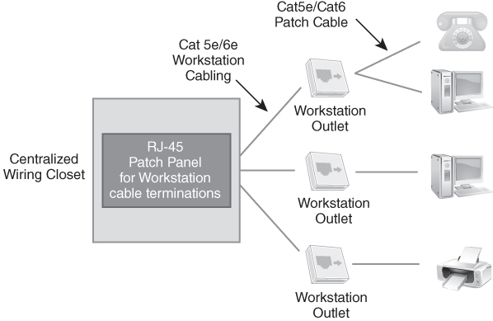
Centralized Wiring Closet to Workstation Connection
FIGURE 7-3 Centralized wiring closet to workstation connection.
Notes:
Star-wired networks
Ethernet LANs are commonly deployed as a series of connected star-wired networks
Most organizations with more than a few network nodes use structured wiring systems interconnected via wiring closets and centrally located data centers

Slide 15
Centralized Wiring Closet to Workstation Connection
Star-wired networks
Ethernet LANs are commonly deployed as a series of connected star-wired networks
Most organizations with more than a few network nodes use structured wiring systems interconnected via wiring closets and centrally located data centers

Slide 16
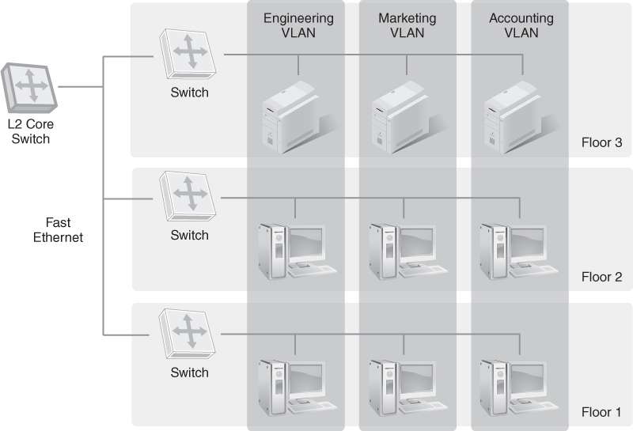
Broadcast Domain and Collision Domain
FIGURE 7-4 Broadcast domain and collision domain.
Notes:
Layer 2 switches forward all Ethernet frames that have a destination broadcast address on all the switch ports
Collision domain is the physical Ethernet network
Each network connection must adhere to the distance limitations of the wiring as well as the signaling of the NIC, hub, or Layer 2 switch
Physical Layer must align with Data Link Layer regarding physical distance based on the type of transmission medium

Slide 17
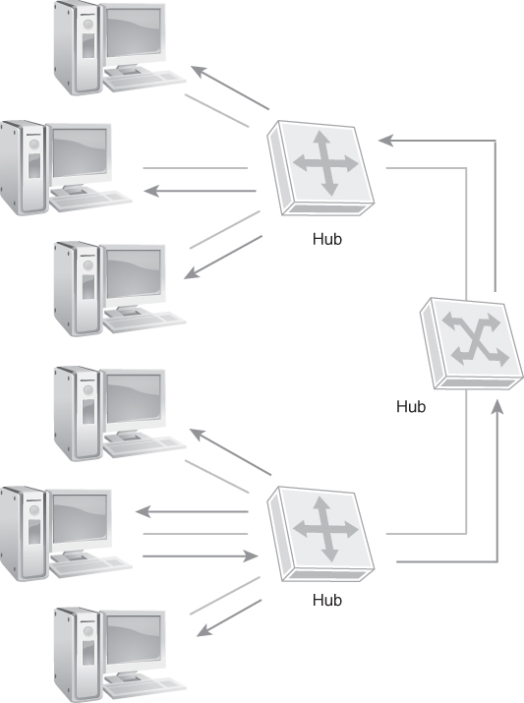
LAN with Centralized Hubs
FIGURE 7-5 LAN with centralized hubs.
Notes:
All nodes are part of a single collision domain
Every node hears the traffic from every other node
Collisions are frequent, affect performance

Slide 18
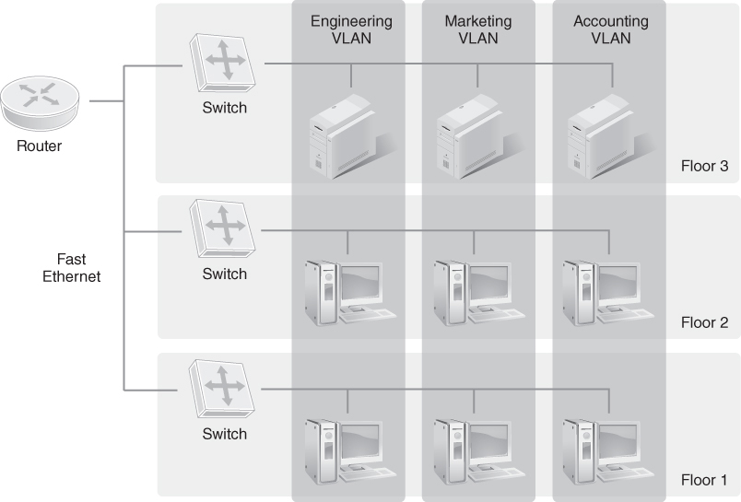
LAN with Centralized Switches
FIGURE 7-6 LAN with centralized switches.
Notes:
Layer 2 switch separates LANs into multiple collision domains
Layer 2 switch forwards traffic to only a single port that has the destination address associated to that port
Nodes connected to other ports never see the traffic that isn’t addressed to them unless they are broadcast addresses
Dramatically reduces collisions and traffic on other collision domains

Slide 19
LAN with Centralized Switches
Layer 2 switch separates LANs into multiple collision domains
Layer 2 switch forwards traffic to only a single port that has the destination address associated to that port
Nodes connected to other ports never see the traffic that isn’t addressed to them unless they are broadcast addresses
Dramatically reduces collisions and traffic on other collision domains

Slide 20
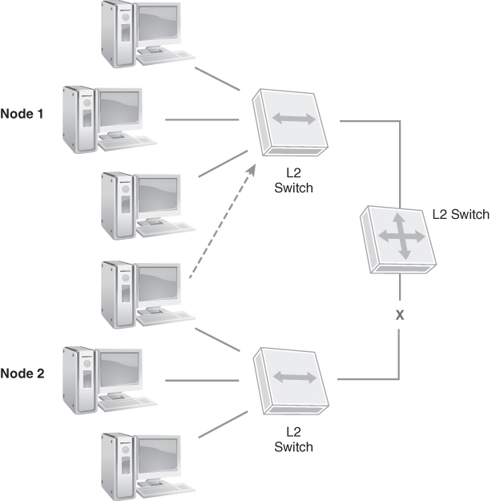
Node 2 Should Be on the Same VLAN as Node 1
FIGURE 7-8 Node 2 should be on the same VLAN as Node 1.

Slide 21
Layer 2 Network Redundancy and Resiliency (1 of 2)
Network redundancy
Maintaining high availability
Requires duplicate or multiple network hardware solutions, such as a backup secondary LAN switch, a second backup power supply, and alternate communication and wiring connections
Network resiliency
Ability of the network to maintain availability and network connectivity
Ability to recover, restore, or self-heal from an outage or disruption to ensure availability
Involves automated or manual backup, recovery, and data restoration
Notes:
Common resiliency methods include:
Multiple connections between critical nodes
Redundant critical devices
Quality of service monitoring to react to service slowdowns
Redirection to avoid congestion
Analysis of the most efficient use of active connections

Slide 22
Layer 2 Network Redundancy and Resiliency (1 of 2)
Common resiliency methods include:
Multiple connections between critical nodes
Redundant critical devices
Quality of service monitoring to react to service slowdowns
Redirection to avoid congestion
Analysis of the most efficient use of active connections

Slide 23
Layer 2 Network Redundancy and Resiliency (2 of 2)
Bridging
Spanning Tree Algorithm
Rapid Spanning Tree Protocol (RSTP)
Multiple Spanning Tree Protocol (MSTP)

Slide 24
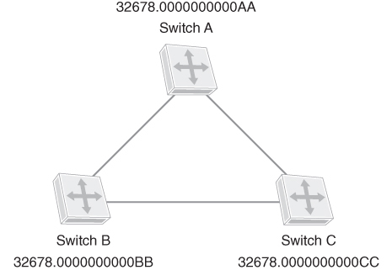
Layer 2 Network Redundancy
FIGURE 7-9 Layer 2 network redundancy.

Slide 25

Bridging
Bridge
Interconnects two or more Ethernet LANs
Provides network segmentation
Creates additional Ethernet collision domains with each LAN connection
Builds MAC address tables that are associated with each network interface on the MAC layer bridge
Makes a forwarding decision (e.g., send the Ethernet frame on to the network with the destination MAC address) or filtering decision (e.g., block the frame from being forwarded because the MAC address is not in the MAC address table of any network interface)

Slide 26
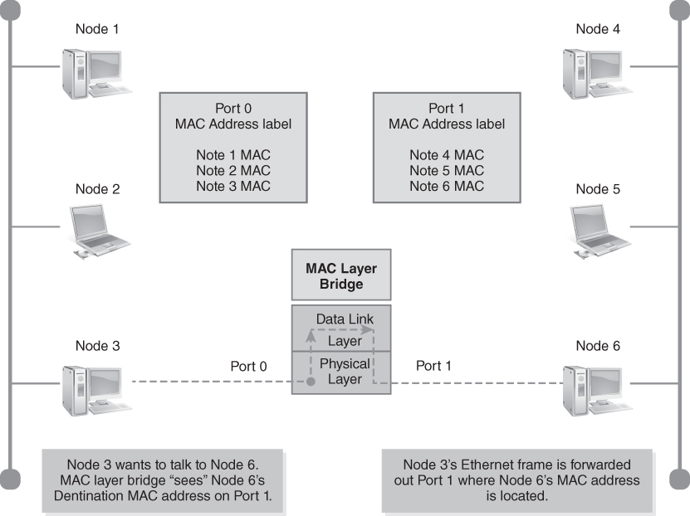
Bridges Build a MAC Address Table
FIGURE 7-10 Bridges build a MAC address table.

Slide 27
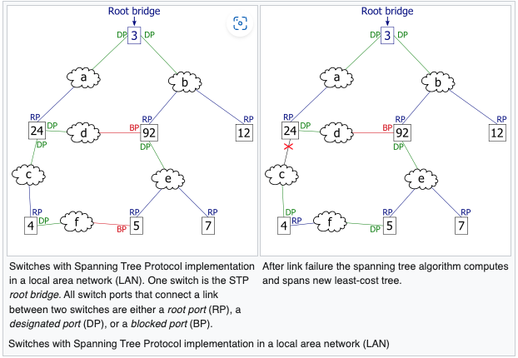
Spanning Tree Algorithm

Slide 28
Spanning Tree Algorithm
The need for the Spanning Tree Protocol (STP) arose because switches in local area networks (LANs) are often interconnected using redundant links to improve resilience should one connection fail.
However, this connection configuration creates a switching loop resulting in broadcast radiations and MAC table instability.
If redundant links are used to connect switches, then switching loops need to be avoided.

Slide 29
Spanning Tree Algorithm
To avoid the problems associated with redundant links in a switched LAN, STP is implemented on switches to monitor the network topology.
Every link between switches, and in particular redundant links, are catalogued.
The spanning-tree algorithm then blocks forwarding on redundant links by setting up one preferred link between switches in the LAN.
This preferred link is used for all Ethernet frames unless it fails, in which case a non-preferred redundant link is enabled.
When implemented in a network, STP designates one layer-2 switch as root bridge.
All switches then select their best connection towards the root bridge for forwarding and block other redundant links.
All switches constantly communicate with their neighbors in the LAN using bridge protocol data units (BPDUs)

Slide 30
Spanning Tree Algorithm
Provided there is more than one link between two switches, the STP root bridge calculates the cost of each path based on bandwidth.
STP will select the path with the lowest cost, that is the highest bandwidth, as the preferred link.
STP will enable this preferred link as the only path to be used for Ethernet frames between the two switches, and disable all other possible links by designating the switch ports that connect the preferred path as root port

Slide 31
Spanning Tree Algorithm
After STP enabled switches in a LAN have elected the root bridge, all non-root bridges assign one of their ports as root port.
This is either the port that connects the switch to the root bridge, or if there are several paths, the port with the preferred path as calculated by the root bridge. Because not all switches are directly connected to the root bridge they communicate amongst each other using STP BPDUs.
Each switch adds the cost of its own path to the cost received from the neighboring switches to determine the total cost of a given path to the root bridge.
Once the cost of all possible paths to the root bridge have been added up, each switch assigns a port as root port which connects to the path with the lowest cost, or highest bandwidth, that will eventually lead to the root bridge

Slide 32
Spanning Tree Algorithm
All switch ports in the LAN where STP is enabled are categorized.
Blocking
A port that would cause a switching loop if it were active.
To prevent the use of looped paths, no user data is sent or received over a blocking port.
BPDU data is still received in blocking state.
A blocked port may go into forwarding mode if the other links in use fail and the spanning tree algorithm determines the port may transition to the forwarding state.

Slide 33
Spanning Tree Algorithm
Listening
The switch processes BPDUs and awaits possible new information that would cause it to return to the blocking state.
It does not populate the MAC table and it does not forward frames.
Learning
While the port does not yet forward frames, it does learn source addresses from frames received and adds them to the MAC table.

Slide 34
Spanning Tree Algorithm
Forwarding
A port in normal operation receiving and forwarding frames.
The port monitors incoming BPDUs that would indicate it should return to the blocking state to prevent a loop.
Disabled
A network administrator has manually disabled the switch port.

Slide 35
Spanning Tree Algorithm
When a device is first attached to a switch port, it will not immediately start to forward data.
It will instead go through a number of states while it processes BPDUs and determines the topology of the network.
The port attached to a host such as a computer, printer or server always goes into the forwarding state, albeit after a delay of about 30 seconds while it goes through the listening and learning states.
The time spent in the listening and learning states is determined by a value known as the forward delay (default 15 seconds and set by the root bridge).

Slide 36
Spanning Tree Algorithm
If another switch is connected, the port may remain in blocking mode if it is determined that it would cause a loop in the network.
Topology change notification (TCN) BPDUs are used to inform other switches of port changes.
TCNs are injected into the network by a non-root switch and propagated to the root.
Upon receipt of the TCN, the root switch will set the topology change flag in its normal BPDUs.
This flag is propagated to all other switches and instructs them to rapidly age out their forwarding table entries.

Slide 37
Spanning Tree Algorithm
Spanning Tree Protocol (STP) uses Spanning Tree Algorithm
Bridges exchange information about detected paths in the network
STP configuration takes several steps; each step refines the spanning tree to determine the best path through the network
Switches in a network follow these steps to configure STP:
Identify the root bridge
Identify the root port (RP)
Elect designated ports
Block other ports

Slide 38
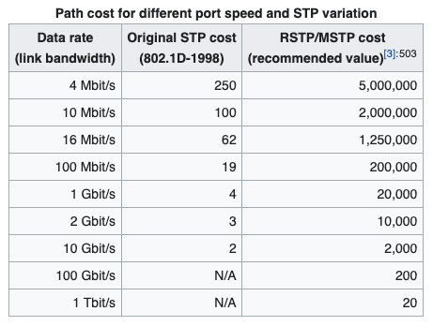
Spanning Tree Algorithm

Slide 39
Rapid Spanning Tree Protocol (RSTP)
Makes spanning tree convergence much faster than STP by modifying convergence behavior
Resolves topology changes within 6 seconds by default; responds to link failures within a few milliseconds
Necessary for supporting real-time network applications
Provides ability to define edge ports, which do not connect to other switches
Defines a handshake method to switch synchronization
Defines different port roles to make failed link recovery much faster than STP

Slide 40
Multiple Spanning Tree Protocol (MSTP)
A multiple spanning tree (MST) is a spanning tree that maps to one or more VLANs
IEEE 802.1s
Provides ability to define spanning trees for individual VLANs or groups of VLANs
Allows network designers to define possible alternate paths within each spanning tree
Each group of VLANs is assigned to an instance of a multiple spanning tree, called a multiple spanning tree instance (MSTI)
The Multiple Spanning Tree Protocol (MSTP) defines data structures to create and maintain spanning trees

Slide 41
VLAN Tagging (1 of 2)
Virtual LANs (VLANs) segregate traffic and increase network performance
Administrators can assign ports to VLANs using static or dynamic methods
Process of forwarding traffic within a VLAN from one switch to another is called VLAN tagging
Tag link is a connection between two switches that transports traffic between the switches
Ports used within the same VLAN are called tagging ports
Tag link may transport traffic from several different VLANs
Switches could use separate links for each VLAN but that’s not very scalable
Adding more VLANs would require additional ports

Slide 42
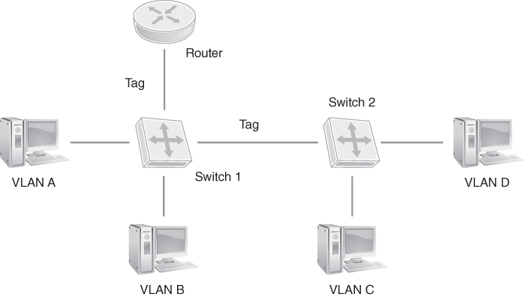
VLAN Tagging (2 of 2)
FIGURE 7-13 VLAN tagging.

Slide 43
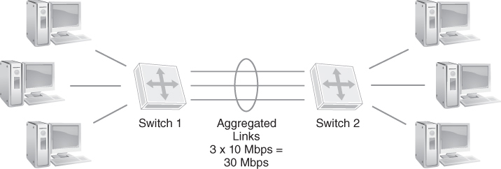
IEEE 802.3ad Link Aggregation
FIGURE 7-14 IEEE 802.3ad link aggregation.

Slide 44
Network Backbones
Hierarchical
Flat
Collapsed

Slide 45
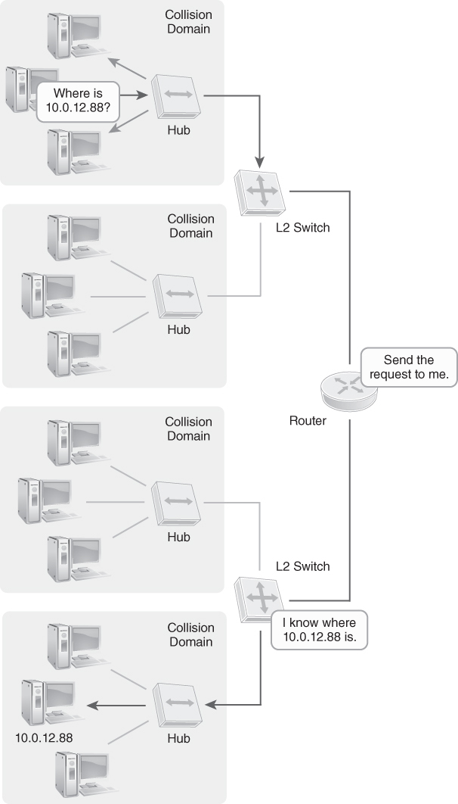
Hierarchical Backbone
FIGURE 7-15 Layer 2 hierarchical backbone.
Notes:
Layer 3 routers separate LANs
Routers are connected to a common medium, such as a bus
Allows switches to be centralized or distributed
As long as bus reaches all of routers, the hardware doesn’t have to be concentrated in a data center

Slide 46
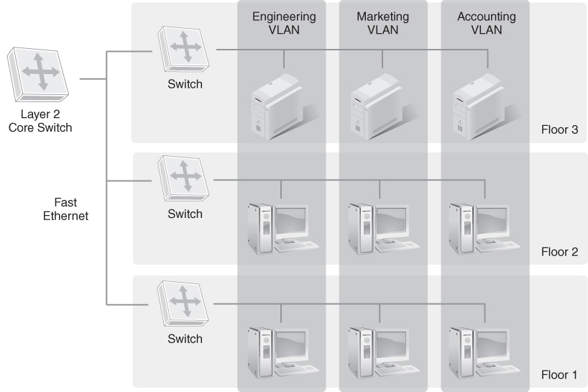
Flat Layer 2 Network Backbone
FIGURE 7-16 Flat Layer 2 network backbone.
Notes:
Developed to address performance problems with hierarchical backbone topology
Uses Layer 2 switches instead of Layer 3 routers to connect LAN segments to the shared medium
Frames reach their destinations faster than Layer 3 routing
Allows switches to be centralized or distributed
Drawback:
Entire LAN becomes a single broadcast domain

Slide 47
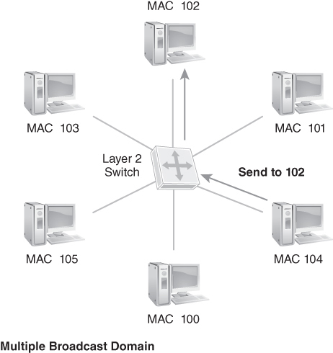
Layer 2 Collapsed Backbone
FIGURE 7-17 Layer 2 collapsed backbone.
Notes:
Developed to further increase network performance
Relies on switching hardware located in a central location
No need for a shared bus
Makes each message transfer between segments a point-to-point connection; speeds up each exchange and reduces overall collisions
Drawbacks:
Centralized nature requires every device to connect to central switch, can cause longer cable runs and potentially result in signal loss
Reliance on a central switch could become single point of failure

Slide 48
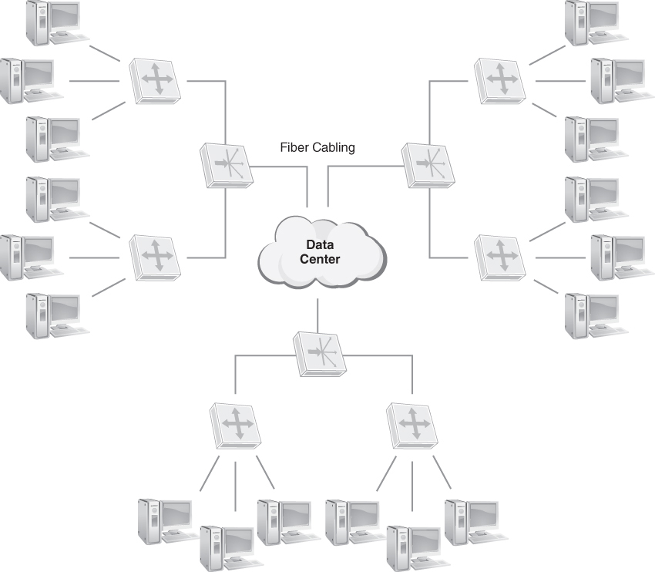
Data Center Collapsed Backbone
FIGURE 7-18 Data center collapsed backbone.
Notes:
Fiber optic collapsed backbone is popular today
Actual backbone of a collapsed backbone is the backplane of the network switch; rack-mounted collapsed backbone is a combination of a collapsed backbone and a flat backbone
Includes rack-mounted switches that are also connected to a high-speed routing switch
Many rack-mounted switches provide the ability to connect with other switches using extremely high-speed connections, such as fiber optic or on-board bus
With rack-mounted switches, backbone speeds of up to 100, 200, or 400 GigE are possible

Slide 49
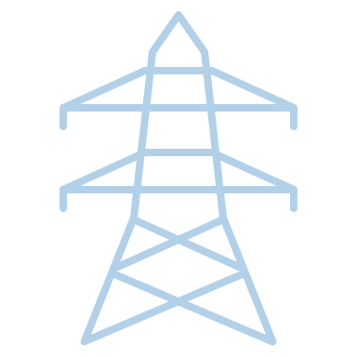
Network Power
Power over Ethernet (PoE)
Provides electrical power and data over an Ethernet cable
PoE-capable devices can operate anywhere an Ethernet connection is available
Provides transportability and flexibility for network devices
Collapsed backbones and rack-mounted backbones provide centralized points to locate power supply units for the rest of the network
Locating these devices in the data center helps to ensure infrastructure support for fault tolerance

Slide 50
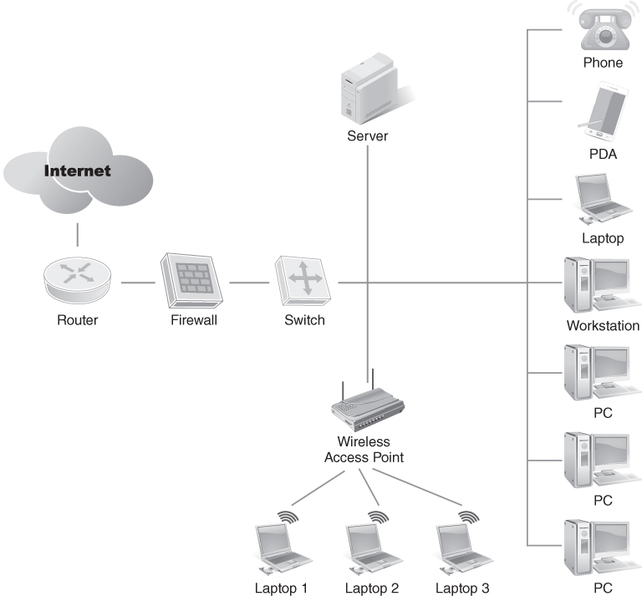
Layer 2 Business Solutions: SOHO Organization
FIGURE 7-19 SOHO network configuration.
Notes:
Two devices are able to service most networking needs:
An Internet router that includes a Layer 3 router and firewall, and a Layer 2 switch of local ports
A Layer 2 switch with an integrated wireless access point
For all but the smallest SOHOs, an additional switch may be necessary to allow all of the devices to connect to the Internet and to one another.
These two devices create a LAN that can connect to the Internet.

Slide 51
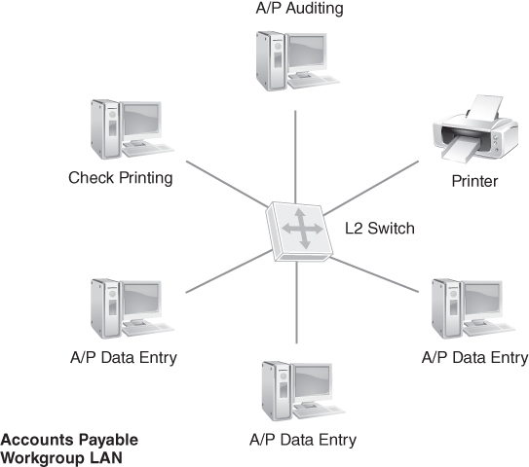
Layer 2 Business Solutions: SMB Organization
FIGURE 7-20 Departmental network configuration.
Notes:
Departmental LANs using VLANs and a collapsed backbone topology
Allows the SMB to group nodes by department but keep network traffic at Layer 2 to support streaming media and voice applications

Slide 52
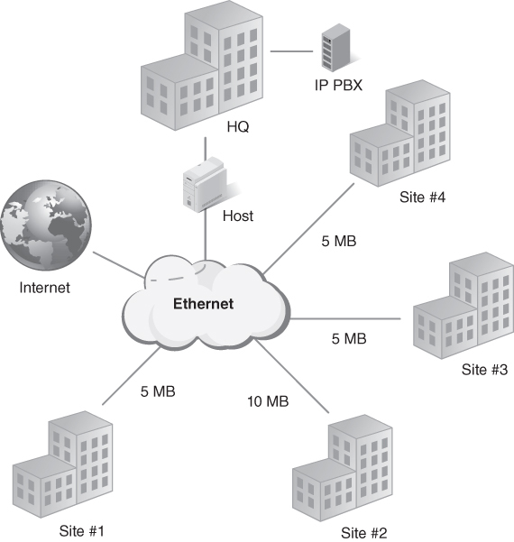
Layer 2 Business Solutions: Enterprise Organization
FIGURE 7-21 Enterprise network configuration.
Notes:
Collapsed backbone topology helps designers create a network that is fast and flexible
Each building throughout the enterprise has its own LAN
Some buildings have several LANs
Each department, and some projects, have their own VLANs
Is designed to support many applications for customers, partners, and employees
Supports many different applications, including IP phone service, audio and video conferencing, and unified communications
Multiple buildings connect at the central data center to create a campus collapsed backbone
Network flows majority of traffic through Layer 2 switches for speed
Each campus network connects to the Internet through one of two redundant WAN connections

Slide 53
Summary
Layer 2 networking
Ethernet LAN topologies and VLANs
Redundancy and resilience
Link aggregation
Layer 2 network business solutions for small offices/home offices (SOHOs), small- and medium-sized businesses (SMBs), and enterprises

