Slide 1
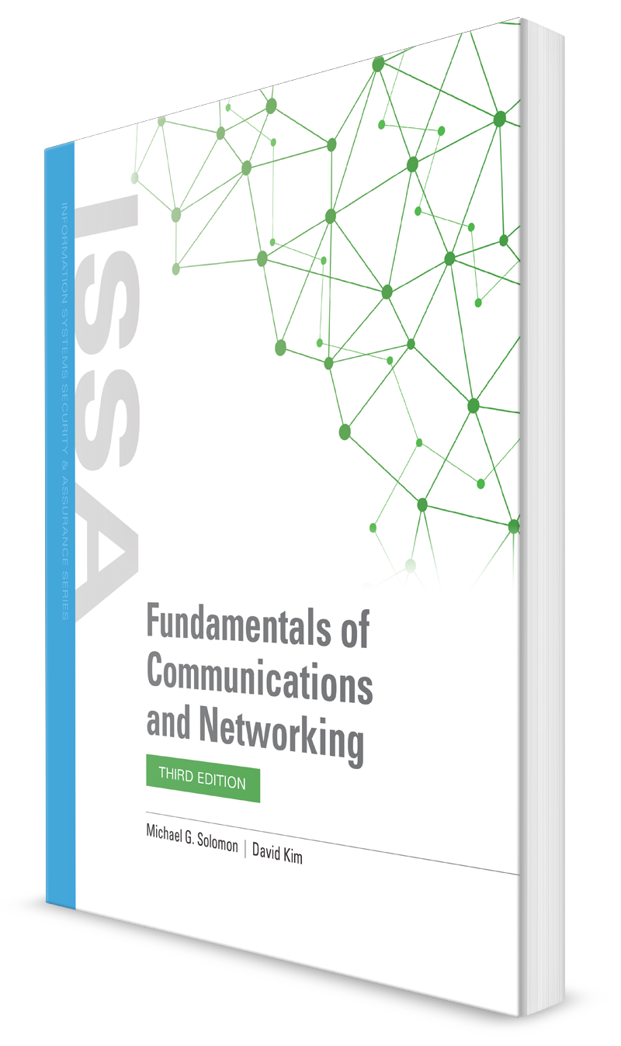
Layer 3 Networking
CHAPTER 8

Slide 2
Learning Objective(s) and Key Concepts
Learning Objective(s)
Key Concepts
Describe how Layer 3 networking protocols are used to establish communications over the network.
Network Layer routing and protocols
How Internetwork routing functions work: LAN to LAN and LAN to WAN
Routing metrics
Link-state and distance-vector routing protocols
Layer 3 resiliency and redundancy

Slide 3
Network Layer Basics
Datagram/ packet encapsulation
Error handling and diagnostics
Fragmentation and reassembly
Internetwork routing
Logical addressing

Slide 4
Network Layer Basics
Datagram/packet encapsulation—
Layer 3 functions include encapsulating messages passed from higher layers into datagrams (also called packets) along with Network Layer header information.
The Layer 3 datagram is encapsulated within the Ethernet II frame format at the Data Link layer.
Error handling and diagnostics—
Layer 3 defines special-purpose protocols that allow logically connected devices to exchange information about the status of a network host or themselves.

Slide 5
Network Layer Basics
Fragmentation and reassembly—
Layer 3 passes datagrams to the Data Link Layer, which has limits on the length of some of its frames for transmission.
To facilitate the exchange between Layer 3 and Layer 2, the Network Layer breaks up a datagram (packet) into fragments that must fit within the maximum transmission unit (MTU) size of the Data Link Layer frame format.
Data or messages coming from Layer 2 to be eventually passed on to the Transport Layer must be reassembled first.
Internetwork routing—
The primary function of the Network Layer is to move data across a series of interconnected networks.
Therefore, the purpose of the devices and software on the Network Layer is to examine each Network Layer packet and its Network Layer addresses from various sources, extract their final destination, and forward them to the route that is the best path toward that destination.

Slide 6
Network Layer Basics
Logical addressing—
Every device on a network has a logical address, which also is called a Layer 3 or Network Layer address.
Whereas the MAC address (Layer 2) is a device’s physical address, its corresponding IP address (Layer 3) is a logical address.
The main difference between these two addresses is that a logical address is
assigned independently to the device.
Should the device leave a network, its logical address (IP address) can be assigned to a different network device.
One similarity the two addresses share is that they both must be unique addresses on a given network.

Slide 7
Network Layer Protocols
Network Layer is essentially the routing layer
Main purpose is to get packets (datagrams) from one network to another
Frame must be handed up to Layer 3 and prepared for transmission on a LAN, WAN, or the Internet
Internet Protocol (IP) is the best known of the Layer 3 protocols
Defines internetwork addressing, but much of what happens on Layer 3 is routing
For the purposes of this chapter, a router is the same thing as a Layer 3 switch

Slide 8
Network Layer Protocols
Multiprotocol environments were present because different manufacturers implemented their own Network Layer protocols and addressing schemas.
This included the following Network Layer protocols:
AppleTalk—Apple Corporation’s Layer 3 protocol
Banyan Vines—Xerox Network Systems (XNS) protocol
DecNet Ph. IV—Digital Equipment Corporation’s Layer 3 protocol
IPX—Novell Netware’s Internetworking Layer 3 protocol

Slide 9
Routing Protocols
Routing protocols
Allow routers to determine which routes are available and which is the most efficient to a destination
Examples are Routing Information Protocol (RIP) and Open Shortest Path First (OSPF)
Routed protocols
Prescribe the formatting of the data being transported across the networks
Include IP and IP subprotocols
Examples of subprotocols are Telnet and Simple Mail Transfer Protocol (SMTP)
A routed protocol can be routed by a routing protocol

Slide 10
Routing Tables
Each entry in a routing table specifies one particular route (path or link).
All routing tables should contain at least one entry—a default route.
A default route is the specified route that an IP packet should take from the source device when no other specific route is identified.
An IP default gateway router is the router that acts as that workstation’s gateway to exit the LAN.

Slide 11

Routing Tables
Routing tables should contain at least one entry—a default route
Default route is the specified route that an IP packet should take from the source device when no other specific route is identified
Routing table entry typically consists of the following:
Network ID or host internetwork logical address
Subnet or prefix mask to extract the network ID from the destination IP address
Forwarding address
Interface port associated with the network ID
Routing metric

Slide 12
Routing Tables
If the destination address of the packet to be forwarded matches an entry in the routing table, the metric value is examined to determine whether this route has the lowest cost (meaning the lowest metric value of the available routes).
If multiple routes are available, the route with the lowest cost is chosen, and the packet is forwarded on its link.
If only one route is available, it is used.
Entries in a routing table, which is kept in the router’s main memory, reference directly connected networks and/or remotely connected networks.
Directly connected networks are those in which one router is linked to another router by a direct connection.
A message routed to a remotely connected router must pass through an intermediary router.

Slide 13
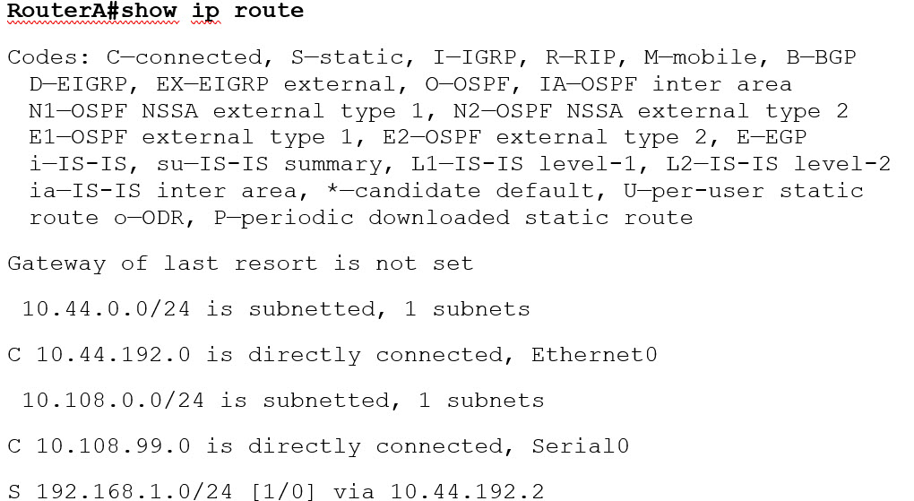
“Show IP” Output

Slide 14
Routing Protocols
IPV4
Routing Information Protocol
(RIP/RIPv2)
Intermediate System-to-lntermediate
System (IS-IS)
Open Shortest Path First (OSPFv2)
Border Gateway Protocol 4 (BGP4)
Interior Gateway Routing Protocol(IGRP) (Cisco proprietary)
Enhanced IGRP (EIGRP) (Cisco proprietary)
IPV6
RIPng
IS-IS for IPv6
OSPFv3
Multiprotocol
BGP (MP-BGP)
(not available)
EIGRP for IPv6

Slide 15
Routed Protocols
Once a packet is formatted in accordance with the packet’s routed protocol, the packet can be forwarded by the routing protocol.
Examples of routed protocols are IP, Novell Internetwork Packet Exchange (IPX), DECnet, AppleTalk, and Banyan Vines, as well as subprotocols of IP such as Telnet, Remote Procedure Call (RPC), Simple Network Management Protocol (SNMP), and Simple Mail Transfer Protocol (SMTP).

Slide 16
Non Routable Protocols
Some protocols cannot be routed.
These protocols assume that all of the hosts with which they must communicate speak the same language and are located on the same network.
For networks running nonroutable protocols to communicate, a network bridge or Layer 2 networking is required.
Examples of nonroutable protocols are Dynamic Host Configuration Protocol (DHCP), NetBIOS Extended User Interface (NetBEUI)
These protocols do not have a Network Layer address; hence, they are nonroutable protocols that must operate at Layer 2.

Slide 17
Routing Protocols Versus Routed Protocols
Routing protocols propagate dynamically learned route information from other routers participating in the same process
Routed protocols are responsible for the delivery of the datagram and contain the Network Layer addressing
Routing protocols use Network Layer information to determine the best path for the packet to take across the network to reach its destination
Routing protocols talk to neighbor routers to learn about networks and the interfaces they are associated with
Neighbor activity refers to the dialogue that neighbor routers and their interconnected interfaces perform

Slide 18
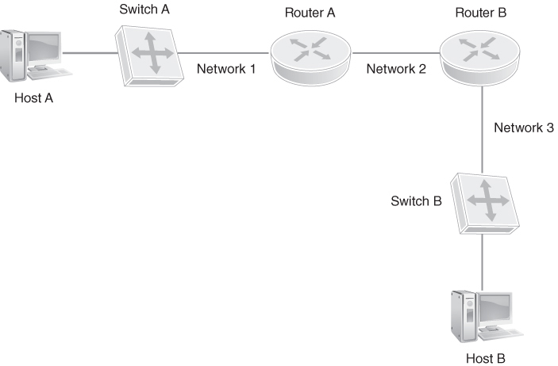
Path Determination
FIGURE 8-2 A sample Layer 3 IP network.

Slide 19
Path Determination
In this scenario on the previous slide, Router A originally knows only about its directly connected networks, Networks 1 and 2.
Router B likewise knows about its directly connected networks, Networks 2 and 3.
There are two ways for these routers to communicate with each other.
One is to configure a dynamic routing protocol, such as one of the examples previously mentioned (RIP, OSPF, BGP, and so on).
A dynamic routing protocol learns about its directly connected routes and then forwards that information to its directly connected routers, or in more complex environments, to other routers configured in the same process.

Slide 20
Path Determination
In the diagram, if you were using a distance vector protocol such as RIP, Router A would forward a copy of its routing table (Networks 1 and 2) to Router B.
Router B would do the same, passing a copy of its routing table (Networks 2 and 3) to Router A.
Router A would see that Network 3 is from an external router and install it in its routing table.
Any future packet forwarded to Router A, destined to Network 3, it would know to forward to Router B.

Slide 21
Path Determination
To show how static routing works, again looking at the prior diagram.
In this example, if Router A needs to get packets to Network 3, then a
static route must be installed in Router A that says, “To get to
Network 3, forward packets to Router B.”
If you set up this environment in a lab and configured that previous static rout and had sniffers, or network capture devices, on each side, you would see the traffic from Router A reaching Host B.
The problem is that the return traffic would fail, because Router B would not know how to pass the return traffic.
Therefore, a static route also must be configured on Router B that says “To get to Network 1, forward packets to Router A.”
This would allow full communication between the two hosts.
Not good for large networks but good for things like gateways of last resort

Slide 22
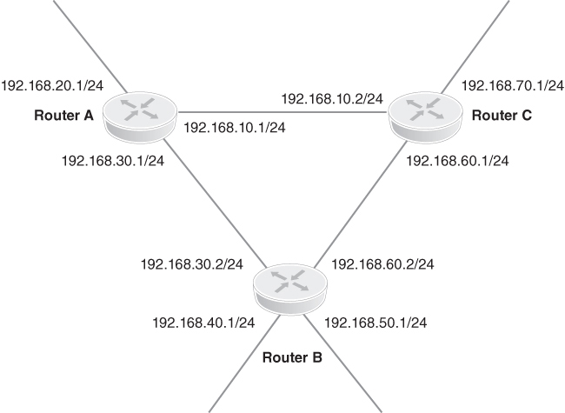
Router Network Addressing (with Multiple Paths)
FIGURE 8-3 Router network addressing.

Slide 23
Router Network Addressing (with Multiple Paths)
To build its routing table:
1. Router A uses the subnet masks associated with each interface to determine that it’s attached to networks 192.168.10.0, 192.168.20.0, and 192.168.30.0.
2. Router A then adds an entry for each network into its routing table along with the information that each network is directly connected.
Router A then sends routing update packets to Routers B and C informing them that it’s directly connected to these three networks.
4. Routers B and C perform the same steps and send routing updates to Router A informing it of their directly connected networks.
5. Router A updates its routing table with the source address included in each router’s routing update packet and the network addresses provided by each router.

Slide 24
Router Network Addressing (with Multiple Paths)
Think about this
Both Routers B and C reported being directly connected to 192.168.60.0.
Which is the better choice for reaching that network, or are they equals?
Should Router A update Router C about the networks reported from Router B?
What if the connection between them is down?
Should Router A pass that information along?

Slide 25
Routing Metrics
Hop count
Bandwidth
Load
Delay
Reliability
Maximum transmission unit (MTU)
Cost

Slide 26
Routing Metrics
Hop Count.
A hop count metric indicates the number ofintermediary routers a packet will have to pass through to reach a destination network.
The hop count is just a count of the number of times a packet must be forwarded by other routers to reach its destination.
Each time a packet is forwarded, it counts as a hop.
Bandwidth.
Sometimes hop count doesn’t really tell the whole story of a link.
Perhaps the link from Router A to Router B is a dial-up line, and the link between Router A and Router C is a dedicated leased T-1 line.
Bandwidth and the condition of the link are other ways to determine the quality of a routing option.
A routing protocol that uses a bandwidth metric chooses a path with higher bandwidth over one with lower bandwidth, regardless of the type of link.
Bandwidth, all by itself, may not be a single indicator of the condition and quality of a link.

Slide 27
Routing Metrics
Load
On any route, hop count and bandwidth generally stay the same.
However, the amount of traffic or load, which is the amount of bandwidth in use on the link, can fluctuate quickly.
A routing protocol that depends too heavily on the line loading for its routing determination may end up with what is called route flapping, rapidly changing the preferred route from one route to another and perhaps back again.
Delay
A delay metric essentially measures a link’s throughput or transit time: the duration time for a packet to completely navigate a link end-to-end.
A routing protocol using a delay metric favors the link with the least delay.
A delay metric can be developed a variety of ways: clocking the time between when a packet is forwarded until the time the packet is acknowledged

Slide 28
Routing Metrics
Reliability
The reliability metric is an indicator of how likely it is that the link may fail during a transmission.
Reliability metrics are either variable or fixed.
A variable reliability metric may be a count of the actual number of failures that have occurred on a link within a specific time.
A fixed reliability metric is a static metric that is typically manually configured by the network administrator and is based on his or her knowledge of a particular link
Maximum transmission unit (MTU)
MTU has been called the fifth factor in deciding the EIGRP metric.
A change in the MTU doesn’t trigger a routing update.
When a change in topology triggers an EIGRP update, the MTU metric updates.
If the router determines there is a tie for a routing decision, the MTU is used as the tiebreaker.

Slide 29
Convergence and Load Balancing
Convergence
Routing update packets are sent out on all links connected to external networks
Routing tables are updated constantly to account for network changes, such as a new router being added or a router being removed
Convergence is achieved when routing tables of directly connected devices are synchronized
Load Balancing
Routing protocols may divide traffic being forwarded to a particular destination address that has two or more paths for use
If a particular link has substantial traffic being forwarded on it to reach a particular network, it’s more efficient to divide the traffic and forward it alternatively on two or more links rather than queue it up and wait for a single link

Slide 30
Traffic Flow
Access control lists (ACLs) are used for packet forwarding or filtering
Packet forwarding
Refers to the network interface forwarding IP packets out the port or interface
Packet filtering
Refers to the network interface blocking the IP packet from traversing out the port or interface
Traffic shaping
Depending on the Layer 3 switch or router vendor, enabling ACLs is done in the configuration file of the network asset
Traffic shaping uses an ACL to define what IP packets or TCP/UDP packets can be forwarded and which are to be blocked

Slide 31
ACLs
ACLs have the following structure:
ACL number—Used to identify an ACL entry on a network interface.
ACL name—Some routers allow a combination of letters and numbers for the name.
ACL functional statement—You can configure the interface to deny or permit a specific source based on address and wildcard mask.
Some routing devices, such as Cisco, configure an implicit Deny statement at the end of each ACL by default. (This is a precautionary measure just in case the network engineer forgets.)
Network protocol—You can specify whether to deny/permit IP, IPX, ICMP, TCP, UDP, NetBIOS, or a specific port number like 21 (Telnet) or 22 (SSH).
Source or destination—You can specify the source or destination target as a single IP, an address range (CIDR), or all addresses on a network or subnetwork.
Log—Some devices are capable of keeping logs when ACL matches are found and a filter or forward decision has been made.
Advanced features—Advanced ACLs allow you to use control traffic through the type of service (ToS), IP precedence, and differentiated services codepoint (DSCP) priority.

Slide 32
Internetwork Routing Functions
LAN-to-LAN routing
LAN-to-WAN routing

Slide 33
LAN-to-LAN
When a host on one LAN transmits a message to a host on another LAN connected to the same router, one of two things can happen, depending on the characteristics of the LANs.
If the two LANs are running the same network technology, such as Ethernet, it’s a simple matter of extracting the destination host’s network ID and forwarding the message packets to the link in the routing table.
However, if the two LANs are running different network technologies, such as Ethernet on one and token ring on the second, a new step must be added to the process to preserve the original message for delivery on the second network technology.
Layer 3 protocols must be able to interface with the frame formats of different Layer 2 networking technologies.

Slide 34
LAN-to-WAN
In much the same way as in LAN-to-LAN routing, the Network Layer protocols running on a LAN router must be able to interface with all of the lower layer protocols and methods.
It’s common that a packet being transmitted to the internetwork will traverse through two or more hops (routers).
At each hop, the message packets must process up from the Physical Layer and Data Link Layer to be recognized and analyzed by the hop’s Layer 3 protocols.
After the router determines the path to which the packet is to be forwarded, the packet is passed down through the lower levels for transmission on that link.

Slide 35
Routing Metrics and Protocols
Link-state routing protocols
Are concerned with tracking the status and type of each link to which a router is connected
Calculates a metric that considers the status (state) of a link and its connection type, speed, and delay
Metric indicates whether the link is active or inactive, its bandwidth, and the cost of transmitting a packet on the link
Example OSPF using Dijkstra’ shortest path first algorithm – considers state, type, speed and delay
Distance-vector routing protocols
Send updates to neighbors when there is a topology change in the network
Only knows the distance and direction (interface port) to neighboring devices that are one hop away

Slide 36
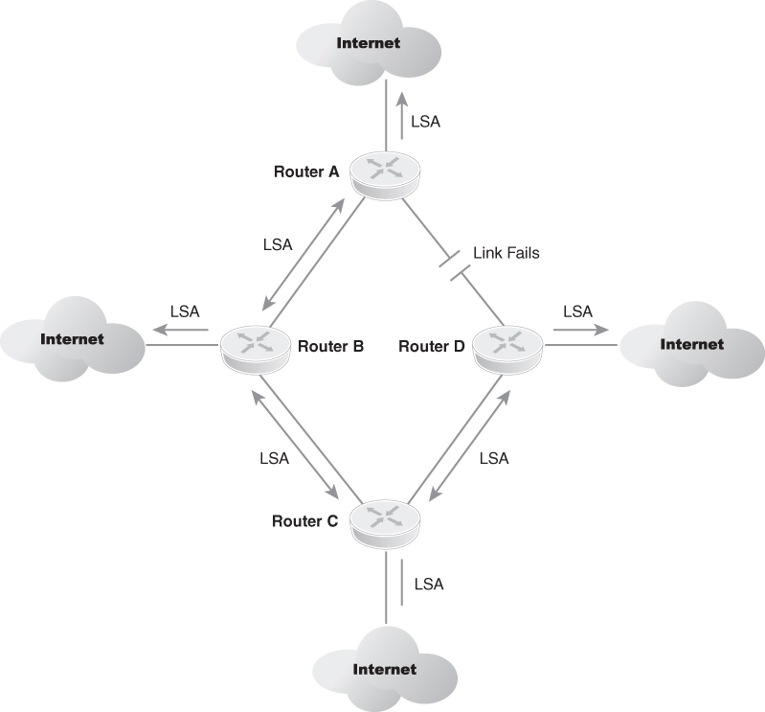
Link-State Advertisements (LSAs)
FIGURE 8-4 Link-state advertisements (LSAs).

Slide 37
Exterior Versus Interior Routing Protocols
Exterior routing protocols
Interior routing protocols
Also called exterior gateway protocols (EGPs)
Are used to route messages outside of an autonomous system (AS) or between two networks
Commonly referred to as interior gateway protocols (IGPs)
Perform routing functions within an autonomous system (AS), which is essentially one routing domain

Slide 38
Autonomous systems
An autonomous system (AS) is a collection of connected Internet Protocol (IP) routing prefixes under the control of one or more network operators on behalf of a single administrative entity or domain, that presents a common and clearly defined routing policy to the Internet.
Each AS is assigned an autonomous system number (ASN), for use in Border Gateway Protocol (BGP) routing.
Autonomous System Numbers are assigned to Local Internet Registries (LIRs) and end user organizations by their respective Regional Internet Registries (RIRs), which in turn receive blocks of ASNs for reassignment from the Internet Assigned Numbers Authority (IANA).
The IANA also maintains a registry of ASNs which are reserved for private use (and should therefore not be announced to the global Internet)

Slide 39
Autonomous systems
Originally, the definition required control by a single entity, typically an Internet service provider (ISP) or a very large organization with independent connections to multiple networks, that adhered to a single and clearly defined routing policy.
In March 1996, the newer definition came into use because multiple organizations can run BGP using private AS numbers to an ISP that connects all those organizations to the Internet.
Even though there may be multiple autonomous systems supported by the ISP, the Internet only sees the routing policy of the ISP.
That ISP must have an officially registered ASN.

Slide 40

Routing Information Protocol (RIP)
Is a distance-vector routing protocol that uses hop count as its routing metric
Maintains a routing table that is updated regularly by neighboring routers (running RIP)
If routing updates are not up-to-date or do not provide a complete picture of a network anomaly, errors in a routing table can cause routing loops
Timers and mechanisms that help to prevent routing loops:
Hold-down timer
Invalid timer
Flush timer
Update timer
Simple split horizon
Split horizon with poisoned reverse

Slide 41
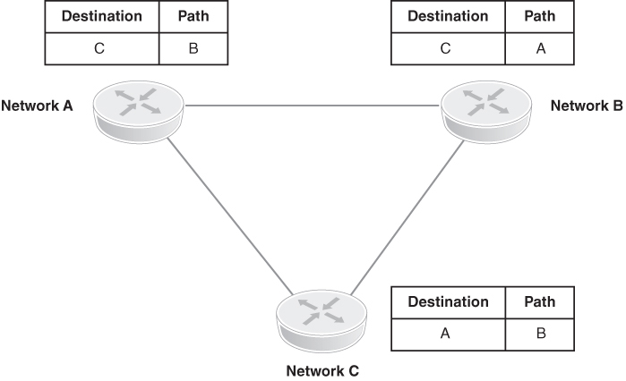
A Simple Network That Is Susceptible to a Routing Loop
FIGURE 8-5 A simple network that is susceptible to a routing loop.

Slide 42
Additional Protocols
RIP Version 2 (RIPv2)
Open Shortest Path First Version 2 (OSPFv2)
Interior Gateway Routing Protocol (IGRP)
Enhanced Interior Gateway Routing Protocol (EIGRP)
Border Gateway Protocol (BGP)

Slide 43
Layer 3 Network Redundancy and Resiliency
Resilience
A network’s capability to maintain a certain level and quality of service at all times, regardless of faults and interruptions
For a network to be resilient, its Physical Layer media, Layer 2 network access functions, and Layer 3 forwarding and addressing functions must have hot-swap redundancy
Redundancy is a form of resilience

Slide 44
Configuring Resilience
Backup or dual power supplies
Battery backup and uninterruptible power supplies (UPSs)
Diesel generators
Backup router CPU processors and modules
Alternate network links
Alternate and redundant wiring and fiber optic cabling paths
Redundant core, distribution, or access switches
Virtualization of routers and their switching functionality
Easiest approach
Run redundant links between the switches and implement Rapid Spanning Tree Protocol (RSTP) or Multiple Spanning Tree Protocol (MSTP)
RSTP and MSTP prevent Layer 2 broadcast loops and configure timer settings to eliminate delays
Notes:
Backup or dual power supplies—Critical network devices can be installed with dual power supplies in the event of failure.
Battery backup and uninterruptible power supplies (UPS)—Needed for electrical outages or failure of the primary electrical source. Battery backup is needed to power down IT assets or continue operations.
Diesel generator—These are used for electrical power backup in the event of a catastrophic electric power outage.
Backup router CPU processors and modules—If the primary CPU processor fails, a secondary CPU processor is ready.
Alternate network links—Alternate links are used for redundancy and high-availability connections.
Alternate and redundant wiring and fiber optic cabling paths—These are used in the event of a cable cut.
Redundant core, distribution, or access switches—A second chassis is installed and fully integrated into the core, distribution, or edge network for high availability.
Virtualization of routers and their switching functionality—To support collapsed backbones and internetworking between LANs. A virtual switch is created in software of a core or distribution switch. A virtual switch allows a physical switch to have more than one logical switch for redundancy and alternate paths to other virtual switches.

Slide 45
Routing Protocol Resilience
First Hop Redundancy Protocols (FHRPs)
Routing protocols that can support the resilience of a network
Ability of the router and its routing protocol to recover quickly is dependent on the configuration of the router, the routing protocol, and the links connected to the router
Configuring the router for load balancing can add to the resilience of the network if the router is connected to equal-cost links of equal capabilities
Examples:
Virtual Router Redundancy Protocol (VRRP), which clusters multiple routers into a single virtual router
Cisco proprietary Hot Standby Routing Protocol (HSRP)

Slide 46
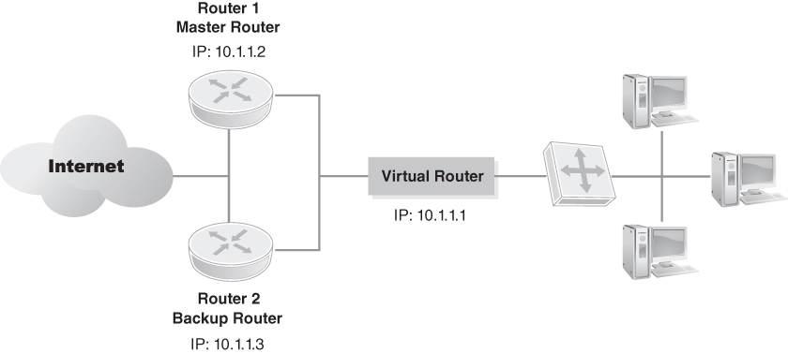
VRRP Creates a Virtual Router That Is the Primary Router for Its Network
FIGURE 8-6 VRRP creates a virtual router that is the primary router for its network.

Slide 47
Summary
Network Layer routing and protocols
How Internetwork routing functions work: LAN to LAN and LAN to WAN
Routing metrics
Link-state and distance-vector routing protocols
Layer 3 resiliency and redundancy

