Slide 1

Network Operations and Management
CHAPTER 12

Slide 2
Learning Objective(s) and Key Concepts
Learning Objective(s)
Key Concepts
Describe how network management, auditing, and monitoring help improve performance and security.
Network fault management
Network operations center
Change control and configuration management
Asset management, loss control, and interruption control
Network performance measurement, monitoring, protocols, and issue resolution

Slide 3
The Scope of Network Operations and Management
Proactive network management
Planning ahead for issues and attempting to avoid them instead of fixing problems
Network operations
Covers all aspects of normal network operations, in addition to determining when things are not normal
Network operations center (NOC)
A central location used to monitor and control networks, and to resolve problems

Slide 4
IT and IT Security Policy Framework (1 of 2)
ISO/IEC 27000 series
Security best-practices standards
NIST SP 800
Information systems security guidelines, recommendations, and technical specs
Information Technology Infrastructure Library (ITIL)
A set of best practices for managing IT infrastructure, development, and operations

Slide 5
IT and IT Security Policy Framework (2 of 2)
Control Objectives for Information and Related Technology (COBIT)
A framework developed by ISACA for IT management
Committee of Sponsoring Organizations (COSO) of the Treadway Commission
Provides guidance on corporate fraud, organizational governance, enterprise risk management, more

Slide 6
Policy and Procedure Best Practices (1 of 3)
Privileged user agreement
Password policy
On-boarding/ off-boarding procedures
Licensing restrictions
International export controls
Data loss prevention
Remote access policy
Incident response policy
BYOD policy
Acceptable use policy
Nondisclosure agreement
System life cycle
Safety procedures and policies

Slide 7
Policy and Procedure Best Practices (2 of 3)
Preventive Measures
Ensure all documentation is current
Archive out-of-date documentation
Ensure all software is up-to-date
Communication
Define clear roles and responsibility descriptions
Make communication easy
Make policies and procedures available
Set up a chain of command
Train the team
Document each action
Always debrief

Slide 8
Policy and Procedure Best Practices (3 of 3)
Reacting to Faults
Limit the false positives
Avoid reporting uncorroborated events
Identify the scope of the fault
Choose the appropriate level of response
Establish a response timeline
Escalation
Establish escalation guidelines
Set specific escalation time goals
Determine when to call for extreme action
Avoid “protectionism”
Being Proactive
Automate
Predict faults
Recognize anomalies
Query intelligently

Slide 9
Network Operations and Management
Staffing and resources
Real-time availability
Audit and monitoring
Collecting data
Reporting information
Configuration change management
Change control board membership
Change control board function
Change control board policies and practices
Capacity planning and readiness
IT asset inventory
Network performance
Service providers

Slide 10
Access Controls for Facilities
NOC technician
Monitors infrastructure performance and overall health
NOC manager
Directs activities that require attention to avoid or resolve outages, performance or capacity deficiencies, or security incidents

Slide 11
Real-Time Availability
Network operations staff collect network infrastructure performance data in real time
Personnel alerted to potential problems before the first end user complains
Real-time status availability allows managers to manage and not just react

Slide 12
Auditing and Monitoring
Monitoring performance
Auditing
Taking individual measurements at scheduled times and recording each measurement
When a measurement falls outside normal range, network management system (NMS) notifies a technician or runs a predefined set of instructions
Comparing measurements to one or more baselines
Identifying early signs of problems and noncompliance

Slide 13
Collecting Data and Reporting Information
Collect data
Analyze data
Send alerts
Report on information

Slide 14
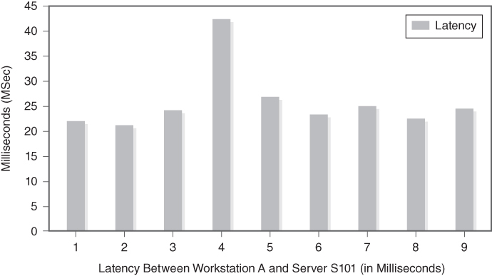
Latency Values Graph
FIGURE 12-1 Latency values graph.

Slide 15
Configuration Change Management
Processes and procedures that govern the way that configuration changes are requested, reviewed, and either declined or implemented
Change control manager or change control board (CCB) review and approve or reject change requests

Slide 16
Change Control Board Membership and Function
CCB Representatives
Management
Individuals representing hardware and software areas
Network security and corporate information security
Finance and procurement departments
NOC staff person as user ombudsman
Hardware vendors and network services providers
CCB Function
Reviews requests for changes to the network configuration
Compares requests to policy, budget, and service-level agreement (SLA) target performance levels
Approves or rejects them

Slide 17
Change Control Board Policies and Practices
Two primary ways to set policies and practices for a CCB
Begin with clean slate and wait for requests to come in
Record decisions/rationale and form policies
Anticipate what may be required and develop policies and practices ahead of time

Slide 18
Capacity Planning and Readiness
NMS monitors device use and triggers alerts when a device nears capacity
Early warning lets network operations personnel make configuration changes to increase network’s readiness to meet organizational goals

Slide 19
IT Asset Inventory
Radio frequency identification
Loss control
Cannibalization

Slide 20
Network Performance (1 of 2)
Decide what to measure (and why)
Select the best measuring tool
Take the measurement
Interpret the results

Slide 21
Network Performance (2 of 2)
Common network performance metrics
Network latency
Packet loss (device errors and discards) and retransmission
Network hardware resource use
Buffer use
Throughput

Slide 22
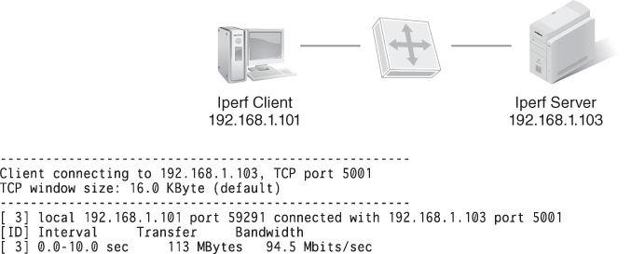
iPerf Output
FIGURE 12-2 iPerf output.

Slide 23
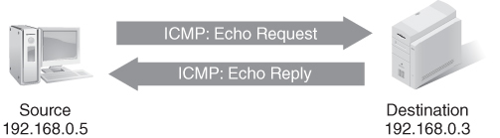
Ping Operation
FIGURE 12-3 Ping operation.

Slide 24
Service Providers
SP
Service provider
External entity that manages the physical infrastructure for a fee
Instead of buying physical infrastructure, organizations rent from SPs
SLA
Service level agreement
An agreement between an SP and a customer
Lists responsibilities of both parties and clarifies what the SP will provide the customer

Slide 25
Network Management
ITU-T Telecommunications Management Network (TMN) Layers
Business management
Service management
Fault and performance management
Element and configuration management

Slide 26
Simple Network Management Protocol (SNMP)
Is a standard protocol designed to help manage devices on an IP network
Collects and processes information about network devices
Typical SNMP-based system has three main components:
One or more devices to monitor
A software agent that runs on each monitored device
Software that communicates with the agents to identify and respond to faults
Central network management system (NMS) receives notifications from monitored devices; notifications are called SNMP traps

Slide 27
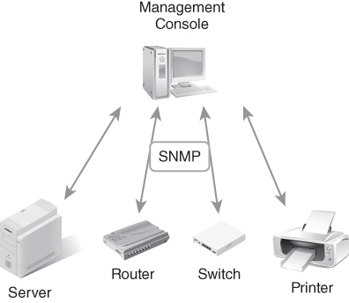
Typical SNMP Fault Management System Components
FIGURE 12-4 Typical SNMP fault management system components.

Slide 28
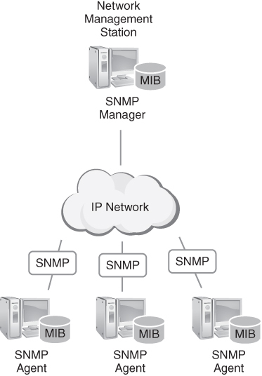
Management Information Bases (MIBs)
FIGURE 12-5 SNMP devices with MIBs.
Notes:
MIB
Is a small database of characteristics for a specific type of device
Individual settings in a MIB are called MIB variables
MIB variables that describe a single device are called a MIB module
Each MIB module represents a specific device
Loading a MIB module into the NMS identifies the device as a managed device
Figure shows SNMP devices with MIBs.

Slide 29
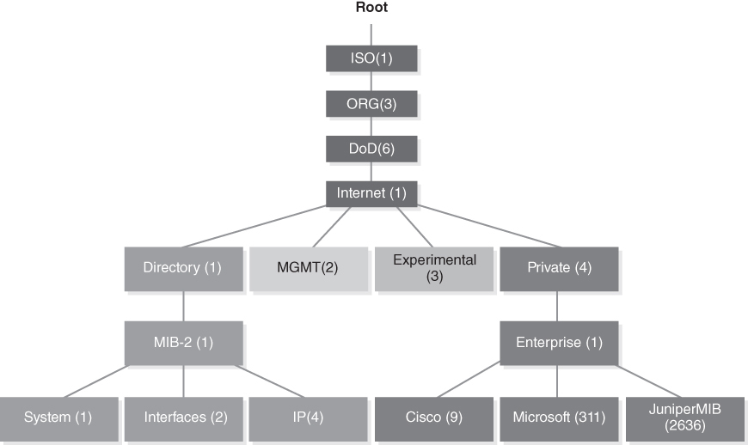
The OID Tree 1.3.6.1.4.1 Identifies Devices Assigned to Private Enterprises
FIGURE 12-6 The OID tree 1.3.6.1.4.1 identifies devices assigned to private enterprises.

Slide 30
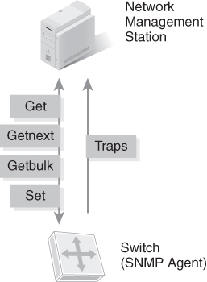
SNMP Operations
FIGURE 12-7 SNMP operations.

Slide 31
SNMP Trap
Is the only type of message the agent initiates; requires no response
Is a message sent to the NMS any time a preconfigured condition is met
Contains the agent OID and the value of the variable
Agent generates traps only for conditions currently configured
Once NMA receives a trap, it can:
Ignore the trap
Log the trap
Notify someone
Instruct the agent to modify a variable
Take a predefined action, such as shutting down the device
Launch a program or script to respond to the trap

Slide 32
FCAPS
F
C
A
P
S
Fault management
Configuration management
Accounting/ asset/ administration management
Performance management
Security management

Slide 33

FCAPS: Fault Management
Detects faults, correct them, and protect the network from future occurrences of similar faults
Predicts faults before they occur
Helps to protect the network and keep it running smoothly
Covers the planning process prior to detection
Allows organizations to respond to faults in a way that is repeatable
Helps to avoid future faults

Slide 34

FCAPS: Configuration Management
Is the process of ensuring that changes to network and device configurations are properly evaluated, authorized, implemented, and documented
Simplifies network management
Results in more stable networks
Helps to do the following:
Document device and software configurations
Control and track changes made to configurations
Provide a path for configuration changes

Slide 35

FCAPS: Accounting Management
Tracks network resource use
Disk usage, CPU time, and network link utilization
Use tracking can:
Help validate network device and bandwidth allocation
Point out when changes would produce better network performance
Can be called billing management because collected information is often used to bill external and internal customers for network use
In some applications of FCAPS, “administration” or “asset” replaces “accounting”

Slide 36

FCAPS: Performance Management
Is the process of monitoring how well the network meets performance standards
Helps staff respond to performance issues quickly
Ensures top performance
Is concerned mainly with the speed and integrity with which packets are delivered
Dropping below a reasonable level should trigger an alarm and some action
Goal is to provide the highest throughput with the lowest response time and error rate

Slide 37

FCAPS: Security Management
Is the process of ensuring that the three main tenets of security are achieved
Properties are also called the basic tenets of security, the security triad, and the C-I-A triad:
Confidentiality
Integrity
Availability
Securing data involves providing assurance that each of the three properties is satisfied

Slide 38
Network Security
Physical security
Access controls
Wireless security
Common network attacks
Network device hardening
Network mitigation solutions
Changing attacks
Blended response

Slide 39

Physical Security
Perimeter fence line
Landscaping that creates a natural barrier
Hand geometry units
Iris scanners
Access control systems and levels of access
Onsite security guards
Barrier systems
Cameras, including infrared cameras for night vision
Digital video recorders (DVRs) onsite to view, record, and retain the footage for a designated time

Slide 40
Access Controls, Wireless Security, and Common Network Attacks
Limit who can access resources
Username and password or passphrase
Biometrics
Role-based access control
Wireless security
Wi-Fi Protected Access 2 (WPA2) or WPA3
Common network attacks
Reconnaissance, eavesdropping, and denial of service
Access controls

Slide 41
Network Device Hardening
A centralized device to protect the entire network
A dedicated countermeasure for each device or resource
A countermeasure for each type of threat
Strict least privilege policy
Multilayered defense

Slide 42
Changing Attacks
Attacks increase in sophistication and impact
Refine network defenses
Multilayered defense
Is flexible
Can react to changing situations and provide continuous protection

Slide 43
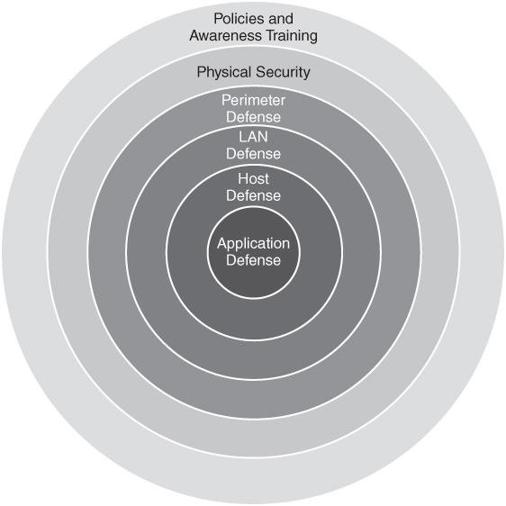
Blended Response / Multilayered Defense
FIGURE 12-8 Multilayered defense.
Notes:
Figure shows how an attacker must compromise multiple layers of countermeasures to reach a protected resource.

Slide 44
Summary
Network fault management
Network operations center
Change control and configuration management
Asset management, loss control, and interruption control
Network performance measurement, monitoring, protocols, and issue resolution

