Slide 1

Network Auditing, Monitoring, and Incident Response
CHAPTER 13

Slide 2
Learning Objective(s) and Key Concepts
Learning Objective(s)
Key Concepts
Describe how network management, auditing, and monitoring help improve performance and security.
Security auditing and analysis
Security monitoring
Responding to security incidents
Business continuity plan (BCP) and disaster recovery plan (DRP)
Planning for disaster and recovery

Slide 3
Purpose of Audits
Review risk management program
Confirm that risk has been identified and addressed
Recommend changes to processes, infrastructure, or other controls
Minimize risk involved with potential liability, negligence, and regulatory compliance
Expose problems and provide assurance of compliance
Notes:
Provides the opportunity to review your risk management program and to confirm that the program has correctly identified and addressed risk to the organization
Reports that auditors create should recommend improvements or changes to the organization’s processes, infrastructure, or other controls as needed
Are necessary because of potential liability, negligence, and mandatory regulatory compliance
Can expose problems and provide assurance of compliance, and may be mandated by legislation, regulation, or contractual agreement

Slide 4
Customer Confidence
Employ auditing standards for conducting audits
Statement of Standards for Attestation Engagements Number 16 (SSAE 16) levels of audit reporting for service organizations
Service Organization Control (SOC) framework
SOC 1 Internal controls over financial reporting
SOC 2 Security and privacy controls; audience: management, regulators, stakeholders
SOC 3 Security and privacy controls: audience: the public

Slide 5
Auditing Benchmarks
Best practices for auditing or reviewing systems, business processes, or security controls
ISO 27002
National Institute of Standards and Technology (NIST) Cybersecurity Framework (CSF)
Information Technology Infrastructure Library (ITIL)
Audit frameworks
Control Objectives for Information and Related Technology (COBIT)
Committee of Sponsoring Organizations (COSO) of the Treadway Commission

Slide 6
Security Monitoring
Baselines
Alarms, alerts, and trends
Systems that spot irregular behavior

Slide 7
Security Monitoring for Computer Systems
Real-time monitoring
Host intrusion detection system (IDS)
System integrity monitoring
Data loss prevention (DLP)
After-the-fact monitoring (non-real-time monitoring)
Application logging
System logging
Host-based activity
Network and network devices

Slide 8
Monitoring Issues
Spatial distribution
Switched networks
Encryption
Data Link Layer encryption (wireless WEP and WPA)
Network Layer encryption (IPSec and some other tunneling protocols)
Application Layer encryption (SSL and SSH and others)

Slide 9
Logging Anomalies
False positives
False negatives

Slide 10

Log Management and Types of Log Information to Capture
Log management
Store logs in a central location
Synchronize clocks of computers and devices
Types of log information to capture
Event logs
Access logs
Security logs
Audit logs

Slide 11
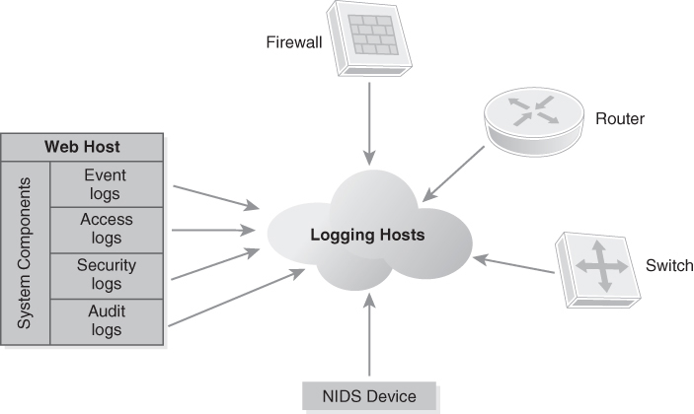
Types of Log Information
FIGURE 13-1 Types of log information.

Slide 12
Responding to Security Incidents
Event
Any observable occurrence, good or bad, in a computer, device, or network
Incident
Any event that results in a violation of the security policy, or poses an imminent threat to the security policy
Security incident
Can be anything from accidental actions that result in a problem up to and including downright malicious actions

Slide 13
Incident Response Plan, Policies, Procedures, and Guidelines (1 of 2)
Incident Response Plan (IRP)
Includes the steps and details required to respond to an incident through all phases
Allows you to proactively respond when incidents occur
Good IRP will determine whether you deal with an incident effectively or if it gets worse and out of control
Notes:
Also called the computer security incident response plan (CSIRP)

Slide 14

Incident Response Plan, Policies, Procedures, and Guidelines (2 of 2)
Policies for responding typically include these sections:
Names and contact information for the individuals who will take responsibility for determining when and if a security incident has occurred
Names and contact information for the individuals and/or groups that are the recipients of the initial notification that a security incident has occurred
Communication methods used for various notifications (email, phone, social media, face to face)
Name and contact information for the person or parties that will take the lead in responding to the incident
Notes:
Policies for responding typically include these sections:
Names and contact information for the individuals who will take responsibility for determining when and if a security incident has occurred
Names and contact information for the individuals and/or groups that are the recipients of the initial notification that a security incident has occurred
Communication methods used for various notifications (email, phone, social media, face to face)
Name and contact information for the person or parties that will take the lead in responding to the incident

Slide 15
Computer Security Incident Response Ream (CSIRT) (1 of 2)
IT personnel
Legal representation
Management and designees from affected operational departments

Slide 16
Computer Security Incident Response Ream (CSIRT) (2 of 2)
Human resources
Public relations
Security officers
Chief security officer

Slide 17
Phases of an Incident and Response
Preparation
Incident identification
Containment
Investigation
Eradication
Recovery and repair
Lessons learned

Slide 18
The Role of Business Continuity and Disaster Recovery Plans
Business continuity plan (BCP)
Disaster recovery plan (DRP)
Notes:
Business continuity plan (BCP)
Defines how an organization will maintain normal day-to-day business operations in the event of a security incident or other event
Disaster recovery plan (DRP)
Defines plans for how personnel and assets will be safeguarded in the event of a disaster and how assets will be restored

Slide 19
The Role of Business Continuity and Disaster Recovery Plans
Business continuity plan (BCP)
Defines how an organization will maintain normal day-to-day business operations in the event of a security incident or other event
Disaster recovery plan (DRP)
Defines plans for how personnel and assets will be safeguarded in the event of a disaster and how assets will be restored

Slide 20

Recovering Systems
BCP and DRP spell out process for recovering data, systems, and other sensitive information
Secure recovery requires an administrator designated to guide the recovery process
Steps should be taken to review details and relevance of the process and to update it where necessary

Slide 21

Business Impact Analysis
Refers to the process of analyzing existing risk and documenting various strategies to minimize identified risk
Results in a list of activities necessary for an organization to conduct business operations
Defines the impact to the organization if any critical activity stops
Is also used to illustrate costs of a failure, for example:
Work backlogs
Profit/loss
Overtime
System repair and replacement
Legal fees
Public relations
Insurance costs

Slide 22
Risk Assessment
Quantitative risk analysis
Type of analysis that associates a dollar value, or cost, with each risk
Qualitative risk analysis
Type of analysis that ranks risks relative to one another

Slide 23
Risk Management
Mitigate
Assign or transfer
Accept
Avoid

Slide 24
Planning for Disaster and Recovery
Policies, procedures, priorities, and practice
Testing and evaluation
Preparation and staging of testing procedures
Frequency of tests
Analysis of test results

Slide 25
Policies, Procedures, Priorities, and Practice (1 of 2)
Always consider and evaluate the proper redundancy measures for all critical resources
Look for adequate protection for systems such as servers, routers, and other devices in case they are needed for emergency usage
Check with all critical service providers to ensure that adequate protection has been taken to guarantee that the services provided will be available
Check for the existence of or the ability to obtain spare hardware wherever necessary
Ensure that the devices not only are appropriate for use, but also can be obtained in an emergency

Slide 26
Policies, Procedures, Priorities, and Practice (2 of 2)
Evaluate any existing SLAs that are currently in place so you know what constitutes acceptable downtime
Establish mechanisms for communication that do not require company resources (because they may be unavailable)
Ensure that the organization’s designated alternate site can be accessed immediately
Identify and document any and all points of failure, as well as any up-to-date redundancy measures that have been put in place to safeguard these points
Ensure that the company’s redundant storage is secure

Slide 27
Testing and Evaluation
Structured walkthrough (tabletop exercise)
Checklist
Simulation
Full interruption
Notes:
Testing must be run in order to ensure that the plan is effective, but this testing is not a one-time event.
It should be conducted on a regular basis to ensure the plan remains effective.

Slide 28
Analysis of Test Results
Quantitatively measure the test results
Elapsed time to perform various activities
Accuracy of each activity
Amount of work completed

Slide 29
Summary
Security auditing and analysis
Security monitoring
Responding to security incidents
Business continuity plan (BCP) and disaster recovery plan (DRP)
Planning for disaster and recovery

