Slide 1

Network Security
CHAPTER 14

Slide 2
Learning Objective(s) and Key Concepts
Learning Objective(s)
Key Concepts
Examine effective network security and troubleshooting techniques.
Security concerns that apply to networks
Risks, threats, and vulnerabilities
Network security risk assessment
Network security controls
Multilayered network defense

Slide 3
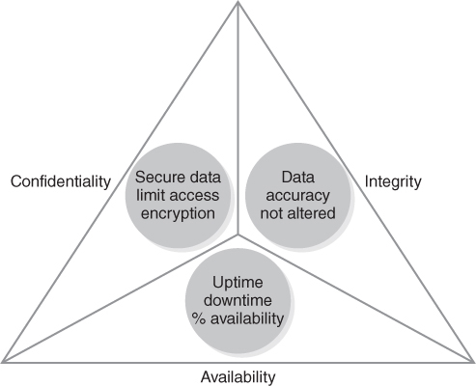
Network Security: Three Tenets of Security
FIGURE 14-1 Three tenets of security.

Slide 4
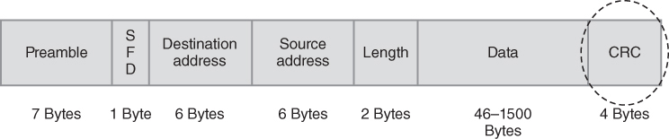
What Is Confidentiality?
Implies data is sensitive and not all users are authorized to access that data
Is a driver for enabling security controls such as role-based access controls, data encryption in transit and at rest, and audit and monitoring
FIGURE 14-2 Data encryption ensures confidentiality.

Slide 5
What Is Integrity?
Pertains to the accurate transmission of bits, bytes, and frames
Can also mean data integrity, which means data is accurate and not altered
Confirmation that data was not altered during transmission is verified at different layers of the protocol stack
Ethernet frames have a built-in data integrity checker called a cyclical redundancy check (CRC)
IP packets have a checksum function within the packet header

Slide 6
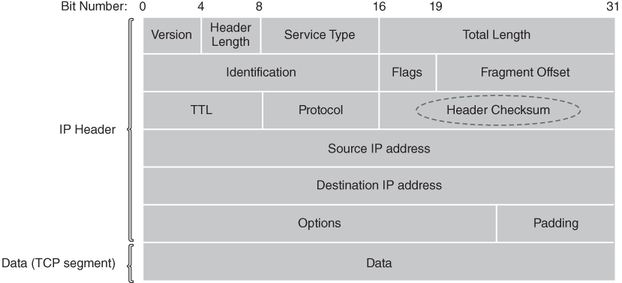
IEEE 802.3 Frame Format with CRC
FIGURE 14-3 IEEE 802.3 frame format with CRC.

Slide 7
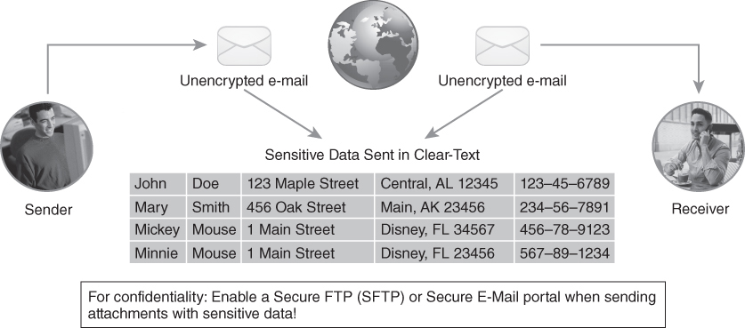
IP Packet Header Checksum
FIGURE 14-4 IP packet header checksum.

Slide 8
What Is Availability?
The system, application, and data are accessible to the user as needed
Required for user access to a system:
Authorized user with valid workstation or laptop device
Network Time Protocol (NTP) and Domain Name System (DNS) servers
Physical network connection via wired or wireless local area network (LAN)
Identification, authorization, and authentication
Role-based access to systems, applications, and data
Auditing, monitoring, and logging of user session

Slide 9
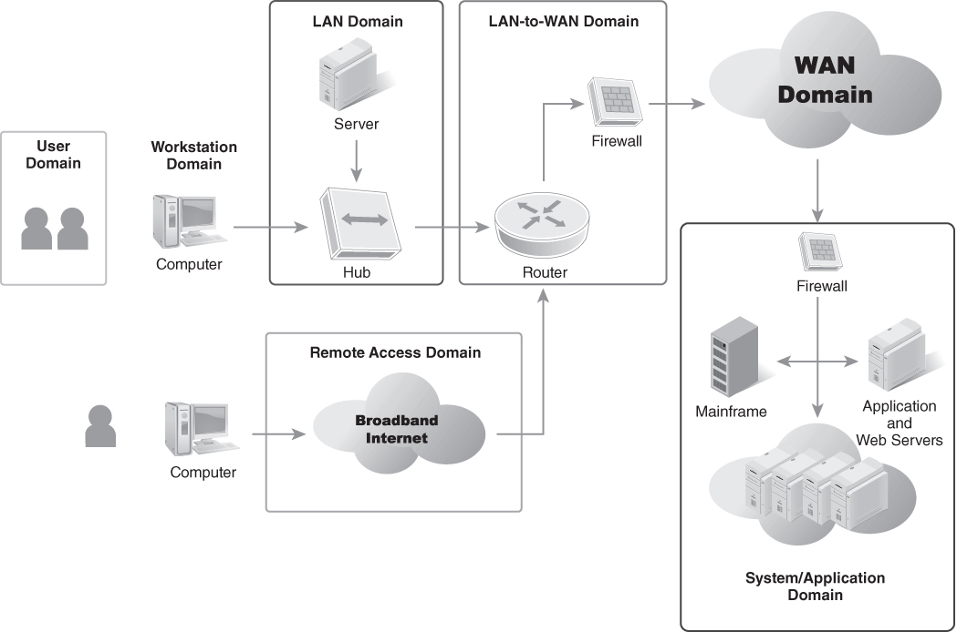
Network Security Scope (1 of 3)
FIGURE 14-5 Seven domains of a typical IT infrastructure.
Notes:
Domains that have or require specific network security controls include the following:
LAN—Network access control (NAC), identification, authorization, authentication, and log monitoring
LAN-to-WAN—Demilitarized zone (DMZ) virtual LAN (VLAN), Internet Protocol Security (IPSec) virtual private network (VPN) terminations, and threat monitoring
WAN—Network performance monitoring, encryption in transit, and use of secure communication protocols
Remote Access—Secure remote access with IPSec VPNs, multifactor authentication, and audit and monitoring enabled

Slide 10
Network Security Scope (2 of 3)
Network engineers need to address the following before identifying network security requirements and controls:
What kind of sensitive data is being transmitted onto the network?
Is the sensitive data encrypted at rest?
Is the sensitive data encrypted in transit?
Are role-based access control schemas defined such that access to sensitive data is granted only for authorized users?
How do we prescreen IT assets?
Are audit trails and logs sent to a syslog server or SIEM platform?

Slide 11
Network Security Scope (3 of 3)
Network engineers need to address the following before identifying network security requirements and controls:
Is the application mission critical, and does it require high availability (99.8% or higher) each month?
Is a VLAN configured to allow only authorized users on the same network segment that access sensitive data?
Is multifactor authentication (MFA) enabled on applications hosted in the public domain that have sensitive data?
Is Transport Layer Security (TLS) 1.3 enabled for proper transmission encryption using AES 256 cipher keys?

Slide 12
Network Risks, Threats, and Vulnerabilities
Examples of Network Risks
Availability to production applications and data is impacted
Integrity of data is compromised
Access controls are compromised
Critical network systems are down
Network performance is degraded
Examples of Network Threats
Compromised access controls
Insider threat
Malware
No visibility into the network
Phishing email
Social engineering
Unaware users
Examples of Network Vulnerabilities
Operating system software vulnerabilities and software bugs
Application software vulnerabilities and software bugs
Weak layered security design

Slide 13
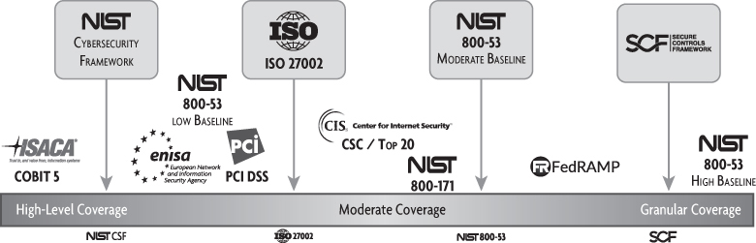
Conducting a Network Security Risk Assessment (1 of 2)
FIGURE 14-7 Compliance and standards define frameworks.
Data from Compliance Forge.com
Notes:
First, pick a framework to use. This can be a regulatory compliance framework, technical standard, or National Institute of Standards and Technology (NIST)–approved standard.

Slide 14
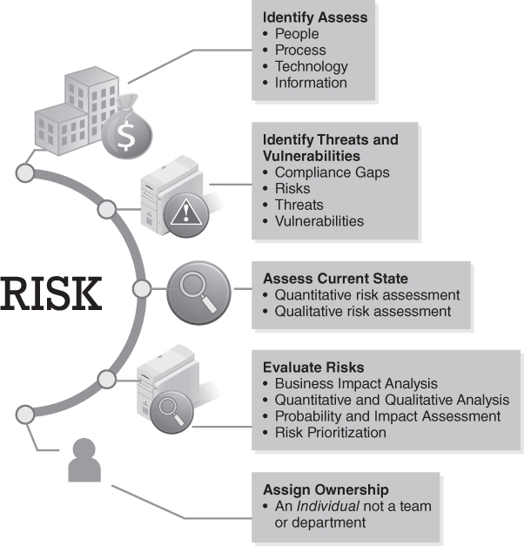
Conducting a Network Security Risk Assessment (2 of 2)
FIGURE 14-8 Network security risk assessment approach.

Slide 15
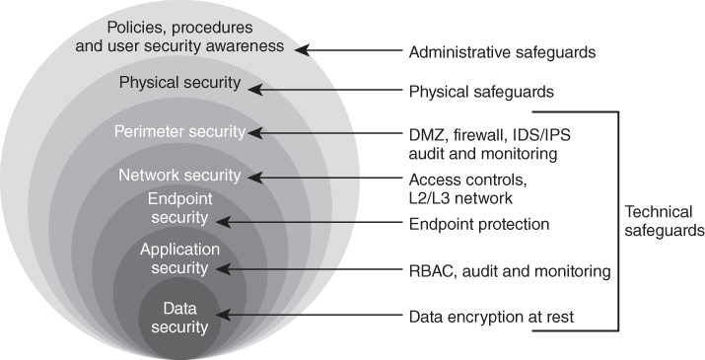
Layered Network Security Architectures
FIGURE 14-9 Defense-in-depth network security architecture.

Slide 16
Network Security Controls
Administrative
Physical
Technical
Notes:
Administrative
Pertains to HR and people
Administrative safeguards include things like HR onboarding/offboarding, background checks, employee handbook, acceptable use policy, and security awareness training completion
Physical
Pertains to the data center, hosting facility, or wiring closets that house sensitive equipment and cabling
Physical safeguards include building access and authorizing visitor access. Environmental safeguards like air conditioning and generators are needed to ensure availability
Technical
Pertains to the hardware and software solutions that are implemented to address gaps or weaknesses in the overall layered security architecture

Slide 17
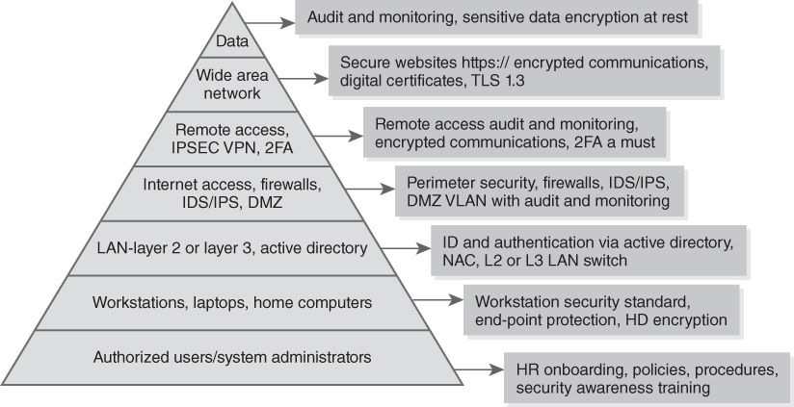
Layered Security Implementation
FIGURE 14-10 Layered security implementation.

Slide 18
How to Implement Security Controls
Compliance gap analyses
Security risk assessments
Gap remediation / security control implementation

Slide 19
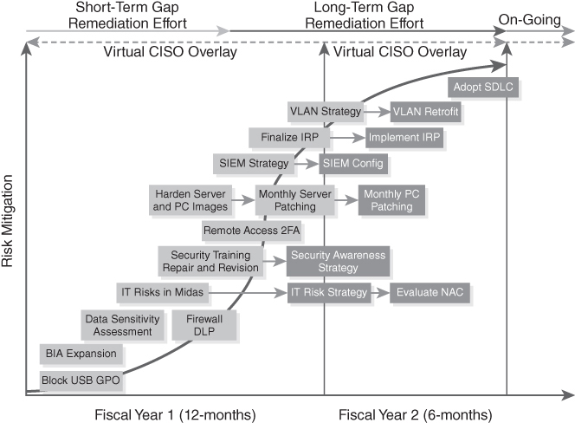
Sample Risk Mitigation Timeline with Virtual CISO Overlay
FIGURE 14-11 Sample risk mitigation timeline with virtual CISO overlay.
Notes:
SMB organizations may want to engage a virtual CISO (vCISO) or part-time CISO to support and drive gap remediation efforts.

Slide 20
Summary
Security concerns that apply to networks
Risks, threats, and vulnerabilities
Network security risk assessment
Network security controls
Multilayered network defense

