Slide 1

Network Troubleshooting
CHAPTER 15

Slide 2
Learning Objective(s) and Key Concepts
Learning Objective(s)
Key Concepts
Examine effective network security and troubleshooting techniques.
Network operations center
Problem resolution methodologies
Tools and applications for troubleshooting
Protocol analysis for troubleshooting IP networks
Troubleshooting for various network scenarios

Slide 3
Network Operations Center
Asset inventory and management
Business communications
Capacity planning
Data backup
Incident response
Firewall and IDS/IPS management
Maintenance
Network monitoring
Patch management
Performance management
SLA management
Service provider and vendor management
Vulnerability management

Slide 4
Network Troubleshooting and Ticketing
Problem identification steps performed during the initial opening of a ticket
Interview the user
Identify the symptoms of the network problem
Determine if anything had changed in the network before the issues appeared
Define individual problems clearly

Slide 5
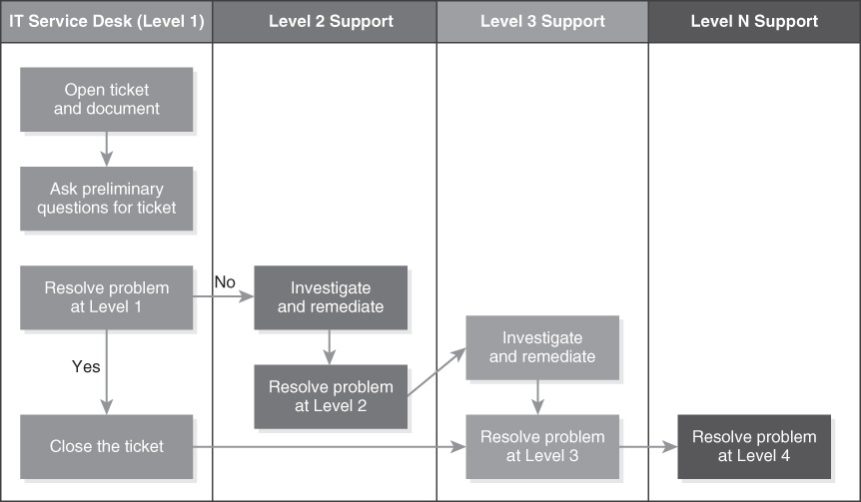
NOC and IT Service Desk Structure
FIGURE 15-1 NOC or IT service desk problem resolution workflow.
Notes:
Level 1 Support
Open a ticket and capture preliminary information; resolve problem if possible
Level 2 Support
Network analyst or engineer rules out Layer 1, 2, 3, and 4 network- and protocol-related issues
Level 3 Support
Senior network engineer and/or protocol expert assists application owner and user regarding issue
Service provider escalation performed
Level 4 Support
NOC director or manager refers owner to vendor or subject matter expert consultant

Slide 6
Network Troubleshooting Approach (1 of 3)
Process of elimination
Physical Layer
Is the cable cut? Did the electric power go out?
With a Physical Layer issue, there is no network availability
Data Link Layer
For wired LANs, is there link integrity between the Ethernet network interface controller (NIC) and the Ethernet switch?
Link integrity will be visibly shown as green LED indicator. No link integrity is visibly shown as a dark LED indicator

Slide 7
Network Troubleshooting Approach (2 of 3)
Process of elimination
Network Layer
Can you ping the destination IP host?
Confirm your IP host has a correct IP default gateway router definition
Ping the IP default gateway router
Confirm your host device MAC layer address is in the Address Resolution Protocol (ARP) cache table
Verify that the destination IP network is listed in the IP route table
Confirm that the MAC layer address of the destination IP host device is in the ARP cache table of its IP default gateway router

Slide 8
Network Troubleshooting Approach (3 of 3)
Process of elimination
Transport Layer
Depending on use of a connectionless (UDP) or connection-oriented (TCP) Transport Layer, UDP will have no guarantee of transmission like TCP does
TCP requires a three-way handshake to confirm a valid communication path exists
TCP also uses acknowledgements to confirm receipt and sequence numbers to reassemble packets in the proper order

Slide 9
Network Troubleshooting Tools (1 of 2)
Physical Layer tools
Testers for copper and fiber optic cabling, RJ-45 connectors, and RJ-45 crimp tools for making patch cables and installing connectors
Network performance monitoring tools
Tools that provide a microscopic look at network bandwidth; number of bits and bytes transmitted; and use of Data Link Layer frames, IP packets, and other protocols transmitted in a given time slot
Network connectivity and testing tools
Tools that provide a link integrity and Network Layer discovery function that allows verification of Physical Layer, Data Link Layer, and Network Layer connectivity

Slide 10
Network Troubleshooting Tools (2 of 2)
Network scanning and discovery tools
Tools that can perform an ARP scan, ping sweep, or other host discovery function on an Ethernet LAN or IP subnetwork
Vulnerability assessment tools
Tools that have a software vulnerability database to confirm if a software patch has been proper installed on an IT asset
Example: Vulnerability assessment scanner
Protocol analysis tools
Software tools that can capture Data Link Layer frames and Network Layer protocols and perform protocol decoding and analysis
Example: Wireshark

Slide 11

Physical Layer Tools
Cable testers
Used to troubleshoot link integrity, pin configurations, terminations, and end-to-end connectivity
For copper-based transmission media, includes toners, continuity testers, Voice over IP (VoIP) signaling, and 1000Base-T signaling
Optical fiber testers
For fiber optic–based transmission media
Confirm link integrity, measure cable distance, and capture loss of signal strength with an optical time division reflectometer (OTDR)

Slide 12
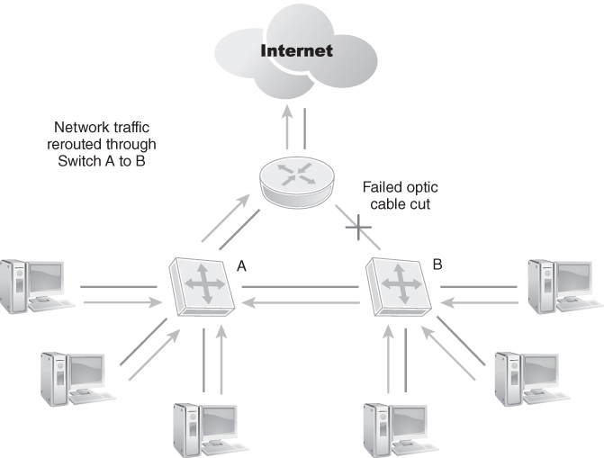
Fiber Backbone Cable Is Cut
FIGURE 15-2 Fiber backbone cable is cut.

Slide 13
Network Performance Monitoring Tools (1 of 4)
Bandwidth
The maximum data transmission speed that can transmit data
Throughput
The actual data transmission speed that is sent through the communication link
Typically measured in number of bits per second
Network utilization
The amount of bandwidth used over a specific period of time
Generally specified as a percentage
Baseline
Identifies normal network traffic patterns and behavior

Slide 14
Network Performance Monitoring Tools (2 of 4)
Capacity planning
The function of monitoring, reporting, and increasing or decreasing bandwidth and circuit costs as needed
Network choke point
A part of the network where the bandwidth and throughput cannot keep pace with the amount of data that must be transmitted
Baselining network connections and links allows you to set threshold alarms for excessive bandwidth usage or abnormal spikes in network traffic flow

Slide 15
Network Performance Monitoring Tools (3 of 4)
Goals and objectives of network monitoring:
Maximize availability
Provide end-to-end visibility throughout the network
Support incident response for network outages or down communication links
Develop baseline definitions for normal network traffic behavior
Measure performance with defined metrics and reporting
Perform capacity planning
Confirm monthly service level agreements (SLAs) are being met by service providers

Slide 16
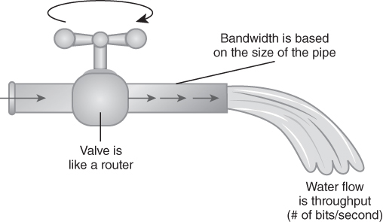
How Do You Measure Bandwidth?
FIGURE 15-3 How do you measure bandwidth?

Slide 17
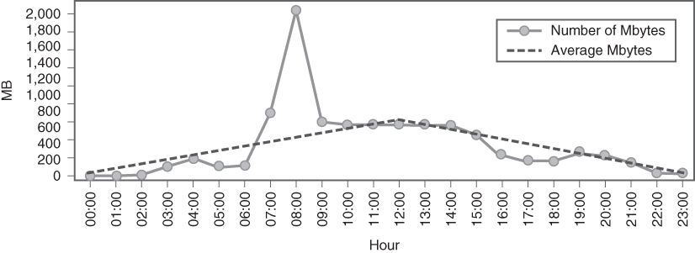
Sample Network Performance Graph with Baseline Definition
FIGURE 15-4 Sample network performance graph with baseline definition.
Data from IdeaData.

Slide 18

Network Performance Monitoring Tools (4 of 4)
Examples of open source network monitoring tools
OpenNMS
Nagios
Spiceworks Connectivity Dashboard
Example of free trial software followed by a license fee
PRTG

Slide 19
Network Traffic Tools
Network traffic or packet test tools
Generate different kinds of network traffic
Enable you to performance test, stress test, and capacity plan your WAN, MAN, or LAN connections and links
Examples of network traffic and packet testers
Bandwidth Place
HELIOS LanTest (Windows, Mac)
iPerf (Mac, Linux)
LAN Speed Test Lite (Windows, Mac)
Netflow Traffic Analysis
Packet Sender (Windows, Mac, Linux)
TamoSoft Throughput Test (Windows, Mac)

Slide 20
Network Connectivity Tool
Ping
Confirms network connectivity
Layer 1 physical connectivity
Layer 2 Data Link Layer connectivity
Layer 3 IP Network Layer connectivity
Traceroute
Verifies IP route or path taken through the IP data network
Confirms end-to-end IP network connectivity
Traceroute is Linux-based; tracert is Windows-based

Slide 21
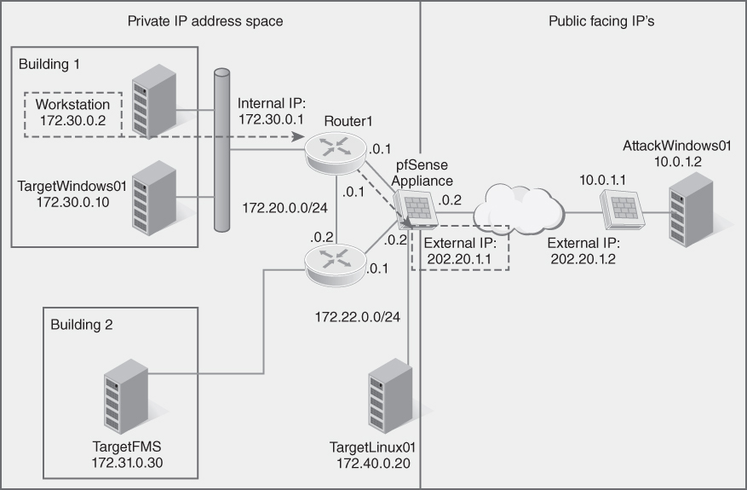
Sample IP Network with Private and Public IP Addresses
FIGURE 15-5 Sample IP network with private and public IP addresses.

Slide 22
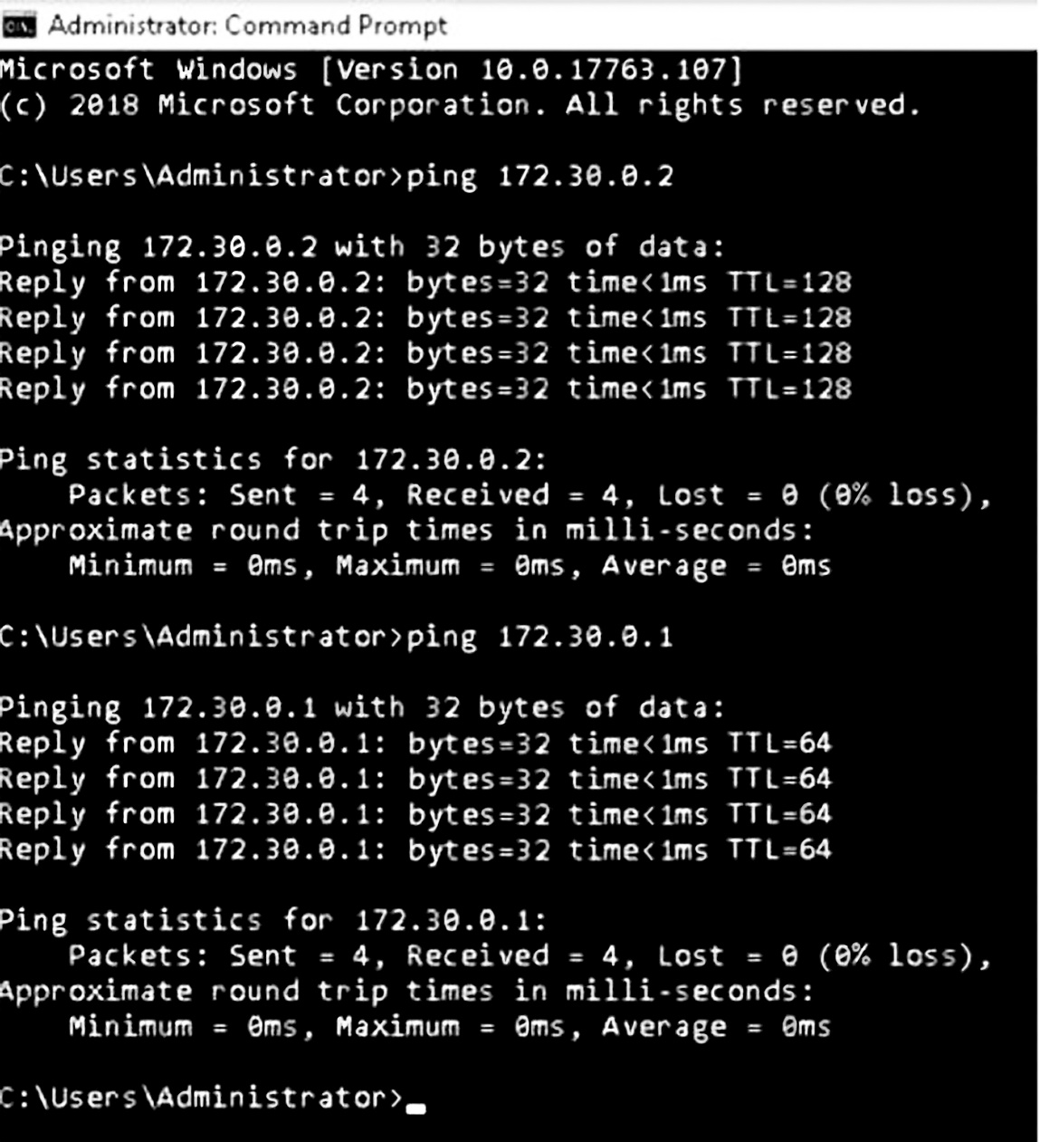
Workstation Pinging Itself and then the IP Default Gateway Router
FIGURE 15-6 Workstation pinging itself and then the IP default gateway router.
Used with permission from Microsoft.

Slide 23
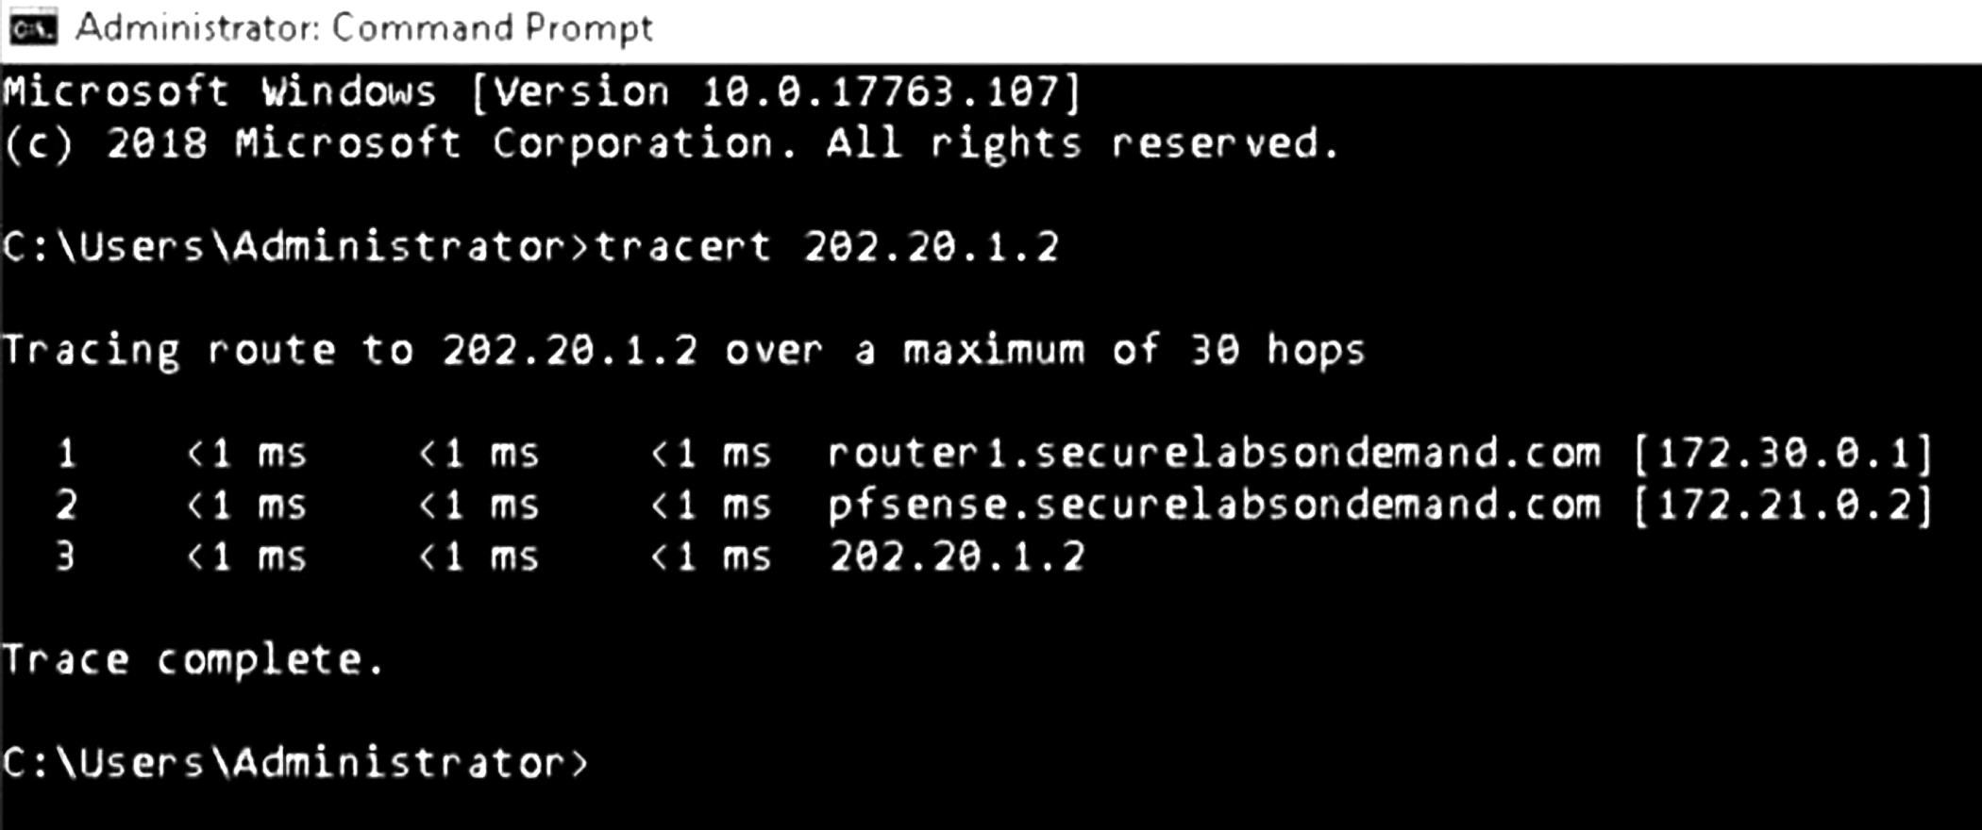
Traceroute Command
FIGURE 15-7 Traceroute command.
Used with permission from Microsoft

Slide 24

Network Scanning and Discovery Tools
two kinds of network scanning discovery tools
Data Link Layer scans
Network Layer scans
Examples
Nmap (Network Mapper)
Spiceworks Inventory
TopMaze
Notes:
Two kinds of network scanning discovery tools:
Data Link Layer scans
Use the ARP scan tool, which works on targeted IP subnetworks or a single Ethernet broadcast domain only
Identify all IP host devices and capture their MAC layer address and IP Network Layer address
Network Layer scans
Use ping sweeps of targeted IP subnetwork numbers to identify IP host devices on an IP subnetwork
Layer 3 scanning devices can test beyond the local IP subnetwork throughout an enterprise as long as internal firewalls do not block the scan packets

Slide 25
Vulnerability Assessment Tools (1 of 2)
Are used to scan IP networks
Tools compare each asset’s operating system and version level to known software vulnerabilities
Tools support a vulnerability management program

Slide 26
Vulnerability Assessment Tools (2 of 2)
National Vulnerability Database (NVD)
Software vulnerabilities are tracked
Common Vulnerabilities and Exposures (CVE)
A comprehensive list of known software vulnerabilities
Examples:
Nexpose
OpenVAS
InsightVM
Nessus
Vulnerability Management Platform

Slide 27
Protocol Analyzer Tools
Monitor traffic
Capture network traffic
Decode protocols
Apply protocol filters
Decode each layer of the protocol stack
Identify erred or dropped packets
Verify if data is encrypted or unencrypted
Analyze network traffic
Build baseline definition
Protocol analysis provides network visibility
Without visibility, network troubleshooting would stop at Layer 2 of the OSI model where Ethernet and the Data Link Layer live
Notes:
Examine, decode, and organize signals, frames, packets, and protocol dialog between a source and destination host
Typical features and functions:
Monitor traffic in real time with synchronized date and time stamps as per Network Time Protocol (NTP) server settings
Capture network traffic in a packet capture or pcap file for future analysis
Decode protocols and organize all source-destination communications
Apply protocol filter to MAC addresses or IP addresses to generate a report of all communications from source to destination
Decode each layer of the protocol stack for Ethernet Data Link Layer frames, IP, and UDP or TCP at the Transport Layer
Identify if there are erred or dropped packets somewhere in the transmission between the source and destination hosts
Verify if data is encrypted or unencrypted in the packet payload
Analyze network traffic such as average packet size in bytes, number of packets transmitted, total number of bytes sent/received, and so on
Build baseline definitions for number of packets, throughput, and bytes transmitted for specific source and destination host devices

Slide 28
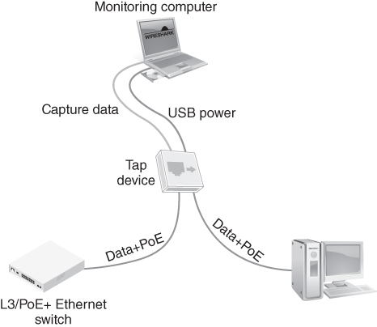
Network Taps Support Remote Monitoring and Protocol Capture
FIGURE 15-8 Network taps support remote monitoring and protocol capture.
Data from https://www.dualcomm.com/products /usb-powered-10-100-1000base-t-network-tap

Slide 29
Network Troubleshooting Using Protocol Analysis: How Protocols Behave
Ethernet destination MAC layer addressing protocol behavior
Address Resolution Protocol (ARP) behavior
IP Network Layer protocol behavior
Transport Layer protocol behavior
Windows client/server protocol behavior

Slide 30
Ethernet Destination MAC Layer Addressing Protocol Behavior
Kinds of destination MAC addresses:
Unicast address (6-byte destination MAC address)
Multicast address
Broadcast address (FF-FF-FF-FF-FF-FF)
Notes:
Kinds of destination MAC addresses:
Unicast address (6-byte destination MAC address)—One-to-one protocol dialogue and communications between a single source and single destination.
Multicast address—One-to-many protocol dialogue and communications from one device to many devices. IPv4 multicast packets are delivered using the Ethernet multicast MAC layer address range 01:00:5e:00:00:00 to 01:00:5e:7f:ff:ff. This range has 23 bits of available address space. The first octet (01) includes the broadcast/multicast bit.
Broadcast address (FF-FF-FF-FF-FF-FF)—One-to-all protocol dialogue and communications where all IP host devices see the broadcast frame.

Slide 31
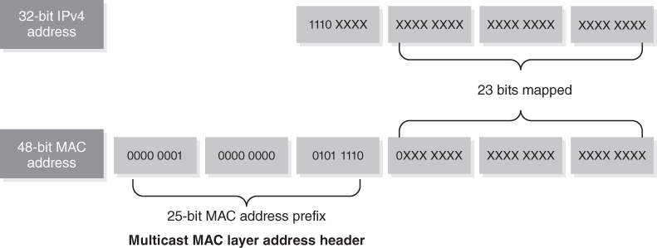
IPv4 to MAC Layer Multicast Address Mapping
FIGURE 15-9 IPv4 to MAC layer multicast address mapping.
Data from Hewlett Packard Enterprise Development LP https://techhub.hpe.com/eginfolib/networking/docs/switches/5130ei/5200-3944_ip-multi_cg/content/483573739.htm

Slide 32
Address Resolution Protocol (ARP) Behavior
ARP request
ARP reply
ARP cache table must align with the IP default gateway router’s ARP cache table
Notes:
ARP request
Ethernet host sends a broadcast frame seeking the MAC layer address of a specific IP destination host
Broadcast frame is transmitted throughout the Ethernet broadcast domain
ARP reply
If specific IP destination host receives the ARP request frame and recognizes the IP address, host will reply to the ARP request with a targeted response to the source device
Destination IP host sends its MAC layer address in the ARP reply frame such that IP communications can commence

Slide 33
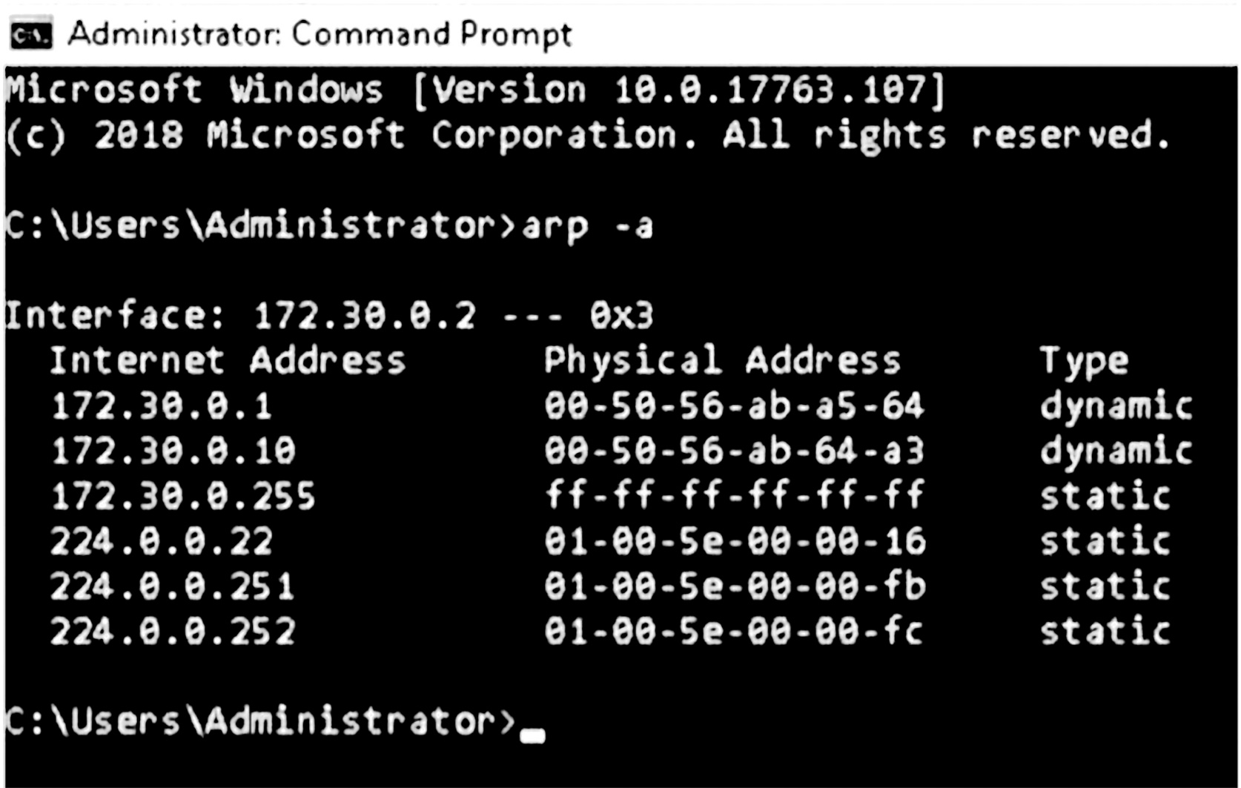
ARP Cache Display in IP Host Device
FIGURE 15-10 ARP cache display in IP host device.
Used with permission from Microsoft.

Slide 34
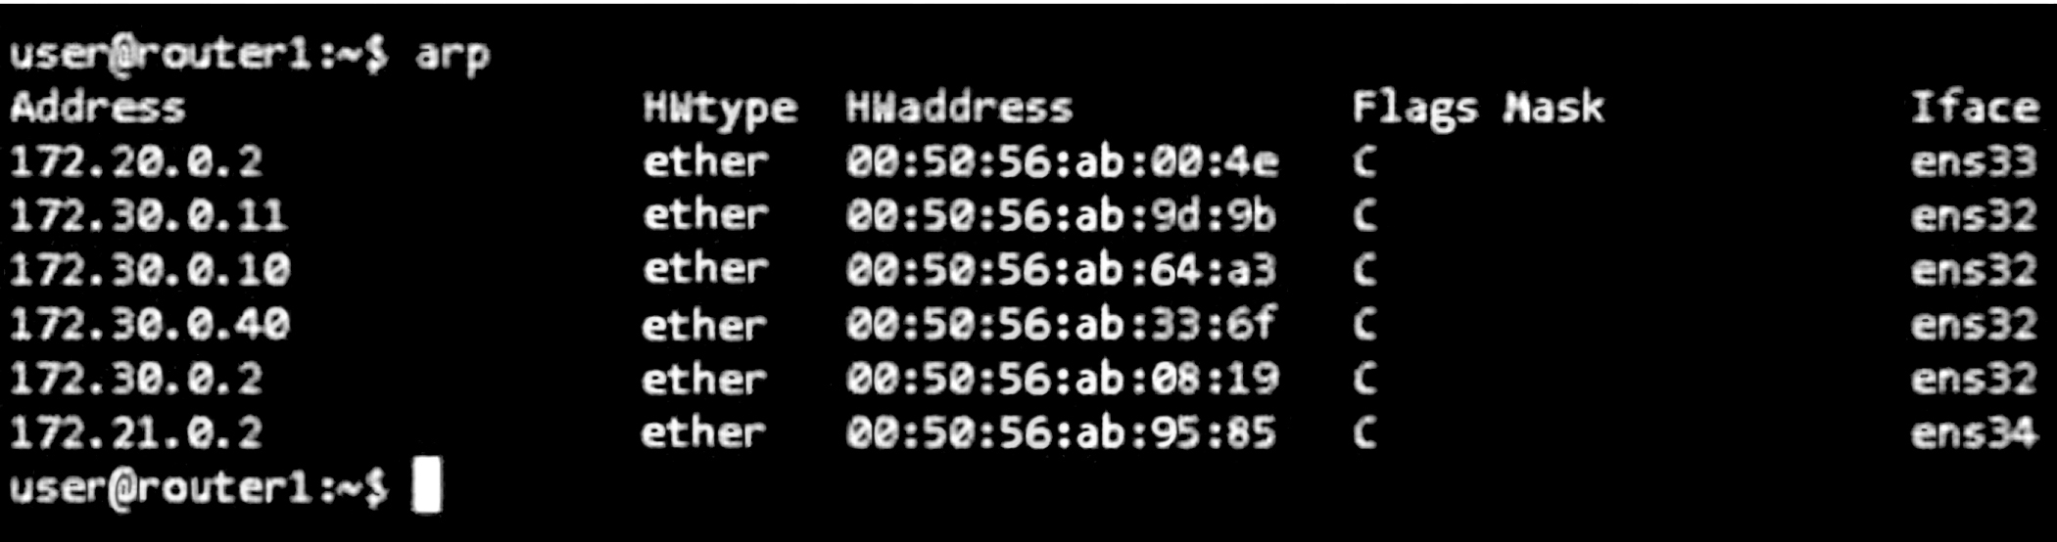
ARP Cache Display in an IP Router
FIGURE 15-11 ARP cache display in an IP router.
Used with permission from Microsoft.

Slide 35
IP Network Layer Protocol Behavior (1 of 2)
Internet Protocol (IP)
A connectionless Network Layer protocol
Packets are transmitted with a best effort delivery
Packets are not acknowledged, and do not have sequence numbering for reassembly at the destination
If an IP packet is lost or erred, entire transmission starts over

Slide 36
IP Network Layer Protocol Behavior (2 of 2)
Internet Control Message Protocol (ICMP)
A family of Layer 3 protocols that provides IP network errors and reporting
ICMP error messages are sent back to the source IP host from the IP default gateway router when IP communications fail
Ping uses the ICMP echo request and echo reply packet to test Layer 3 connectivity
Notes:
Because IP is connectionless and best effort delivery, capturing the entire protocol interaction between source and destination IP host is needed to properly troubleshoot

Slide 37
Transport Layer Protocol Behavior (1 of 2)
User Datagram Protocol (UDP)
A connectionless transport protocol; best-effort packet delivery
Does not utilize acknowledgements or packet sequence numbering
Does not require a valid communication channel prior to sending IP packets
Used for fast communications and data transfers
Errors result in a retransmission

Slide 38
Transport Layer Protocol Behavior (2 of 2)
Transmission Control Protocol (TCP)
A connection-oriented transport protocol
More overhead than UDP to guarantee end-to-end packet delivery
Embeds connection-oriented protocol behavior with:
A TCP/IP three-way handshake between source and destination IP host devices
Unique sequence numbers at the destination for each TCP packet
Uniquely acknowledging each TCP packet by incrementing packet sequence
Used for large file transfers or ones that require reliable transmission

Slide 39
Windows Client/Server Protocol Behavior
Active Directory (AD) system
Is a Microsoft directory and file management system
Identifies, authenticates, and authorizes domain users and computers
Assigns and enforces security policies for workstations
Is a directory service database
Uses Lightweight Directory Access Protocol (LDAP) for accessing and maintaining distributed directory information services
LDAP
The protocol used for login to a Windows server and environment
The protocol used to access directory services and other functions from the Windows LAN environment

Slide 40
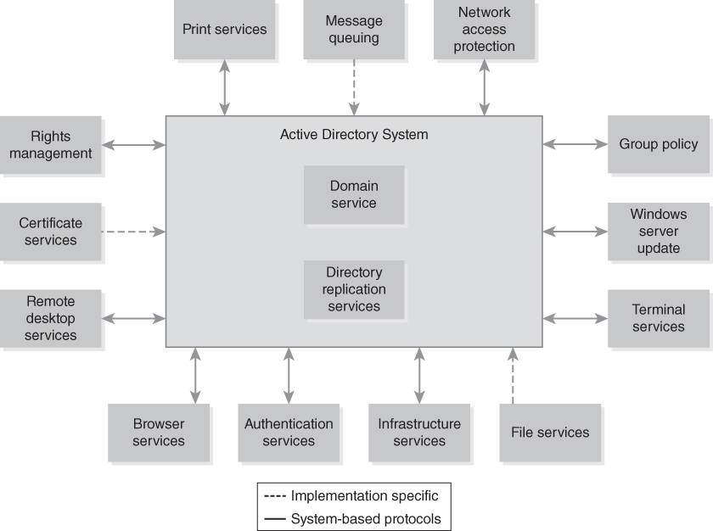
Windows Active Directory System
FIGURE 15-12 Windows Active Directory system.
Used with permission from Microsoft

Slide 41
Network Troubleshooting Scenarios (1 of 3)
Names not resolving
Incorrect gateway definition
Incorrect netmask
Duplicate IP address

Slide 42
Network Troubleshooting Scenarios (2 of 3)
Duplicate MAC addresses
Expired IP address
Rogue DHCP server
Untrusted SSL certificate
Incorrect time

Slide 43
Network Troubleshooting Scenarios (3 of 3)
Exhausted DHCP scope
Blocked TCP/UDP ports
Incorrect host-based firewall settings
Incorrect ACL settings
Unresponsive service

Slide 44
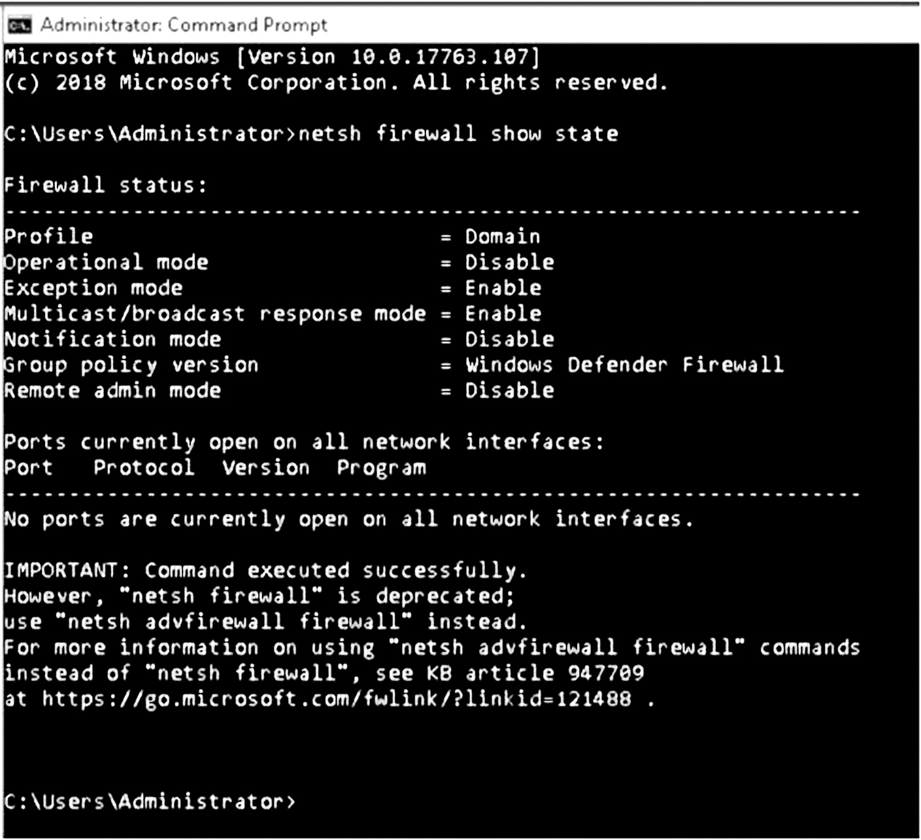
Windows Host Firewall Port Display
FIGURE 15-13 Windows host firewall port display.
Used with permission from Microsoft.

Slide 45
Summary
Network operations center
Problem resolution methodologies
Tools and applications for troubleshooting
Protocol analysis for troubleshooting IP networks
Troubleshooting for various network scenarios

