Slide 1
PREDICTING THE SEVERITY OF A COLLISION

Slide 2
Predicting the severity of a collision is important for public safety
Road transport is a widely used mode of transport and daily millionss of commuters travel from one place to another.
Also, thousands of people loose lives daily in these accidents.
Predicting Severity of an accident will help
Allows individuals to take alternative when they get to know that there is be a high severity accident on that route.
Also, they can avoid certain types or routes in certain weather conditions.
Gives insight for government officials in alerting public by putting more sign boards where ever there are high severity accidents are taking place.

Slide 3
Data Acquisition and Cleaning
Total 37 inputs listed in the sample data set.
Dropped some of the duplicate features that are present to describe the data in another column and IDs that are meant to uniquely represent a record in the dataset.
Also, cleaned up the blank cells by dropping them and in some places fling them with default values.
At this stage there are about 194673 records with 13 features and 1 target variable.

Slide 4
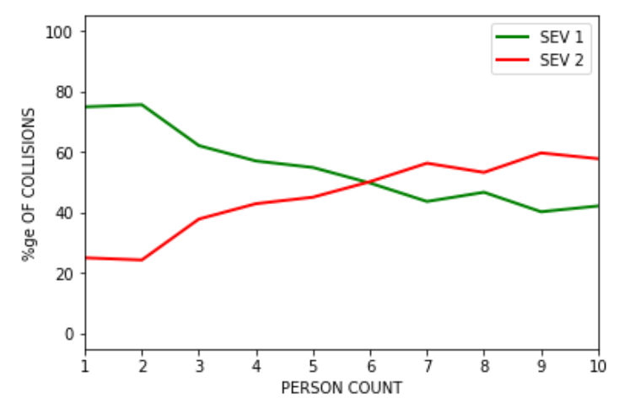
More persons, high severity
When the number of people involved in the collision is more then the chances of it becoming a high severity collision are more.

Slide 5
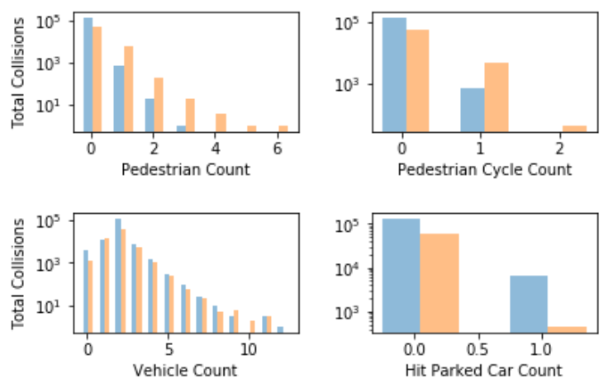
Pedestrian and Pedestrian cycle
If the collision includes pedestrians or pedestrian cycle then it will most likely be a high severity accident.

Slide 6
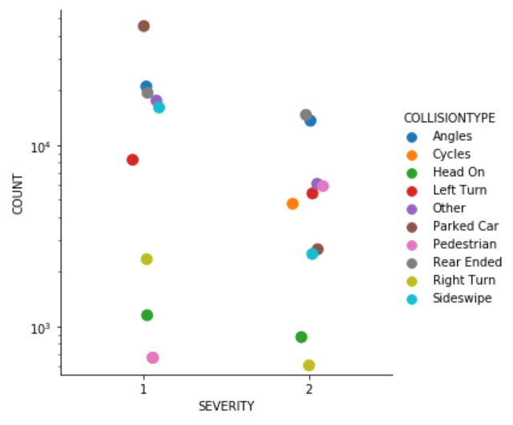
Collision Type
The collision type can also give some useful insight in particular cases. Cycles and Pedestrians are more in Sev 2.

Slide 7
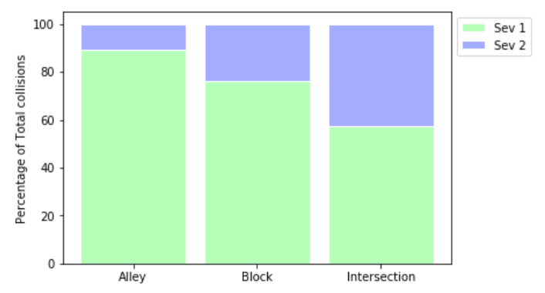
Address Type
Close to 90% of Alley accidents are classified as Sev 1, this is a very good input for our analysis further.

Slide 8
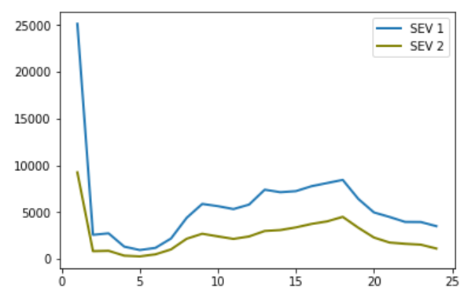
Time of the collision
The time of the collision does not really give us clarify on the severity as both the lines tend to follow the same curve.

Slide 9
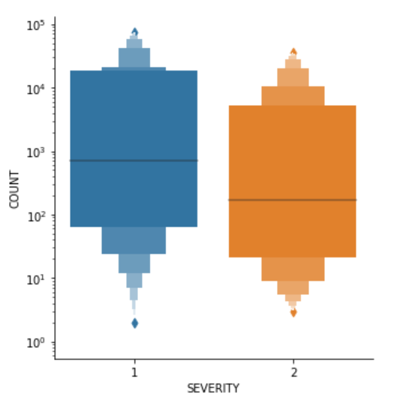
Weather
Based on the median and the distribution of collisions, it gives an impression that the weather has a role in the severity.

Slide 10
Conclusion and Future Directions
People can avoid those routes where the prediction of severity of an accident is high.
It can be integrated with Google maps to alert drives travelling on that road to take conscious decisions.
Government officials can further dig into the data to identify if there are certain roads becoming dangerous under circumstances such as bad weather, low lighting etc.
First responders can use this data in getting the needed support to the victims as quickly as possible before reaching the site of the incident.

