Slide 1
REEL
A Movie Recommendation System
BICT242 — Data Scalability and Analytics | Course Project | Dataset: MovieLens (ml-latest-small)

Slide 2
OBJECTIVE
Recommending movies people will actually enjoy
Design, build and evaluate a movie recommendation system using real rating data — comparing content-based, collaborative-filtering and matrix-factorization approaches, then shipping the best-performing model as a working system.
01
Collect & clean
MovieLens ratings, movies and tags
02
Engineer features
genre/tag TF-IDF, user-item matrix
03
Train & compare
content, CF, SVD, hybrid models
04
Evaluate & ship
RMSE/MAE, Precision/Recall/F1, working app

Slide 3
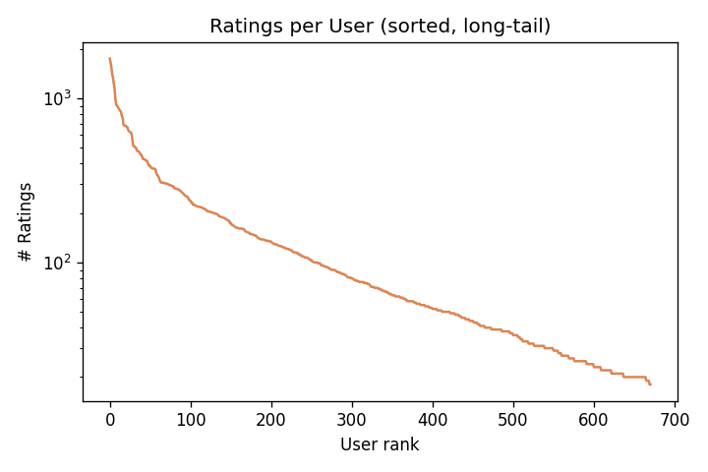
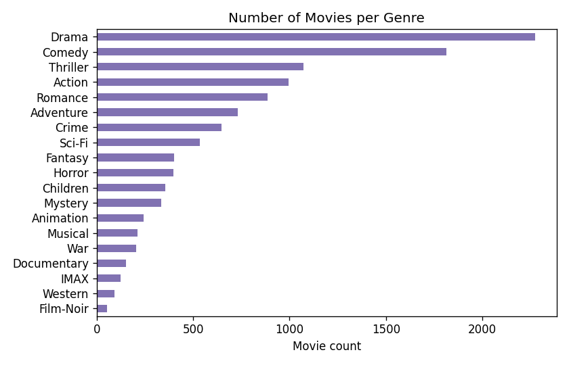
DATASET
MovieLens ml-latest-small
671
4,801
94,537
97.1%
users
movies (after filtering)
ratings
matrix sparsity
Four raw files — movies.csv, ratings.csv, tags.csv, links.csv — from GroupLens Research. Users were pre-filtered to ≥5 ratings and movies to ≥3 ratings to stabilise similarity computation.
Long-tail ratings per user
Movies per genre

Slide 4
FEATURE ENGINEERING
Turning raw ratings into model inputs
1
Content “soup”
2
User-item matrix
Genres (×3 weight) + free-text tags, vectorised with TF-IDF for content-based similarity.
671 × 4,801 sparse matrix of ratings, shared by collaborative filtering and SVD.
3
Bayesian popularity
4
Release year & clean title
Rating count × mean, shrunk toward the global mean so 1-rating movies can't top the charts.
Parsed from the raw title string for filtering and display.

Slide 5
MODELS
Four approaches, evaluated head-to-head
1
2
3
4
Content-Based
Item-Based CF
Matrix Factorization
Hybrid
TF-IDF cosine similarity over genres & tags. No cold-start problem; coarse signal.
Cosine similarity between item rating vectors; weighted-average prediction.
Truncated SVD, 50 latent factors, mean-centred ratings.
α·SVD + (1−α)·Content, α tuned to 0.9 on validation data.

Slide 6
EVALUATION METHODOLOGY
How the models were judged
Split
Per-user 80/20 train/test (min. 10 ratings to be eligible) — 75,875 train / 18,662 test ratings
Rating accuracy
RMSE & MAE on held-out ratings, vs. a “user-mean” baseline
Ranking quality
Precision@K, Recall@K, F1@K for K = 5, 10, 20; relevant = rating ≥ 4.0
Leakage control
Similarity & factor models retrained on train-only data; seen items excluded from candidates

Slide 7
RESULTS — RATING PREDICTION
Both learned models beat the naive baseline
Item-based CF achieves the lowest error — with 671 users, its item-item structure outperforms a 50-factor SVD.

Slide 8
RESULTS — TOP-N RANKING QUALITY (F1@K)
Item-based CF ranks best at every K

Slide 9
MODEL SELECTION
Item-based CF in production, content-based as fallback
PRODUCTION DEFAULT
Best F1@K at every K; lowest RMSE/MAE among learned models.
Item-Based Collaborative Filtering
COLD-START FALLBACK
Used when a movie/user has too little history for CF to work.
Content-Based Similarity
BALANCED OPTION
Nearly matches CF while staying more robust to sparse items.
Hybrid (α = 0.9)

Slide 10
IMPLEMENTATION
From notebook to a usable system
recommender.py — reusable MovieRecommender class + CLI (--user, --movie, --method)
$ python3 recommender.py \
--user 15 --method hybrid --n 5
Selectable method per call: hybrid (default), item_cf, or svd
0.533 Lethal Weapon 2 (1989)
0.531 Full Monty, The (1997)
0.530 Money Train (1995)
0.530 Another 48 Hrs. (1990)
0.530 17 Again (2009)
Trained artifacts (similarity matrices, SVD factors) persisted for fast reuse
Published interactive web demo: “movies like X” and “recommend for user”

Slide 11
LIMITATIONS & FUTURE WORK
Where this could go next
Richer content signal
Better factorization
Temporal awareness
Online evaluation
Pull plot synopsis, cast & director from TMDb via the existing links.csv IDs.
Grid-search latent factors k; move to ALS/SGD with explicit regularization.
Weight recent ratings more heavily — tastes and catalogues shift over time.
A/B test against click-through or watch-through, not just held-out rating accuracy.

Slide 12
Thank you
Reel — a MovieLens recommendation system built and evaluated for BICT242: Data Scalability and Analytics.

