Slide 1
Event Travel Portal Attendee User Manual
Last Updated July 2018

Slide 2

Table of Contents
Action / Screen | Slide
Profile page | 3
Edit Profile (and add Delegate) | 4
RSVP to event | 5
View Event you will be attending | 6
Edit your Other Attendee Details for event | 7
HOW TO: RSVP TO EVENT
Action/Screen | Slide
RSVP to event (Yes/No + enter your Other Attendee Details) | 5
Complete your Attendee Profile (if incomplete) | 4

Slide 3
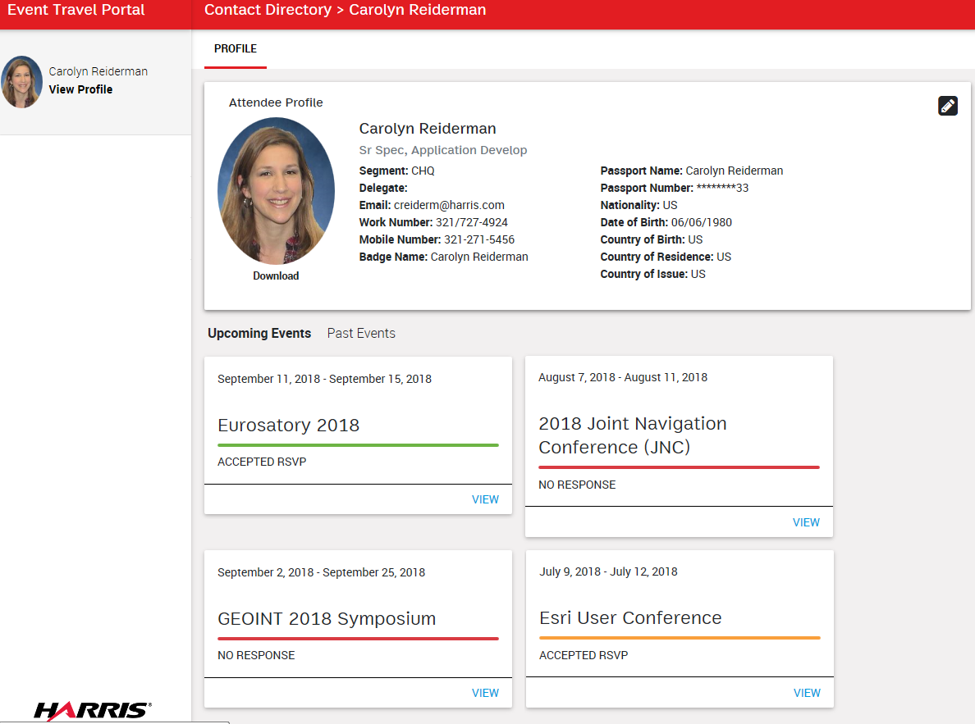
Profile Page
When you enter the Event Travel Portal, you see your Profile Page:
Your profile information
Allows you to Edit your profile information (e.g. add passport) and add a Delegate for yourself
Lists the events you have been invited to participate as an attendee
Shows if you have RSVP’d to this event or not
Click VIEW to RSVP and Edit your Attendee Details for this event
Click PROFILE tab to return to your Profile Page
6
2
1
Go to
Edit Profile
3
4
5
5
Go to
Edit Attendee Details
Go to
RSVP to Event
Notes:
Q: Confirm that an attendee only has access to Profile page

Slide 4
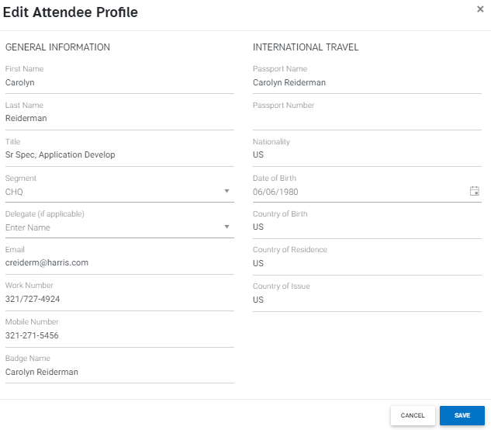
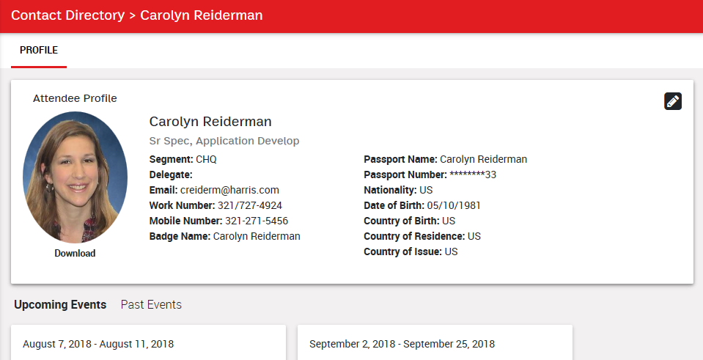
Edit Profile
From Profile Page, click Edit icon
Add information to complete your profile
Note: International Travel fields required only if you will be supporting an event out of country
Press SAVE
2
1
3

Slide 5
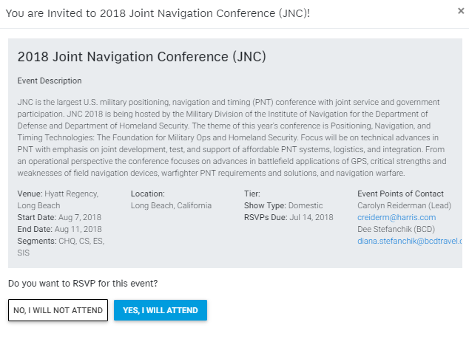
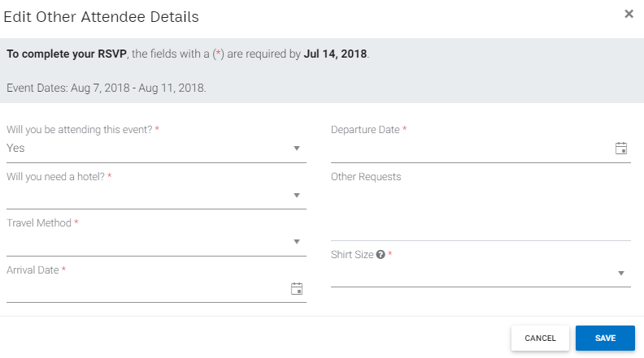
RSVP to Event
From the Profile Page, on an event that you have not RSVP’d yet, click VIEW
Read about the event
Notice RSVP Due date: By this date, let us know if you will be attending and fill out your Other Attendee Details (see step 5)
RSVP by Pressing:
NO, I WILL NOT ATTEND, or
YES I WILL ATTEND
Fill out your Other Attendee Details for this event
Press SAVE
2
3
5
4
1
6

Slide 6
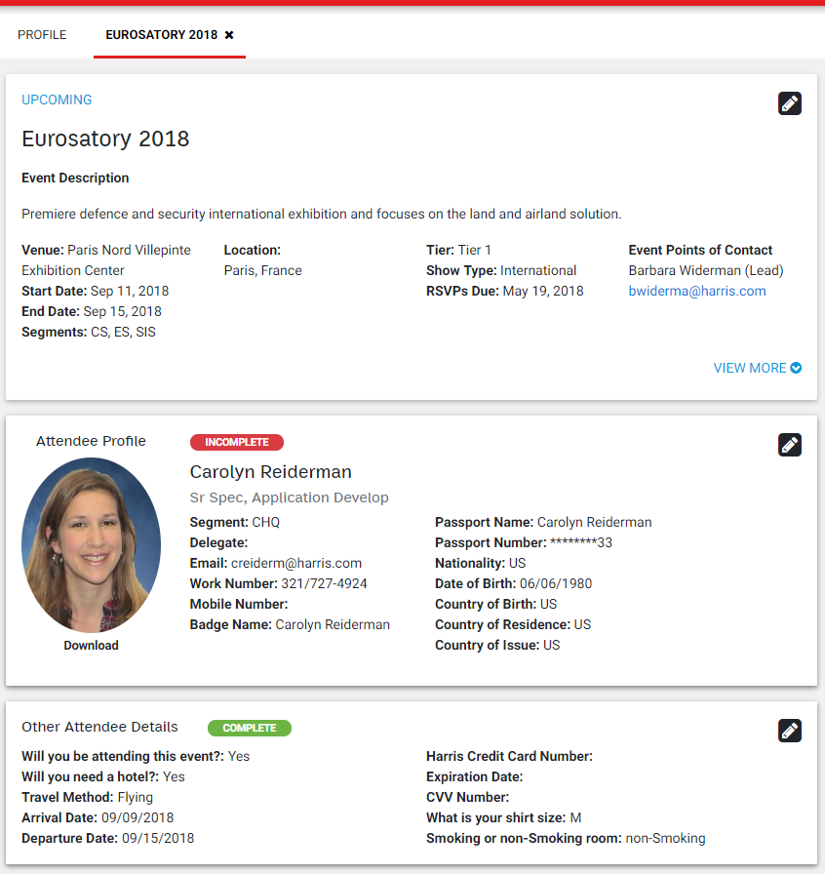
View Event you will be attending
From the Profile Page, click VIEW on event
Read about the event
Status of whether your Attendee Profile has been completed
If your Attendee Profile is incomplete or to edit, press pencil icon
Status of whether your Other Attendee Details for this event have been completed
If your Other Attendee Details are incomplete or to edit, press pencil icon
2
3
4
5
6
Go to Edit Other Attendee Details for Event
(next slide)
1

Slide 7
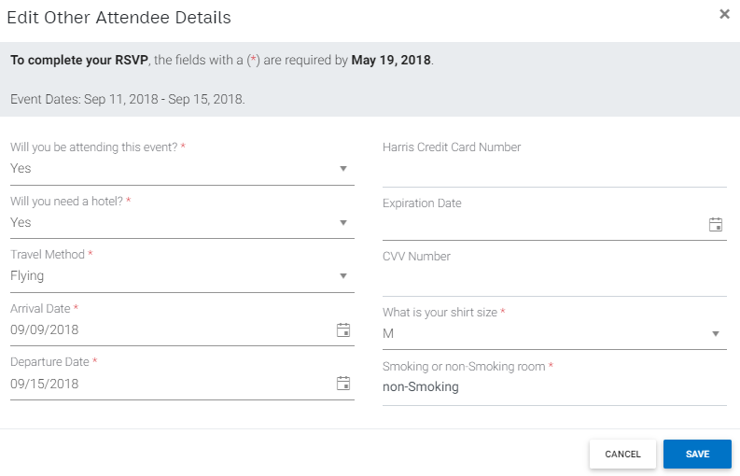
Edit Other Attendee Details for Event
From the Profile Page, click VIEW on event
In Other Attendee Details panel, press pencil icon
Notice the date when this form must be completed by
Fill out this form about your travel arrangements, etc for this specific event
Press SAVE
3
4
5
2
1

