Slide 1



messic
«behind the scenes»

Slide 2




«messic»
strictly speaking, messic is a service which deploy a RESTful API to organize a music library.
♫
service
+
monitor
Note: It is NOT installed as a service of the SO, it is just a process without UI + monitor application.

Slide 3

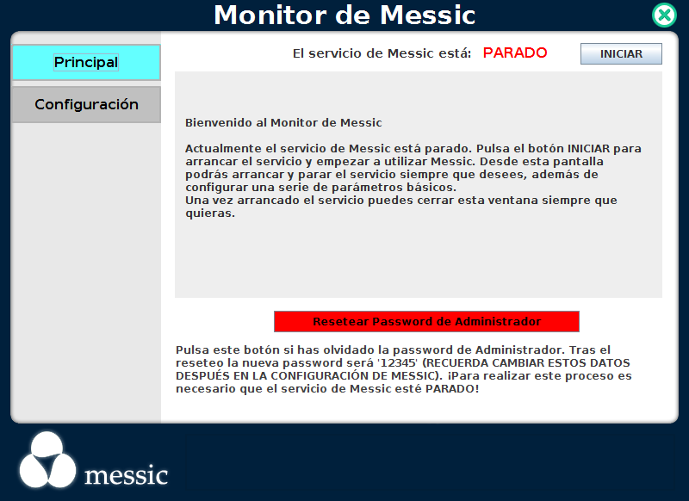
«messic monitor»
messic monitor is an indepent application to mainly check the messic service status.
server status
start/stop messic service
This app can monitor the service status, start & stop the service, basic configuration and so on.

Slide 4



«messic service»
messic service export a restful api and a web UI.
♫
RESTful API
Web App
The idea is to consume these services from any device.

Slide 5


«native clients»
Currently we have two native clients: android smartphone and TV
♫
RESTful API
The idea is to consume these services from any device.

Slide 6






«overview architecture»
messic server is a Java development
Web App
CORE
SPRING FRAMEWORK
MESSIC PLUGINS
JRE 1.8
A Java development over an OSGI framework

Slide 7

«open source»
messic is an open source development (GPLv3). It is hosted in Github and we are hoping the collaboration of the community.
https://github.com/spheras/messic

Slide 8
«future»
Hello World, messic is here
Improve Plugin System
Improve Web Client Style and Usability
Unit Testing!!
Audio Format Conversions
Improve Automatic Cataloging Algorithm
Plugins, Plugins, Plugins
Make Social, Share concept
…………… what ever make it a better tool
https://github.com/spheras/messic

Slide 9
«that's all folks!»
?
?
?
messic
?
?
It's time to ask
Some resources got from:
http://freepsdfiles.net/
http://www.freepik.es/

