Slide 1







Stack Overflow Developer Survey 2019.
Calvin Philmore
12/23/22

Slide 2



OUTLINE
Executive Summary
Introduction
Methodology
Results
Visualization – Charts
Dashboard
Discussion
Findings & Implications
Conclusion
Appendix

Slide 3

EXECUTIVE SUMMARY
Front end programming languages are among the most popular languages with an on-going upward trend of popularity among developers.
Developers having, or acquiring front end programming language, are likely to have high salaries.
The most eminent databases like MySQL are declining in popularity.
Developers looking to stay competitive or get employed should learn the popular programming languages.

Slide 4

INTRODUCTION
This presentation attempts to highlight the growing trends and the current trends of software skills.
These trends demonstrate that technology is always evolving and changing every year.
The data shows that programming languages come with higher salaries.
The presentation shows that the men are likely to make up majority of developers in the IT industry.

Slide 5

METHODOLOGY
Data was acquired from the “Stack Overflow Developer Survey 2019”.
The current technology trend was studied and juxtaposed to the future technology trends in order to gain exploratory insight.
IBM Cognos Dashboard was employed to display data visualization and analyze the data.
Python data visualization tools was used to analysis programming languages and salaries.

Slide 6
RESULTS

Slide 7
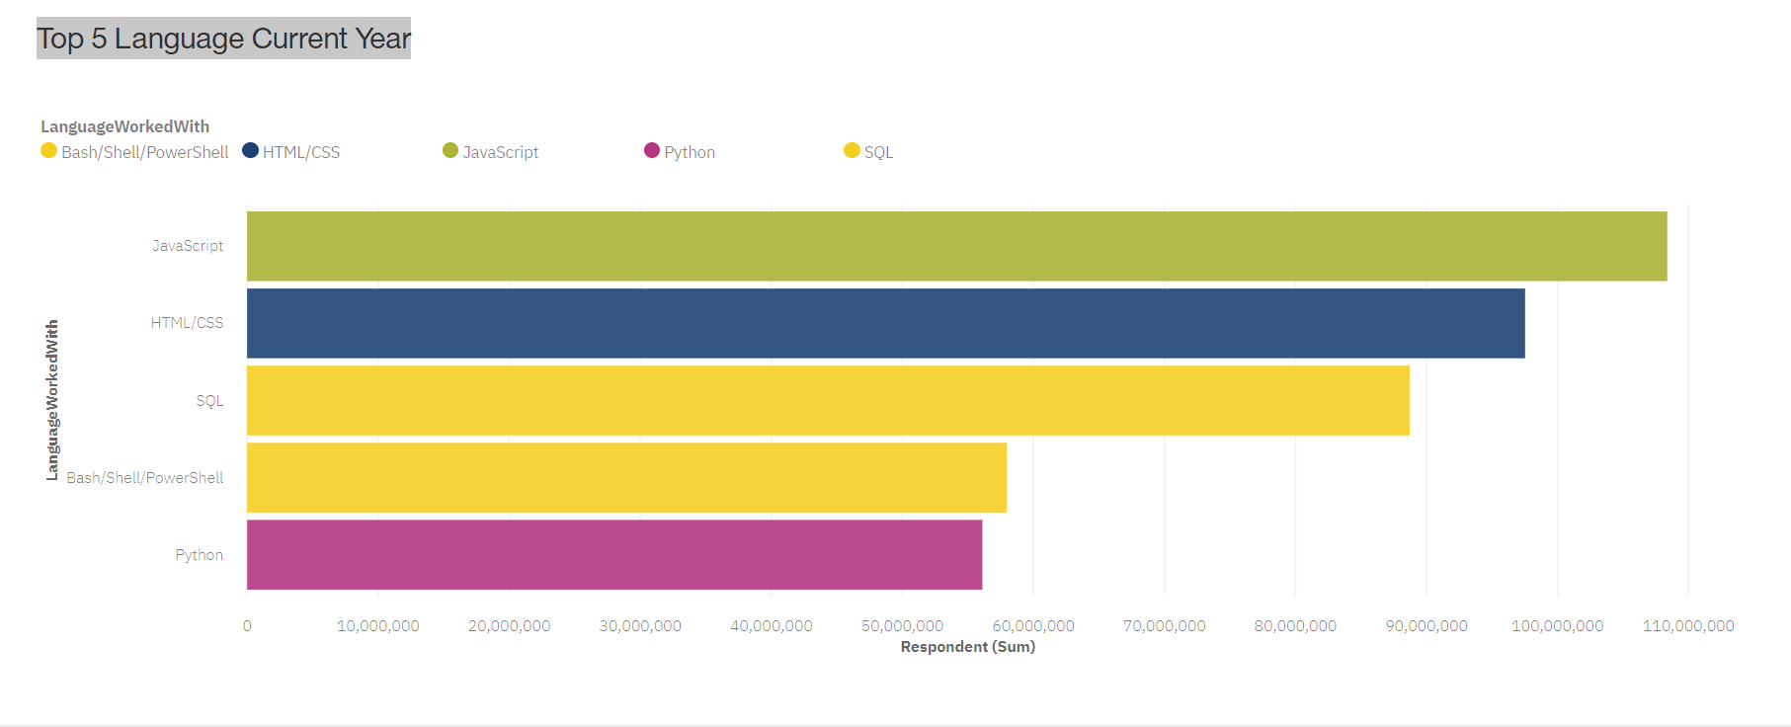
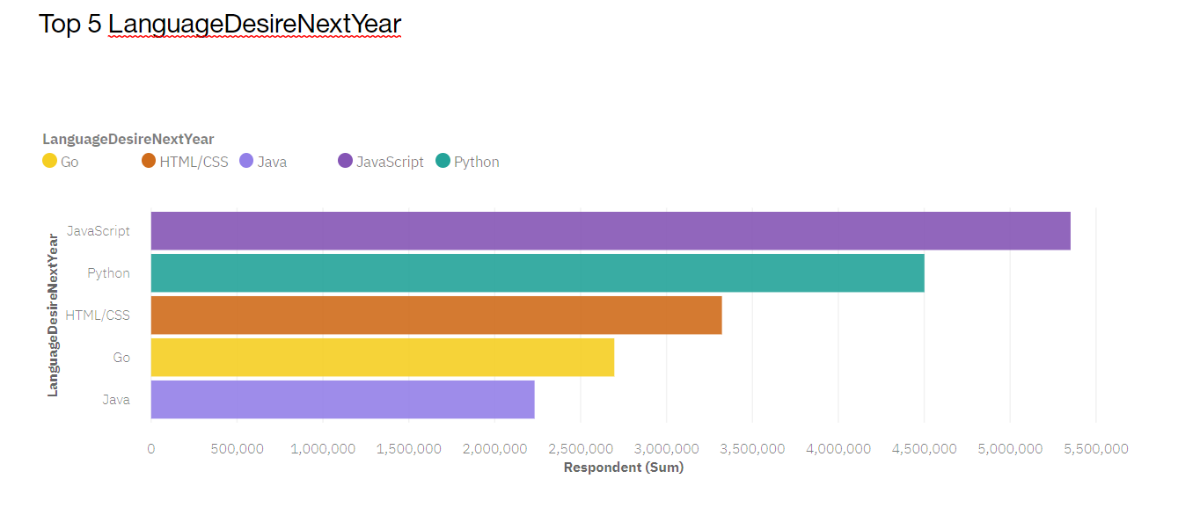
PROGRAMMING LANGUAGE TRENDS
Current Year
Next Year

Slide 8
PROGRAMMING LANGUAGE TRENDS - FINDINGS & IMPLICATIONS
Findings
JavaScript is a top trending popular programming language.
Python comes a close second as a desired language to learn for next year.
SQL and Bash/Shell/Power is not among the most desired languages of next year.
Implications
JavaScript/HTML/CSS remains necessary language to learn as a developer.
Python will likely continue to be a desired language for developers.
SQL and Bash/Shell/Power are not the most desired languages possibly due to not being necessary for front end development.

Slide 9
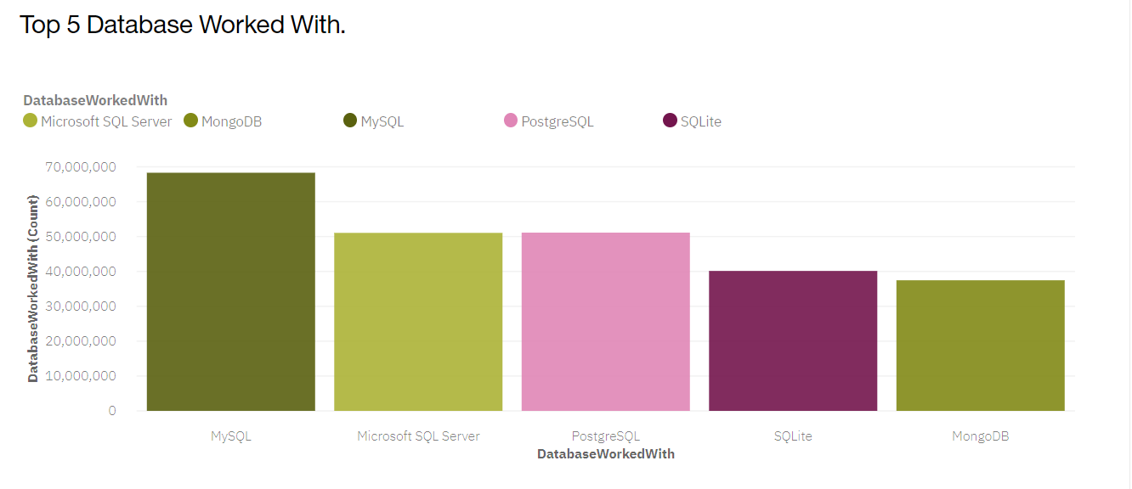
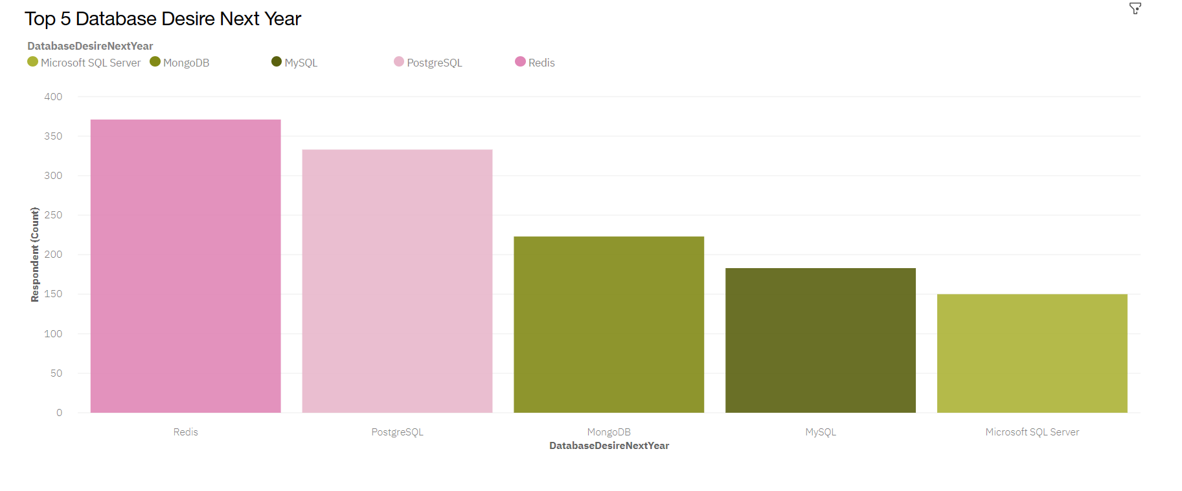
DATABASE TRENDS
Current Year
Next Year

Slide 10
DATABASE TRENDS - FINDINGS & IMPLICATIONS
Findings
MySQL is currently among the popular and widely used database, but it is decreasing in popularity.
Interests in PostgreSQL is increasing in popularity while remaining among the top database used.
Redis will likely be a popular database for next year.
Implications
To stay competitive, learning the top databases is beneficial to developers.
Employers are likely to employ developers with knowledge of PostgreSQL.
Redis will be a beneficial skill for next year.

Slide 11

DASHBOARD
Click the Link to view the Cognos dashboard.

Slide 12
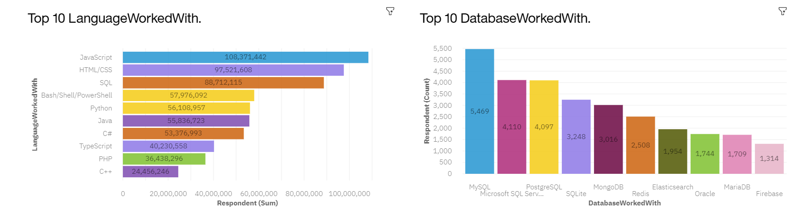
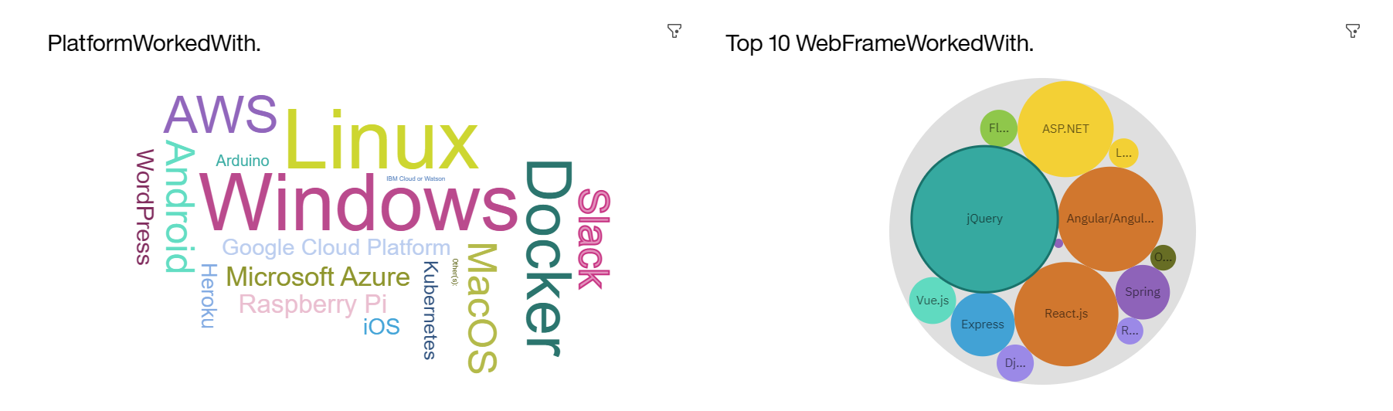
Current Technology Usage

Slide 13
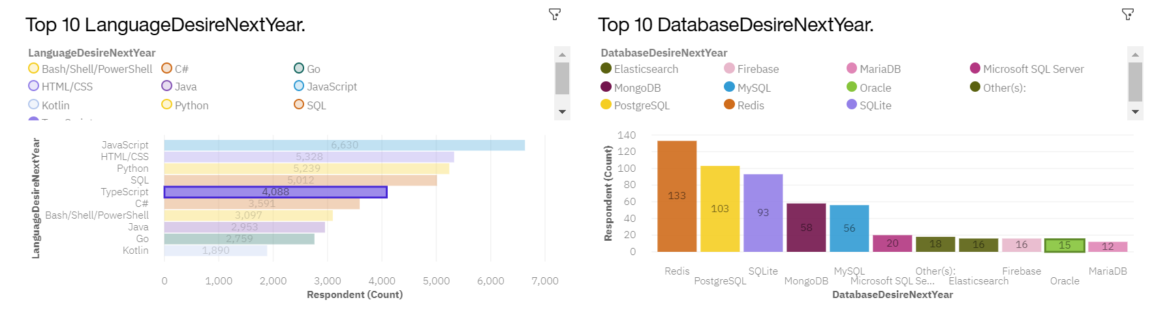
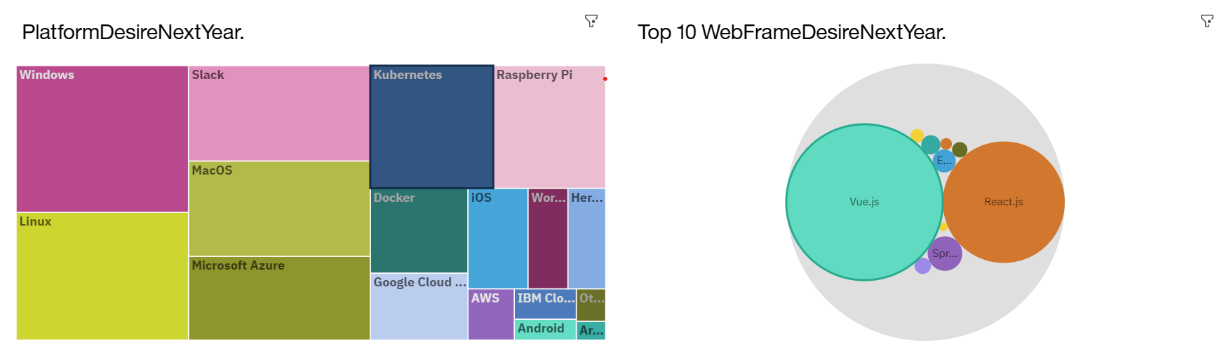
Future Technology

Slide 14
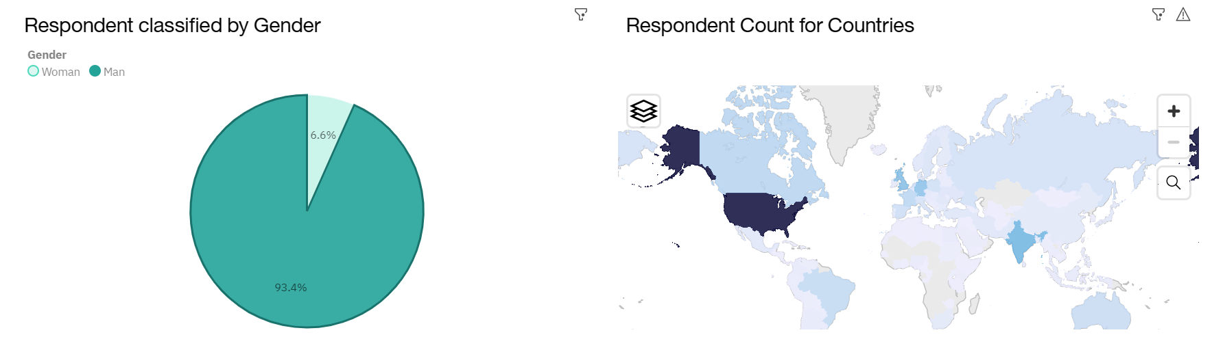
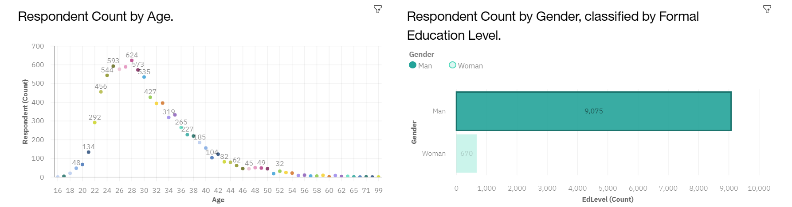
Demographics

Slide 15
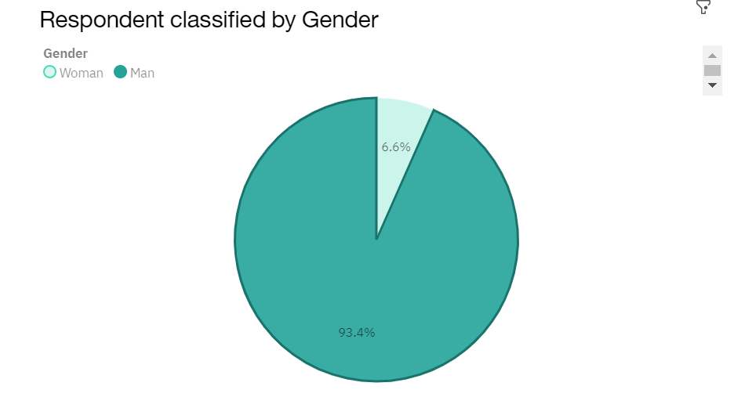
DISCUSSION
The majority respondents of this survey were male. Further research can be conducted with more female respondents or an equal sample group to deduce whether the results differs.

Slide 16
OVERALL FINDINGS & IMPLICATIONS
Findings
JavaScript, another front-end language, remain the top programming language.
Window & Linux are most desired platforms for next year.
JavaScript framework Vue.Js overtakes React.js in popularity.
Men make up most of the respondents between the age 26-28.
Implications
JavaScript popularity maybe due to being the desired language for the front-end development.
Window & Linux are among commonly used operating systems.
Vue.Js overtaking React popularity is due to Vue being more oriented to novice, making it more conductive.
Male respondents could differ from female respondents.

Slide 17

CONCLUSION
Front end programming languages like JavaScript and HTML/CSS are among the most popular for web development.
Developers looking to stay competitive would benefit from learning from top desired languages.
Male developers are among the top respondents in the survey suggesting that men make up the majority of developers in the IT field.

Slide 18

APPENDIX

Slide 19
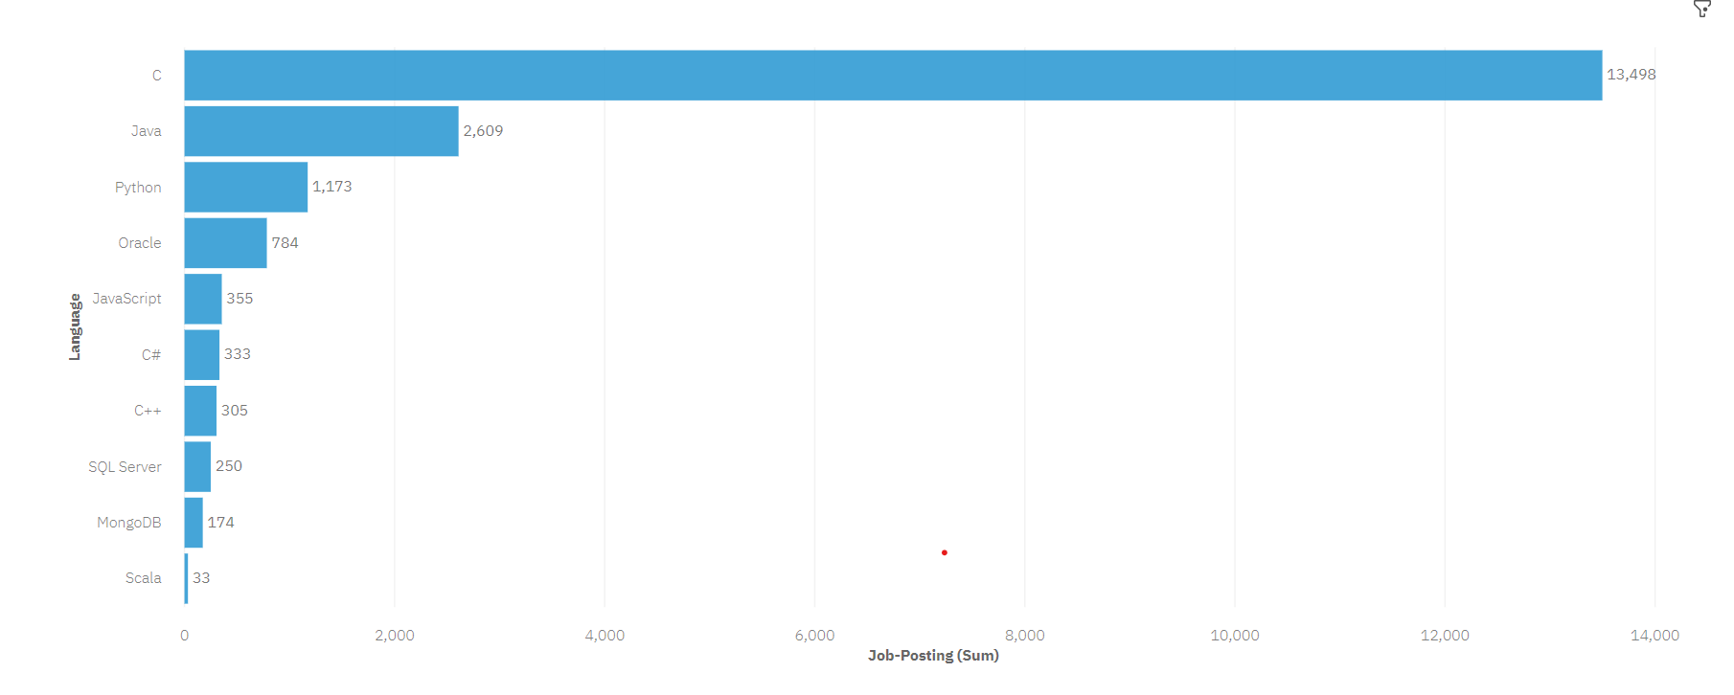
JOB POSTINGS

Slide 20
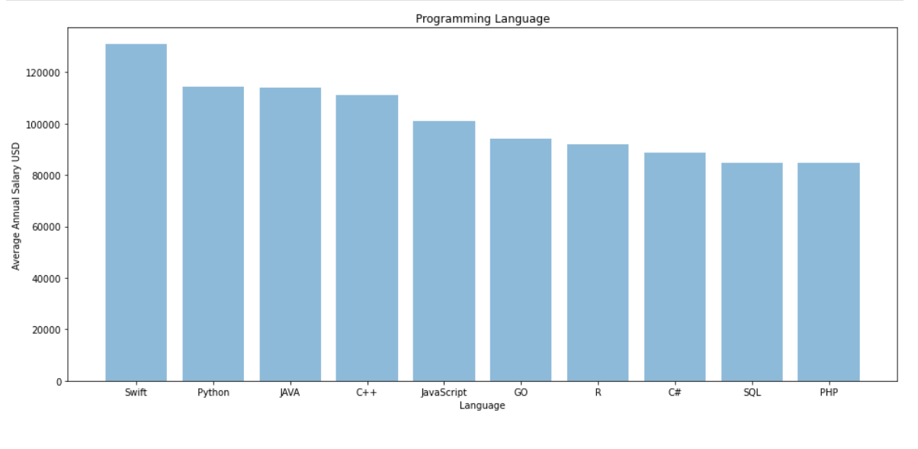
POPULAR LANGUAGES

