Slide 1
Covid-19 ICU admission prediction

Slide 2
Motivation
→ Older patients having comorbidities have less chances of survival after being hospitalised due to COVID-19.
→ Covid-19 patients with history of hypertension, obesity, chronic lung disease, diabetes, and cardiovascular disease have the worst prognosis and most often end up with deteriorating outcomes such as ARDS and pneumonia.
→ There is a period where the patient is asymptomatic, and the incubation period is between 2 and 14 days. However, within this period, if respiratory symptoms develop, it is important to seek immediate care.
→ Similarly, there are many more patterns which we can analyse. After analysing them, we came to a conclusion that Patient’s initial conditions and previous health records have a relation with being admitted to ICU and post health conditions.

Slide 3
Motivation
→ We also observed that there are many cases where patients are not given ICU based on their current situation, but later, due to their previous comorbidities, their conditions worsened and resulted in death.
→ On the other hand, due to the increasing no of cases daily and limited health care resources available, It's quite important that we utilise these resources in the best way possible.So, we cannot afford to admit more patients to ICU without any reasonable logic.
→ Thus we aim to develop a model that would recommend whether or not a patient should be admitted to ICU based on his initial conditions and previous health record. This way, patients who died after not admitted to ICU would have better chances of survival.

Slide 4
Literature Review
Paper :- Pool Testing for Covid-19: Suitable splitting procedure and pool for India. (Link in references section )
Review :- With the sudden outbreak of coronavirus, it has become quite challenging to control its spread. The only way to do so is to detect already infected persons and isolate them. With limited testing facility, we need to minimise the no of tests done on a given pool without compromising the detection of infected ones. The author aimed to generalise an equation for predicting the number of tests to be done in a given pool of data in order to detect every infected person in a given pool. This would minimise the unnecessary test done before. The percentage of tests required varies and depends on various factors like size of pooled sample, probability of an individual being affected in the population which depends on the area and no of cases in that area. For example, according the model, if the probability of infection is 0.05 in a pool size 32, then 14 tests are sufficient to detect all the affected individuals. As we can see that the no of tests required to actually detect all the infected persons is much less than individual testing. This will certainly help us in increasing our testing capacity and thus get a better hold on the situation.

Slide 5
Literature Review
Paper :- Scoring systems for predicting mortality for severe patients with COVID-19 (Link in Reference section)
Review :- The author aimed to analyse the risk factors for mortality of severe patients with COVID-19. Via this study, he want to establish a scoring system that would give a prediction of in-hospital deaths, given the details about the hospital and clinical conditions of the patients. For this, they collected patients’ clinical data from different hospitals in wuhan and analysed them. After doing the analysis, they created a model using Lasso Regression and multivariate analysis. As a result they found out various interesting things like the mortality rate in males and females depending upon their age, strength of antibiotics received based on the severity of the patient’s condition, comparison of treatment and outcomes in training cohort. Some of the interesting findings are - respiratory failure was the most frequently observed complication with 41.6% of total complications, followed by AMI, ALI and AKI which accounts to 25.7% , 23.0% and 16.8% respectively. All these findings are also tabulated in the form of tables to give a clear picture.

Slide 6
Dataset Description
No of records:- 2.63 lakh.
Timestamp like :- last update date, date when symptoms occurred, date of admission, death, etc.
Comorbidities like: hypertension, diabetes, neumonia, asthma, obesity, etc.
Patient’s state, country, region.
Outcome attributes: Admission to ICU, patient died or not.
Domain of attributes:
1->YES ; 2->NO ; 97->NA; 98->Ignored; 99->Not specified

Slide 7
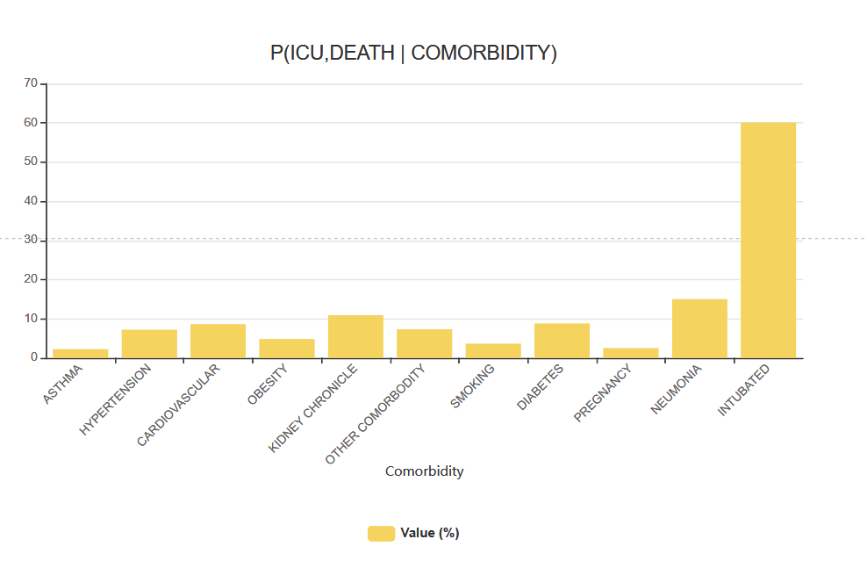
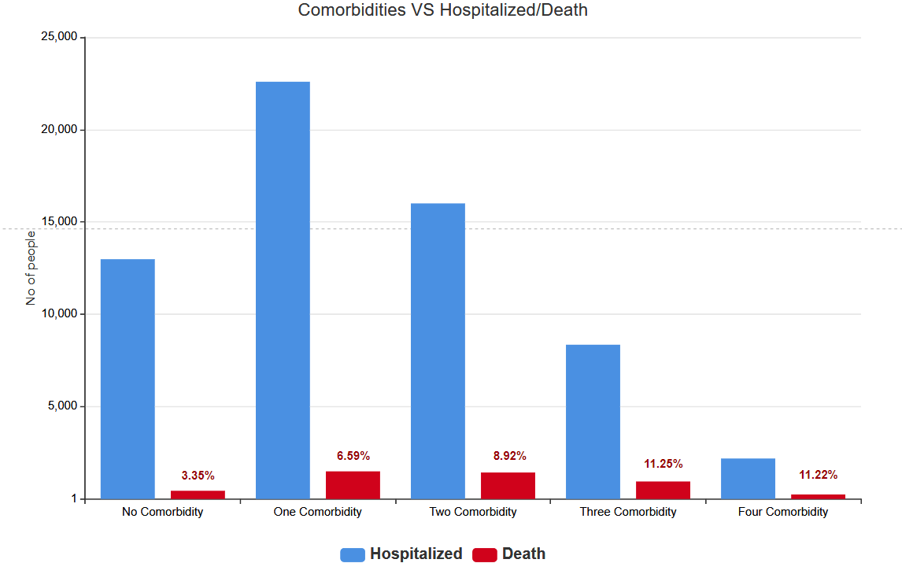
Exploratory Data Analysis

Slide 8
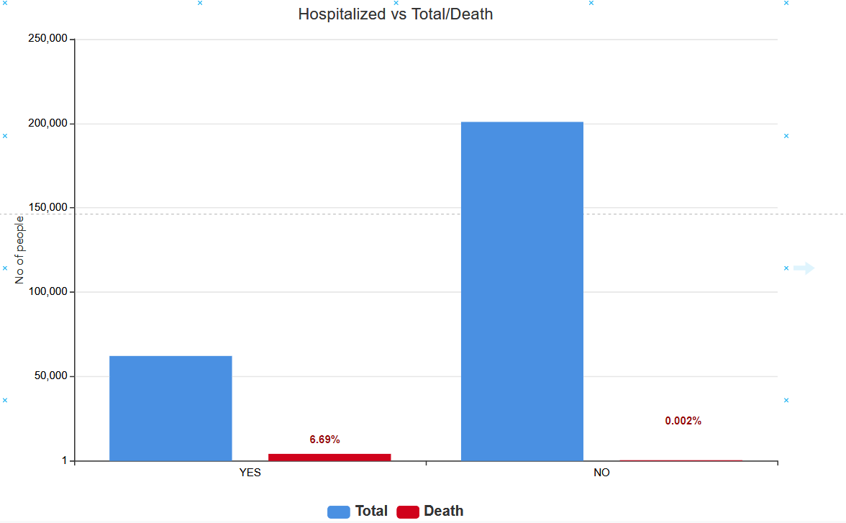
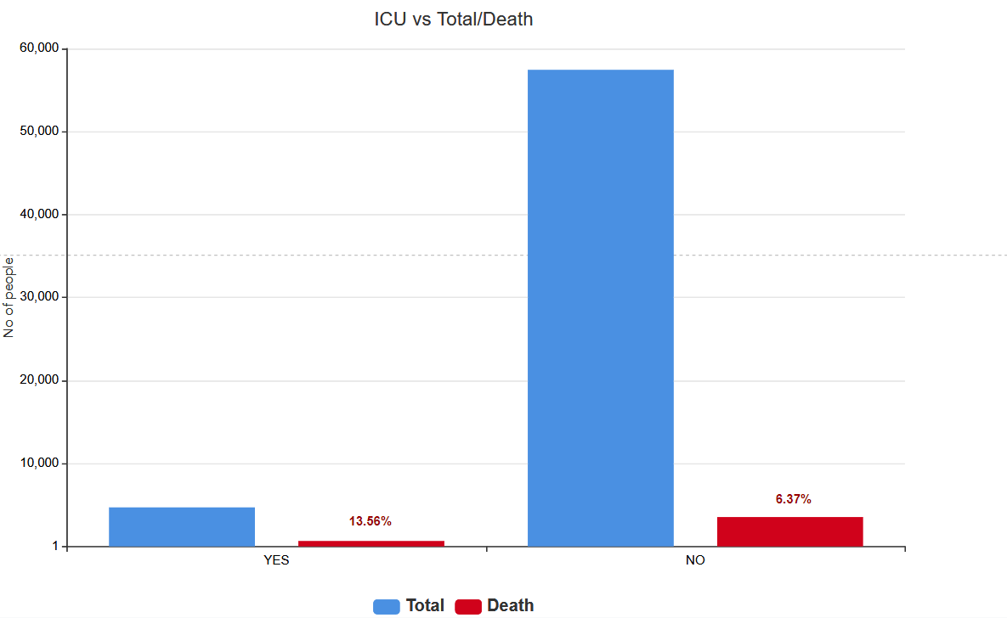
Exploratory Data Analysis

Slide 9
BASIC PREPROCESSING
Translated the attributes from spanish to english.
Records having some missing or undefined values were removed to reduce noise
Derived deaths feature from date of death attribute (Date is Nan if alive).
Some more analysis about the frequency vectors were done and how they are affecting the outcome (death or ICU). That part would be discussed in more detail in ANALYSIS section.

Slide 10
Methodology

Slide 11
Metric Used for evaluation
Our dataset was slightly imbalanced, so accuracies won’t reflect the correct estimation for our predictions.
As we are predicting the ICU admissions, that means there should be least scope for false negatives.
But, false positives also matter as we want to manage resources as well.
Therefore, there is a tradeoff between precision and recall.
⇒ Metric used : F1-score and Roc-Auc score.

Slide 12
Baseline models
We trained multiple machine learning models, including Naive bayes classifier, Logistic Regression, Random Forest classifier, Support Vector Machine and XGBoost classifier. These were the baseline models.
Before training different models, since our data was imbalanced, we tried oversampling and undersampling using SMOTE, which synthesises new minority instances to balance our data.

Slide 13
Recall, Precision, F1-score and Roc-auc score
Metric/Models | Random Forest | Logistic Regression | XGBoost classifier | Categorical NB | Bernoulli NB | SVM Linear | SVM rbf
Recall | 0.2278 | 0.2584 | 0.2532 | 0.2690 | 0.2632 | 0.2780 | 0.2840
Precision | 0.5665 | 0.5950 | 0.5924 | 0.5624 | 0.5940 | 0.6006 | 0.5928
F1-score | 0.3241 | 0.3596 | 0.3542 | 0.3630 | 0.3636 | 0.3788 | 0.3827
Roc-Auc | 0.6691 | 0.69150 | 0.6862 | 0.6910 | 0.6951 | 0.6202 | 0.6396

Slide 14
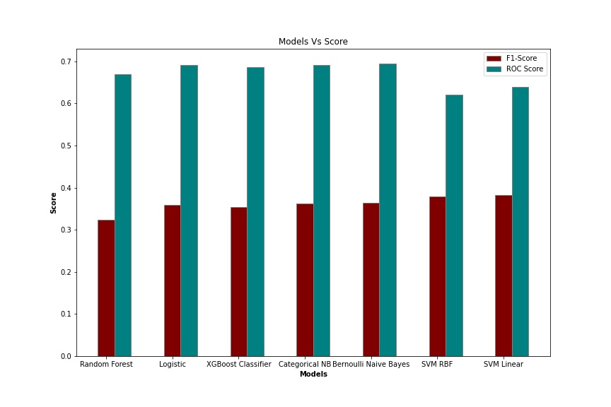
Comparison of Scores for Different Models
Among different models, SVM and Naive Bayes performed better.
As patients with similar comorbidities forms a group and are close to each other, so data is separable and SVM performs better.
Naive Bayes performed better, as the features were mostly independent and even by intuition this problem seems to require conditional probability based solution.

Slide 15
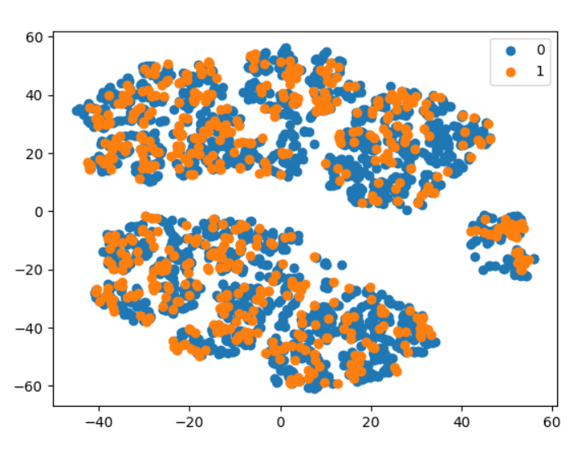
Dimensionality reduction and visualisation
PCA with no of components = 10
T-sne plot after applying PCA

Slide 16
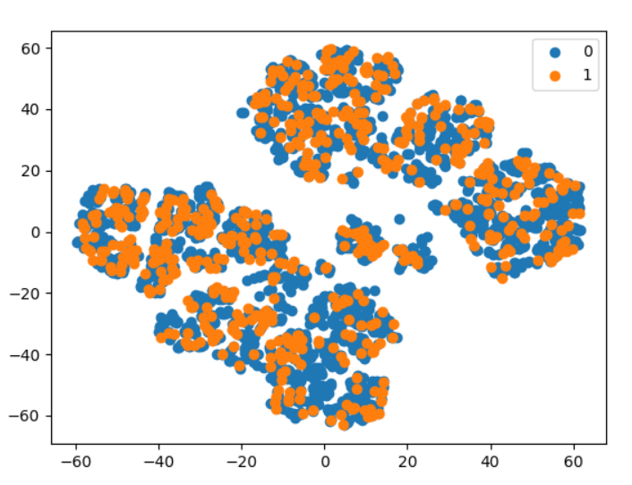
Dimensionality reduction and visualisation
SVD with no of components = 10
T-sne plot after applying SVD

Slide 17
Dimensionality reduction and visualisation
Dimensionality reduction affected the performance of our model significantly.
We had 14 features previously, which itself is quite feasible in terms of computation.
Therefore, we decided not to go forward with the principle components and considered all the previous features instead.

Slide 18
Training models after feature selection
We did feature selection, using the correlation matrix.
Considering the top-10 features that were having higher correlation to the target, and then training the same models and comparing the accuracies.

Slide 19
Comparison of Scores for Different Models (Top 10 Best Features)
Metric/Models | SVM RBF | Logistic Regression | XGBoost classifier | Categorical NB
Recall | 0.2731 | 0.2628 | 0.2678 | 0.2639
Precision | 0.6159 | 0.5966 | 0.5972 | 0.5733
F1-score | 0.3784 | 0.3639 | 0.3687 | 0.3615
Roc-Auc | 0.6235 | 0.6943 | 0.6922 | 0.6170

Slide 20
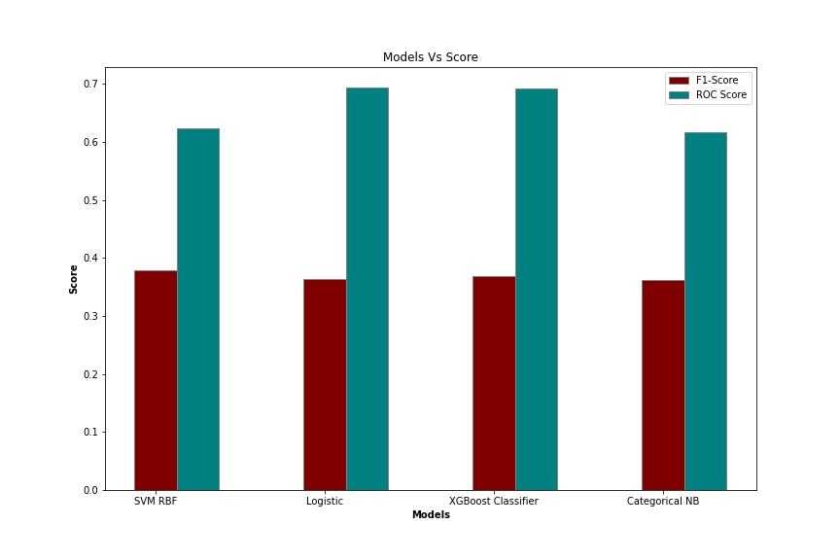
Comparison of Scores for Different Models (Top 10 Best Features)
After selecting top-k features, here we checked for k=10
The f1-scores didn’t changed much, even reduced for some models.
The reason being most of our features are independent, can be seen in the EDA. And each attributes have more or less similar contribution towards the target attributes, so we have to include all the features.

Slide 21
Clustering based idea for grouping and labelling the groups
There were many data points that were pointing to different labels, showing the obvious human behavior.
To solve that problem we tried to experiment with the dataset using the basic idea of unsupervised learning. As in clusters we don’t look at labels and then group the data points.
Similarly, here we grouped the patients with the same features and then labelled them according to the majority label of that particular group.
Again we trained our models and compared with the previously trained models.

Slide 22
Recall, Precision, F1-score, Roc-Auc score
Metric/Models | Random Forest | Logistic Regression | XGBoost classifier | Categorical NB | Bernoulli NB | SVM Linear | SVM rbf
Recall | 0.4838 | 0.5223 | 0.4853 | 0.5878 | 0.5775 | 0.6237 | 0.5801
Precision | 0.6563 | 0.6536 | 0.6097 | 0.6619 | 0.6657 | 0.6475 | 0.6543
F1-score | 0.5548 | 0.5366 | 0.5366 | 0.6213 | 0.6165 | 0.6334 | 0.6122
Roc-Auc | 0.7837 | 0.7744 | 0.7863 | 0.7831 | 0.7818 | 0.7609 | 0.7772

Slide 23
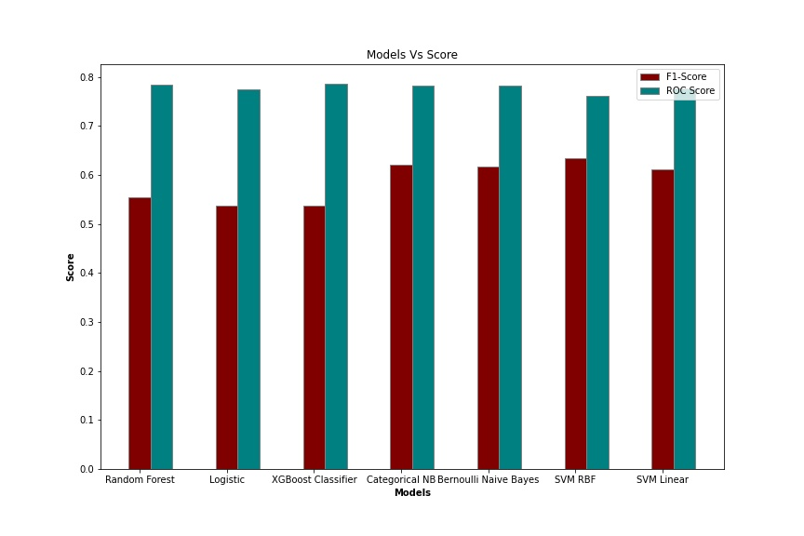
Comparison of Scores for Different Models for Clustering
The F1-score nearly doubled, precision remained nearly same but decent change in recall value was observed.
Increase in recall means, we were reducing the False Negatives and increasing True Positives.
Reason for drastic change, as same data points were pointing to different labels, so it was making data impure.
After modifying the data, impurity was reduced, which even solved the class imbalanced problem.

Slide 24
Feature selection after Clustering
We did feature selection, using the correlation matrix.
Considering the top-10 features that were having higher correlation to the target, and then training the same models and comparing the accuracies.

Slide 25
Recall, Precision, F1-score, Roc-Auc score
Metric/Models | SVM RBF | Logistic Regression | XGBoost classifier | Categorical NB
Recall | 0.5192 | 0.5287 | 0.6098 | 0.1474
Precision | 0.6583 | 0.6554 | 0.6721 | 0.5609
F1-score | 0.5806 | 0.5825 | 0.6385 | 0.2335
Roc-Auc | 0.7205 | 0.7882 | 0.7928 | 0.5569

Slide 26
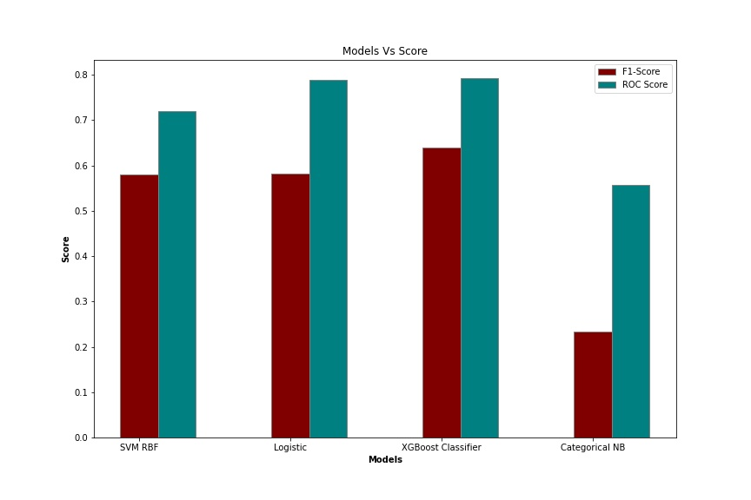
Comparison of Scores for Different Models (Top 10 Best Features)
After selecting top-k features, here we checked for k=10
The f1-scores didn’t changed much, even reduced for some models.
The reason being most of our features are independent, can be seen in the EDA. And each attributes have more or less similar contribution towards the target attributes, so we have to include all the features.

Slide 27
Optimisations
Stacking
It involves two levels, one level includes multiple baselines models and the second level has one meta learner.
We trained multiple models including Naive bayes, Svm, XGBoost and random forest classifiers.
And after getting predictions from all the models, we feed those predictions to meta-learner (logistic regression in our case), which in turn gives us final predictions.
The basic difference is that instead of majority voting, we train a model in this layer to give final predictions.

Slide 28
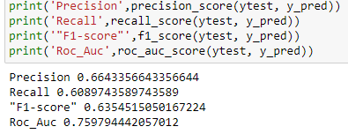
Recall, Precision, F1-score, Roc-Auc score
It improved the f1-score by 1-2 %.
Reason being, instead of using one model, we are considering predictions from multiple different models and then predicting.
It basically provides us with the advantages of all the models.
Base models → Categorical, SVM(Linear), SVM(rbf), random forest, bernoulli, xgb_classifier
Meta model → Logistic regression

Slide 29
Bagging
Here we used Bootstrapping as our bagging technique. We created 100 bootstraps samples and then trained 100 models on that. Then we took the majority voting for our final predictions.
In Bagging, we are actually creating parallel weak learners and then taking summation over all models, this reduces the variance compared to the individual variance of the weak model.

Slide 30
Recall, Precision, F1-score, Roc-Auc score
Metric/Models | Random Forest | Logistic Regression | XGBoost classifier | Categorical NB | Bernoulli NB | SVM Linear | SVM rbf
Recall | 0.6538 | 0.6196 | 0.5299 | 0.6452 | 0.6282 | 0.6367 | 0.6410
Precision | 0.5839 | 0.6387 | 0.5610 | 0.6265 | 0.6363 | 0.6367 | 0.6355
F1-score | 0.6169 | 0.6290 | 0.5450 | 0.6357 | 0.6322 | 0.6367 | 0.6382
Roc-Auc | 0.7592 | 0.7588 | 0.7047 | 0.7667 | 0.7619 | 0.7655 | 0.7670

Slide 31
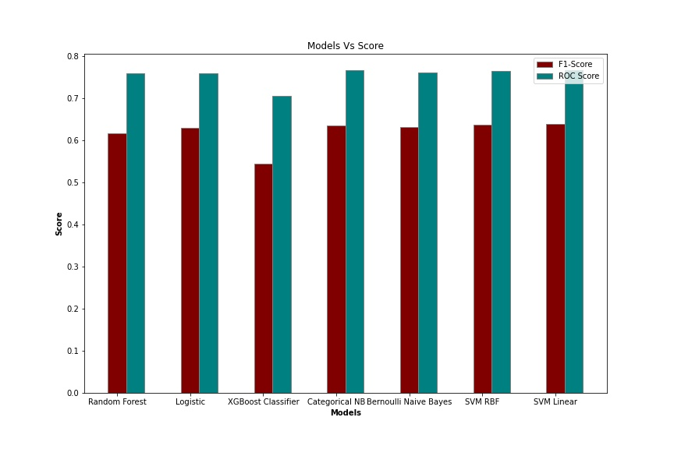
Comparison of Scores for Different Models for Bagging
Most of the models before bagging were giving f1-score around 58, but after bagging it is around 63.
Reason being the main principle of bagging, we train different weak learners and then take voting over all models, in order to reduce the variance of final model, thus avoiding overfitting.

Slide 32
Boosting
We used ADA-Boost as our boosting technique.
In Bagging, we are actually creating parallel weak learners and then making final predictions, as variance reduces compared to different models.
In Boosting, we actually learn sequentially, we train a model and then learn from the mis-classifications. Then,we train our subsequent models by giving more weights to the records that were misclassified.
We’re kind of penalizing the misclassifications and awarding the correct ones.

Slide 33
Ada-Boost performance
F1-Score :- 0.6376
Recall :- 0.5940
Precision :- 0.688
Reason for Ada-Boost to perform better :- It performs better than an individual model, as after each iteration we learn from the wrongly classified records and try to classify it correctly in the further trees we create. So it helped in the increasing the f1-score. It’s results were more or less comparable to the Bagging.

Slide 34


XGBoost Regressor
Before Bagging After Bagging
XGBoost regressor will optimise after each iteration for regression task, and at the last step we tuned different thresholds and reported the best accuracy. In XGboost classifier, it only optimises for the classification purpose, so there is slight difference, that’s why it performed slightly better.

Slide 35
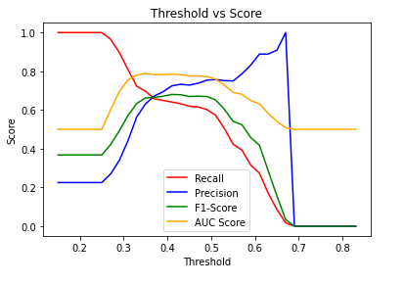
Score vs threshold in XGBoost Regressor
For threshold around 0.36, the precision and recall values were merging.
And then using this threshold we converted our continuous values into the 0’s and 1’s.

Slide 36
Bagging and stacking model
Generated 50 bootstrap sample.
For each bootstrap sample, we trained multiple models including Naive bayes, Svm, XGBoost and random forest classifiers.
Each of them gave their predictions.
These predictions were fed to a logistic regressor, which in turn gave us the final predictions.
We got 50 such predictions. Mean of these 50 predictions is the final predicted output of this Bagging and stacking model

Slide 37
Bagging and stacking performance
F1-Score :- 0.5327
Recall :- 0.4871
Precision :- 0.5876
Roc score :- 0.6939
Reason for bad performance :- Because of multiple ML models with 50 bagging samples, the model became too complex and led to overfitting. Therefore, we decided not to go forward with these kind of combinations.

Slide 38
Analysis
Baseline Model: Among different models, SVM and Naive Bayes performed better.
As patients with similar comorbidities forms a group and are close to each other, so data is separable and SVM performs better. Naive Bayes performed better, as the features were mostly independent and even by intuition this problem seems to require conditional probability based solution.
Training models after feature selection: After selecting top-k features, here we checked for k=10. The f1-scores didn’t changed much, even reduced for some models. The reason being most of our features are independent, can be seen in the EDA. And each attributes have more or less similar contribution towards the target attributes, so we have to include all the features.
Clustering based idea for grouping and labelling the groups: The F1-score nearly doubled, precision remained nearly same but decent change in recall value was observed. Increase in recall means, we were reducing the False Negatives and increasing True Positives. Reason for drastic change, as same data points were pointing to different labels, so it was making data impure. After modifying the data, impurity was reduced, which even solved the class imbalanced problem.

Slide 39
Analysis
Stacking: It improved the f1-score by 1-2 percent. Reason being, instead of using one model, we are considering predictions from multiple different models and then predicting.
It basically provides us with the advantages of all the models.
Bagging: Most of the models before bagging were giving f1-score around 58, but after bagging it is around 63. Reason being the main principle of bagging, we train different weak learners and then take voting over all models, in order to reduce the variance of final model, thus avoiding overfitting.
Boosting: Reason for ADA-Boost to perform better :- It performs better than an individual model, as after each iteration we learn from the wrongly classified records and try to classify it correctly in the further trees we create. So it helped in the increasing the f1-score. It’s results were more or less comparable to the Bagging.
Stacking and Bagging: Reason for bad performance : Because of multiple ML models with 50 bagging samples, the model became too complex and led to overfitting. Therefore, we decided not to go forward with these kind of combinations.

Slide 40
Analysis
XGB Regressor: For threshold around 0.36, the precision and recall values were merging. And then using this threshold we converted our continuous values into the 0’s and 1’s.

Slide 41
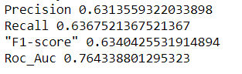
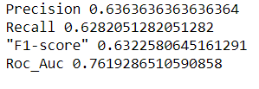
Best-Models
SVM: As patients with similar comorbidities forms a group and are close to each other, so data becomes separable and SVM performs better.
Naive Bayes: Naive Bayes performed better, as the features were mostly independent and even by intuition this problem seems to require conditional probability based solution.

Slide 42
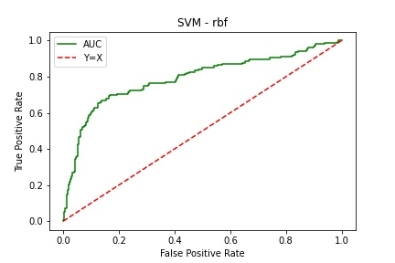
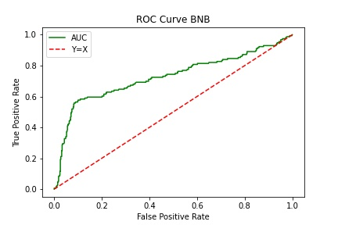
Best - Models
ROC for SVM RBF kernel
ROC for Naive Bayes

Slide 43
Contribution
Bhavesh: Preprocessing, feature selection, model training, Stacking
Navam: Boosting, Preprocessing, feature selection, model training
Huzaifa: Bagging, Boosting, Visualization, model training
All The Analysis is done after discussion among group members.

