Slide 1
Surround Sound App
Team 0MBPS:
Mohd. Huzaifa
Sitaram
Bhavesh Khatri
Prince Yadav
Harsh Kumar

Slide 2

Motivation

Slide 3

Motivation

Slide 4
Approach
We have made an application that sends audio files across multiple android devices.
● Connect multiple client devices to the party host using Wifi module.
● After connection is made successfully, host picks a media file and start hosting.The media file is then transferred to all the client devices using socket connection at once.
● Now host can play or pause the song or interact with the seekbar, the message will be transmitted to all the client devices via socket connection and synchronization will be done in the background before the song starts.

Slide 5
Features Implemented
WiFi connection among multiple devices.
Synchronized audio playback on multiple devices using socket server and client.
Play/Pause and progress bar in the Exoplayer (media player).
Interacting UI with toasts and hints for easy navigation.

Slide 6
Challenges Faced
The main challenge was to synchronize the playback of the media files on the linked devices. To accomplish this, we used socket programming for the communication among the devices during play and pause operations on the host device.
We initially used WiFi Direct for the connection among the devices, but not all the smartphone devices have the support of WiFi Direct. So, we shifted to utilising WiFi connection for the connections.
We had to switch to the ExoPlayer from MediaPlayer at a later stage because we when extended our app to multiple devices, we faced the issue in the synchronization.

Slide 7
Future Works
Making it energy efficient.
Provide 3D sound effects.
Extend this application to other media files,eg. video files.
The idea can also be extended to play the live streaming media on the multiple devices.

Slide 8
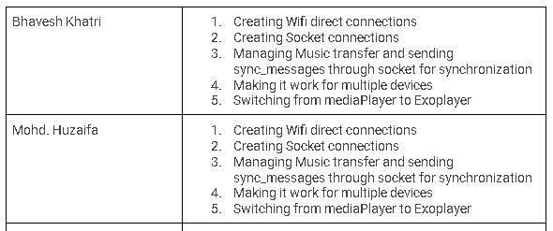
Individual Contribution

Slide 9
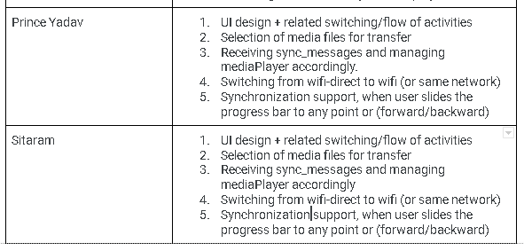
Individual Contribution

