Slide 1
M4 Macro-processing Language
Geoffrey Sewell

Slide 2
What will be shown?
What’s a macro processor?
History of M4
Uses
Autotools
Syntax
Hopefully, you all learn something from this!!!

Slide 3
What’s a Macro-processor?

Slide 4
General Macro Processor
Copies a stream of text to a different location
Makes use of replacements
GPM (General Purpose Macro processor)

Slide 5
Uses
Language Expansion
Textual Replacements
Text Reformatting

Slide 6
History of M4
Developed in 1977 based off of ideas by Christopher Strachey
Developed by Brian Kernighan and Dennis Ritchie
Derives from GPM (the General Purpose Macroprocessor)
Original macro used to run Rational Fortran
  Provides a control structure for Fortran
  Fortran is more like C

Slide 7
Uses of M4
Autotools
Handle hierarchical files
  M4 can recursively look through files
Features
  Arguments
  Condition testing
  Arithmetic
  String and substring substitution
  Macro Expansion

Slide 8
Autotools
Collection of packages
Tools to create build system from simple instructions
Central place to put fixes and improvements

Slide 9
Tools
Aclocal
Autoheader
Libtoolize
Automake (explained later)
Autoconf (explained later)
Configure
Libtool

Slide 10

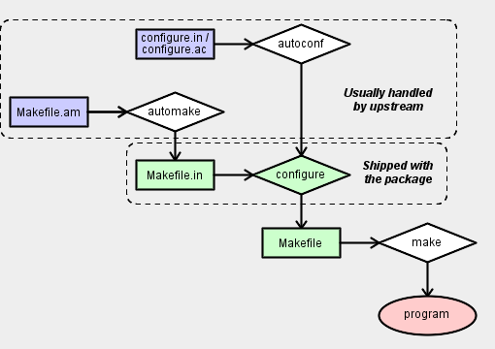
http://devmanual.gentoo.org/general-concepts/autotools/

Slide 11
AutoConf
Automatically configures source code packages
Able to allow packages to work with many kinds of UNIX systems
Transform a user written configure .ac/.in file to a shell script
Generates Configure file

Slide 12
AutoMake
Produces makefiles for use with the make command
Used with AutoConf
Constructs Makefile.in, install-sh, missing, COPYING, depcomp

Slide 13
Why/ Why not use Autotools
Why
  Unpredictable Environment
Why not
  When it’s more troublesome to do it

Slide 14
Basic Constructs of M4

Slide 15
Name
Sequence of characters (letters, numbers, ‘_’) that are binded to a macro
Must not start with a number
First01
alpha

Slide 16
Quotes
String to be quoted is placed in ` and ‘
Must be balanced
Can use quotes in the middle of another set of quotes
  Expansions won’t occur if name is in quotes
Changequote
Nested quotes = stop expansion
``time’’ = `time’

Slide 17
Comments & Tokens
Comments
  Started by ‘#’ and ended by ‘\n’ (newlines)
  Not ignored by the language
  When ‘\n’ entered, comment is ended
Tokens
  Anything that’s not a name or a quote

Slide 18
Macro Invocation
name1
Geof(arg1,arg2,arg3,…)
Not a standard Macro Invocation
  Bad()
    Empty Parentheses = empty string

Slide 19
Macro Invocation (cont.)
Too few arguments…
  Other arguments seen as an empty string
  No error returned
Arguments expanded first

Slide 20
Define New Macros
Use define keyword
Will map a name to an expansion
  Expansion can involve another expansion
Define(hey, `Hello World.’)

Slide 21
Delete Macro
Undefine(`macroName’)
`’ are necessary for this to be done
Will unbind a macro name with an expansion

Slide 22
Macro Arguments
Argument n refered to as $n
Arguments are positional
Define(switch, `$2, $1’)
What’s the result?

Slide 23
Macro Defn Test
Ifdef(name, string1, string2)
Test to see if a Macro is defined
Specialized if statement
String 2 is optional

Slide 24
String Comparison ifelse
Ifelse(string1, string2, equal, not-equal)
Same concept as If Else statements in most programming languages
Any Idea what this would do?
Ifelse(cold, hot, `fresh’, clean, froggy, `tight’, `supafly’)

Slide 25
Special Characters
$# - number of arguments
$* - runs through all arguments
$ - nothing special
$@ - same as $* but quotes argument

Slide 26
Rename Macros
Defn(name)
Copy a macro expansion to another name
Only works if it’s considered to be an expansion

Slide 27
Counting and Arithmetic
Incr(#)
Decr(#)
Eval(expr) where expression is an arithmetic expression

Slide 28
Redefine
Like a stack
Can have multiple definitions for a macro
Pushdef(name, expansion)
  Add expansion to macro
Popdef(name)
  Takes away an expansion associated with a macro
Define will replace top most expansion

Slide 29
Recursion
Works like most other languages
define(`reverse', `ifelse($#, 0, , $#, 1, "$1", `reverse(shift($@)), `$1")')
Shift
  Looks at all arguments except the first one

Slide 30
For loop
Forloop(valName,start, end, statement)
In actuality a recursive call
  No real implementation for loops
  define(`forloop', `pushdef(`$1', `$2')_forloop(`$1', `$2', `$3', `$4')popdef(`$1')')
  define(`_forloop', `$4`'ifelse($1, `$3', , `define(`$1', incr($1))_forloop(`$1', `$2', `$3', `$4')')')

Slide 31
String Manipulation
Len(string1)
Substr(string1,pos,#ofchars)
Index(string1,string2)
Translit(string,set1,set2)
  Can use regular expressions
  Example
  patsubst(`GNUs not Unix', `[A-Z][a-z]+')

Slide 32
References
http://en.wikipedia.org/wiki/GNU_build_system
http://en.wikipedia.org/wiki/GNU_build_system#GNU_Automake
http://www.cs.utah.edu/dept/old/texinfo/m4/m4.html
http://devmanual.gentoo.org/general-concepts/autotools/

