Slide 1
Accelerating lemma learning using joins LPAR 2008 – Doha, Qatar
Nikolaj Bjørner, Leonardo de Moura
Microsoft Research
Bruno Dutertre
SRI International

Slide 2

Satisfiability Modulo Theories (SMT)
SAT
Theories
SMT
Arithmetic
Bit-vectors
Arrays
…

Slide 3
Satisfiability Modulo Theories (SMT)
Arithmetic

Slide 4
Satisfiability Modulo Theories (SMT)
Array Theory
Arithmetic

Slide 5
Satisfiability Modulo Theories (SMT)
Uninterpreted Functions
Array Theory
Arithmetic

Slide 6




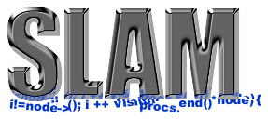

SMT: Some Applications @ Microsoft
HAVOC
Hyper-V
Terminator T-2
VCC
Vigilante
NModel
F7
SAGE

Slide 7
SMT@Microsoft: Solver
Z3 is a new solver developed at Microsoft Research.
Development/Research driven by internal customers.
Free for academic research.
Interfaces:
http://research.microsoft.com/projects/z3
Z3
Text
C/C++
.NET
OCaml

Slide 8
SMT = DPLL + Theories
¬a=b ∨ f(a)=f(b), a < 5 ∨ a > 10, a > 6 ∨ b = 2
Guessing (case-splitting)
Deducing (BCP + Theory propagation)
Conflict resolution → Backtracking + Lemma
Most SMT solvers use only the literals from the given formula!

Slide 9

Is SMT fast???
a[0] = 0
if (c₁) { a[1] = 0; } else { a[1] = 1; }
…
if (c_{n}) { a[n] = 0; } else { a[n] = 1; }
assert(a[0] == 0);

Slide 10
Is SMT fast???
a₁= write(a₀, 0, 0)
(¬c₁ ∨ a₂ = write(a₁,1,0))
(c₁ ∨ a₂ = write(a₁,1,1))
…
(¬c_{n} ∨ a_{n+1} = write(a_{n},n,0))
(c_{n} ∨ a_{n+1} = write(a_{n},n,1))
read(a_{n+1},0) ≠ 0
It takes O(2^{n}) time if lemmas do not use new literals!

Slide 11
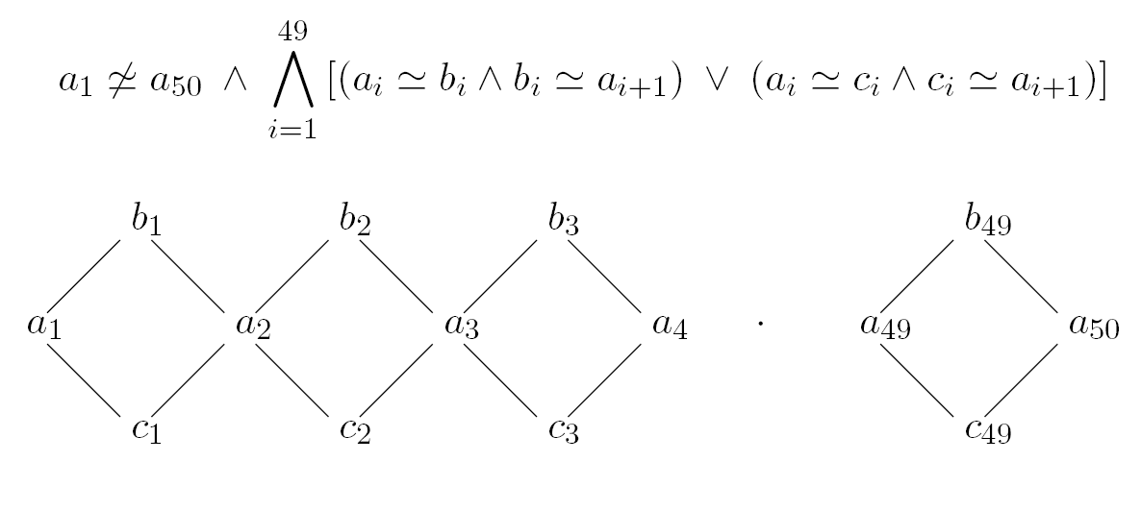

“Diamonds are eternal”

Slide 12
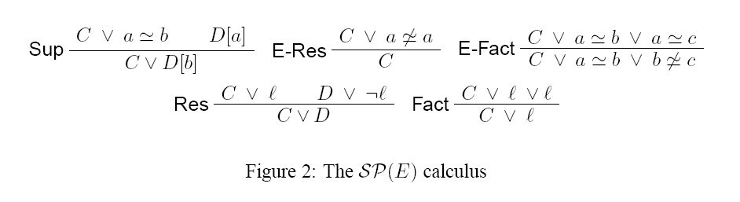
SP(E) calculus
It can solve “diamonds” in polynomial time.
Very slow in practice!

Slide 13
DPLL (E + Δ)
New literals can be created
Case-splitting (guessing)
Lemma Learning
Any SP(E) inference can be simulated by DPLL(E+Δ)

Slide 14
How do we create Δ?

Slide 15
Look ahead
New literal
p
l
S
¬p
l

Slide 16
Look ahead
S
S, l

Slide 17
“The plan”
Define language L (of new literals). Examples:
(Bounds) x > 5
(Equality) x = y
(Difference) x – y < 3
Theory propagation for L
Join operator for L
p
S₁
S₁ S₂
S
S₂
¬p

Slide 18
Join: Examples (Bounds)
¬p ∨ q, ¬q ∨ x>5, p ∨ x>y, y > 4

Slide 19
Join: Examples (Bounds)
¬p ∨ q, ¬q ∨ x>5, p ∨ x>y, y > 4
p
{ x > 5 }

Slide 20
Join: Examples (Bounds)
¬p ∨ q, ¬q ∨ x>5, p ∨ x>y, y > 4
p
¬p
{ x > 5 }
{ x > 4 }

Slide 21
Join: Examples (Bounds)
¬p ∨ q, ¬q ∨ x>5, p ∨ x>y, y > 4
p
¬p
{ x > 5 }
{ x > 4 }
{ x > 5 } { x > 4 } = {x > 4}

Slide 22
Join: Examples (Equalities)
{ x = y, y = z, x = z } { x = z, z = w, x = w } = {x = z}

Slide 23
Join: Examples (Difference constraints)
{ x - y < 3 } { x - y < 2, y - z < 1, x - z < 3} = {x - y < 3}

Slide 24
Join
Other examples:
Linear arithmetic: polyhedral.
Array partial equalities:
a =_{i} b (forall x: x = i ∨ a[x] = b[x])
k-look ahead.

Slide 25
Conclusion
SMT solvers are fast, but they may choke in simple formulas.
DPLL(join) = SMT + “Abstract Interpretation”.
Future work: new literals during conflict resolution.
http://research.microsoft.com/projects/z3
Thank You!

