Slide 1
Experiments in Software Verification using SMT Solvers VS Experiments 2008 – Toronto, Canada
Leonardo de Moura
Microsoft Research

Slide 2
Agenda
What is SMT?
Experiments:
Windows kernel verification.
Extending SMT solvers.
Garbage collector (Singularity) verification
Supporting decidable fragments.

Slide 3

Satisfiability Modulo Theories (SMT)
SAT
Theories
SMT
Arithmetic
Bit-vectors
Arrays
…

Slide 4
Satisfiability Modulo Theories (SMT)
Arithmetic

Slide 5
Satisfiability Modulo Theories (SMT)
Array Theory
Arithmetic

Slide 6
Satisfiability Modulo Theories (SMT)
Uninterpreted Functions
Array Theory
Arithmetic

Slide 7
Z3
Z3 is a new solver developed at Microsoft Research.
Development/Research driven by internal customers.
Free for academic research.
Interfaces:
http://research.microsoft.com/projects/z3
Z3
Text
C/C++
.NET
OCaml

Slide 8


HAVOC
Verifying Windows Components
Lahiri & Qadeer, POPL’08,
Also: Ball, Hackett, Lahiri, Qadeer, MSR-TR-08-82.

Slide 9
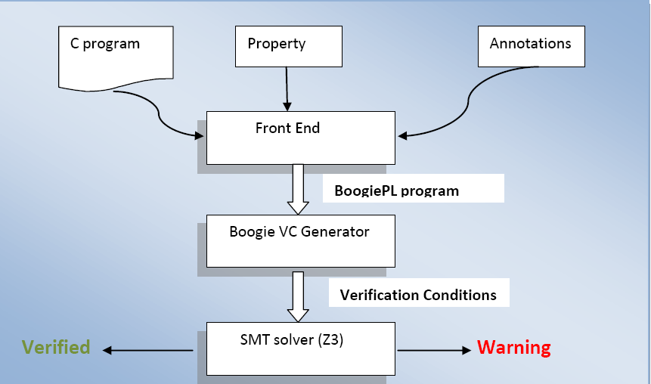

HAVOC's Architecture

Slide 10
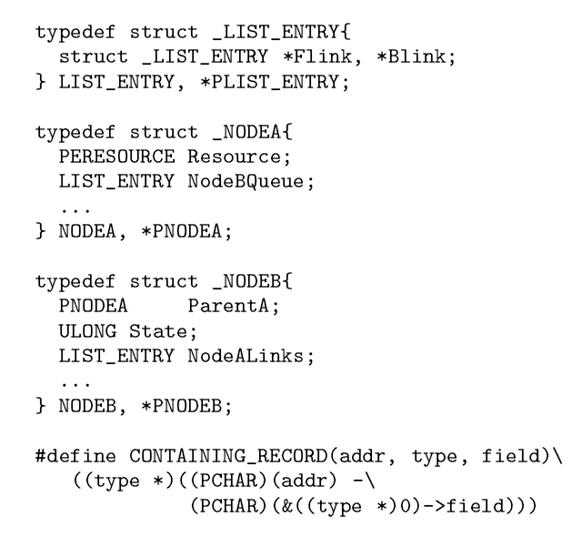
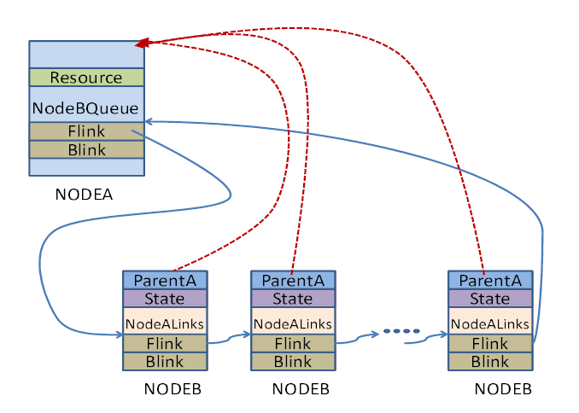
Heaps and Shapes
Representative shape graph in Windows Kernel component
Doubly linked lists in Windows Kernel code

Slide 11
Precise and expressive heap reasoning
q
IRP
IRP
p
link
link
next
prev
next
prev
state
state
PENDING
PENDING
Pointer Arithmetic q = CONTAINING_RECORD(p, IRP, link) = (IRP *) ((char*)p – (char*)(&(((IRP *)0)→link)))
Transitive Closure Reach(next, u) ≡ {u, u->next, u->next->next, …} forall (x, Reach(next,p), CONTAINING_RECORD(x, IRP, link)->state == PENDING)

Slide 12
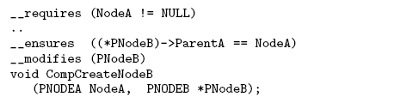
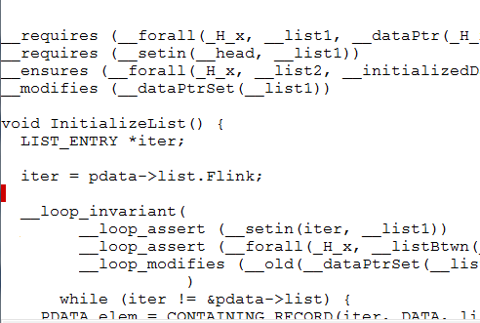
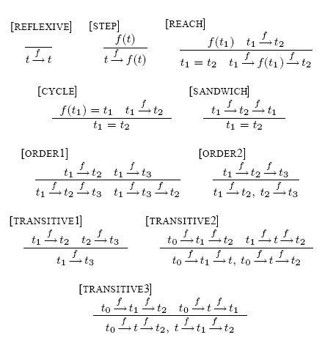
Annotation Language & Logic
Procedure contracts
requires, ensures, modifies
Arbitrary C expressions
program variables, resources
Boolean connectives
quantifiers
Can express a rich set of contracts
API usage (e.g. lock acquire/release)
Synchronization protocols
Memory safety
Data structure invariants (linked list)
Challenge:
Retain efficiency
Decidable fragments

Slide 13
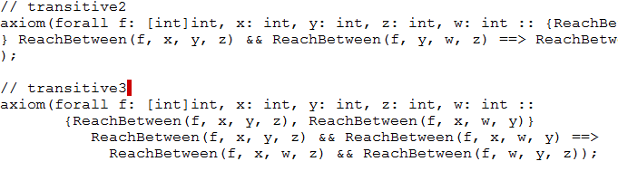
Efficient logic for program verification
Logic with Reach, Quantifiers, Arithmetic
Expressive
Careful use of quantifiers
Encoding using quantifiers and triggers

Slide 14
Success Story
Used to check Windows Kernel code.
Found 50 bugs, most confirmed.
250 lines required to specify properties.
600 lines of manual annotations.
3000 lines of inferred annotations.
Houdini-like algorithm
(Flanagan, Leino)

Slide 15
Extending Z3
Axioms
Inference rules (not supported yet)
Very lazy loop
New Z3 theory (too complicated for users)

Slide 16
Axioms
Easy if theory can be encoded in first-order logic.
Example: partial orders.
x: p(x,x)
x,y,z: p(x,y), p(y,z) ⇒ p(x,z)
x,y: p(x,y), p(y,x) ⇒ x = y
Problems:
Is E-matching or SP a decision procedure for this theory?
Model extraction
Efficiency

Slide 17
Inference rules
Some users (e.g., HAVOC) want to provide inference rules to Z3.
More flexibility (e.g., side conditions)
High level language for implementing custom decision procedures.

Slide 18
Very lazy loop
Adding a theory T:
Replace T symbols with uninterpreted symbols.
Invoke Z3.
If unsatisfiable, then return UNSAT.
Inspect the model + implied equalities (i.e., assigned literals and equalities).
Check if the assigned theory literals + equalities are satisfiable.
If they are, then return SAT.
Otherwise, add a new lemma and/or implied equalities go back to step 2.
Model Based Theory Combination [SMT’08]

Slide 19
Very lazy loop (example)
¬p(a,f(c)) or ¬p(a, f(d))
p(a,b)
p(b,f(c))
c = d
z3
Model:
¬p(a,f(c)), p(a,b), p(b,f(c)),
b = c, f(c) = f(d)
unsat
T-Lemma:
¬ p(a,b) or ¬ p(b,f(c)) or p(a,f(c))
¬p(a,f(c)) or ¬p(a, f(d))
p(a,b)
p(b,f(c))
c = d
¬ p(a,b) or ¬ p(b,f(c)) or p(a,f(c)
z3
unsat

Slide 20

Verifying Garbage Collectors
- Automatically and fast
Chris Hawblitzel
http://www.codeplex.com/singularity/SourceControl/DirectoryView.aspx?SourcePath=%24%2fsingularity%2fbase%2fKernel%2fBartok%2fVerifiedGCs&changeSetId=14518

Slide 21
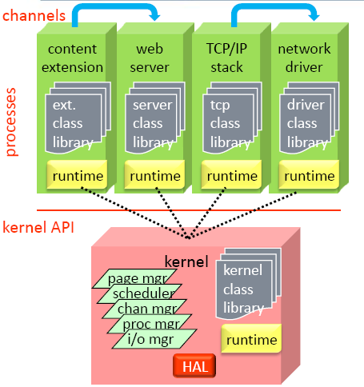
Context
Singularity
Safe micro-kernel
95% written in C#
all services and drivers in processes
Software isolated processes (SIPs)
all user code is verifiably safe
some unsafe code in trusted runtime
processes and kernel sealed at execution
static verification replaces hardware protection
all SIPs run in ring 0
Communication via channels
channel behavior is specified and checked
fast and efficient communication
Working research prototype
not Windows replacement
shared source download

Slide 22
Context
Bartok
MSIL → X86 Compiler
BoogiePL
Procedural low-level language
Contracts
Verification condition generator
Garbage Collectors
Mark&Sweep
Copying GC
Verify small garbage collectors
more automated than interactive provers
borrow ideas from type systems for regions

Slide 23
Goal: safely run untrusted code
MSIL
MSIL: MSFT Intermediary Language
untrusted
code
compiler
typed x86
I/O
exception
handling
garbage
collector
trusted computing
base
(minimize this!)
linker, loader
safety verifier

Slide 24
Mark-sweep and copying collectors
abstract
graph
A
(root)
B
C
mark-sweep
copying from
copying to
A
A
A
C
C
B
B
B

Slide 25
Garbage collector properties
safety: gc does no harm
type safety
gc turns well-typed heap into well-typed heap
graph isomorphism
concrete graph represents abstract graph
effectiveness
after gc, unreachable objects reclaimed
termination
efficiency
verified
not
verified

Slide 26
Proving safety
abstract
graph
$AbsMem
A
(root)
B
C
$toAbs
$toAbs
concrete
graph
Mem
A
B
procedure GarbageCollectMs()
requires MsMutatorInv(root, Color, $toAbs, $AbsMem, Mem);
modifies Mem, Color, $toAbs;
ensures MsMutatorInv(root, Color, $toAbs, $AbsMem, Mem);
{
call Mark(root);
call Sweep();
}
function MsMutatorInv(...) returns (bool) {
WellFormed($toAbs) && memAddr(root) && $toAbs[root] != NO_ABS
&& (forall i:int::{memAddr(i)} memAddr(i) ==> ObjInv(i, $toAbs, $AbsMem, Mem))
&& (forall i:int::{memAddr(i)} memAddr(i) ==> White(Color[i]))
&& (forall i:int::{memAddr(i)} memAddr(i) ==> ($toAbs[i]==NO_ABS <==> Unalloc(Color[i])))}
function ObjInv(...) returns (bool) { memAddr(i) && $toAbs[i] != NO_ABS ==>
... $toAbs[Mem[i, field1]] != NO_ABS ...
... $toAbs[Mem[i, field1]] == $AbsMem[$toAbs[i], field1] ... }

Slide 27
Controlling quantifier instantiation
Idea: use marker
Relativize quantifiers using marker
function{:expand false} T(i:int) returns (bool) { true }
function GcInv(Color:[int]int, $toAbs:[int]int, $AbsMem:[int,int]int, Mem:[int,int]int) returns (bool) {
WellFormed($toAbs)
&& (forall i:int::{T(i)} T(i) ==> memAddr(i) ==>
ObjInv(i, $toAbs, $AbsMem, Mem)
&& 0 <= Color[i] && Color[i] < 4
&& (Black(Color[i]) ==> !White(Color[Mem[i,0]]) && !White(Color[Mem[i,1]]))
&& ($toAbs[i] == NO_ABS <==> Unalloc(Color[i])))
}

Slide 28
Controlling quantifier instantiation
Insert markers to enable triggers
procedure Mark(ptr:int)
requires GcInv(Color, $toAbs, $AbsMem, Mem);
requires memAddr(ptr) && T(ptr);
requires $toAbs[ptr] != NO_ABS;
modifies Color;
ensures GcInv(Color, $toAbs, $AbsMem, Mem);
ensures (forall i:int::{T(i)} T(i) ==> !Black(Color[i]) ==> Color[i] == old(Color)[i]);
ensures !White(Color[ptr]);
{
if (White(Color[ptr])) {
Color[ptr] := 2; // make gray
call Mark(Mem[ptr,0]);
call Mark(Mem[ptr,1]);
Color[ptr] := 3; // make black
}
}
Can we do better?

Slide 29
Decidable Fragments
EPR (Effectively Propositional)
Aka: Bernays–Schönfinkel class
Stratified EPR
Array Property Fragment
Stratified Array Property Fragment
It can be used to verify the GC properties!

Slide 30
EPR
Prefix ∃*∀* + no function symbols.
Examples:
∀x,y,z: ¬p(x,y) or ¬p(y,z) or p(x,z)
∀x: ¬p(x,a) or ¬q(x,b)
Why is it useful?
Model checking problems
QBF
Finite model finding
Useful theories: partial orders.

Slide 31
EPR: decidability
Finite Herbrand Universe.
¬p(a,a) or ¬q(a,b)
¬p(b,a) or ¬q(b,b)
¬p(c,a) or ¬q(c,b)
p(a,a)
p(b,b)
p(c,c)
p(c,a) or q(c, b)
∀x: ¬p(x,a) or ¬q(x,b)
∀x: p(x,x)
p(c,a) or q(c, b)
Herbrand Universe
{a, b, c}
Exponential blowup
SAT-solver

Slide 32
EPR: efficient implementation
DPLL(SX) calculus: DPLL + substitution sets (BDDs) [IJCAR’08]
¬p(a,a) or ¬q(a,b)
¬p(b,a) or ¬q(b,b)
¬p(c,a) or ¬q(c,b)
∀x: ¬p(x,a) or ¬q(x,b)
∀x: ¬p(x1,x2) or ¬q(x3,x4) + {(a,a,a,b), (b,a,b,b), (c,a,c,b)}
Substitution set (BDD)

Slide 33
Stratified EPR
Many sorted first order logic.
S₁ < S₂ if there is a function f : … S₁ … → S₂
A formula is stratified if there is no sort S s.t. S < S
A stratified formula has a finite Herbrand Universe.
Example:
∀x S₁: f(g(x)) = a
g(b) = c
where:
g : S₁ → S₂
f : S₂ → S₃
a : S₃
b : S₁
c : S₂
Herbrand Universe:
{ a, b, c,
g(b), f(g(b)), f(c)}

Slide 34
Stratified EPR and Unsorted Logic
Sort inference + restrictions
Problematic example:
∀x, y: f(x) != f(y) or x = y
∀x: f(x) != c
∀x: x = a
∀x S₁, y S₁: f(x) != f(y) or x = y
∀x S₁: f(x) != c
∀x S₃: x = a
f : S₁ → S₂
c : S₂
a : S₃
Cardinality Constraint

Slide 35
Almost there…
(forall i:int::{T(i)} T(i) ==> memAddr(i) ==>
ObjInv(i, $toAbs, $AbsMem, Mem)
&& 0 <= Color[i] && Color[i] < 4
&& (Black(Color[i]) ==> !White(Color[Mem[i,0]]) && !White(Color[Mem[i,1]]))
&& ($toAbs[i] == NO_ABS <==> Unalloc(Color[i])))
(forall i: Addr
ObjInv(i, $toAbs, $AbsMem, Mem)
&& (color[i] = black or color[i] = white or color[i] = gray)
&& (Black(color[i]) ==> !White(color[Mem[i,f0]]) && !White(Color[Mem[i,f1]]))
&& ($toAbs[i] == NO_ABS <==> Unalloc(Color[i])))

Slide 36
Array Property Fragment (APF)
∀i₁, …, i_{n}: F[i₁, …, i_{n}],
F is in NNF, then the following atoms can contain universal variables:
i_{k} > t (t is ground)
i_{k} > i_{k’}
i_{k} != t (t is ground)
i_{k} != i_{k’}
L[a[i_{k}]] (i_{k} only appears in a[i_{k}])

Slide 37
Examples
Array is sorted:
∀i,j: i <= j implies a[i] <= a[j], or equivalently:
∀i,j: i > j or a[i] <= a[j]
Array update b = write(a, j,v)
b[j] = v
∀x: x > j-1 or b[x] = a[x]
∀x: x < j+1 or b[x] = a[x]
Equivalent to:
∀x: x = j or b[x] = a[x]

Slide 38
Stratified APF
Yeting Ge (Intern 2008)
Nested (stratified) arrays in APF.
Stratified EPR + some arithmetic.
Example:
∀i,j: i <= j implies a[a’[i]] <= a[a’[j]]
It supports other extensions for pointer arithmetic.

Slide 39
Conclusion
Users frequently need new theories.
Quantifiers.
Inference rules.
Very lazy loop.
Decidable fragments are useful in practice.
http://research.microsoft.com/projects/z3
Thank You!

Slide 40
Is Z3 available for commercial use?
Not yet…
However,
PEX (comes with Z3) and Chess will be available for commercial use for VS users.
http://research.microsoft.com/Pex/
http://research.microsoft.com/projects/chess/
SLAM/SDV 2.0 (comes with Z3) is part of DDK and will ship with the next version of Windows.
http://research.microsoft.com/slam/

