Slide 1
AWS Project: S3 Event Notifications with SNS
Hands-on Cloud Computing Project by Sphoorthy

Slide 2
Objective / Scope
The objective of this project is to configure Amazon S3 event notifications to trigger Amazon SNS topics, which then notify subscribers (via email) whenever new objects are uploaded to the S3 bucket.
This demonstrates event-driven cloud architecture used in automation and monitoring.

Slide 3
Services Integrated
- Amazon S3 (Object storage and event generation)
- Amazon SNS (Simple Notification Service)
- IAM (Access policies)
- Email (SNS subscription delivery)

Slide 4
Steps Performed
1. Created an SNS Topic.
2. Subscribed via Email (confirmed subscription).
3. Created an S3 Bucket.
4. Configured Event Notifications on S3.
5. Uploaded a file to the bucket.
6. Verified email notifications.

Slide 5
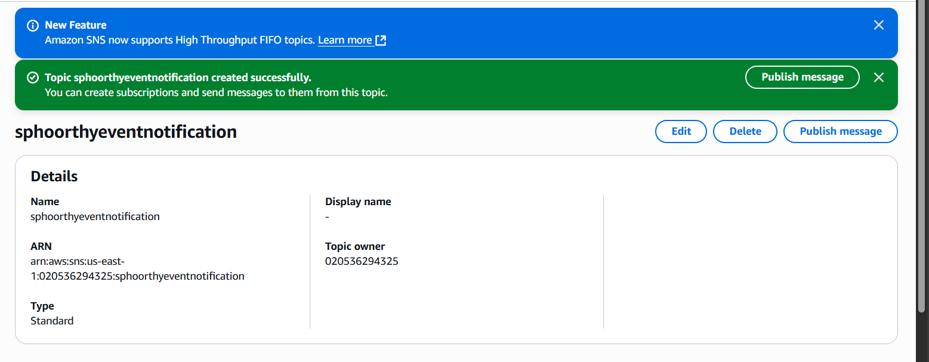
Screenshot: project output

Slide 6
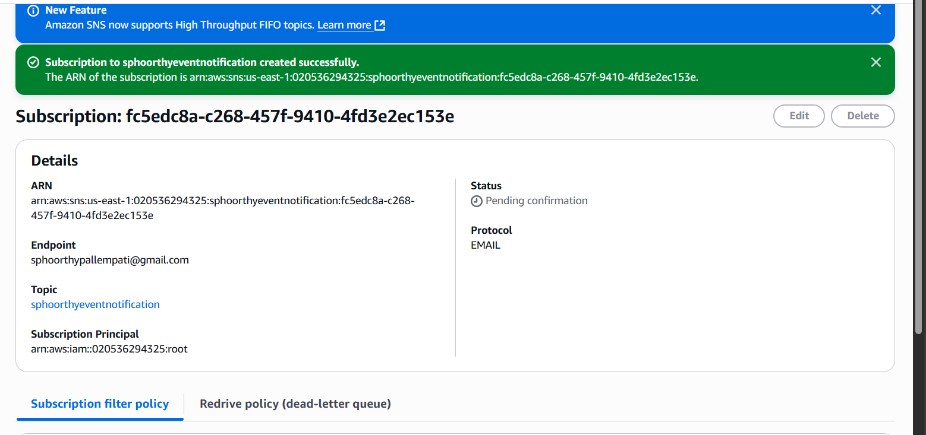
Screenshot: project output

Slide 7
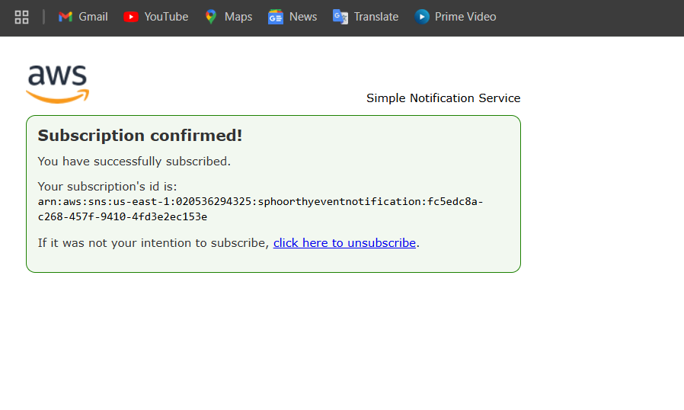
Screenshot: project output

Slide 8
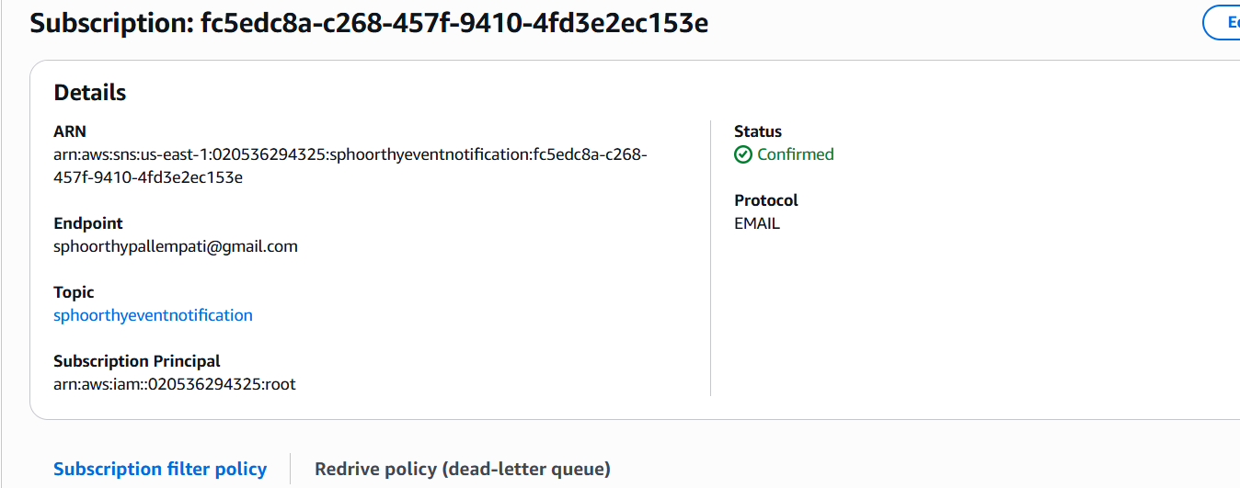
Screenshot: project output

Slide 9
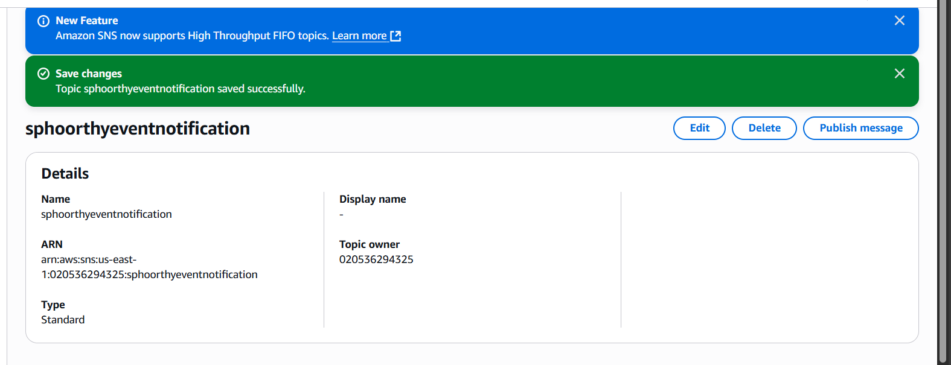
Screenshot: project output5

Slide 10
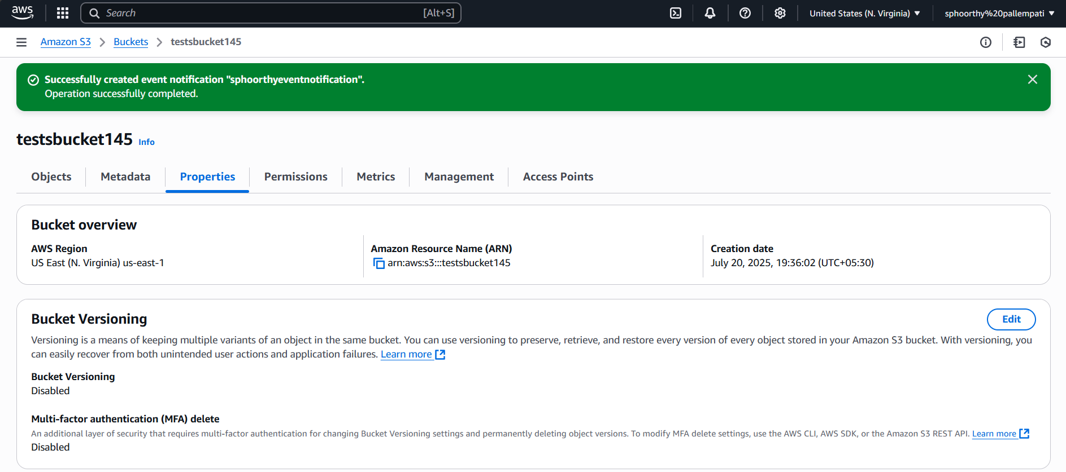
Screenshot: project output

Slide 11
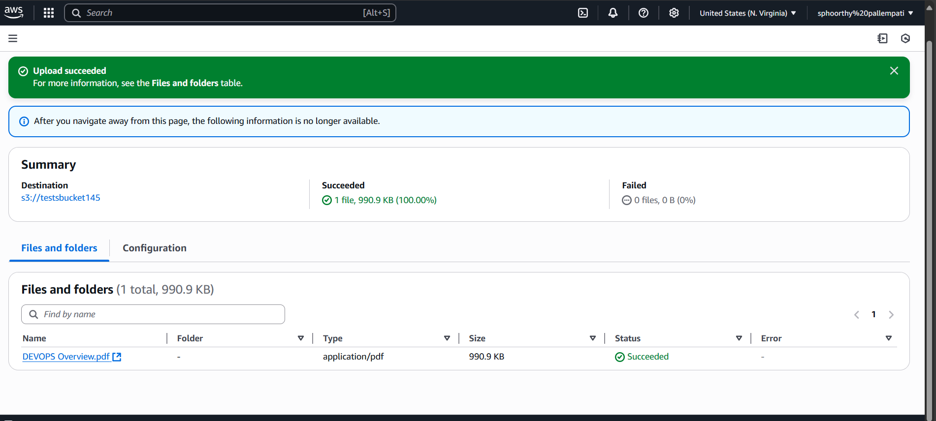
Screenshot: project output 7

Slide 12
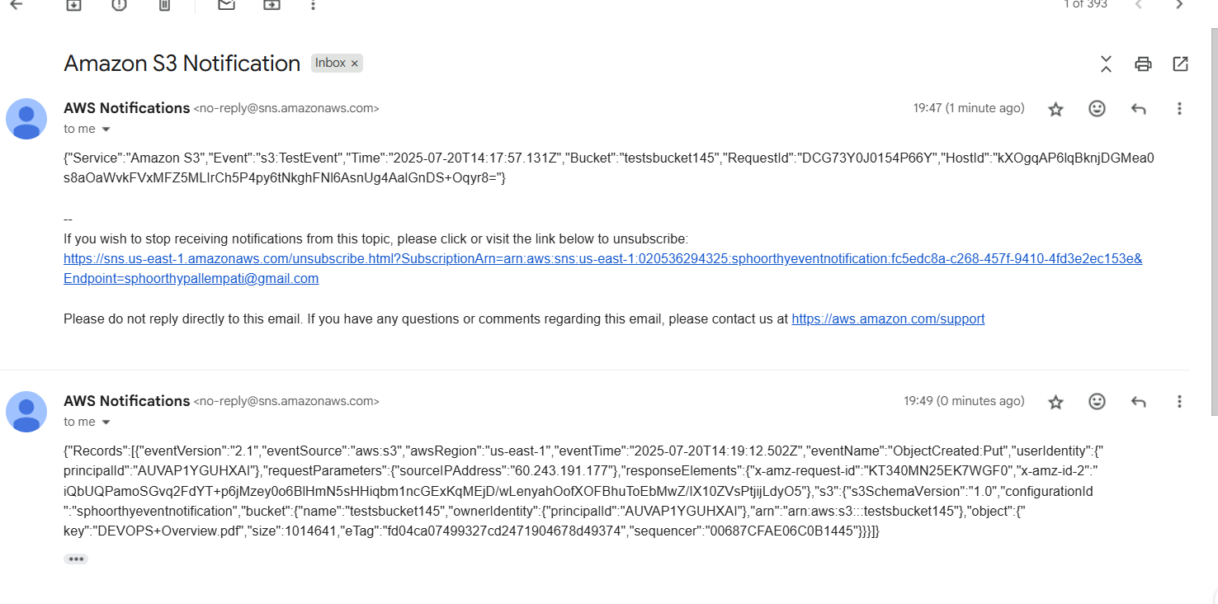
Screenshot: project output 8.png

Slide 13
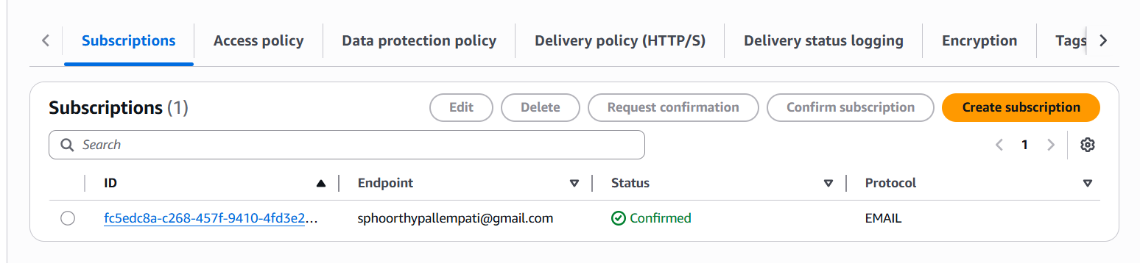
Screenshot: project output

Slide 14
Challenges Faced
- Subscription remained in 'Pending Confirmation' until verified via email.
- Had to replace default access policy with a custom SNS policy linking S3 Bucket ARN and SNS Topic ARN.

Slide 15
Output Verification
- SNS Topic: Active
- Subscription: Confirmed
- S3 Bucket: Configured event notification
- Email: Notification received on file upload

Slide 16

Thank You
Project Demonstration Completed Successfully

