Slide 1
ROVA New/Change Control Set
Detailed build, test & governance methodology
Model risk validation discussion — UKXB / UKXD fraud control workflow
1
Scoring mechanics
How a payment is scored and routed to HOLD / STOP
2
Build & validate (steps 1–5)
Turn a fraud pattern into a test scenario that fires correctly
3
Widen testing (steps 6–8)
Check wider fraud coverage and genuine-payment impact
4
Governance & deployment (steps 9–12)
Sense-check, approve, sign off and roll out

Slide 2
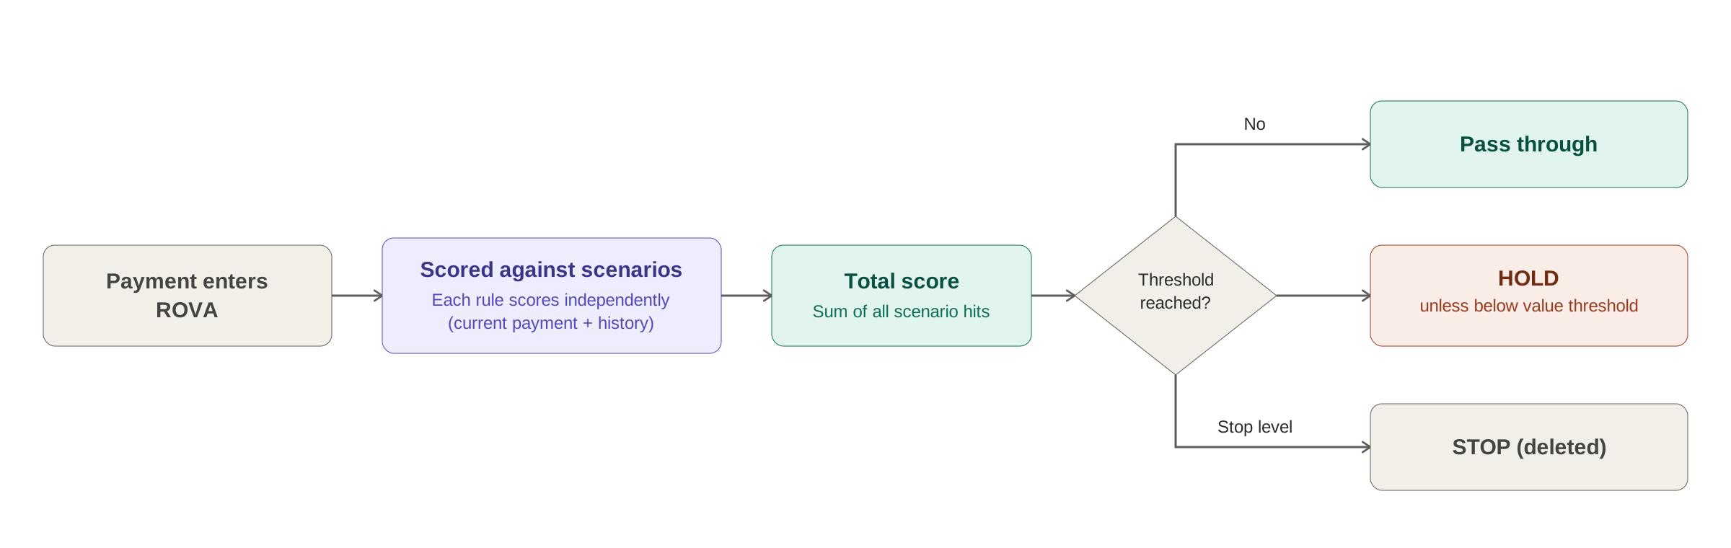
How a ROVA scoring decision is made
Conceptual design — rule-based scenarios, each scored independently
Scenarios mirror real fraud patterns; there is no single Bank-set threshold for “review this payment” — thresholds are tuned against real fraud cases and their impact on genuine payments.

Slide 3
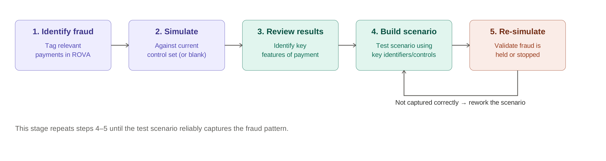
Stage 1 — Build & validate a test scenario
Steps 1–5: turn a newly identified fraud into a working control

Slide 4
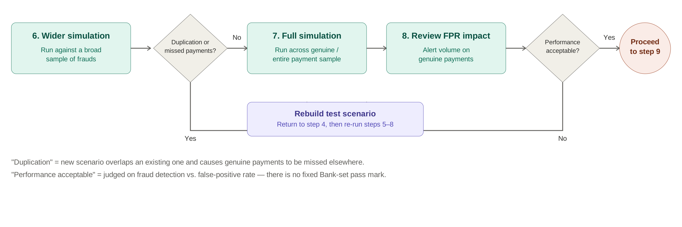
Stage 2 — Widen testing & assess impact
Steps 6–8: confirm the new scenario works at scale without harming genuine payments

Slide 5
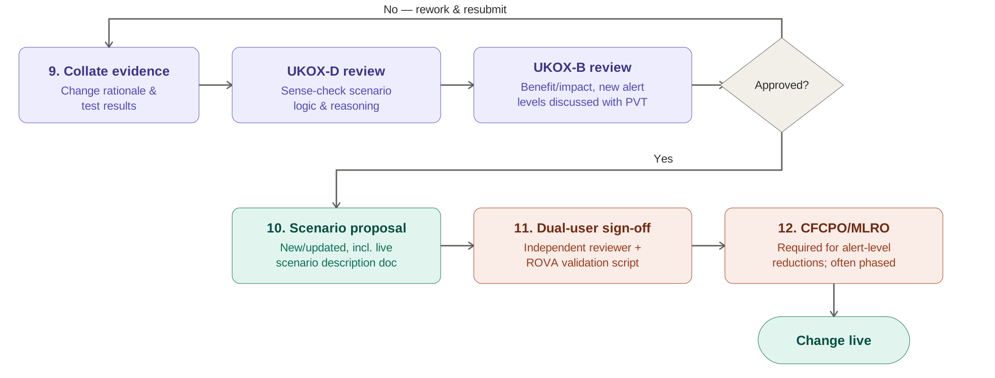
Stage 3 — Governance, sign-off & deployment
Steps 9–12: evidence, independent review and control sign-offs before go-live
Dual-user control: the person signing off thresholds is never the scenario’s creator — enforced by ROVA and checked by UKOX-D’s control-set validation script.

