Slide 1
Tutorial

Slide 2
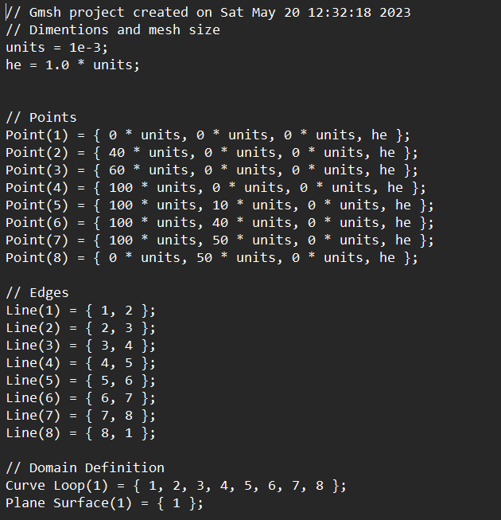
Define Domain using GMSH
Points:
Point(p_id) = { x, y, z, h };
Edges:
Edge(e_id) = { p_id, p_id };
Edge Loop:
Curve Loop(c_id) = { e_id, … };
Surface:
Plane Surface(s_id) = { c_id, … };

Slide 3
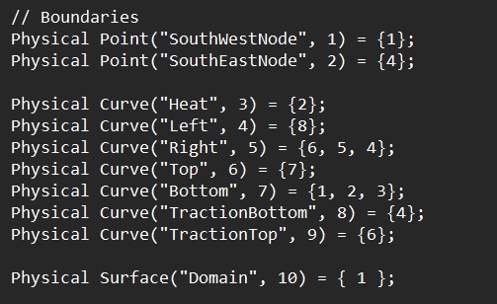
Adding Boundaries
Point Boundary:
Physical Point(“Name”, b_id) = { p_id, … };
Edge Boundary:
Physical Curve(“Name”, b_id) = { e_id, … };
Surface Boundary:
Physical Surface(“Name”, b_id) = { s_id, … };

Slide 4
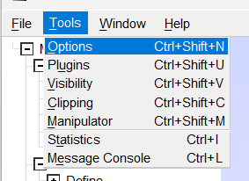
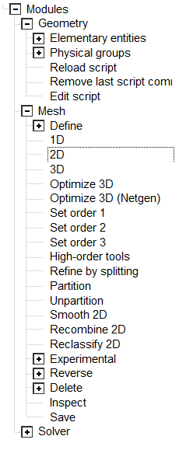
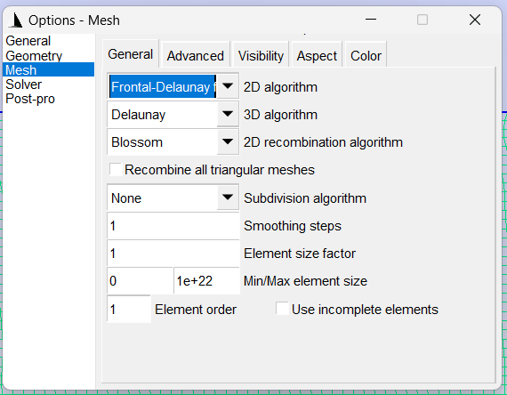
Meshing
Step 1:
Step 2:
Choose correct meshing algorithm
Tools -> Options
Mesh -> General
In 2D algorithm, choose Frontal-Delaunay for Quads
Generate Mesh
Expand “Mesh”
Click “2D”
To get quads, click “Recombine 2D”

Slide 5
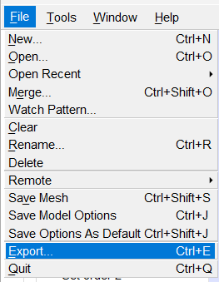
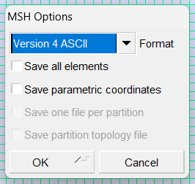
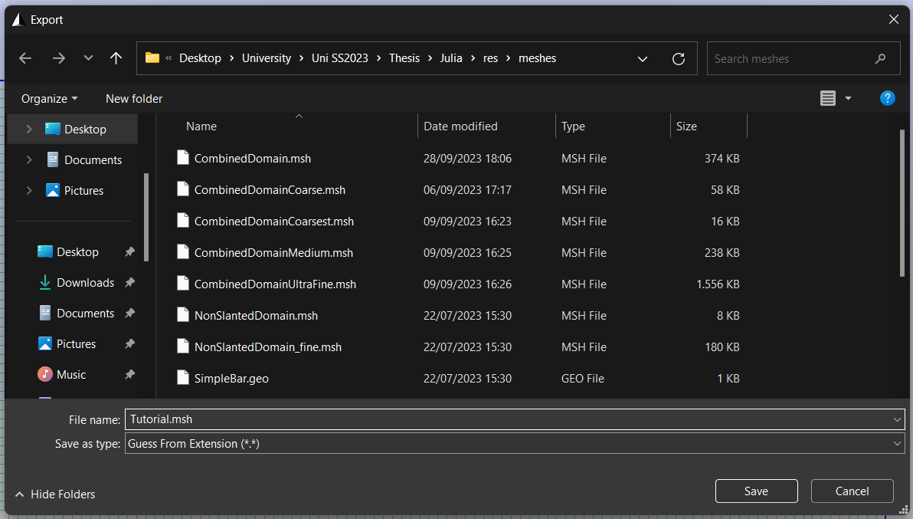
Export Mesh
Step 1
Step 3
Export
File -> Export
Add the “.msh” extension to the file name
Make sure the format is Version 4 ASCII
Don’t need to export all elements, as only name elements are considered in the simulation
Step 2

Slide 6
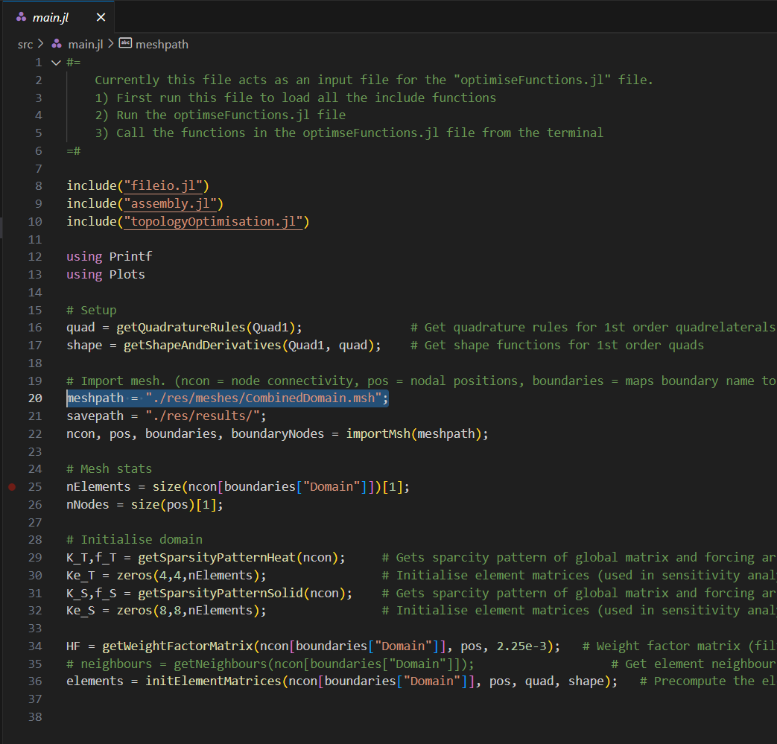
Script Initialization (main.jl)
Choose an appropriate filter radius
Line 34 in this version of the script
Should be larger than 1.5 elements.
Run “main.jl” ensuring the correct mesh file is chosen
Line 20 in this version of the script
Manually Enter “useLattice = <true/false>” into the console
This file acts as an initialization file.

Slide 7
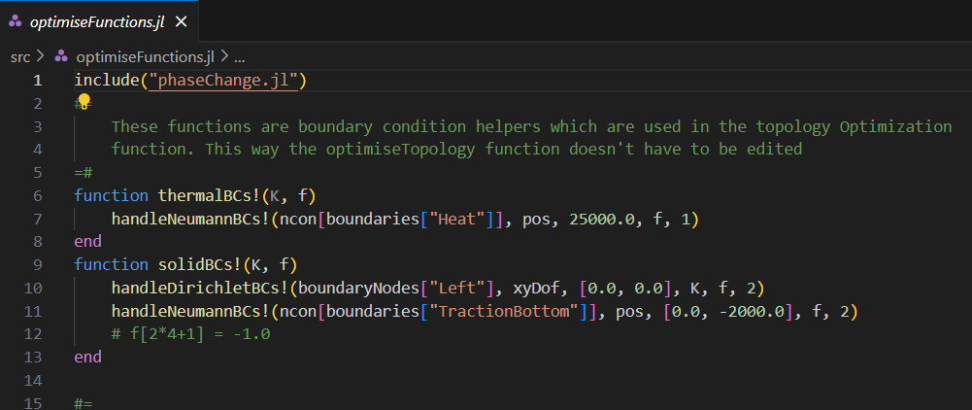
Topology Optimization (optimiseFunctions.jl)
Define Boundary Conditions
In “thermalBCs”, the thermal boundaries are defined. A heat flux is used for Neumann boundary conditions
In “solidBCs”, the structural boundaries are defied. A distributed load is defined for Neumann boundary conditions
Run the file once the boundary conditions are set
Call an optimize or solve function

Slide 8
Phase Change (phaseChange.jl)
The phase change solver requires a relative density distribution to be defined. This can be obtained though a topology optimization or by reading from a previously saved .vtu file.
Either
Perform topology optimization
Read relative density from file
reldense = readReldenseVTK(<filepath>)[boundaries["Domain"]]
Note that “[boundaries["Domain"]]” is used to only keep the domain relative densities
Run the file and call a solve function

