Slide 1
Docker progress
docker build -> created the moneyserver inside container
docker run -> run the container and map the port
progres db in docker
Docker compose ,bring progressdb and money server together in a network. (shall continue)
Sample: kb_school/Docker_for_money

Slide 2
Routing
Why :
1. respond to browser uri
2. Help manage code module relations in an understandable pattern

Slide 3
Browser Side:uri
: //host/money/:money
: //host/money /:money /currency/
: //host/money /:money /currency/:currencyposition
: //host/jokes/

Slide 4
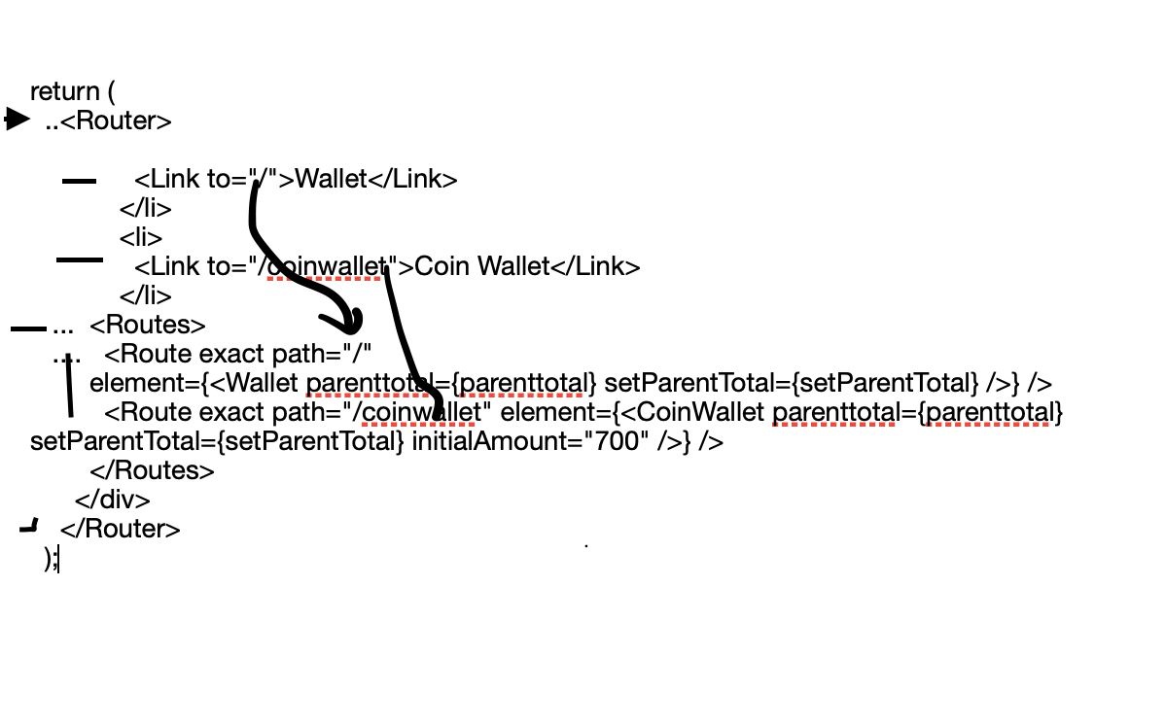
Browser Side : React dom router
Sample: kb_school/html_css-to-React/REACT_COMPS/wallet_pair

Slide 5
Server Side
Routes : money -> money/currency ,jokes,
level 1 :yellow
level 2: green
Sub-paths correspond to nested directory hierarchy
Params data don’t form nesting, i.e req.param1 ,req.param_n or through query req.query.val for path?val=123,
Sample :kb_school/html_css-to-React/REACT_COMPS/reachformoney

