Slide 1
Welcome — KB Linux Foundation
Adopted Linux Course
For Intention Space
KB Linux Foundation • Slide 1

Slide 2
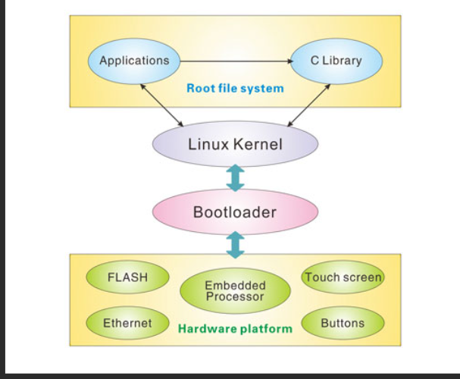
Where IS The PROCESS & Where Is The STATE ?
KB Linux Foundation • Slide 2

Slide 3
IPTP SHELL

Slide 4
IPTP shell
Github https://github.com/spicecoder/IS_ITTP_Shell
IPTP protocol is based on Pulses
Intentions carry a bunch of Pulses
Pulses are basic unit of interaction between machines and between man -machine

Slide 5

Android adb shell

Slide 6

Android SDK
Adb –the debug bridge
Provides a bridge to Android linux kernel
Make sure andoid sdk is in your path /shell profile
Not meant for App dev

Slide 7

Goal –IPTP
Shall make IPTP shell the main interface for fast app development

Slide 8
Why getmethere fails
Short kernel-level reason (one sentence)
The kernel attaches a current working directory pointer inside each process’s kernel task structure (task_struct). When the shell forks and execs a script, the child process has its own task_struct; changing cwd in the child updates that process’s kernel state only — the parent’s task_struct stays unchanged.

