Slide 1
Welcome — KB Linux Foundation
Adopted Linux Course
For Intention Space
KB Linux Foundation • Slide 1

Slide 2
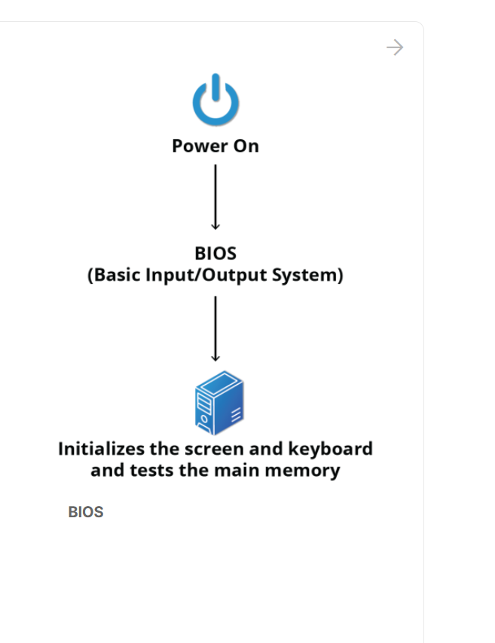
Power on trigger

Slide 3
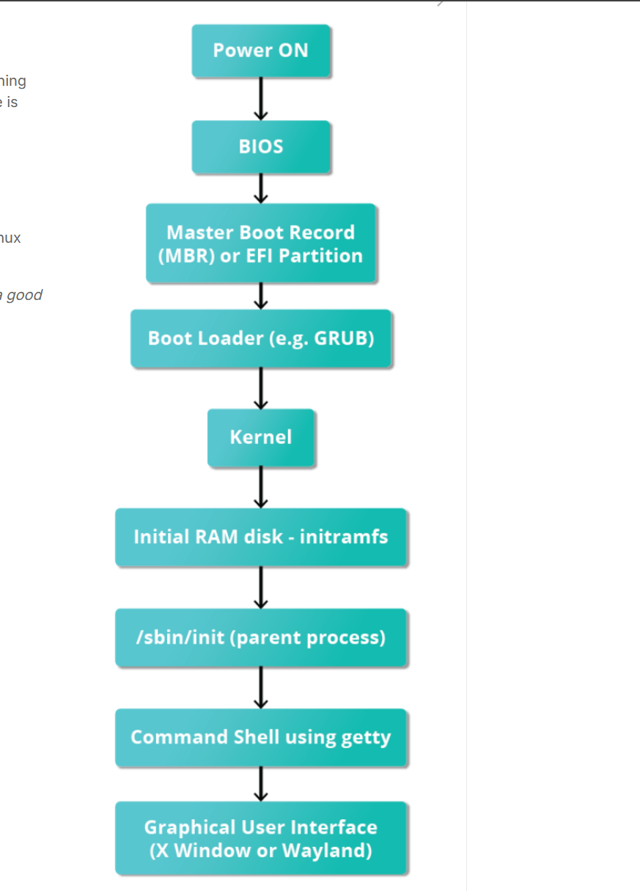
Boot Process

Slide 4
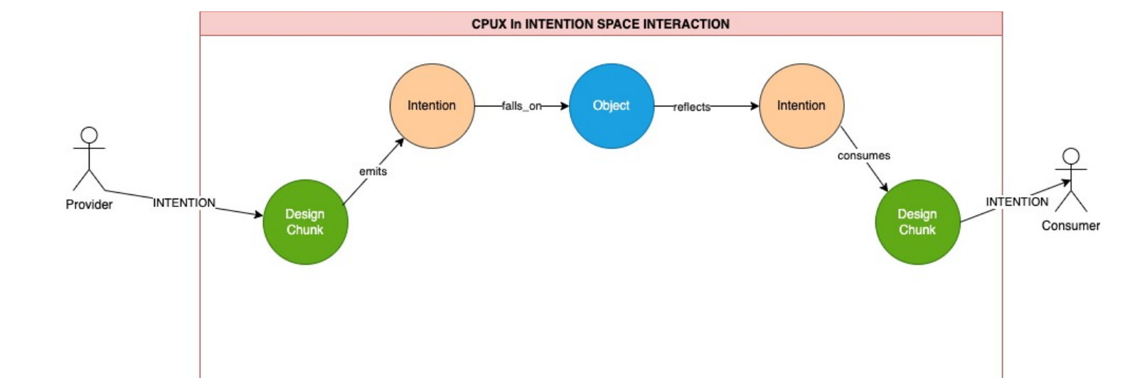
How To Break Down The Booting Process into Steps
Recognizing processes (DNs), interactions (Intentions) and the runtime contexts (Objects / Fields)."
KB Linux Foundation • Slide 2

Slide 5
Intention — the explicit signal in the communication tunnel
Definition: a directed, context-laden signal (a pulse) that asks for action or announces state — carries purpose, provenance and constraints.
Why it was invisible: OS/network abstractions emphasized mechanics (bytes, calls, packets) not purpose; intent lived implicitly in protocols or human policy.
What Intention adds: surfaces the *why* — who wanted it, under what conditions, and what contract governs the result.
Quick mapping: DN emits Intention (who, why, constraints) → Object reflects Pulse → DN absorbs and acts — Intention makes the chain explainable.
Intention Space — Intention Slides • Slide 1
Notes:
Speaker notes:
- Lead with the short definition and emphasize 'purpose, provenance, constraints'.
- Explain why traditional abstractions ignored explicit intention: they focused on HOW (mechanics), not WHY (purpose).
- Give an example: a write() syscall vs an intentioned write that carries consent/audit tags; how receivers may behave differently when intent metadata is present.
- Walk the quick mapping with a simple example: user requests sync → service emits intent 'sync', object (file) reflects pulse, downstream consumer acts differently because intent indicates 'manual correction' vs 'automated sync'.
- Tip for presenters: ask the audience for a 30-second example of an intention they've recently performed (e.g., 'I meant to archive this file').

Slide 6
Linux Boot — an Intention Space Mapping (Overview)
Map each boot phase as: Process → Object (state) → Emitting DN → Intention (pulse) → Absorbing DN
Objects mediate: disk sectors, firmware tables, memory regions, sockets act as reflectors of pulses
Distinguish persistent (disk/flash) vs volatile (RAM/initramfs) objects; both are part of the Field
Design exercise: annotate boot logs with DN/I/O chains to expose implicit intentions
Notes:
Speaker notes:
Introduce the idea: present boot as a sequence of processes that create or read object-states and emit implicit intentions.
Explain mapping template briefly with a small example (firmware emits hardware.initialized intent recorded in firmware tables).
Tell students we'll later annotate journalctl/dmesg output with this mapping.

Slide 7
Boot Steps — Detailed Intention Mapping from journalctl -b
1. Power On → Firmware (BIOS/UEFI) — Process: POST, device init
Object: firmware tables, reset vector
Emitter DN: firmware
Intent: hardware.initialized
Absorber: boot device controller/bootloader
2. MBR / EFI Partition read — Process: read boot image
Object: disk partition/MBR (persistent)
Emitter DN: firmware/disk controller
Intent: boot.image.found
Absorber: bootloader
3. Bootloader (GRUB) runs — Process: choose kernel, load into RAM
Object: kernel image in memory, kernel-params
Emitter DN: bootloader
Intent: kernel.load.request
Absorber: kernel init code
4. Kernel init into RAM — Process: decompress, probe drivers, set irq/syscall tables
Object: kernel-in-memory, interrupt vectors (open gates)
Emitter DN: kernel
Intent: kernel.ready_for_init
Absorber: initramfs/init
5. initramfs & pivot to root — Process: mount root fs, load drivers
Object: rootfs mounted, /dev populated
Emitter DN: initramfs
Intent: rootfs.mounted, drivers.loaded
Absorber: init (systemd)
6. /sbin/init (systemd) starts services — Process: start units, open sockets
Object: unit states, sockets, PID1
Emitter DN: systemd/init
Intent: service.start, socket.listen
Absorber: service processes (sshd, NetworkManager)
7. Login → user shell / GUI — Process: getty/login, session created
Object: session token, tty/gui state
Emitter DN: login manager
Intent: session.created
Absorber: shell/desktop DN and human DN
Boot -> Intention Space • Slide 2
Notes:
Speaker notes:
Walk each step slowly. For each bullet: read the process line, point to the object that changes, and ask students 'who would absorb this intent?'
Highlight transitions: persistent disk -> volatile RAM (where kernel opens gates). Emphasize that DNs do not call each other directly.
Suggest live demo: run 'journalctl -b' and pick lines to annotate with DN/I/O mapping.

Slide 8
Why recognising Intention matters today (identity, complexity, ethics)
Identity & provenance: explicit intentions carry origin and context (who/role/time) — crucial for accountability.
Complexity management: intentions compress contract info so many DNs can reason about sequencing and side-effects.
Policy & consent: attach consent/constraints to intentions (TTL, allowed uses) so objects and DNs can enforce policy automatically.
Social & environmental ethics: intentions let designers predict impact (resource cost, privacy exposure) before execution.
Operational gains: better tracing, noiseless debugging (trace intentions rather than raw logs), and safer composability.
Intention Space — Intention Slides • Slide 2
Notes:
Speaker notes:
- For each bullet, give a short concrete example:
* Identity: intent envelope includes emitter and signature so receivers can verify provenance.
* Complexity: show how an intent header reduces mental load when reasoning about chains of services.
* Policy: describe consent field and TTL, and how a storage system could enforce them.
* Ethics: mention resource hints (cost budgets) and how they inform decisions (e.g., defer heavy processing).
* Operational: replacing noisy log tracing with intent_id-centric tracing reduces cognitive load for on-call teams.
- Quick classroom exercise: ask teams to add a mock intent header to one API call and discuss what would change in downstream consumers.

Slide 9
keywords
Distro
Upstream
Downstream
Kernel
Bootloader
Bios
Userland

Slide 10
commands by category
Quick reference:
FS & files: ls, cd, cp, mv, rm, chmod, chown, mount, umount, df, du
Processes & services: ps, top, htop, pgrep, pkill, systemctl, journalctl
Networking: ip, ss, ping, curl, dig, tcpdump (optional)
Packaging: apt, dpkg, dnf, rpm
Text & search: grep, awk, sed, find, locate, man
Shell & scripting: bash, chmod +x, crontab, set -euo pipefail

Slide 11
Quick prac
id -u
Prints your numeric user ID (1000 in your case).
Whoami
cat
grep "$(whoami)" /etc/passwd
pronabpartha:x:1000:1003::/home/pronabpartha:/bin/bash
This line defines a user named pronabpartha with UID 1000, belonging to GID 1003, using /bin/bash as their login shell and having their home directory at /home/pronabpartha.

