Slide 1
Welcome — KB Linux Foundation
Adopted Linux Course
For Intention Space
KB Linux Foundation • Slide 1

Slide 2
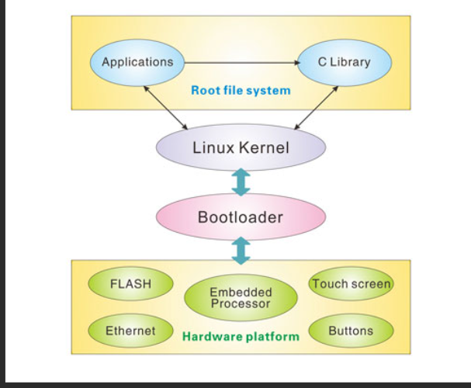
Where IS The PROCESS & Where Is The STATE ?
KB Linux Foundation • Slide 2

Slide 3
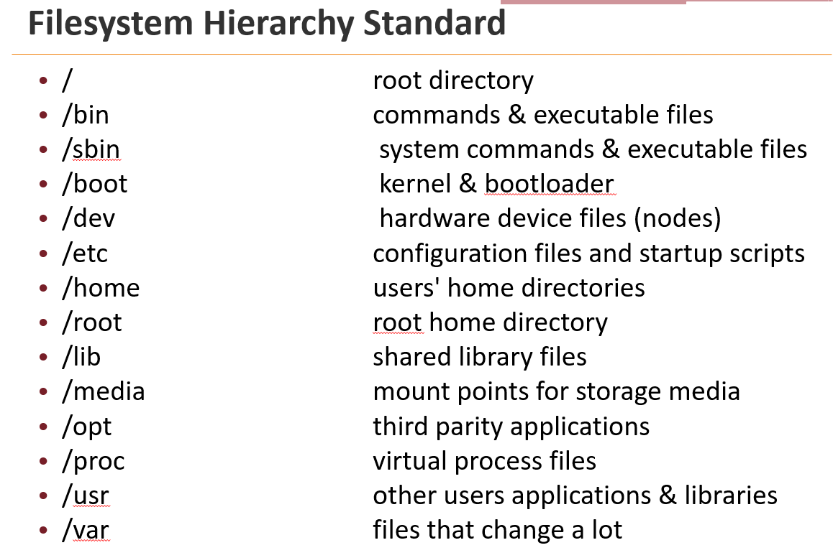
Linux – every thing is a file..?

Slide 4
Taste Of devices as file
# list input devices (evdev) short for "event device"
ls -l /dev/input/*
# which process has the console open? (may need sudo)
sudo lsof /dev/console
# check PID 1 process
ps -p 1 -o pid,comm,cmd
# list fd of PID 1 (may show device files opened)
sudo ls -l /proc/1/fd

Slide 5
What is a Process in Linux
A process is a running instance of a program managed by the kernel
• Kernel view: represented by task_struct (PID, state, scheduling info)
• Key attributes: PID, PPID, UID/GID, memory map, file descriptors, signals
• Memory layout: text/code, data, heap (dynamic), stack (per-thread)
• Lifecycle: fork() → (child) execve() → run → exit(); parent uses wait()/waitpid()
• States: running, sleeping (interruptible/uninterruptible), stopped, zombie
• Processes vs threads: threads are lightweight processes sharing the same memory
• Inspect & debug: ps, top, pstree, /proc/<pid>, strace, lsof
Takeaway: a process is the kernel-managed execution context that isolates a program's resources and memory from other processes.

Slide 6
Layered Cycle Speeds — Kernel, IoT Monitor, Display
Why speeds matter across layers
• Different layers operate on different time scales; design must reconcile these for correctness and UX.
Typical layers & characteristic cycle times
• Kernel / Interrupts: microseconds — fast IRQ handling, softirqs, scheduling (e.g., HZ=1000, tickless/nohz)
• Device DMA / HW controllers: micro → milli — DMA transfers, GPU framebuffers, hardware timers
• IoT Monitor / Sensor sampling: milliseconds — sensor poll rate or interrupt-based sampling (10ms–1000ms)
• Network / Bus: milliseconds → 10s ms — network latency, wireless jitter
• Display device (frame rate): frames at 60 Hz (≈16.7 ms) or 120 Hz (≈8.3 ms)
• Human operator / UX: ≈100 ms+ perceptual latency (responsiveness target)
How these layers work together (practical patterns)
  Boot-time knobs (examples) • Interrupts → kernel quickly captures events; hand off to userland via device nodes or netlink (low jitter).
  • Buffering & timestamps: kernel or driver timestamps events; buffers decouple fast producers from slower consumers.
  • Aggregation / downsampling: high-rate sensors aggregate before sending to reduce load.
  • Scheduling & priorities: use real-time policies (SCHED_FIFO) for hard deadlines; isolate CPUs for low-latency tasks.
  • Frame sync: compositor matches sensor + app updates to display refresh (vsync) to avoid tearing.
  • Watchdogs / timeout: detect and recover missed deadlines (driver or userspace monitors).
  • Kernel cmdline: hz=1000 nohz_full=1 isolcpus=2-3 (tune tick rate, isolate CPUs).
  • CPU frequency governor: set to 'performance' to avoid throttling for latency-sensitive tasks.
  • Device-tree / driver params or udev: set default sampling rates, enable IRQ affinities, set permissions.
  • systemd/udev services: start driver-proxy daemons early to reduce warm-up latency.
Takeaway: align producer speed, buffering, and consumer deadlines; pick where you trade latency vs throughput.

Slide 7
FD –file descriptors and processes
The integer is the file descriptor number (non-negative integer). FD 0 = stdin, 1 = stdout, 2 = stderr by convention.
# open FD 3 in parent (current shell)
exec 3> /tmp/fdtest.txt
# write parent's pid via FD3
echo "parent PID $$ (writing via FD3)" >&3
# subshell: different PID, but can write via FD3 (inherited FD)
( echo "subshell PID $$ (writing via inherited FD3)" >&3 )
# group in current shell: same PID as parent
{ echo "group PID $$ (running in current shell)">&3; }
# close FD 3 and inspect file
exec 3>&-
cat /tmp/fdtest.txt

Slide 8
Why getmethere fails
Short kernel-level reason (one sentence)
The kernel attaches a current working directory pointer inside each process’s kernel task structure (task_struct). When the shell forks and execs a script, the child process has its own task_struct; changing cwd in the child updates that process’s kernel state only — the parent’s task_struct stays unchanged.

Slide 9
Process –sub Process
Pipe — variable lost
$ echo "hello" | read var
$ echo "var is: '$var'"
var is: ''
# read ran in a subshell; parent var not set
Process substitution — variable preserved
$ read var < <(echo "hello")
$ echo "var is: '$var'"
var is: 'hello'
# read ran in current shell; var set

