Slide 1

JAVA & ANDROID

Slide 2
INTRODUCTION
It is a special type of method which is used to initialize the object.
It is invoked when an instance of object is created and memory is allocated for the object.
Each time an object is created using new() keyword at least one constructor (it could be default constructor) is invoked to assign initial values to the data members of the same class.
Rules for writing Constructor:
Constructor name must be same as its class name
Constructor must have no explicit return type

Slide 3
METHOD
CONSTRUCTOR
It is not necessary to use the same name of the class to create a Method.
Method is an ordinary member function which is used to expose the behavior of an object
Methods must have return type unless it is specified as void.
Compiler does not create a method in any case if one is not available.
Methods invoked explicitly using the dot operator.
The name of the Constructor should be same as the class name it resides.
Constructor is a member function of a class used to initialize the state of an object.
Constructor does not have a return type.
Java compiler creates default constructor if the program doesn’t have one.
Constructor invoked implicitly. i. e. Invoked using the keyword ‘new’.

Slide 4
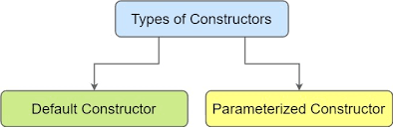

Slide 5
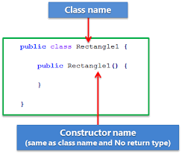
DEFAULT CONSTRUCTOR

Slide 6
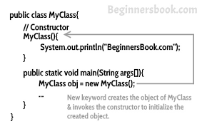

Slide 7
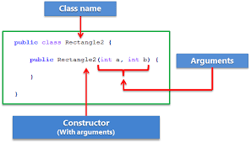
PARAMETERIZED CONSTRUCTOR

Slide 8
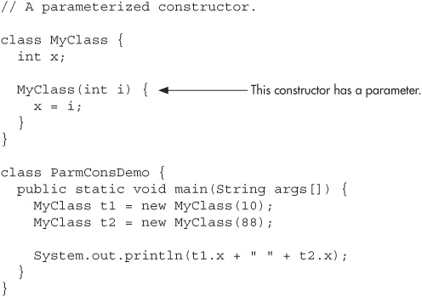

Slide 9
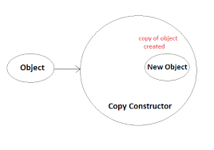
COPY CONSTRUCTOR

Slide 10
