Slide 1

JAVA & ANDROID

Slide 2
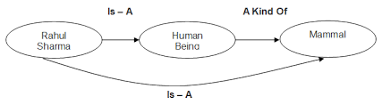
INTRODUCTION
Inheritance represents the IS-A relationship, also known as parent-child relationship.
Inheritance in java is a mechanism in which one object acquires all the properties and behaviors of parent object.
class Subclass-name extends Superclass-name
{
//methods and fields
}

Slide 3
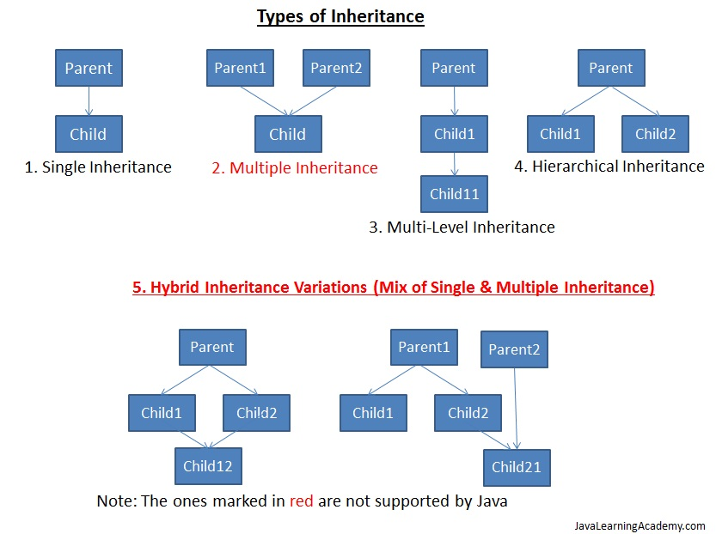

Slide 4
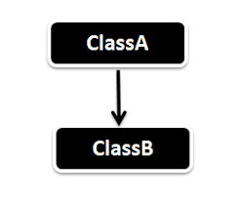
SINGLE INHERITANCE

Slide 5
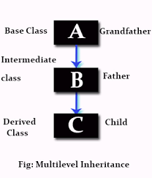
MULTILEVEL INHERITANCE

Slide 6
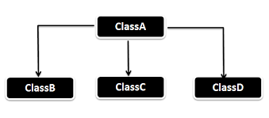
HIERARCHICAL INHERITANCE

Slide 7
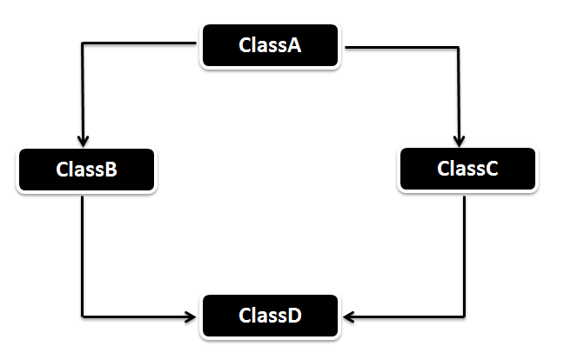
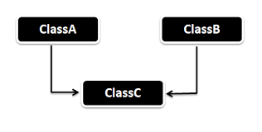
MULTIPLE INHERITANCE AND HYBRID INHERITANCE (not supported in java)

Slide 8
TERMS USED IN INHERITENCE
Class: A class is a group of objects which have common properties. It is a template or blueprint from which objects are created.
Sub Class/Child Class: Subclass is a class which inherits the other class. It is also called a derived class, extended class, or child class.
Super Class/Parent Class: Superclass is the class from where a subclass inherits the features. It is also called a base class or a parent class.
The extends keyword indicates that you are making a new class that derives from an existing class. The meaning of "extends" is to increase the functionality.
Reusability: As the name specifies, reusability is a mechanism which facilitates you to reuse the fields and methods of the existing class when you create a new class. You can use the same fields and methods already defined in previous class.

