Slide 1

JAVA & ANDROID

Slide 2
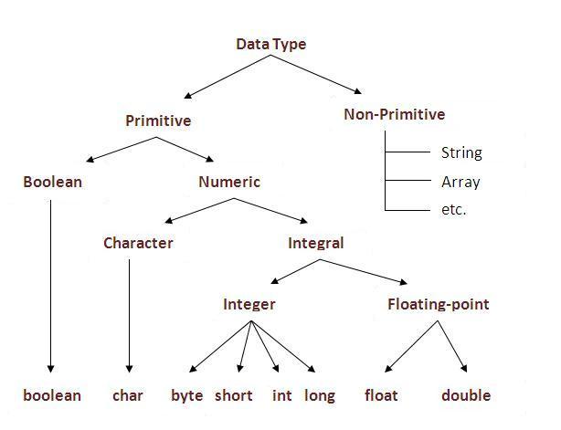
Data Types in Java
Data types represent the different values to be stored in the variable.

Slide 3
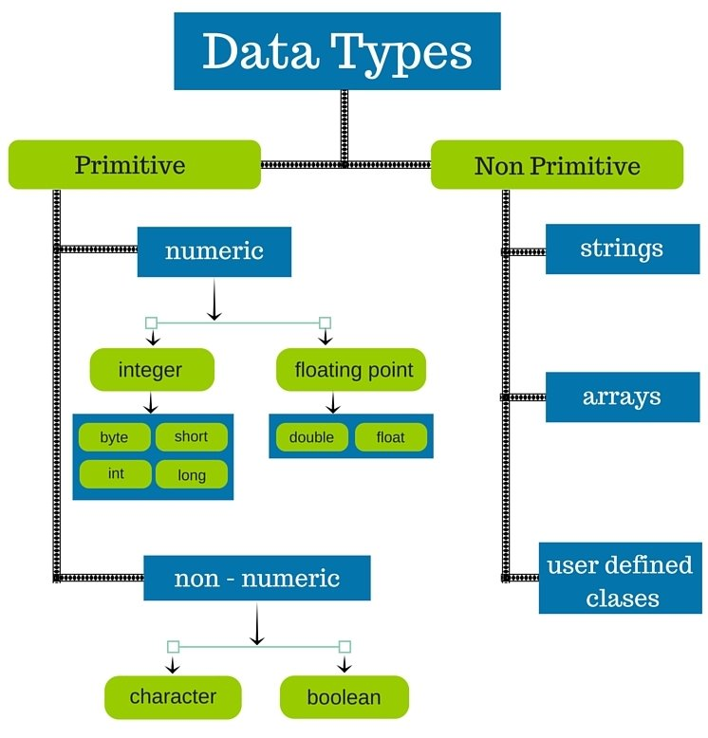

Slide 4
Data Type | Default Value | Default size
boolean | false | 1 bit
char | '\u0000' | 2 byte
byte | 0 | 1 byte
short | 0 | 2 byte
int | 0 | 4 byte
long | 0L | 8 byte
float | 0.0f | 4 byte
double | 0.0d | 8 byte

Slide 5
Variable
Variable is name of reserved area allocated in memory. In other words, it is a name of memory location. It is a combination of "vary + able" that means its value can be changed.

Slide 6
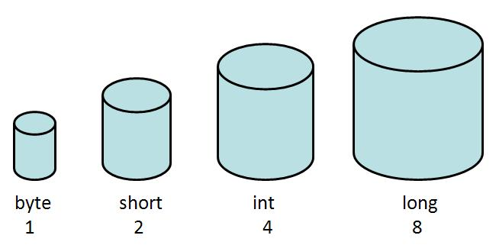

Slide 7
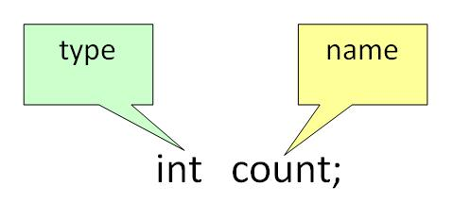
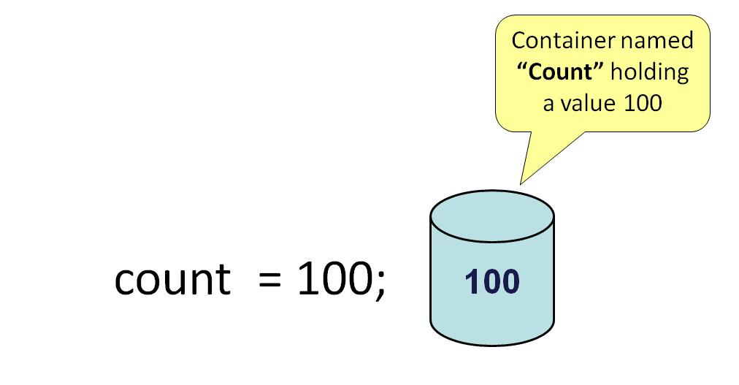
Variable Declaration:
Variable Initialization:

Slide 8
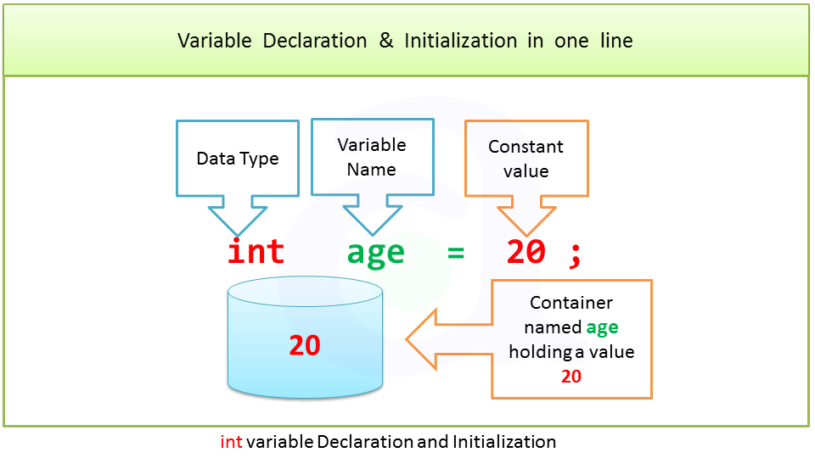

Slide 9
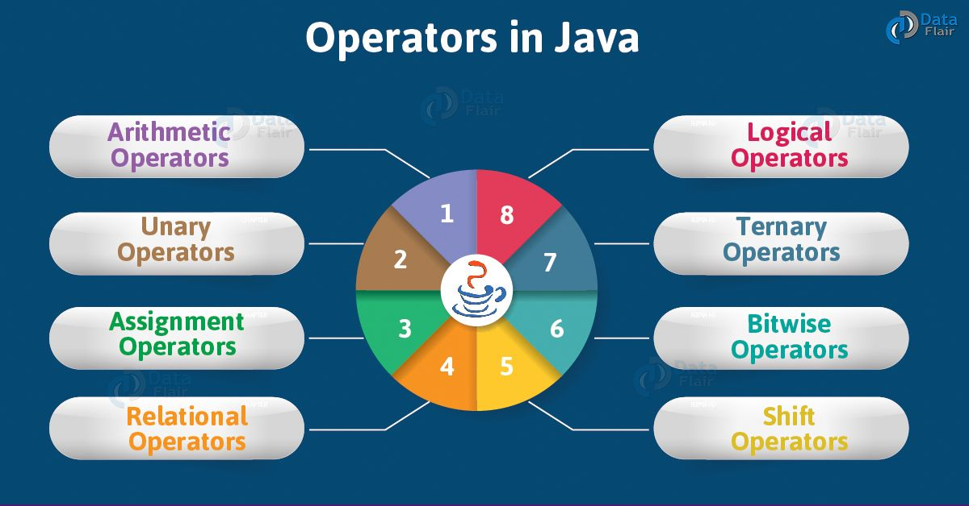

Slide 10
Unary | postfix | expr++ expr--
 | prefix | ++expr --expr +expr -expr ~ !
Arithmetic | multiplicative | * / %
 | additive | + -
Shift | shift | << >> >>>
Relational | comparison | < > <= >= instanceof
 | equality | == !=
Bitwise | bitwise AND | &
 | bitwise exclusive OR | ^
 | bitwise inclusive OR | |
Logical | logical AND | &&
 | logical OR | ||
Ternary | ternary | ? :
Assignment | assignment | = += -= *= /= %= &= ^= |= <<= >>= >>>=

Slide 11
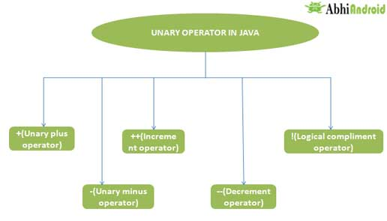

Slide 12
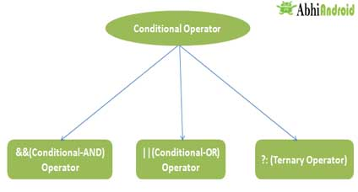

Slide 13
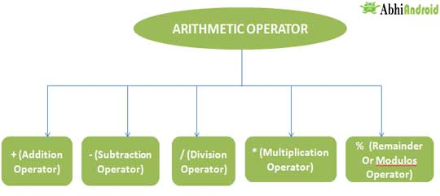

Slide 14
