Slide 1

JAVA & ANDROID

Slide 2
METHOD OVERLOADING
If a class has multiple methods having same name but different in parameters, it is known as Method Overloading.
Method overloading increases the readability of the program.
There are two ways to overload the method in java
By changing number of arguments
By changing the data type
Can we overload java main() method? YES

Slide 3
Can we overload main() method?
Yes, by method overloading. You can have any number of main methods in a class by method overloading.
Class Overloading{
Public static void main(int a){
System.out.println(a);
}
Public static void main(String args[])
{
System.out.println(“Main() method invoked”);
Main(10);
}

Slide 4
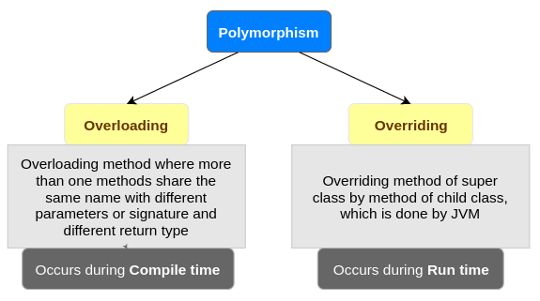

Slide 5
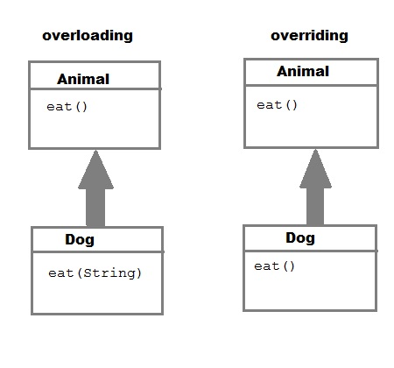

Slide 6
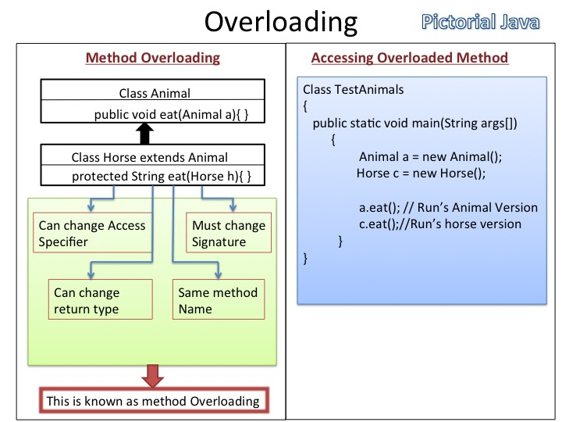

Slide 7
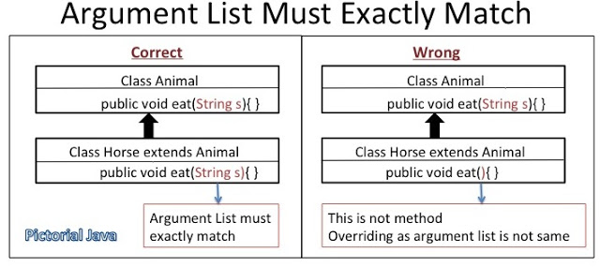
RULES OF METHOD OVERRIDING

Slide 8
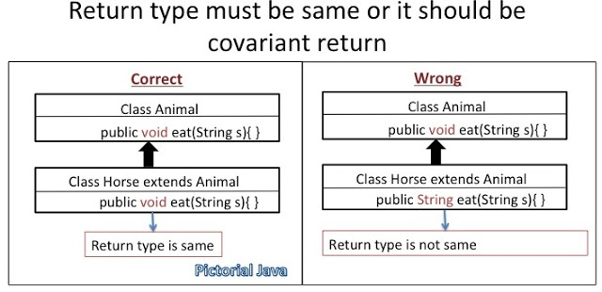

Slide 9
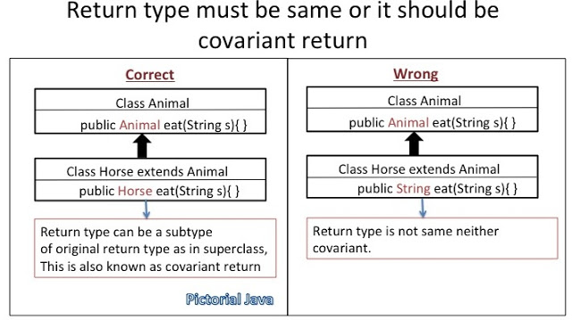

Slide 10
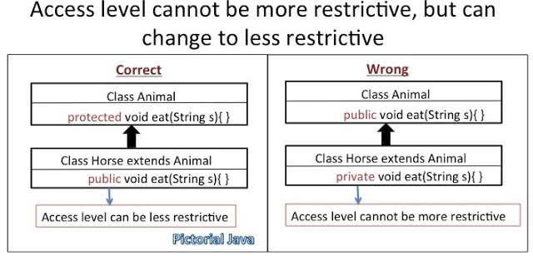

Slide 11
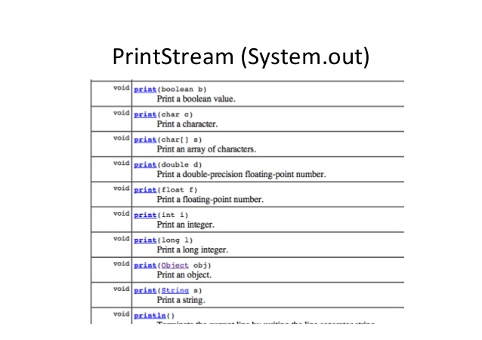

Slide 12
OVERRIDING/ RUNTIME POLYMORPHISM

Slide 13
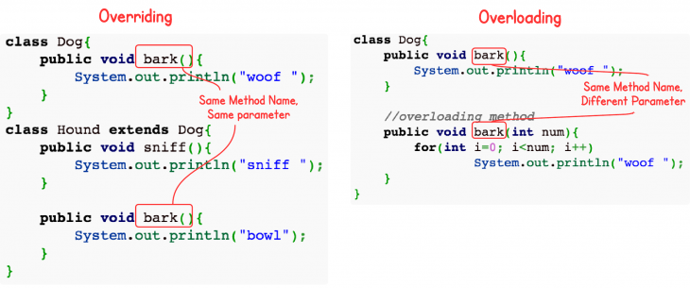

Slide 14
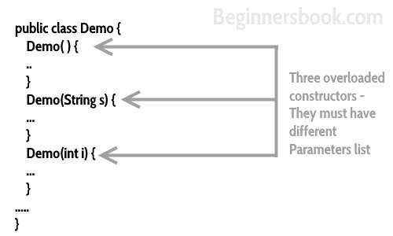
CONSTRUCTOR OVERLOADING

