Slide 1

JAVA & ANDROID

Slide 2
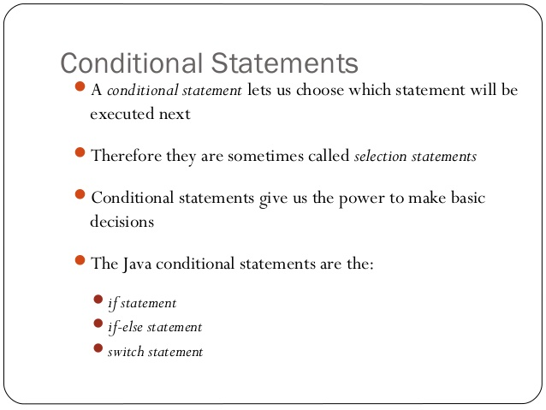

Slide 3
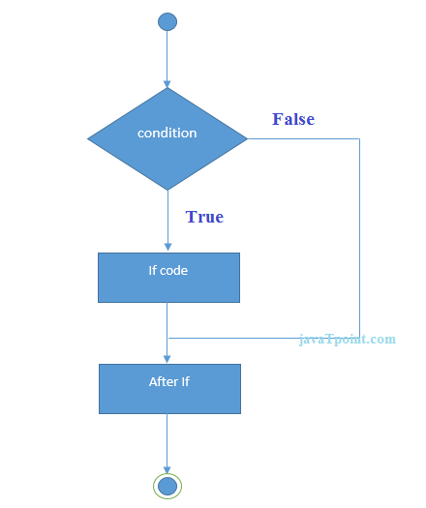
Java if Statement:

Slide 4
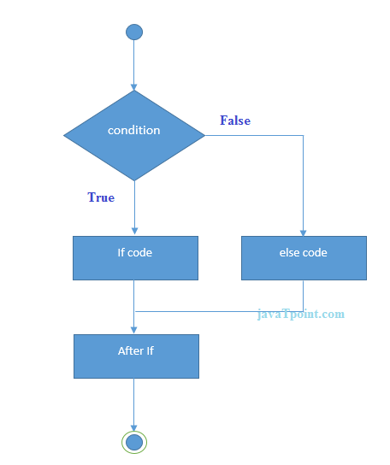
Java if-else Statement:

Slide 5
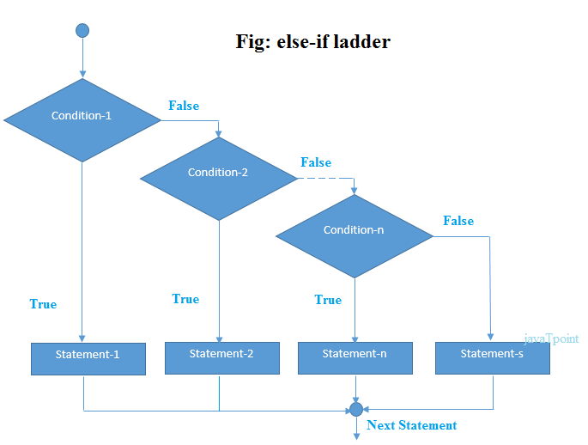

Slide 6
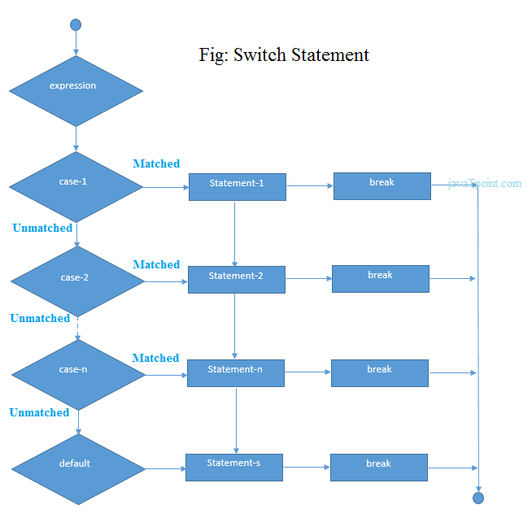
Java Switch Statement:

