Slide 1

JAVA & ANDROID

Slide 2
KEYWORDS IN JAVA
SUPER
THIS
FINAL
STATIC

Slide 3
Super keyword
The super keyword in java is a reference variable which is used to refer immediate parent class object.
super can be used to refer immediate parent class instance variable.
super can be used to invoke immediate parent class method.
super() can be used to invoke immediate parent class constructor.
Whenever you create the instance of subclass, an instance of parent class is created implicitly which is referred by super reference variable.

Slide 4
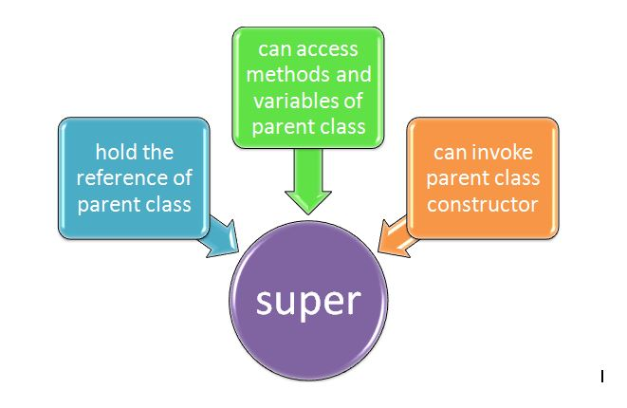

Slide 5
SUPER CREATED IMPLICITLY BY COMPILER
class Animal{
Animal(){System.out.println("animal is created");}
}
class Dog extends Animal{
Dog(){
System.out.println("dog is created");
}
}
class TestSuper{
public static void main(String args[]){
Dog d=new Dog();
}}

Slide 6
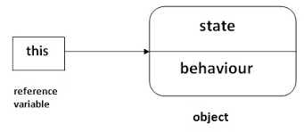
This keyword
Basically Java “this” keyword refers to the current object.
“this” is the reference variable which is holding the object of current class.

Slide 7
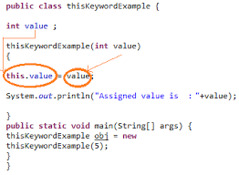

Slide 8
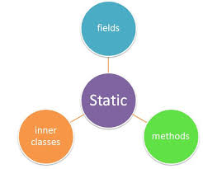
Static keyword
The static keyword in java is used for memory management mainly. We can apply java static keyword with variables, methods, blocks and nested class. The static keyword belongs to the class than instance of the class.
The static can be:
variable (also known as class variable)
method (also known as class method)
block
nested class

Slide 9
Static variable:
The static variable can be used to refer the common property of all objects (that is not unique for each object) e.g. company name of employes, college name of students etc.
Restrictions for static method:
The static method can not use non static data member or call non-static method directly.
this and super cannot be used in static context.
Static block:
Is used to initialize the static data member.
It is executed before main method at the time of classloading.
Static nested class:
A static class i.e. created inside a class is called static nested class in java.
It can access static data members of outer class including private.
It cannot access non-static data members and methods.
It can be accessed by outer class name.

Slide 10
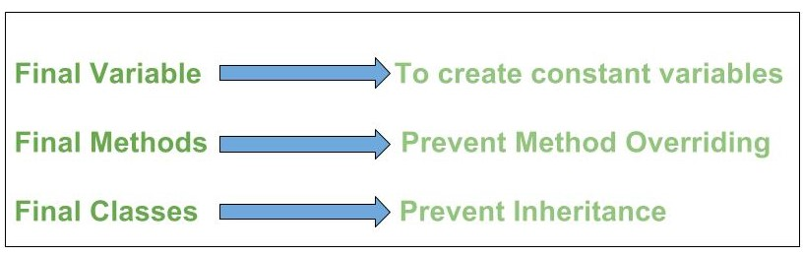
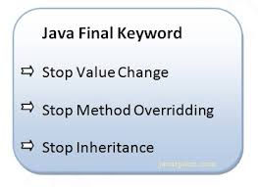
final keyword
The final keyword in java is used to restrict the user. The java final keyword can be used in many context. Final can be:
variable
method
class

