Slide 1

JAVA & ANDROID

Slide 2
INTRODUCTION
Abstraction is a process of hiding the implementation details and showing only functionality to the user.
Abstraction lets you focus on what the object does instead of how it does it.
For example sending SMS, you just type the text and send the message. You don't know the internal processing about the message delivery.
There are two ways to achieve abstraction in java
Abstract class (0 to 100%)
Interface (100%)

Slide 3
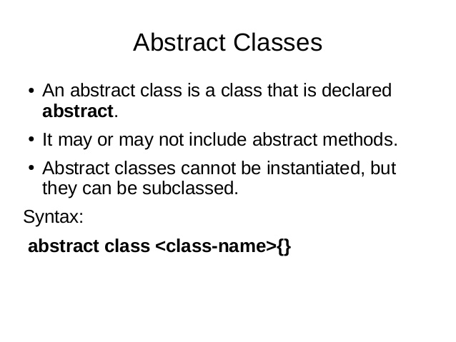

Slide 4
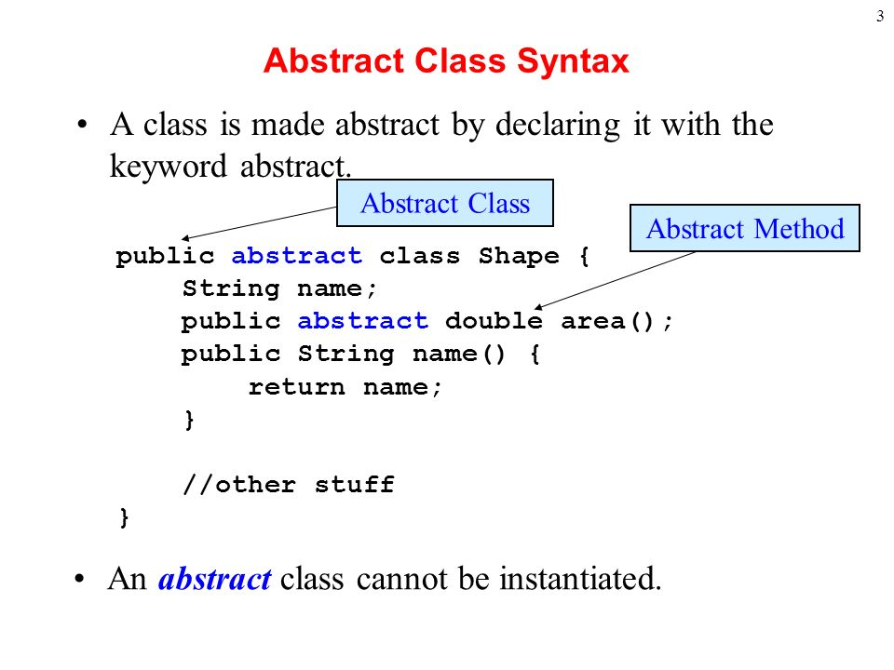

Slide 5
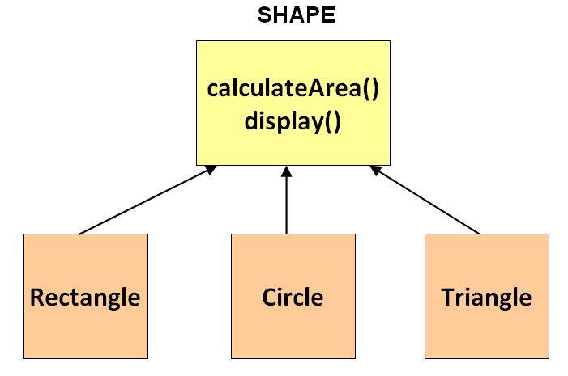

Slide 6
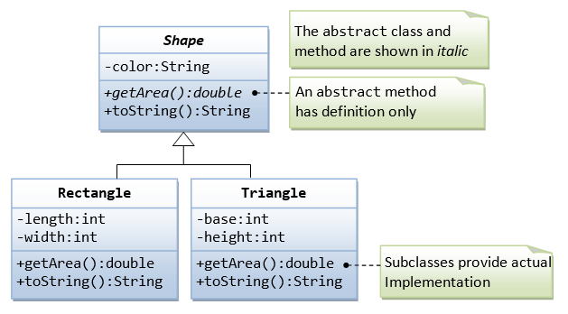

Slide 7
Some important key points about abstract classes in Java.
There are cases when it is difficult or often unnecessary to implement all the methods in parent class. In these cases, we can declare the parent class as abstract, which makes it a special class which is not complete on its own.
An instance of an abstract class cannot be created, we can have references of abstract class type.
An abstract class can contain constructors and it is invoked when an instance of a inherited class is created.
we can have an abstract class without any abstract method. This allows us to create classes that cannot be instantiated, but can only be inherited.

Slide 8
Cont.,
A class derived from the abstract class must implement all those methods that are declared as abstract in the parent class.
Abstract class cannot be instantiated which means you cannot create the object of it. To use this class, you need to create another class that extends this class and provides the implementation of abstract methods, then you can use the object of that child class to call non-abstract methods of parent class as well as implemented methods.
If a child does not implement all the abstract methods of abstract parent class, then the child class must need to be declared abstract as well.

Slide 9
ABSTRACT METHOD
A method without implementation is known as abstract method.
A method must always be declared in an abstract class, or in other words you can say that if a class has an abstract method, it should be declared abstract as well.
Always end the declaration with a semicolon(;).
It must be overridden. An abstract class must be extended and in a same way abstract method must be overridden. 4) A class has to be declared abstract to have abstract methods.
Note: The class which is extending abstract class must override all the abstract methods.

Slide 10
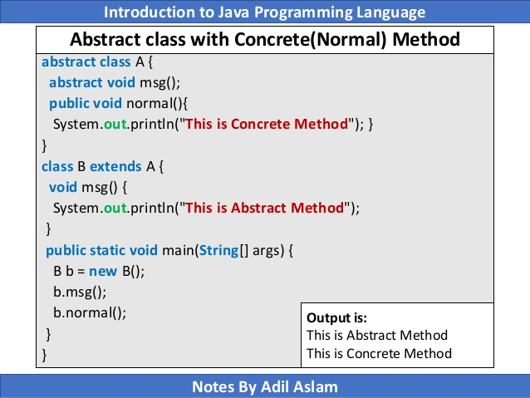

Slide 11
