Slide 1

JAVA & ANDROID

Slide 2
INTRODUCTION
A Java method is a collection of statements that are grouped together to perform an operation.
When you call the System.out.println() method, for example, the system actually executes several statements in order to display a message on the console.
Depending on whether a method is defined by the user, or available in standard library, there are two types of methods:
Standard Library Methods
User-defined Methods

Slide 3
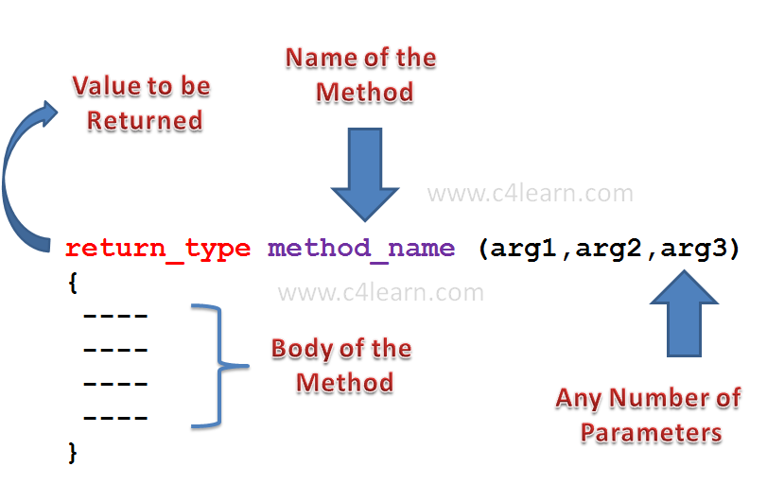

Slide 4
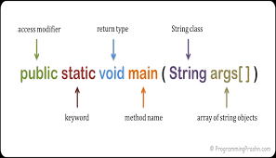

Slide 5
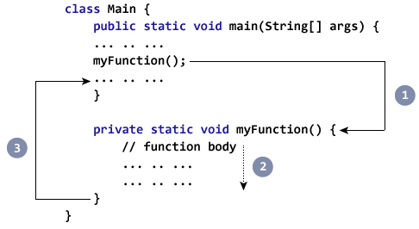

Slide 6
Type of declaration of methods based on return type and arguments
Method without return type and without arguments.
Method without return type and with arguments.
Method with return type and without arguments.
Method with return type and with arguments.

Slide 7
