Slide 1

JAVA & ANDROID

Slide 2
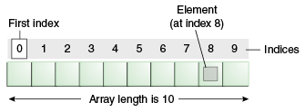
ARRAY
Array is an object the contains elements of similar data type. It is a data structure where we store similar elements. We can store only fixed set of elements in a java array.
Array in java is index based, first element of the array is stored at 0 index.

Slide 3
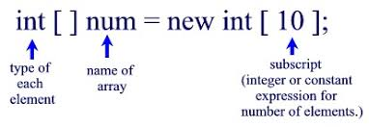
Single Dimensional Array/ 1d-array
DECLARATION
dataType[] arr; (or) dataType []arr; (or) dataType arr[];
INSTANTIATION
arr=new datatype[size];
We can declare, instantiate and initialize the java array together by:
int a[]={33,3,4,5};//declaration, instantiation and initialization

Slide 4
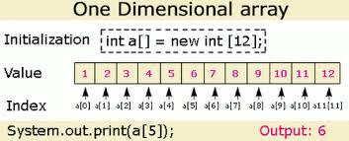

Slide 5
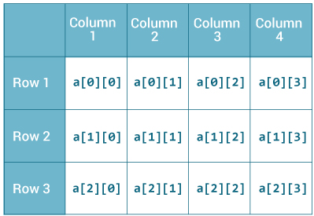
Multidimensional array / 2d array
Data is stored in row and column based index (also known as matrix form).
DECLARATION
dataType[][] arrayRefVar; (or)
dataType [][]arrayRefVar; (or)
dataType arrayRefVar[][]; (or)
dataType []arrayRefVar[];
INSTANTIATION
int[][] arr=new int[3][3];//3 row and 3 column

Slide 6
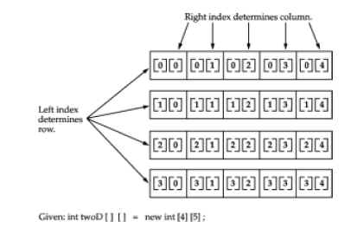

Slide 7
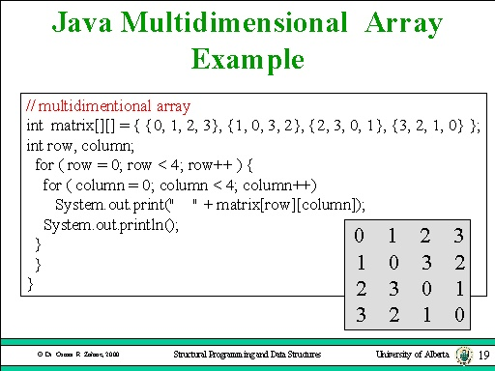

Slide 8
