Slide 1

JAVA & ANDROID

Slide 2
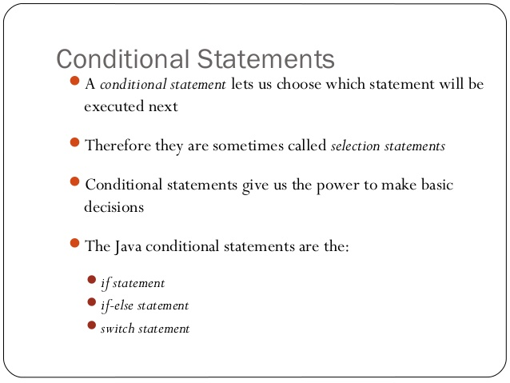

Slide 3
Decision Making in Java (if, if-else, switch, break, continue, jump)
Java’s Selection statements:
if
if-else
nested-if
if-else-if
switch-case
jump – break, continue, return
These statements allow you to control the flow of your program’s execution based upon conditions known only during run time.

Slide 4
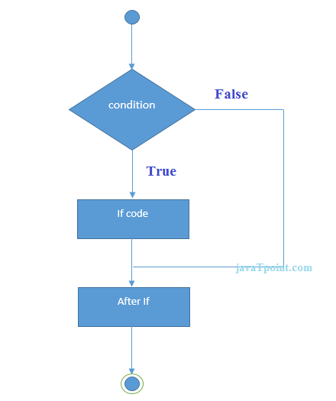
Java if Statement:

Slide 5
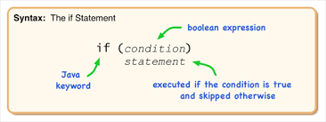

Slide 6
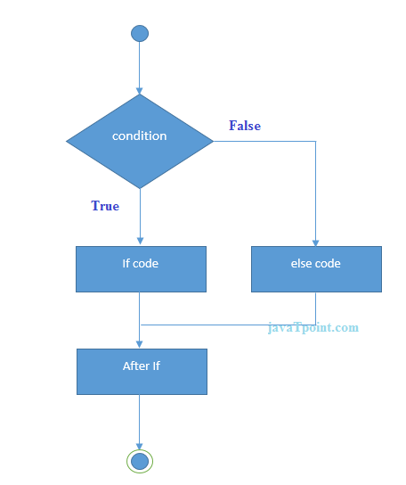
Java if-else Statement:

Slide 7
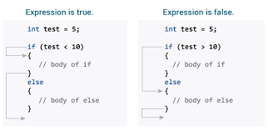

Slide 8
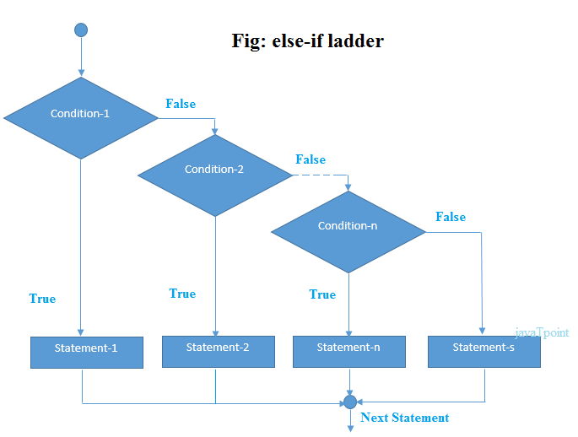

Slide 9
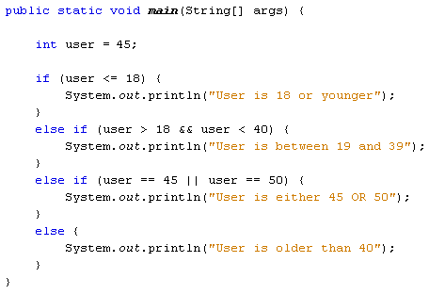

Slide 10
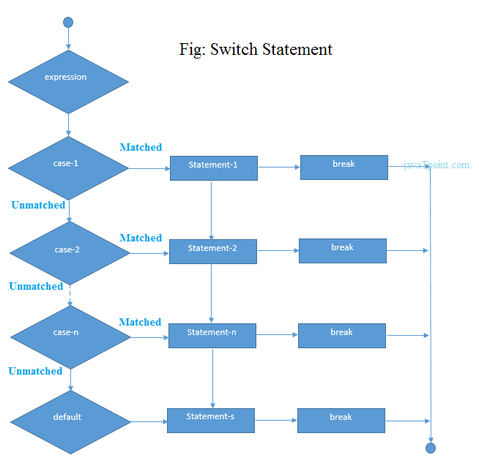
Java Switch Statement:

Slide 11
